Slide 1
Advances in searching for galactic axions with a Dielectric Haloscope (MADMAX)
Antonios Gardikiotis
Universität Hamburg
On behalf of the MADMAX Collaboration
11th August 2022
17th Patras Workshop on Axions, WIMPs and WISPs
Mainz
11-08-2022 | Antonios Gardikiotis

Slide 2
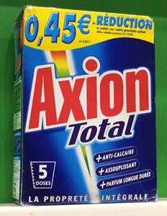
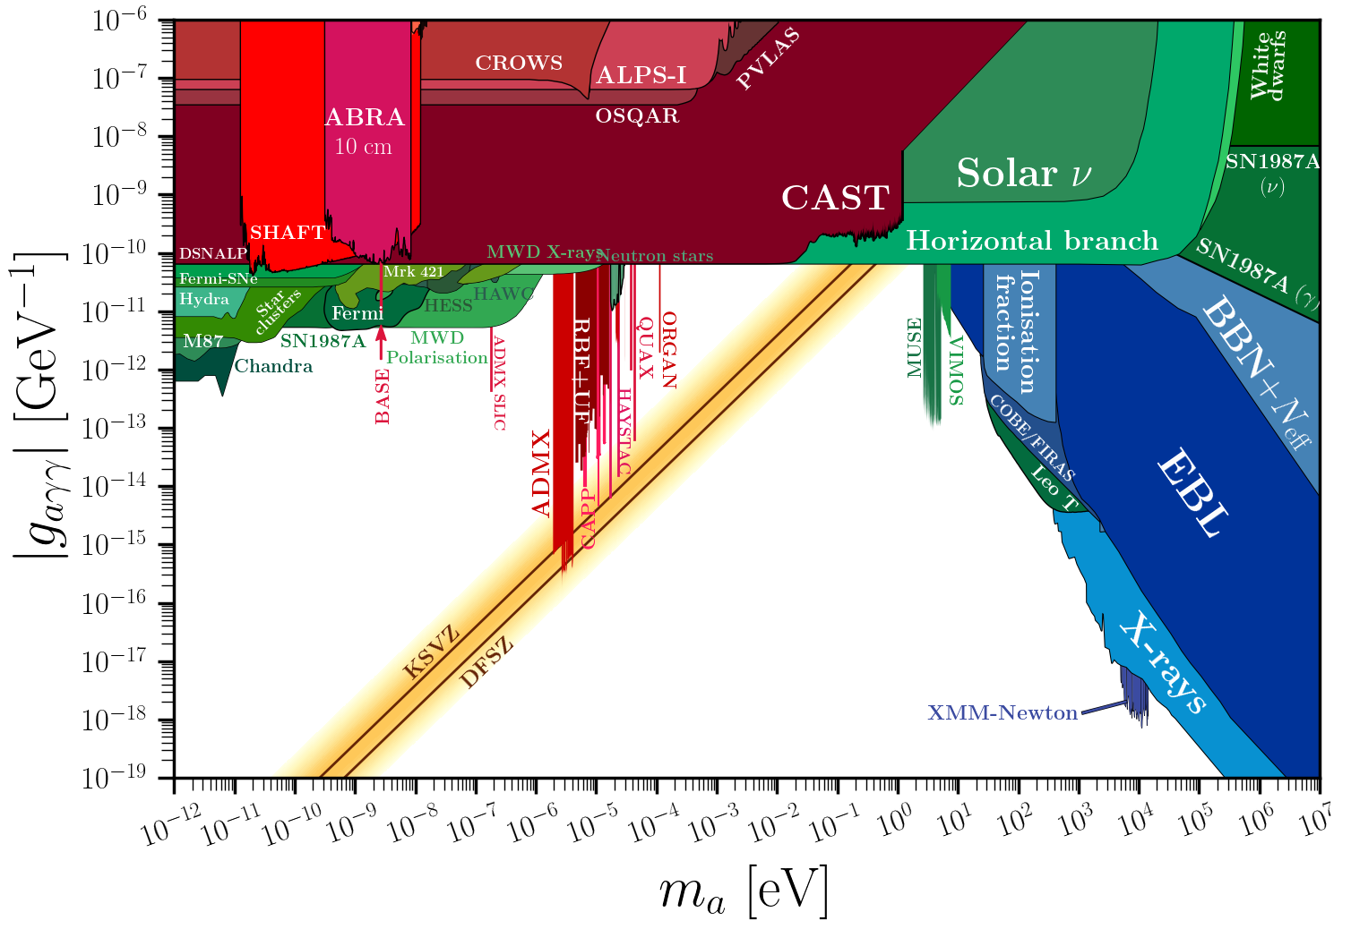
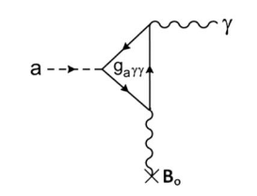
The Axion
The Axion:
• Pseudo Nambu-Goldstone boson
• Small mass and weak couplings
• Elegant solution of the strong CP problem
• Primakoff/Sikivie effect:
Photon-Axion conversion in strong EM fields
• Axion can explain the observed DM density
Plot from https://cajohare.github.io/AxionLimits/
40 to 180 µeV
cavities (post-inflationary scenario)
Nat. Commun. 13, 1049 (2022)
(https://doi.org/10.1038/s41467-022-28669-y)
dielectric haloscopes
Axion-Maxwell equation under external B-field:
$$∇×H−\dot{D}=J_{f}+g_{αγ}B_{0}\dot{α}$$
11-08-2022 | Antonios Gardikiotis | 2

Slide 3
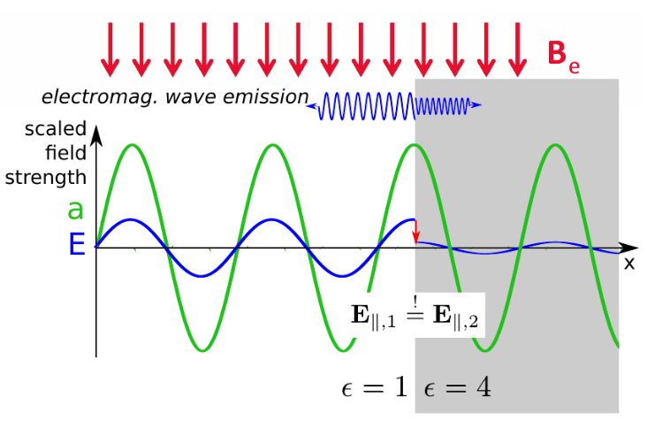
Dielectric Haloscope
The cosmological axion field a(t) inside an external magnetic field B_{e} sources a tiny axion induced electric field $E_{α}$
$E_{α}$~ 10⁻¹² V/m for 10 T in vacuum
𝑬_{𝒂} is different in materials with different 𝜀
E|| must be continuous at the boundaries
$$E_{α}=−\frac{g_{αγ}B_{e}}{\text{ε}}α$$
$$α=α_{0}\cos{(m_{α}t)}$$
Power emitted from a single surface:
$$P_{sig}=2.2∙{10}^{−27}W\left(\frac{A}{1m^{2}}\right){\left(\frac{B_{e}}{10T}\right)}^{2}$$
11-08-2022 | Antonios Gardikiotis | 3

Slide 4
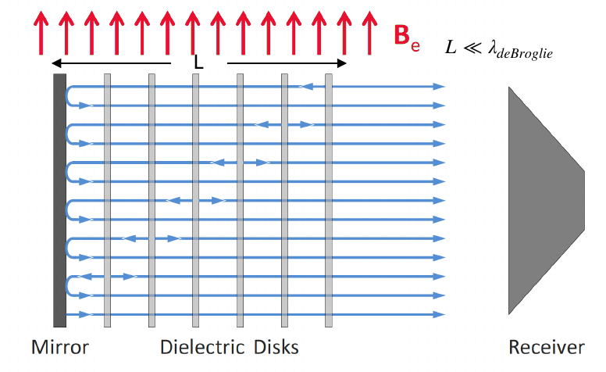
Dielectric Haloscope
Boosted emitted power :
• coherent emission from multiple interfaces by
controlling the discs separations and
constructive interference
L
𝐿 < 𝜆_{deBroglie}
$$P_{sig}=2.2∙{10}^{−27}W\left(\frac{A}{1m^{2}}\right){\left(\frac{B_{e}}{10T}\right)}^{2}∙β^{2}$$
power “Boost factor” 𝛽²
$$β^{2}=\frac{P_{sig}}{P_{mirror}}$$
Simulations indicate:
|β²| > 10⁴ achievable with 80 discs
with dielectric constant ε~ 24 (LaAlO₃)
β² is affected by BC’s inaccuracies of the discs: disc mis-positioning, tilting, thickness variations
• EM radiation escapes at open end
Detect Traveling wave instead of standing wave modes
11-08-2022 | Antonios Gardikiotis | 4

Slide 5
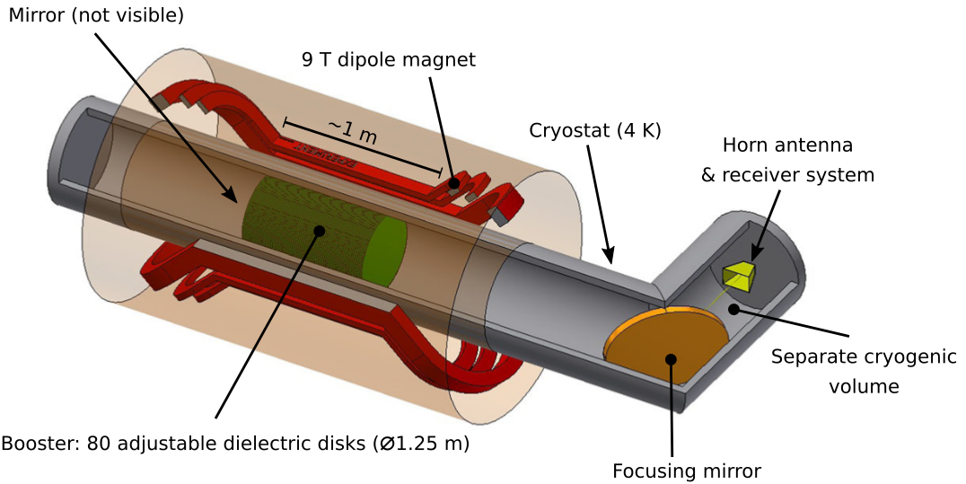
The MADMAX Experiment
MADMAX White Paper
Eur. Phys. J. C. 79 (2019) 186
Main challenges
Booster mechanics
Magnet
Receiver at cold,
B-field environment
Start with prototypes to
validate concepts
11-08-2022 | Antonios Gardikiotis | 5

Slide 6
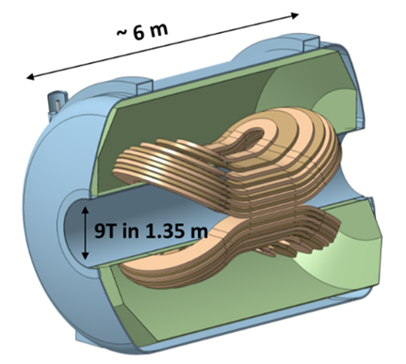
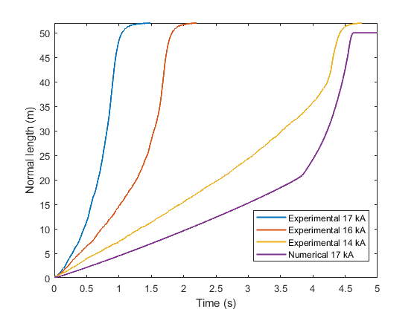
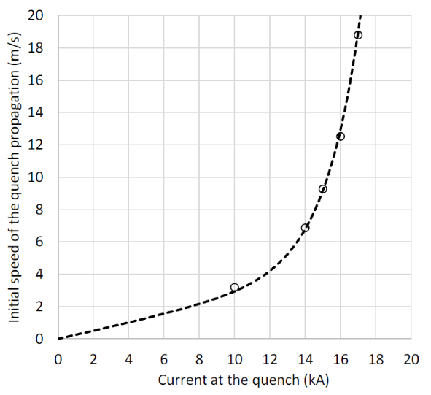
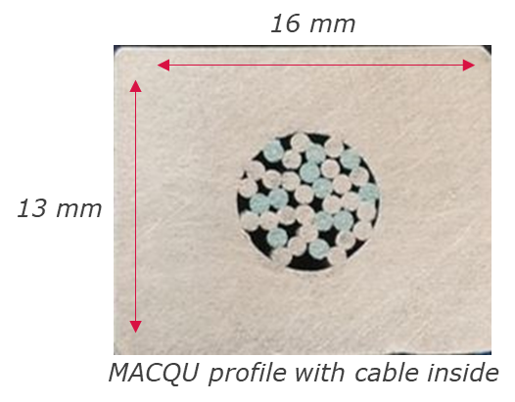
MADMAX Magnet Update
→ Main Challenges :
Reliable quench protection
Feasibility of conductor production (CICC)
Quench propagation velocity were measured in a
dedicated setup: MAdmax Coil for Quench Understanding
→ Main project risk mitigated:
Quench propagation according to requirements for safe operation
MACQU
Development in innovation partnership
Quench
propagation
Quench velocity
simulation
Novel conductor:
Cable In Copper Conduit
11-08-2022 | Antonios Gardikiotis | 6

Slide 7
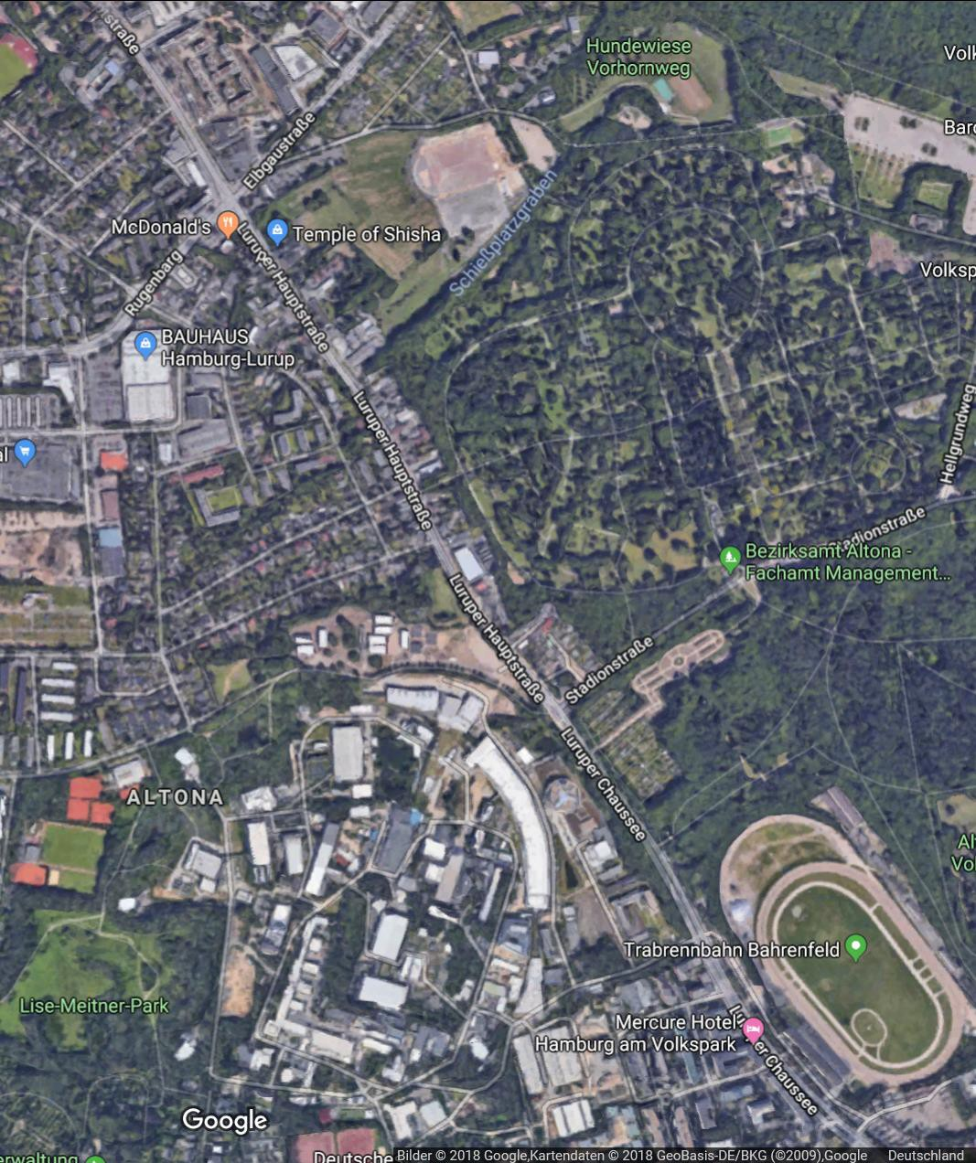
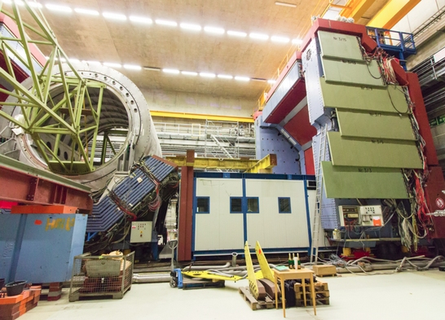
Designated Experimental Site @ DESY
MADMAX to be built at HERA Hall North
Make use of DESY infrastructure
Benefit: re-use H1 yoke as magnetic
shielding to reduce fringe field
HERA Hall North
H1 Yoke
UHH
DESY
11-08-2022 | Antonios Gardikiotis | 7

Slide 8
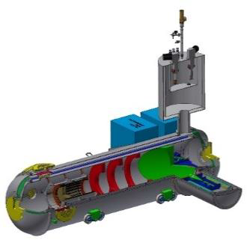
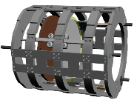
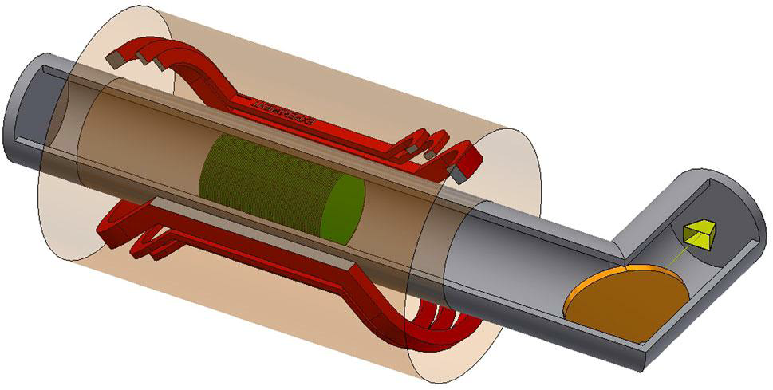
Time Scale
Design Phase PrototypingPhase ConstructionPhase
Foundationof
MADMAX
Collaboration
First ALP measure-
mentat CERN
First physicsdatataking
at cold @ CERN
First endorsement
byDESY PRC
Prototype commissioning
tostartin 2023
Full-size MADMAX
magnet commissioning
UsageofMORPURGO magnetapproved
byCERN Research Board for2021-2025
11-08-2022 | Antonios Gardikiotis | 8

Slide 9
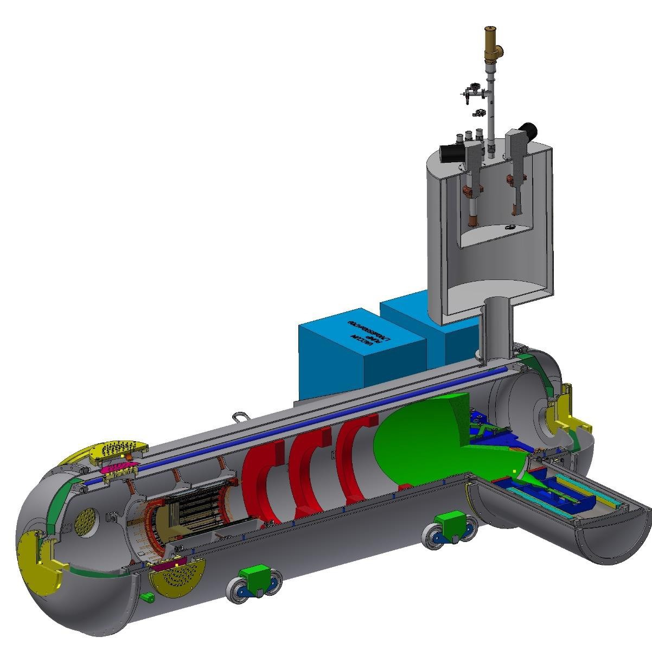
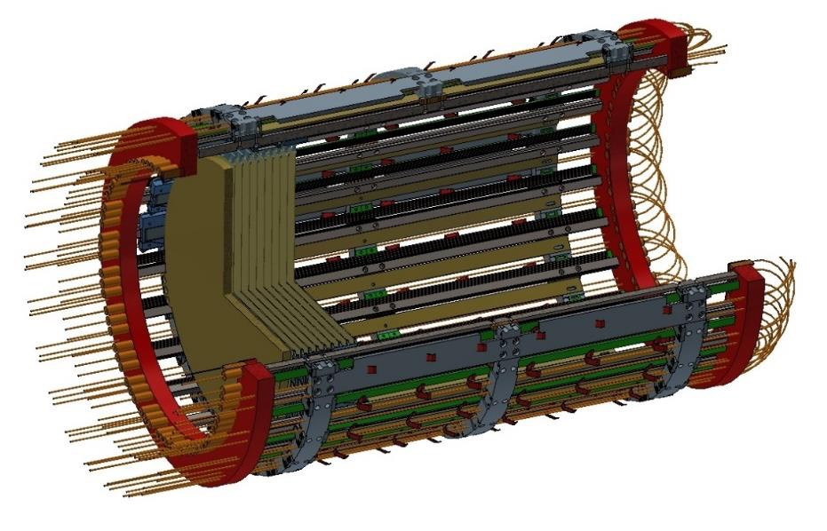
The MADMAX Prototype
Prototype Cryostat
(4 K, thermosyphon principle)
Scaled down prototype of MADMAX
– Booster with up to 20 dielectric discs 300 mm in diameter
– Cryostat will be delivered at DESY @ 2022-2023
– Receiver cryostat designed and flexible in use
– K-band Antenna received
– Optical system components under construction
# Demonstrating the feasibility of key technologies for MADMAX
# Competitive ALP search with a dielectric haloscope
– 20 Ø300 mm discs
– piezo positioners
– laser interferometer
Ø 1.2 m
Focusing mirror
Receiver cryostat
11-08-2022 | Antonios Gardikiotis | 9

Slide 10
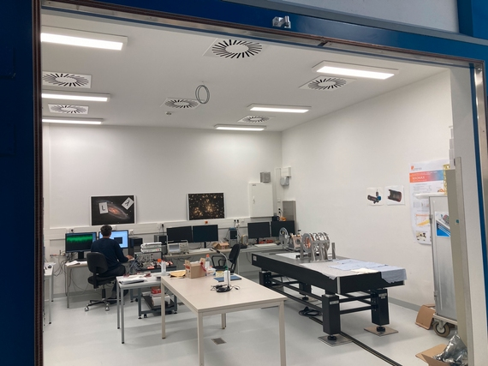
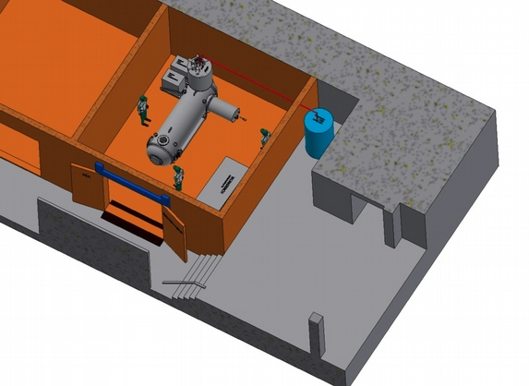
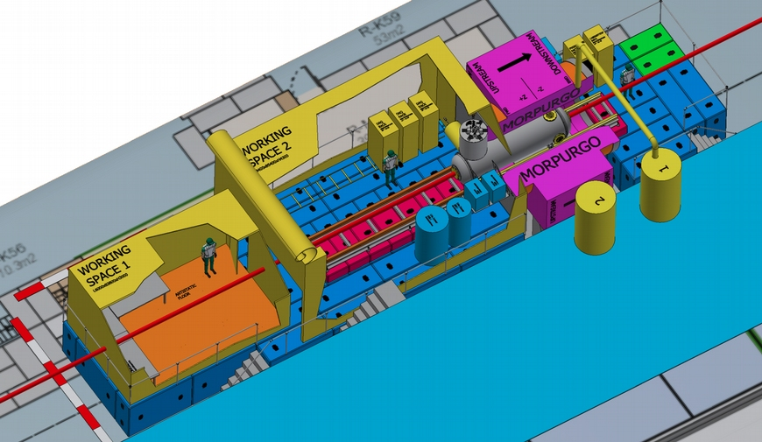
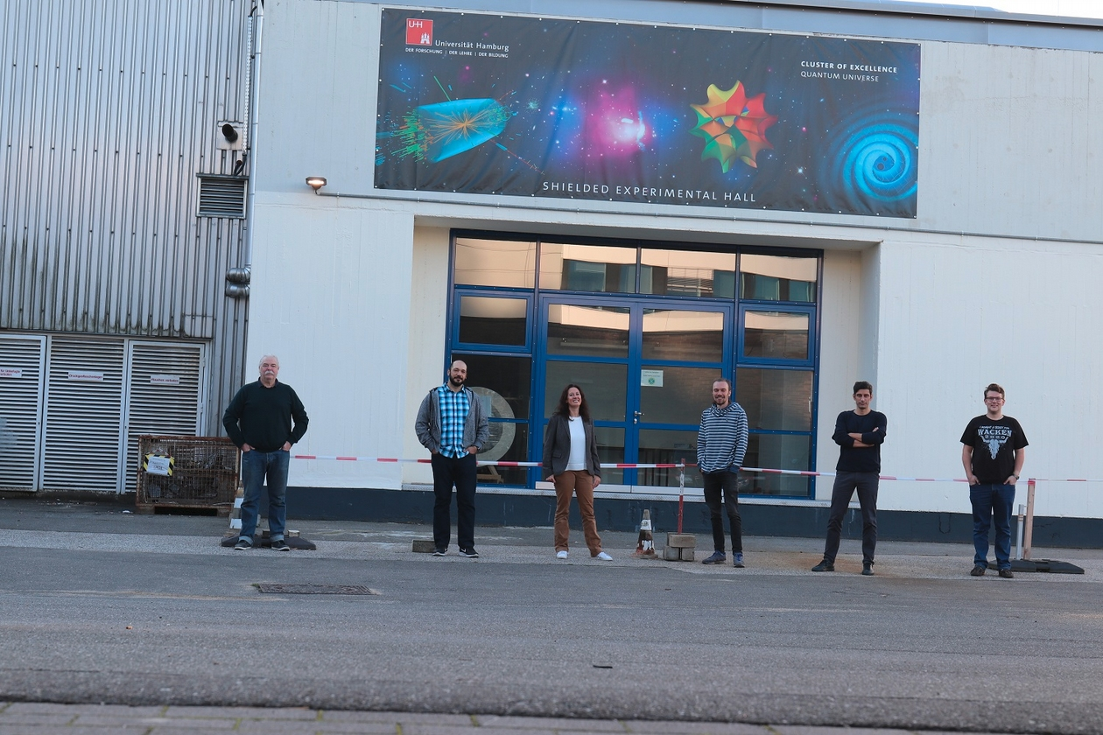
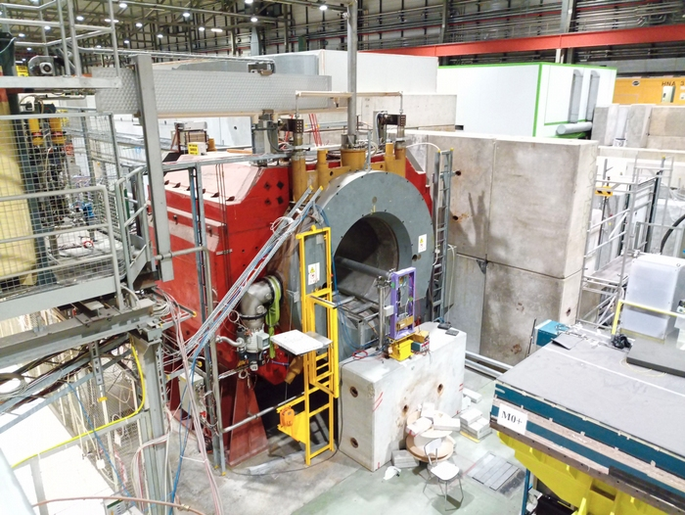
The MADMAX Prototype
MORPURGO magnet @ CERN
MADMAX Prototype to be installed in the Shielded Experimental HaLL (SHELL) @ DESY
• Commissioning begin of 2023
First axion physics measurements in MORPURGO magnet @ CERN
• Physics runs at CERN in 2024 & 2025
Shielded RF lab in Hamburg
11-08-2022 | Antonios Gardikiotis | 10

Slide 11
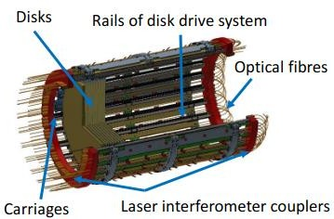
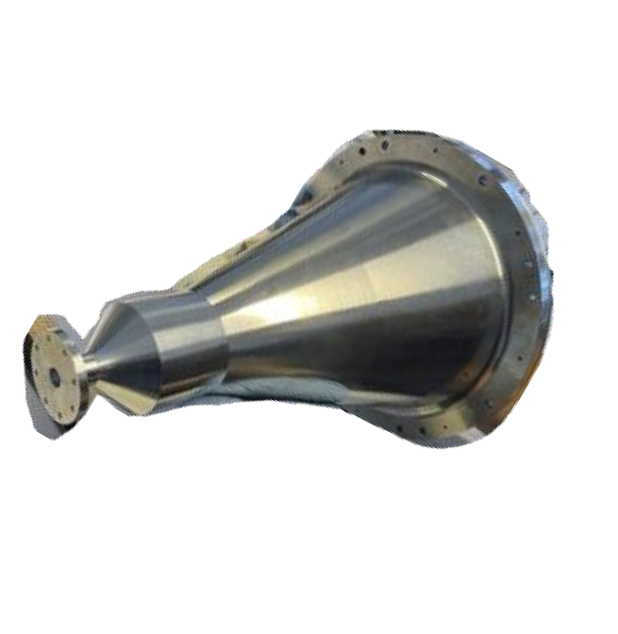
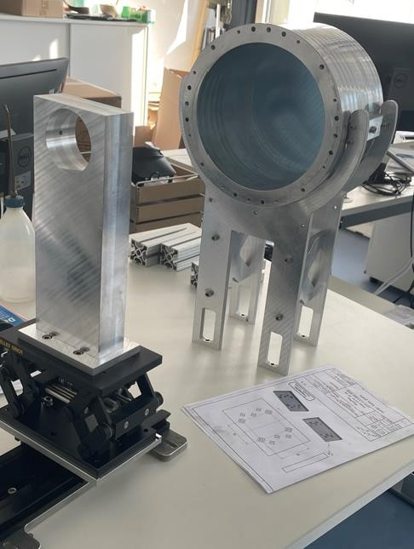
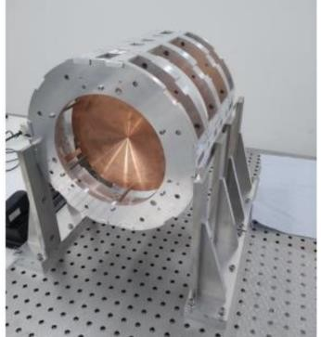
Prototyping strategy: MADMAX test setups
0.1 m
0.3 m
Parabolic taper
Spacing ring
Sapphire
Prototype booster
Operating conditions:
− Cryogenic temperatures: 4 K
− High magnetic field: up to ~10 T
− Vacuum or cold He exchange gas
Single Sapphire Ø300 mm discs
or
Tiled discs made of LaAlO₃ 3’’ wafers
P200
Open booster
Cu mirror
1 Ø200 mm disc
Cu mirror
CB200
Closed booster
Cu mirror
≥3 Ø200 mm discs
CB100
Closed booster
Cu mirror
3 Ø100 mm discs
fixed disc spacing
Optimized @ ~19 GHz
Test setups to assess the RF response to small changes (or inaccuracies) in the hardware potentially effecting the boost factor
11-08-2022 | Antonios Gardikiotis | 11

Slide 12
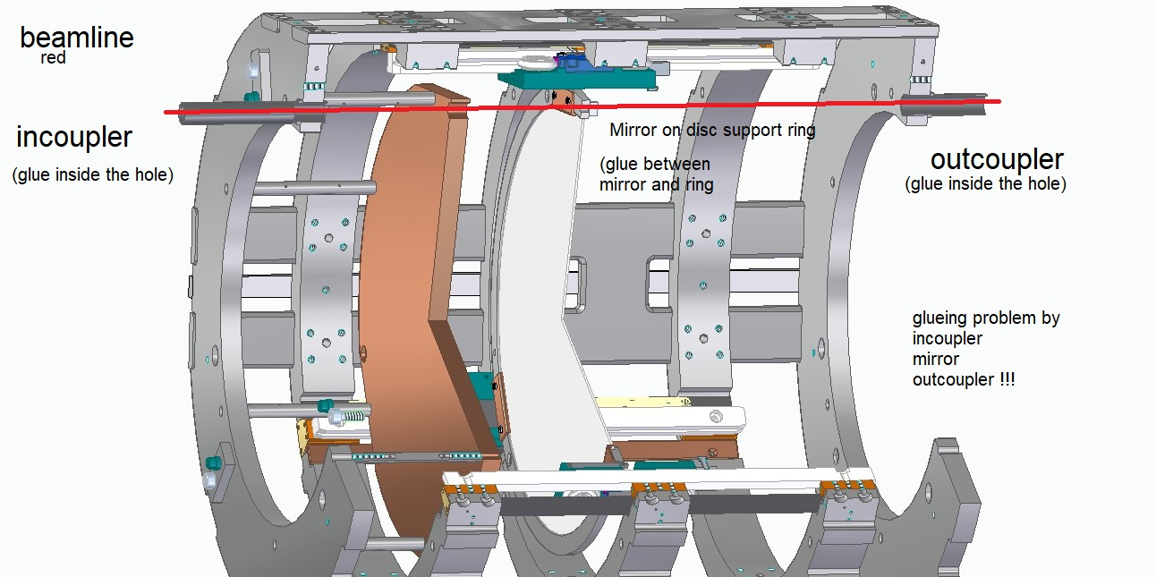
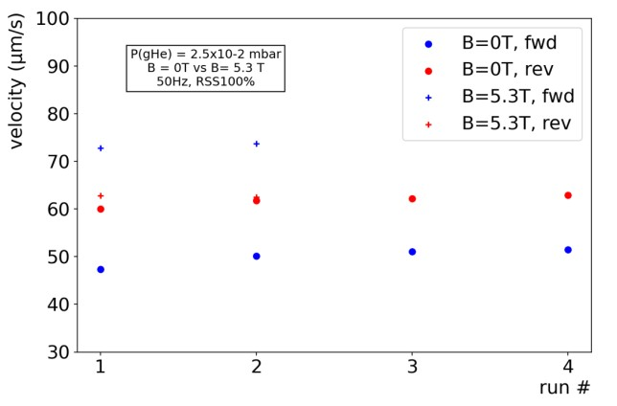
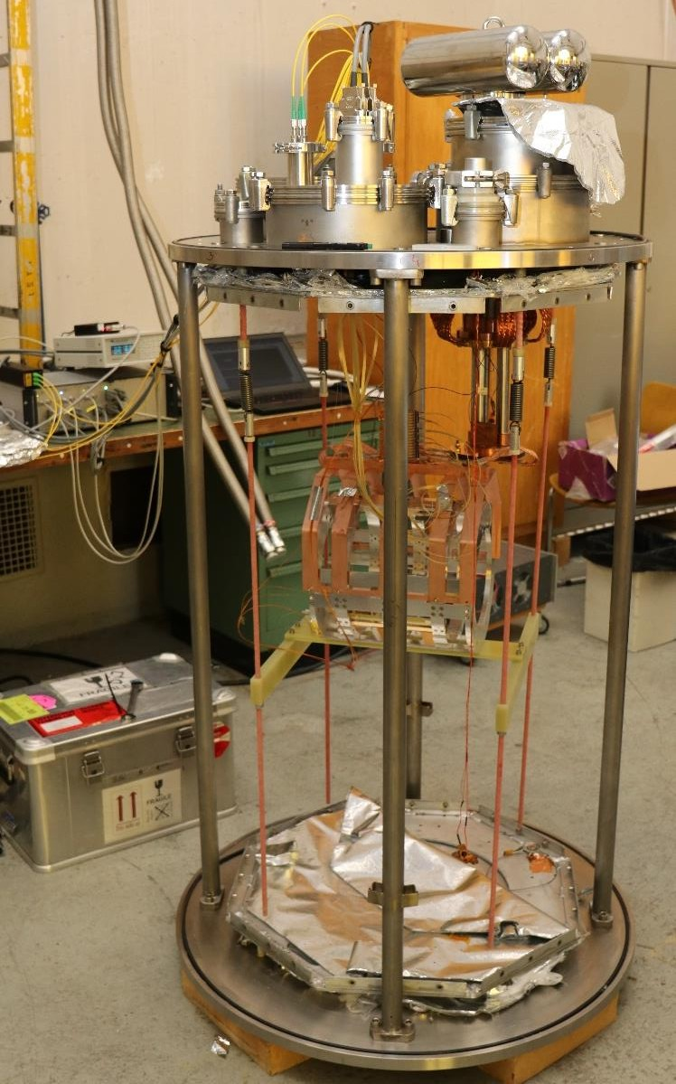
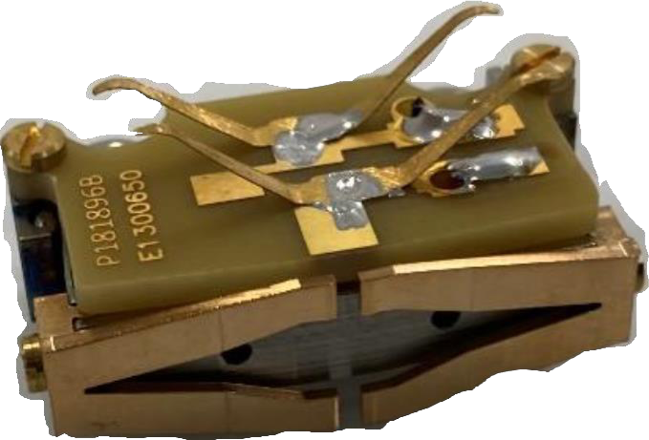
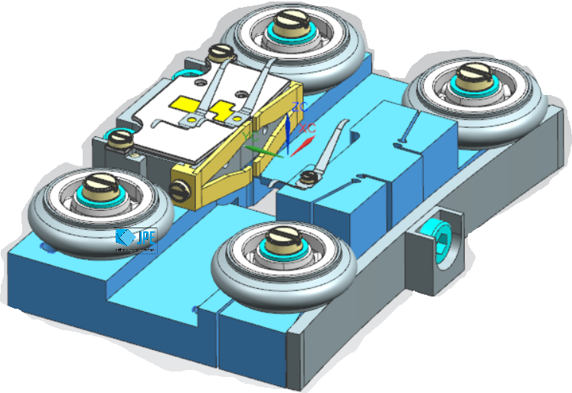
Mechanics Prototype: Project 200
3
4
Piezo-motor operated inside the 5.3 T ALPS II magnet @ 5 K
Project200 successfully tested at CERN’s cryolab and in 1.6 T Morpurgo magnet
Attocube laser interferometer works at cryogenic temperatures
P200 backbone structure keeps optics alignment during cool-down
A disk can be moved with three motors using the laser interferometer feedback
1
300 mm
2
530 mm
1 - Cu mirror (fixed position)
2 - Sapphire disc (adjustable positions)
3 - P200 support structure
4 - (3x) JPE piezo motors
– speed of > 100 μm/s in cold
– position accuracy < 2 μm in cold
CERN cryostat
Mechanical feasibility R&D Milestones achieved
11-08-2022 | Antonios Gardikiotis | 12

Slide 13
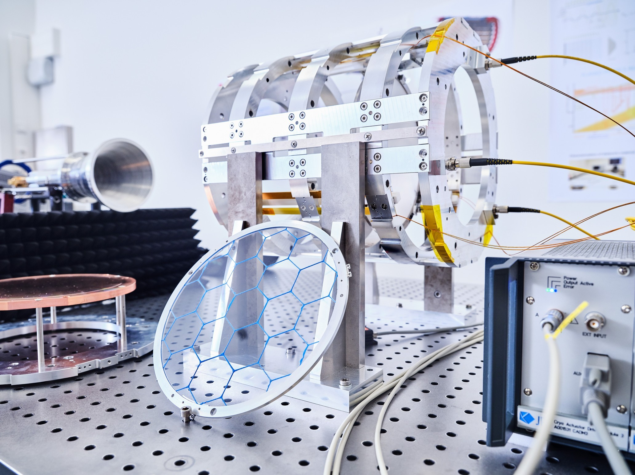
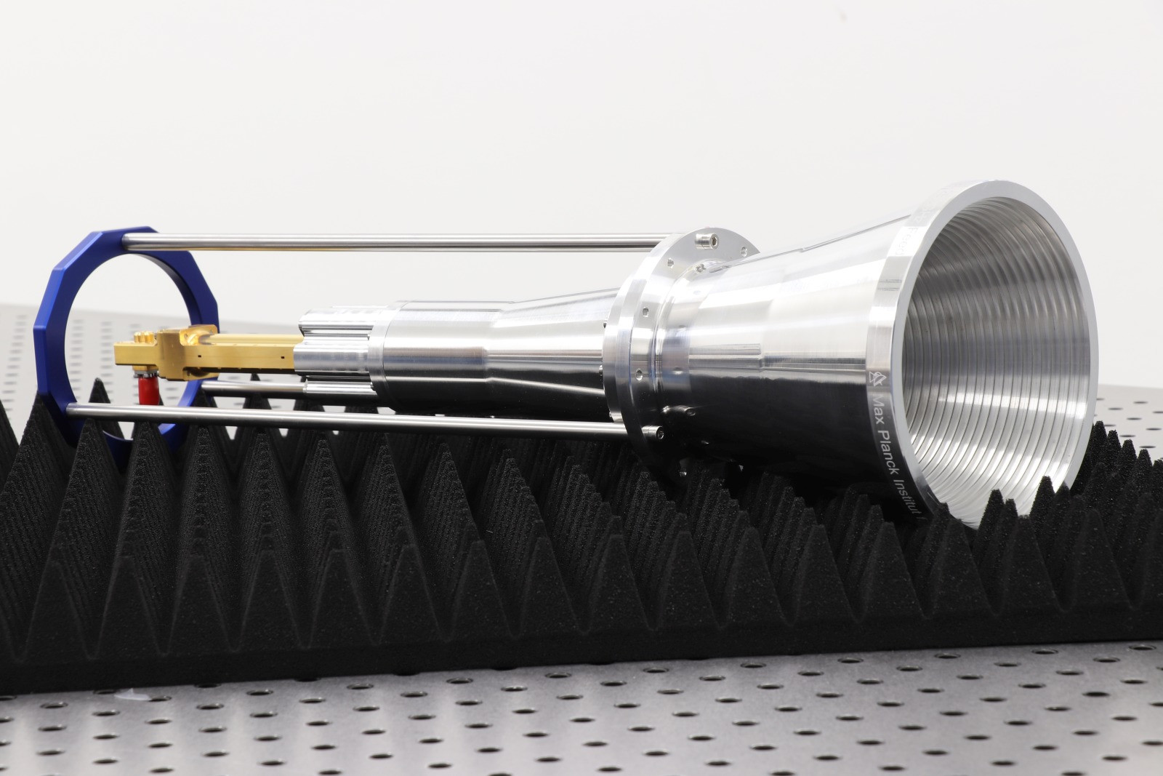
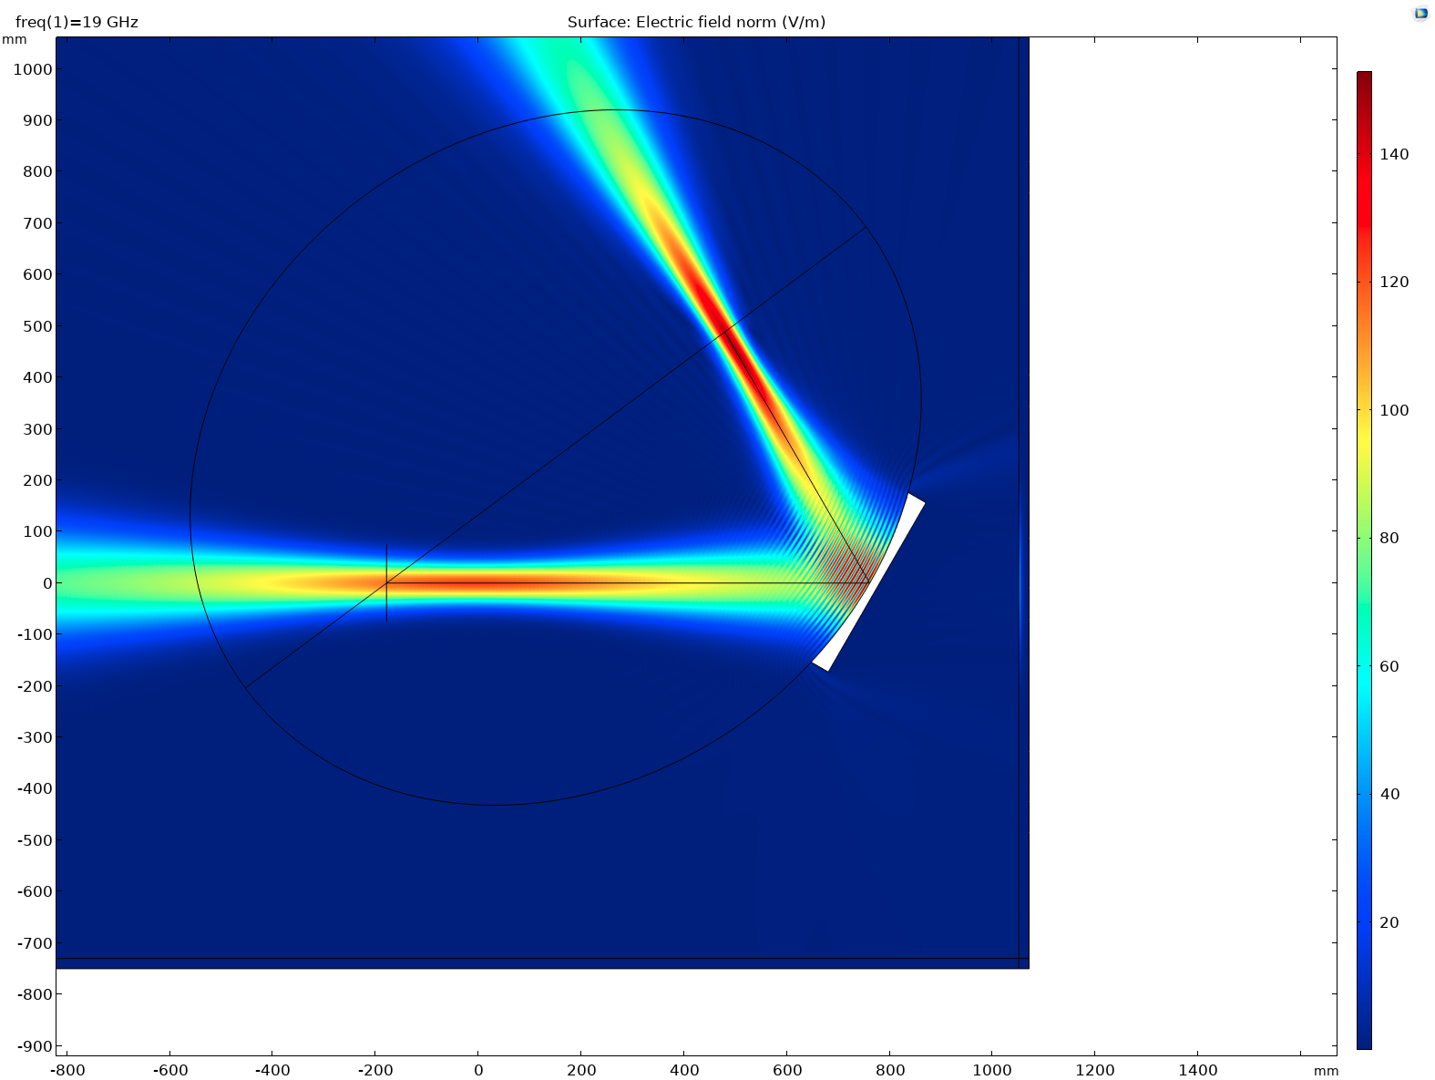
Project200 RF studies @ SHELL
COMSOL 2D simulation
K-band antenna
1
2
Test Prototype antenna
Reflectivity measurements of the (P200 – ellipsoid mirror- antenna) system for losses estimation
3D CST MWS and COMSOL simulations
Measurements and simulations of tiled discs
Jens Ruessmann
Simulated Gaussian beam from:
1. Phase center of the K-band antenna to
2. Booster’s nominal phase center
11-08-2022 | Antonios Gardikiotis | 13

Slide 14
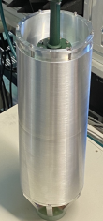
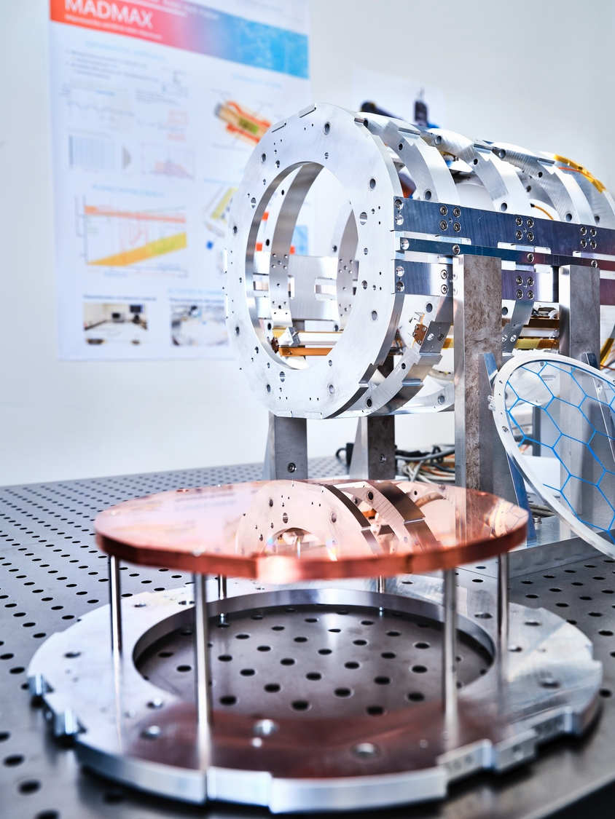
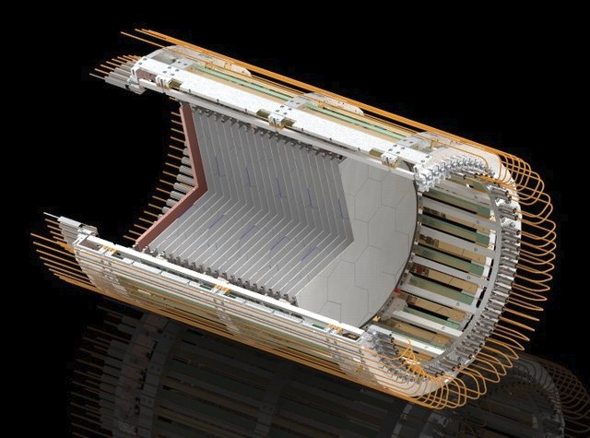
Understanding the RF behavior of boosters
CB100
P200
R / P - booster
2022 - 2023
Gradually study effects of open boundary conditions
Reflectivity and noise power measurements in CB100
T_{sys} gives valuable information on the system response and the boost factor
A promising approach under investigation:
reciprocity* between axion-induced and reflectivity-induced electromagnetic fields
* See Poster “Axion Haloscope Calibration from Reciprocity” by J. Egge
11-08-2022 | Antonios Gardikiotis | 15

Slide 15
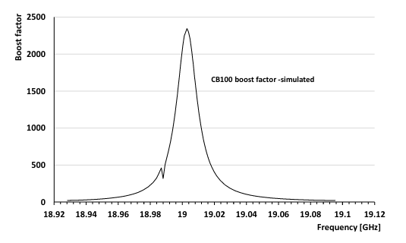
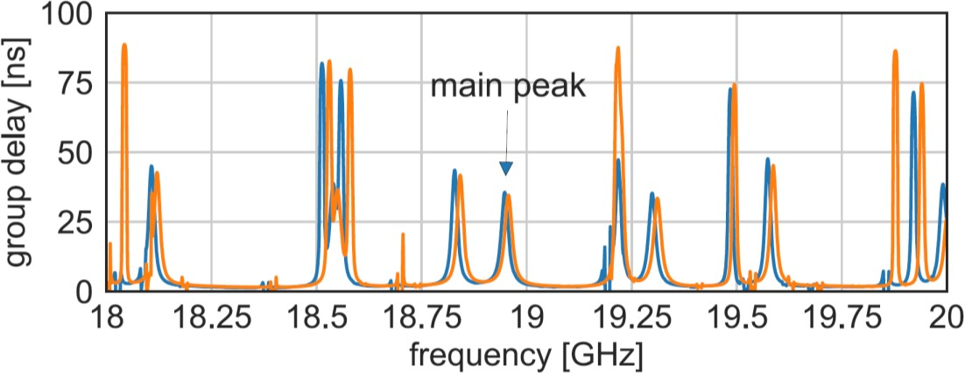
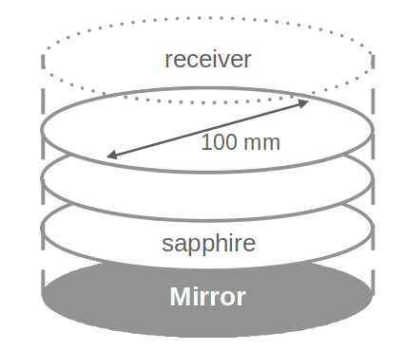
Closed Booster simulations & measurements
A small & simple dielectric haloscope
“Closed”: conducting boundary
(understand and mitigate transverse losses)
Can be operated at cryogenic temperatures
Good qualitative match between simulation & measurement
# First Hidden Photon search @ MPP
# First ALP search in MORPURGO magnet @ CERN
Receiver
Parabolic taper
3x Ø100 mm sapphire disks
Simulated boost factor of CB100
Sim
Data
11-08-2022 | Antonios Gardikiotis | 15

Slide 16
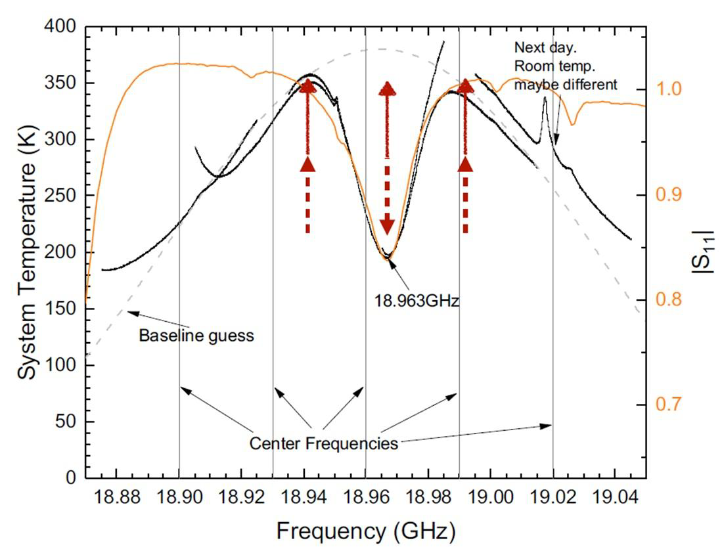
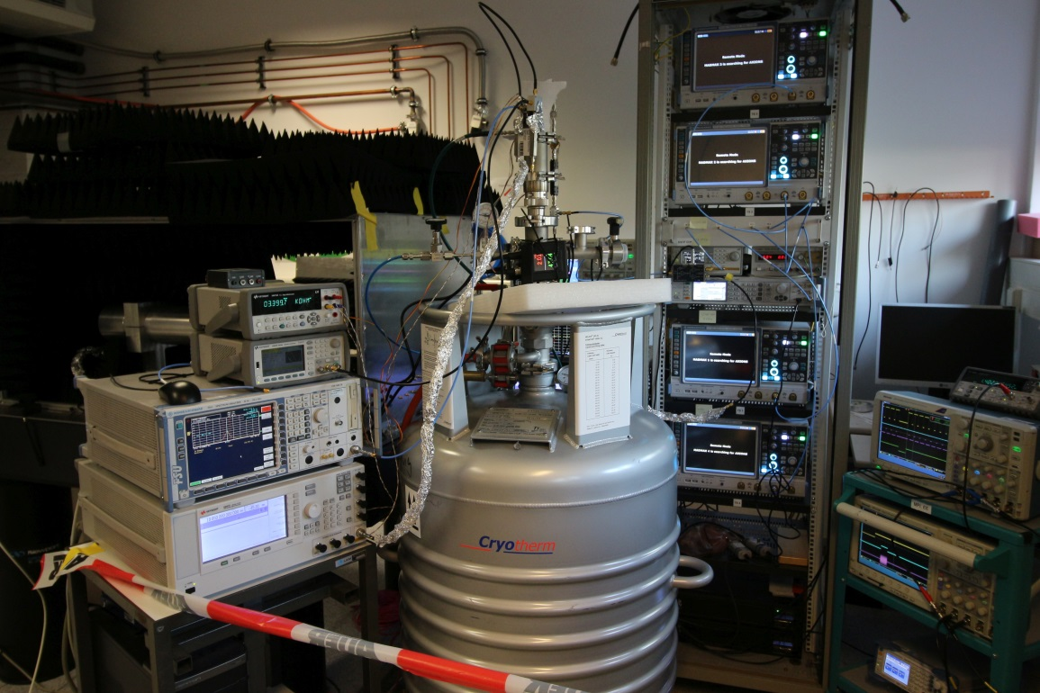
CB100 temperature/Reflectivity measurements
Pre-Amplifier
10-20 GHz
Signal Analyzer
0-50 MHz
Detection system
T_{sys} behavior at 5 RT measurements
T_{sys} calibration with a noise source
Dip in T_{sys} corresponds to the dip of the Reflectivity measurement
Infer boost factor using model with parameters inferred from thermal and RF measurements
Test setup with 4 samplers and fake axion injection:
Detection of 1.2 x 10⁻²² W signal within few days
11-08-2022 | Antonios Gardikiotis | 16

Slide 17
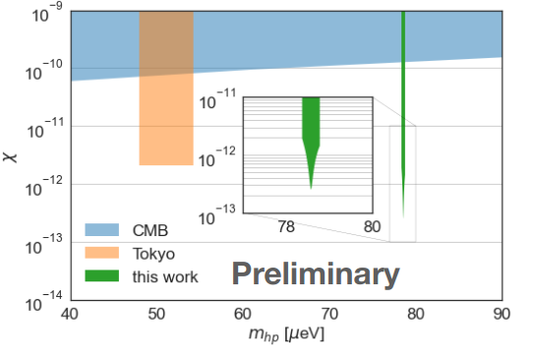
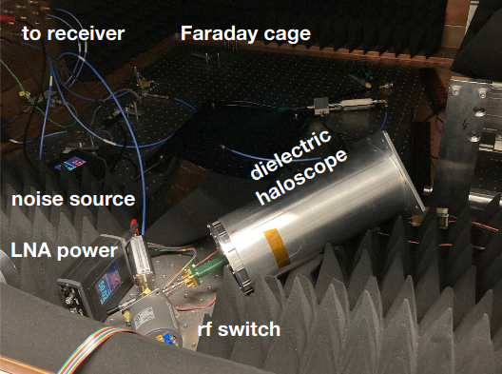
Hidden photon search
Hidden photon to microwave conversion w/o B field @ RT
• 32 days of data taking
Noise temperature ~ 200K
• No excess power observed
SENSITIVITY:
stringent analysis on the way
11-08-2022 | Antonios Gardikiotis | 17

Slide 18
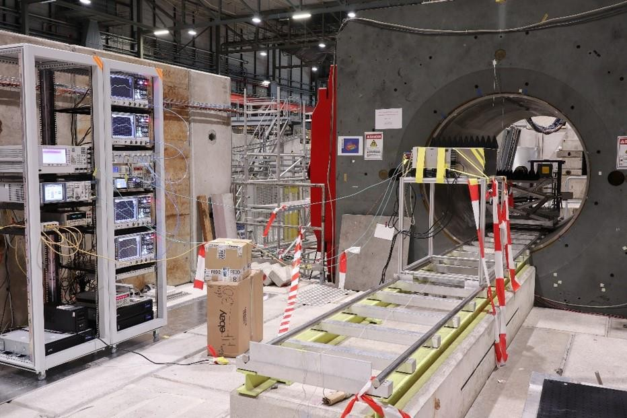
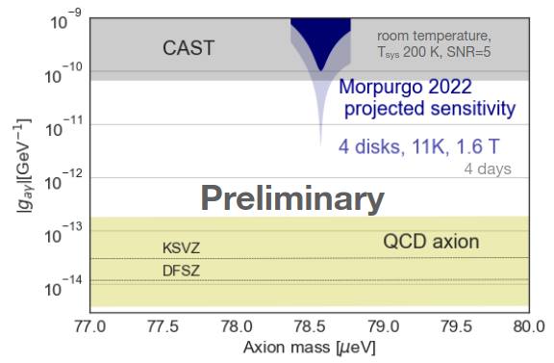
First ALP search
ALP search in CERN ’s Morpurgo magnet (1.6 T) in Mar/Apr 2022
SENSITIVITY:
stringent analysis on the way
DAQ system
Closed Booster 100
10 hrs @ 1.6T, with ~200 K noise temperature
No excess power found.
Planning upgrade with a T < 10 K system
11-08-2022 | Antonios Gardikiotis | 18

Slide 19
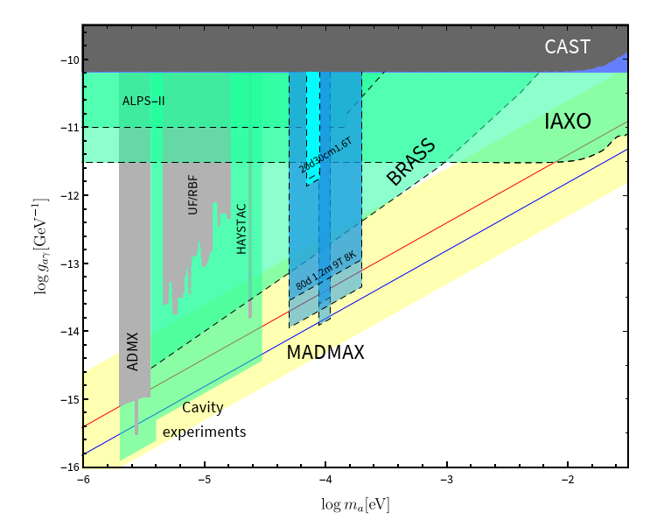
MADMAX Sensitivity
5σ above system noise temperature
50 % of the theoretically obtainable maximum power
MADMAX Prototype:
𝑁_{disk}=20
𝐴_{disk}=0.07m²
𝐵∥=1.6T
𝑇_{sys}=8K
MADMAX:
𝑁_{disk}=80
𝐴_{disk}=1.2m²
𝐵∥=9T
𝑇_{sys}=8K
alreadyexplored/excluded
theoryprediction
MADMAX (Prototype)
otheraxionexperiments
[arXiv:2003.10894]
11-08-2022 | Antonios Gardikiotis | 19

Slide 20
Summary & Conclusion
MADMAX prototype cryostat to be delivered 2023 at UHH
Major R&D milestones reached
Feasibility of piezo actuators at 5 K & 5.3 T
Mechanical concept of MADMAX baseline design verified→ P200
Highest technological risk for magnet eliminated → MACQU
Booster understanding well under way
First physics measurements with CB100 in CERN MORPURGO magnet
11-08-2022 | Antonios Gardikiotis | 20

Slide 21
Backup

Slide 22
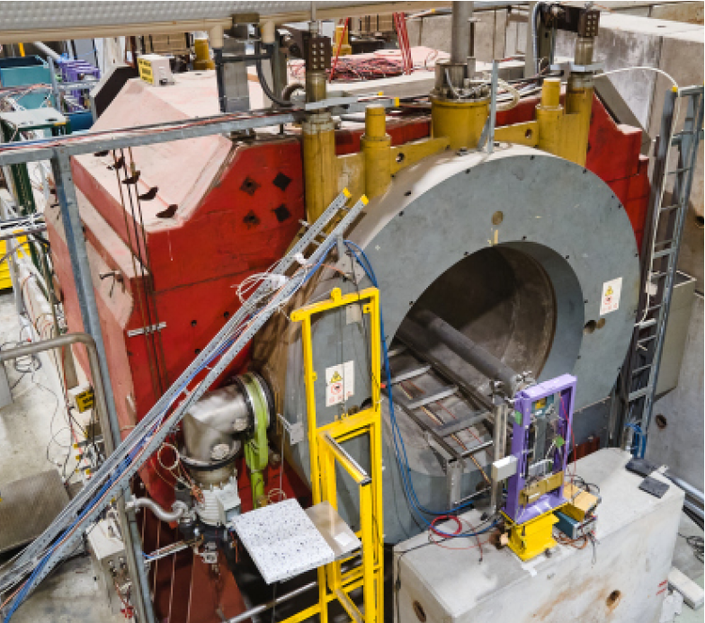
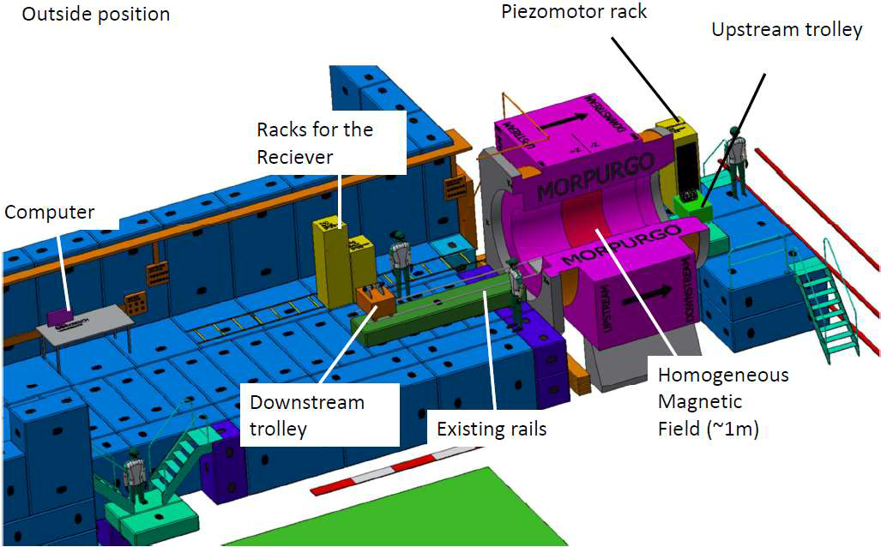
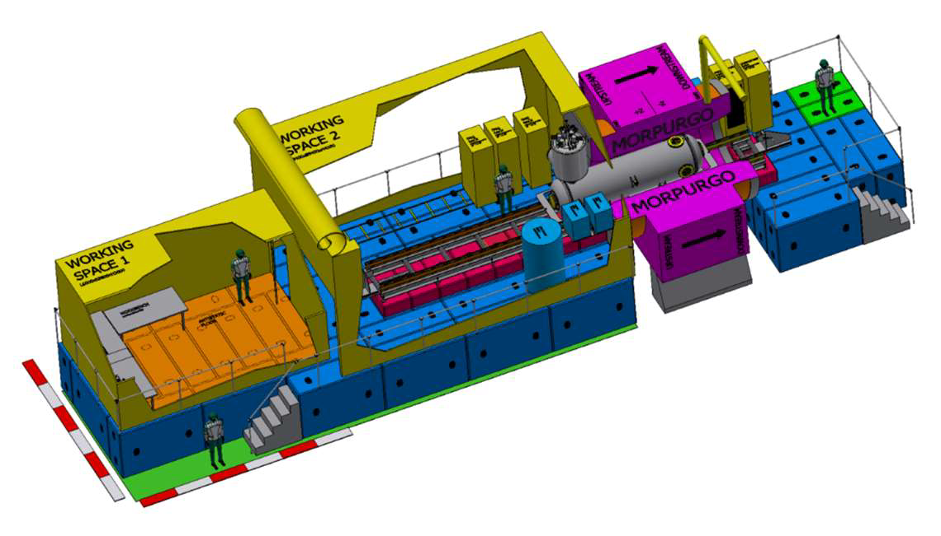
Morpurgo Magnet at CERN
2022+2023 warm tests 2023/24+2024/25 cold tests
1.6 m
CB200
P200
^{EMC} r-Booster P-Booster ? Interest ?
CB100
P200
Time slots for MADMAX at MORPURGO
11-08-2022 | Antonios Gardikiotis | 18

Slide 24
Prototyping strategy: MADMAX test setups
Name | acronym | disc diameter [mm] | Nr. of discs | Availability
Closed booster 100 | CB100 | 100 | 3 | 2021
Closed booster 200 | CB200 | 200 | ≥3 | 2022
Project 200 | P200 | 200 | 1 | 2021
Reduced booster | R-booster | 300 | ≥3 | 2023
Prototype booster | P-booster | 300 | 20 | 2024
11-08-2022 | Antonios Gardikiotis | 24

