Slide 1
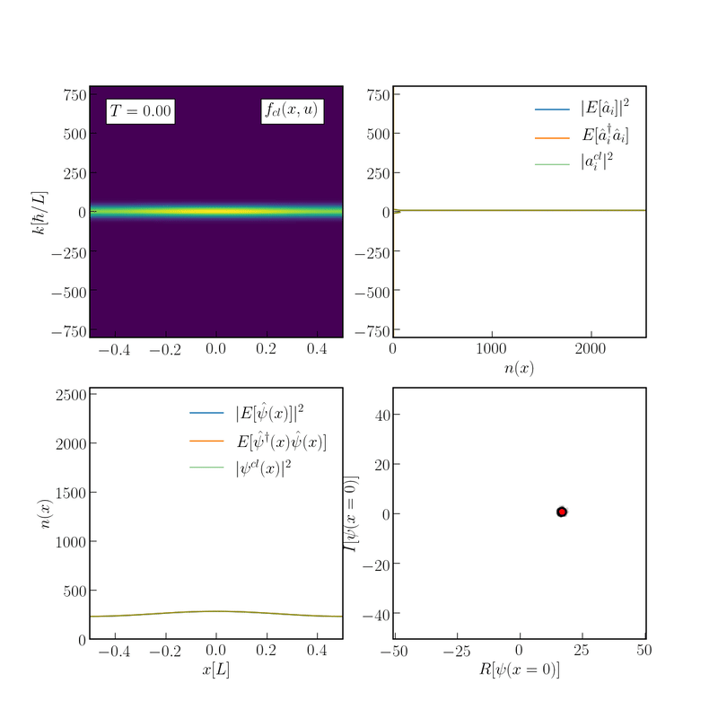
Testing the mean field theory of scalar field dark matter
Andrew Eberhardt (Stanford University)
In collaboration with: Michael Kopp (University of Stockholm) Alvaro Zamora (Stanford University) Tom Abel (Stanford University)
Mainz 2022
Related work: arXiv:2206.06519 arXiv:2111.00050 arXiv:2108.08849

