Slide 1
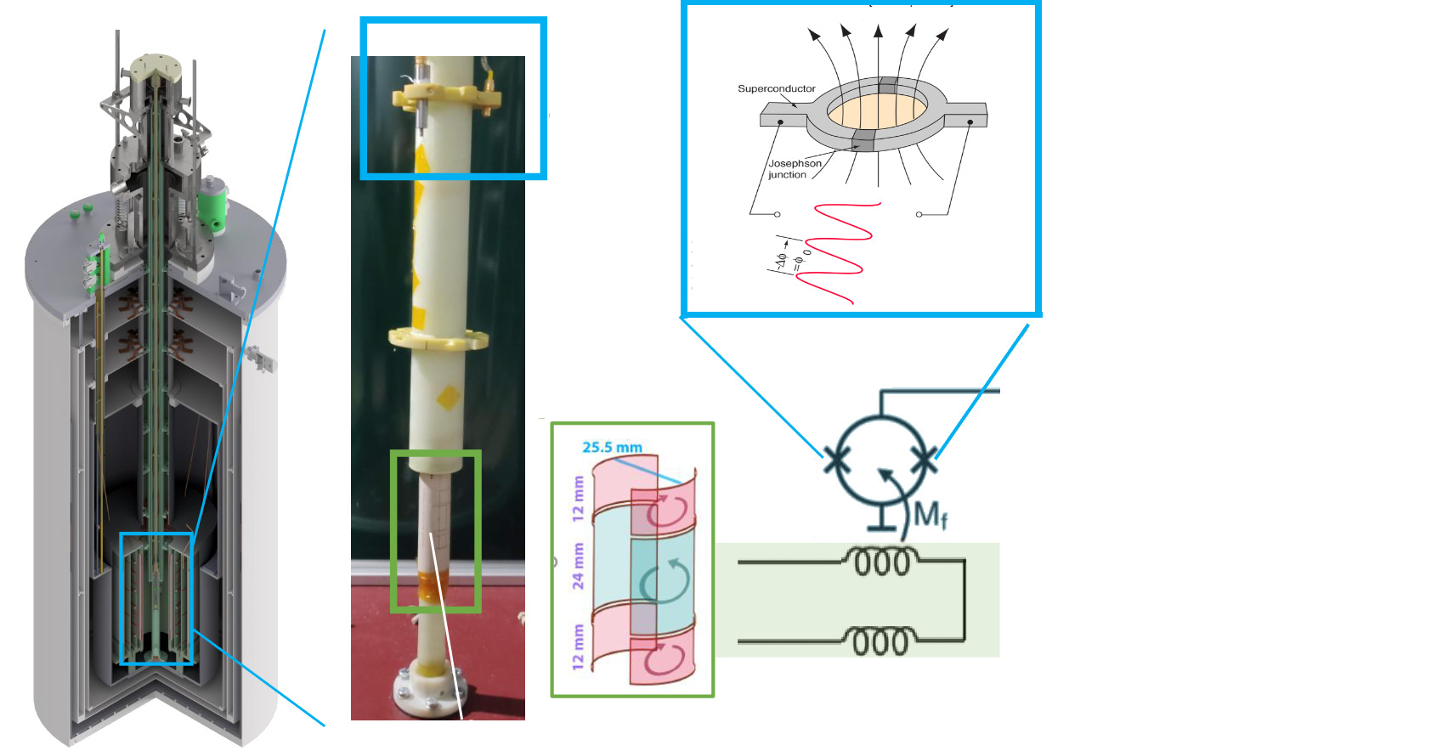
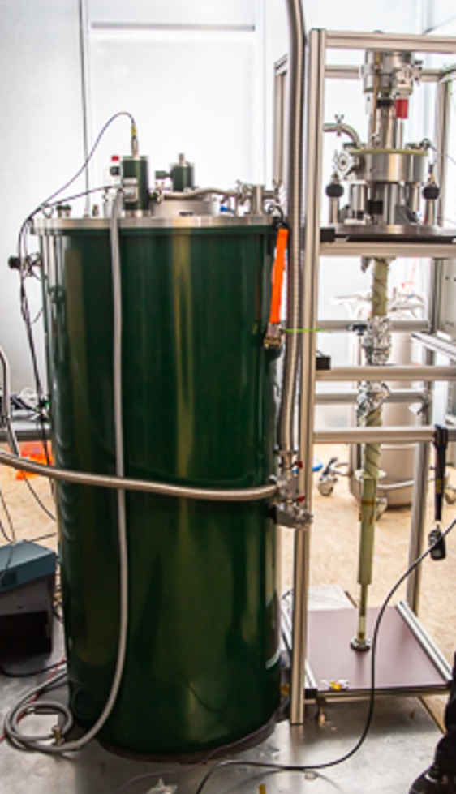
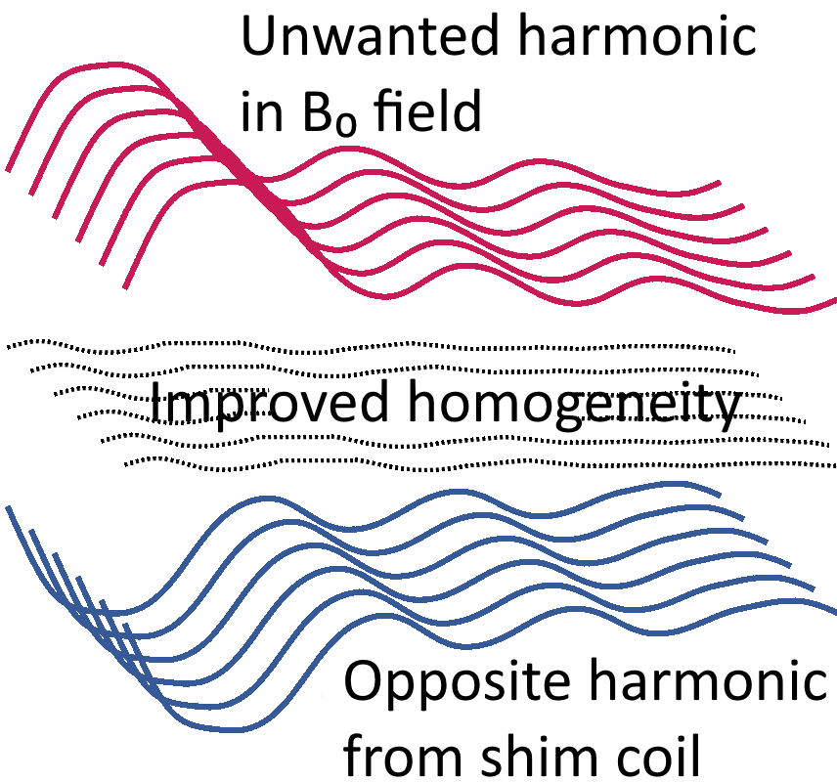
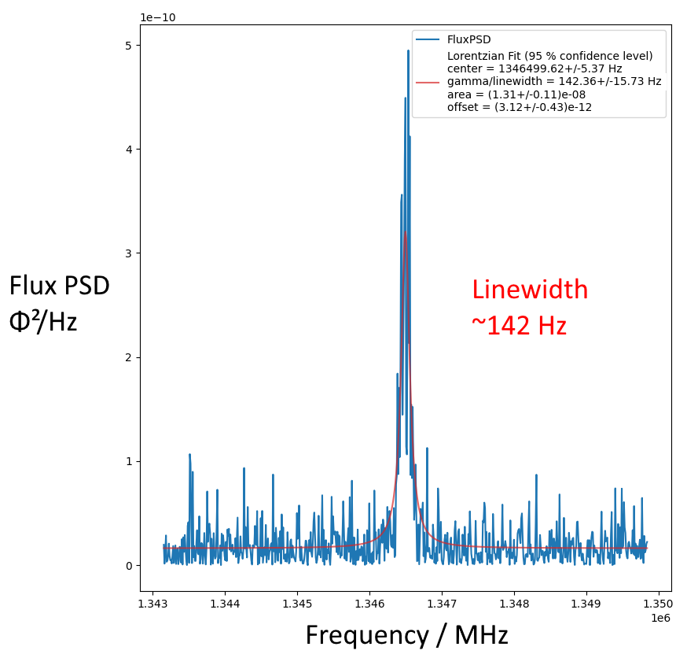
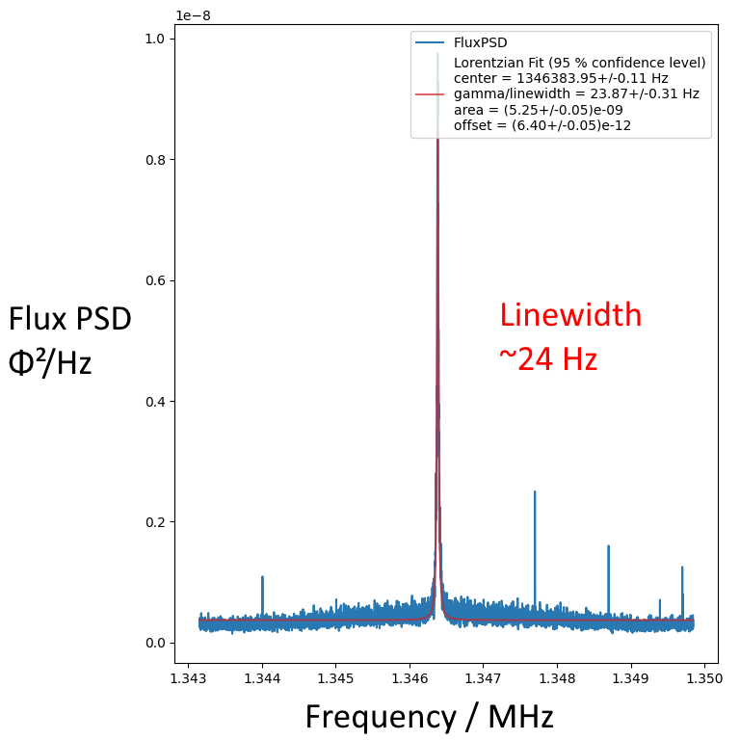
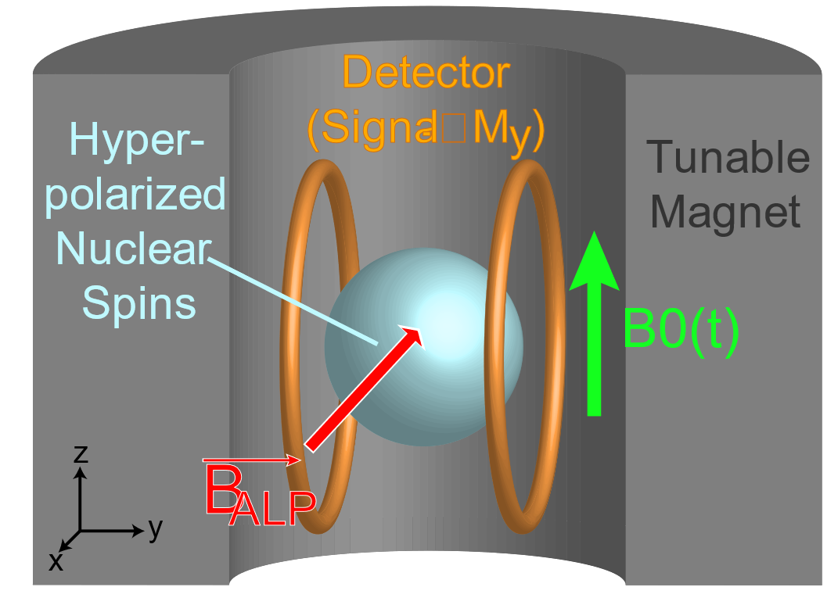
Shimming & SQUID Detection for CASPEr-Gradient
Poster #28 – Julian Walter (HIM & JGU)
juwalter@students.uni-mainz.de
CRYOSTAT
SHIMMING
8 separate shim magnets
automated field ramping
use optimization algorithm to find best settings
most effective for us: Bayesian method
before shimming
after shimming
thermally polarized liquid Methanol sample
0.05T leading field (SC)
setup tested with pulsed NMR
goal: search for ALPs
Shimming improves SNR

