Slide 1


Gravitational Focusing of Dark Matter Streams in Solar Neighborhood and Implications for Detection
Abaz Kryemadhi, Andreas Mastronikolis, Konstantin Zioutas
Profited from Mark Vogelsberger
17th Patras workshop on Axions, WIMPS, and WISPS, Aug 8-12, 2022, Mainz Germany

Slide 2
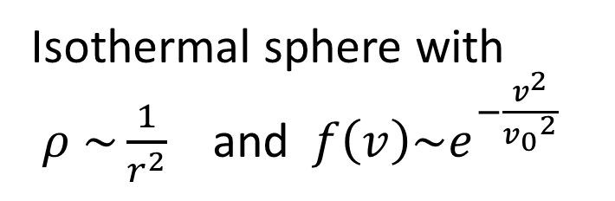
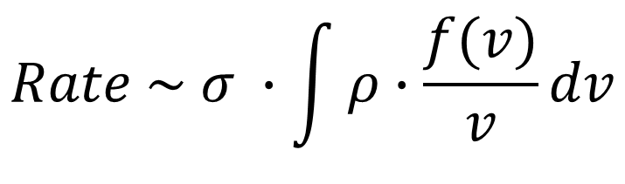
Dark Matter Rate
Standard Halo Model
Rate on detectors depends on
Isothermal sphere with
$ρ \sim \frac{1}{r^{2}}$ and $f\left(v\right)\sim e^{−\frac{v^{2}}{{v_{0}}^{2}}}$
$$Rate \sim σ ∙\int{ρ∙\frac{f(v)}{v}}dv$$
Cross Section of processes from Particle Physics
Astrophysics & Cosmological Simulations
Astroparticle Physics

Slide 3
Fine-Grain Streams and Cosmological Simulations
The cold nature of dark matter yields particles with nearly zero dispersions
( ~10⁻¹⁰ c for WIMPs and 10⁻¹⁷ c for Axions) at the last scattering
Mark Vogelsberger and Simon D. M. White used a geodesic deviation equation and the N-body equations of motion:
The DM distribution at a
typical point in the halo is described as a superposition of many fine-grained streams with discrete velocity distributions, each of which has a very small velocity dispersion
Mark Vogelsberger and Simon D. M. White,
Mon. Not. R. Astron. Soc. 413, 1419–1438 (2011)

Slide 4
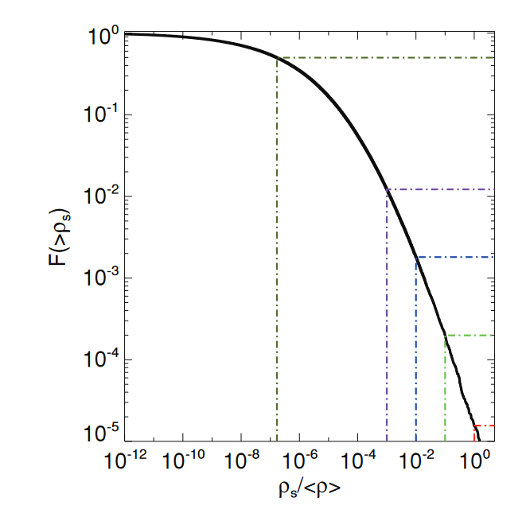
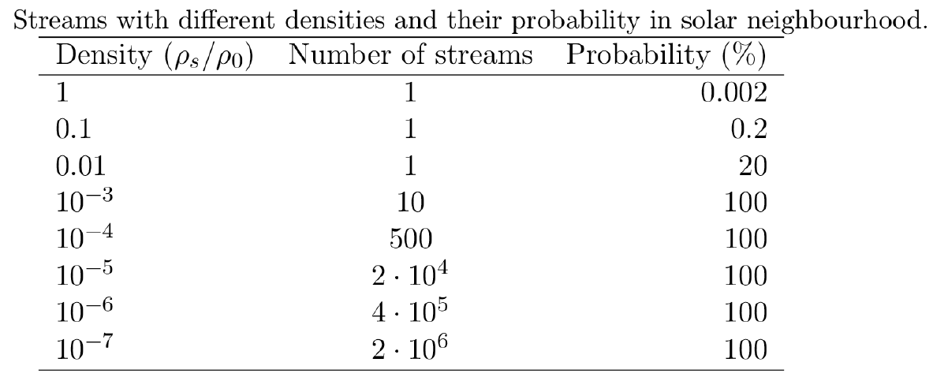
Fine-Grained Stream Abundance
Mark Vogelsberger and Simon D. M. White,
Mon. Not. R. Astron. Soc. 413, 1419–1438 (2011)
2 million streams with density 10⁻⁷ ρ₀

Slide 5
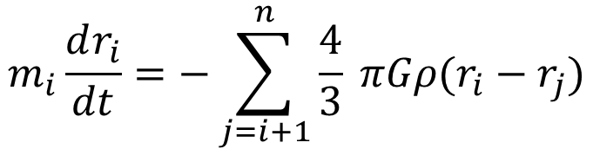
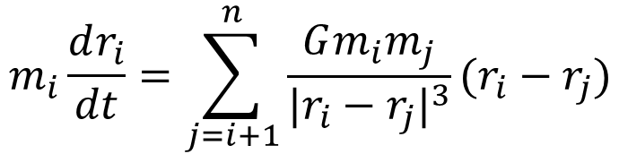
Fine-Grain streams at Solar Position
Analytical calculations of zero dispersion streams by Sun or other planets have been done before, however realistic streams would have some dispersion and are affected by gravity of more than one solar body
We focused on simulating the fine-grained particles to include
Dispersion
Multi-body effects (Sun, Earth)
Stand-alone N-body simulation could be adapted by DM groups to calculate the Gravitational effects on DM rates
$$m_{i}\frac{dr_{i}}{dt}=\sum_{j=i+1}^{n}{\frac{Gm_{i}m_{j}}{|r_{i}−r_{j}|^{3}}}(r_{i}−r_{j})$$
Python
Numpy, Scipy
Scipy.integrate.odeint package as equation solver
Outside Solar Bodies
$$m_{i}\frac{dr_{i}}{dt}=−\sum_{j=i+1}^{n}{\frac{4}{3}} πGρ(r_{i}−r_{j})$$
Inside Solar Bodies

Slide 6
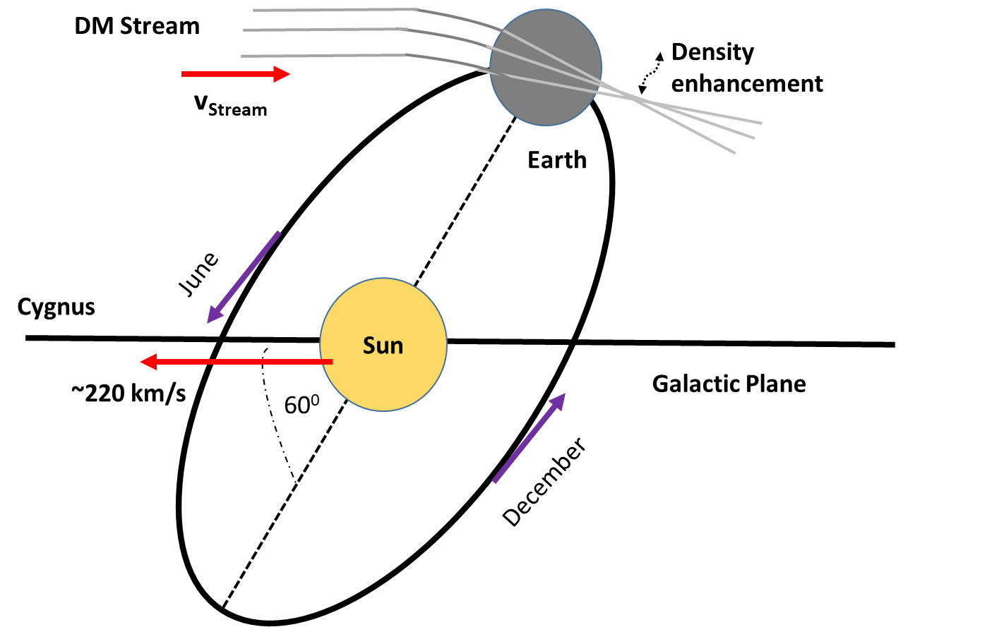
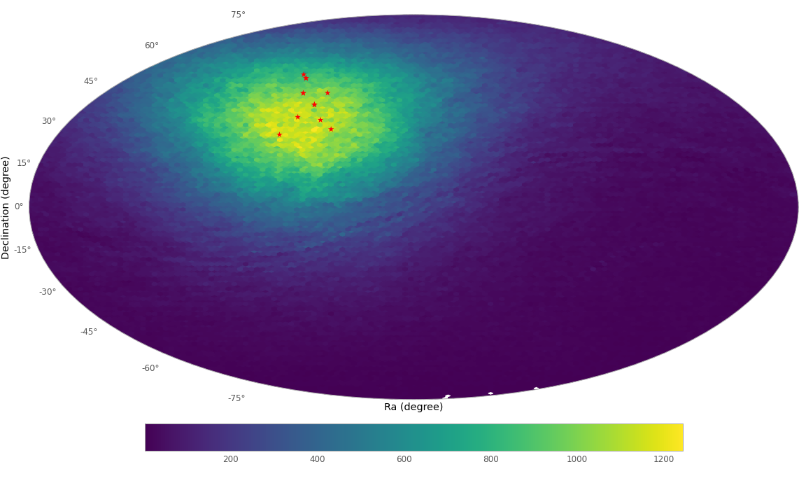
Schematics of Solar system headed towards the Cygnus and illustration of a stream experiencing gravitational effects of Sun and Earth
Simulated particles arrive with a peak around Cygnus (Red) as expected from other findings

Slide 7
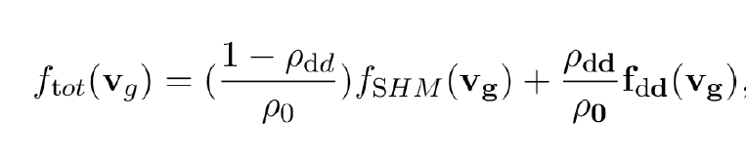
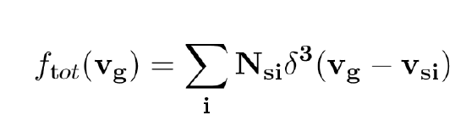
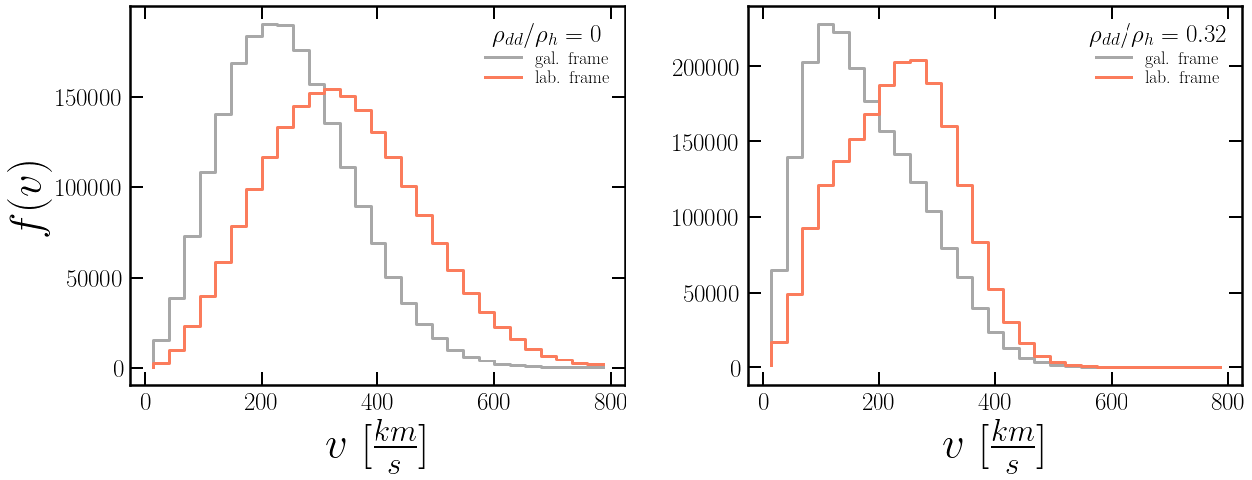

Slide 8
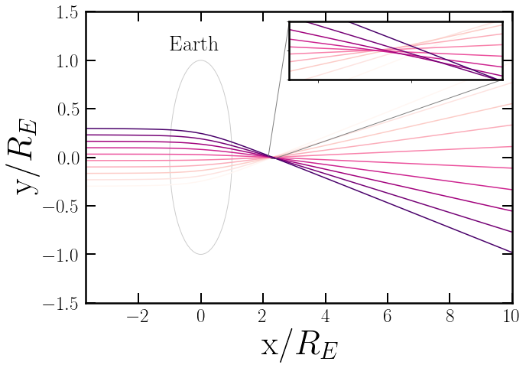
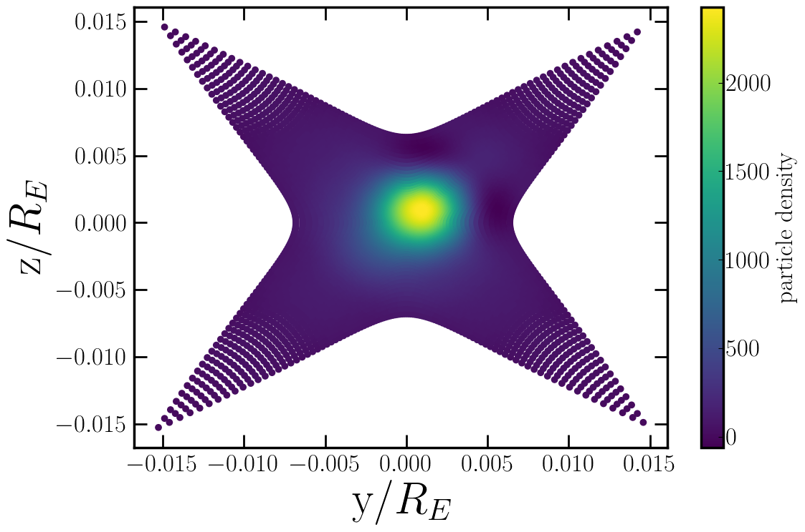
Particles come closer as they enter inner Earth focusing some distance away
Y-Z projection of simulated particles arriving through the Earth at the focus point

Slide 9
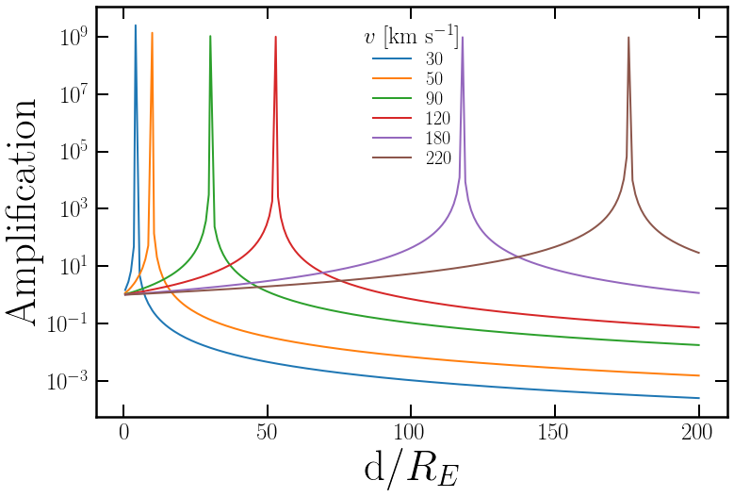
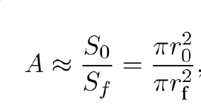
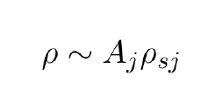
Amplification Definition:
Density After Focusing

Slide 10
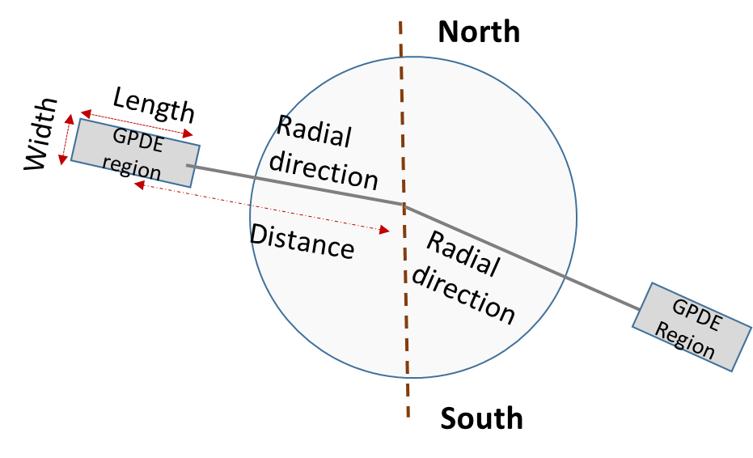
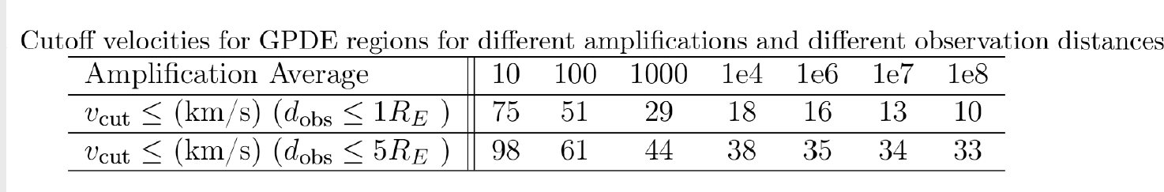

Slide 11
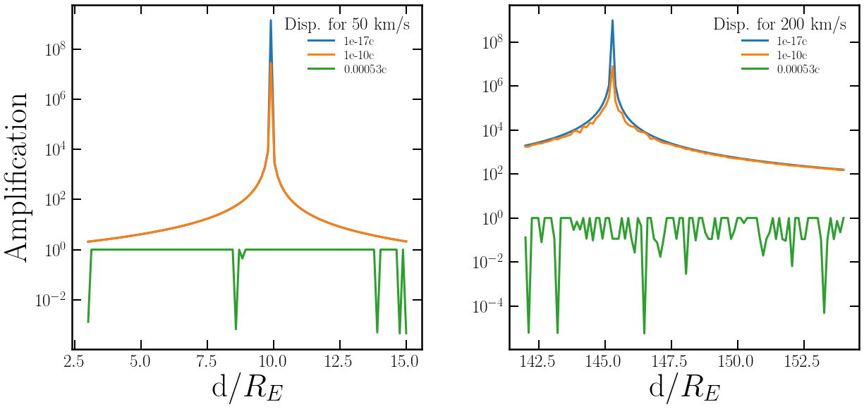
Max amplification axions ~ 10⁹
Max amplification WIMPs ~ 10⁸

Slide 12
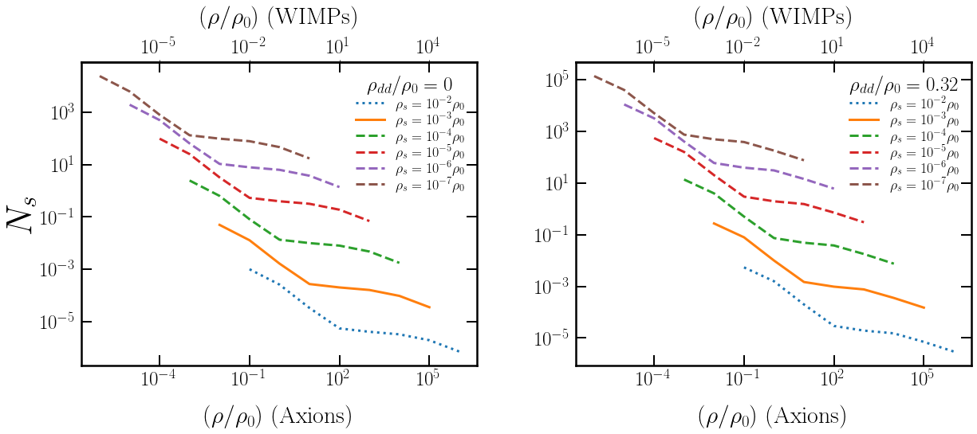
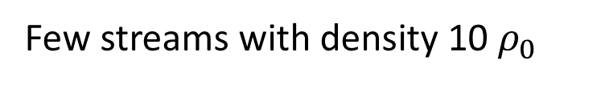

Number of streams with particular density, and amplifications where density enhancements are located within one R_{E}
Few streams with density 10 $ρ_{0}$
About 50 streams with density 10 $ρ_{0}$

Slide 13
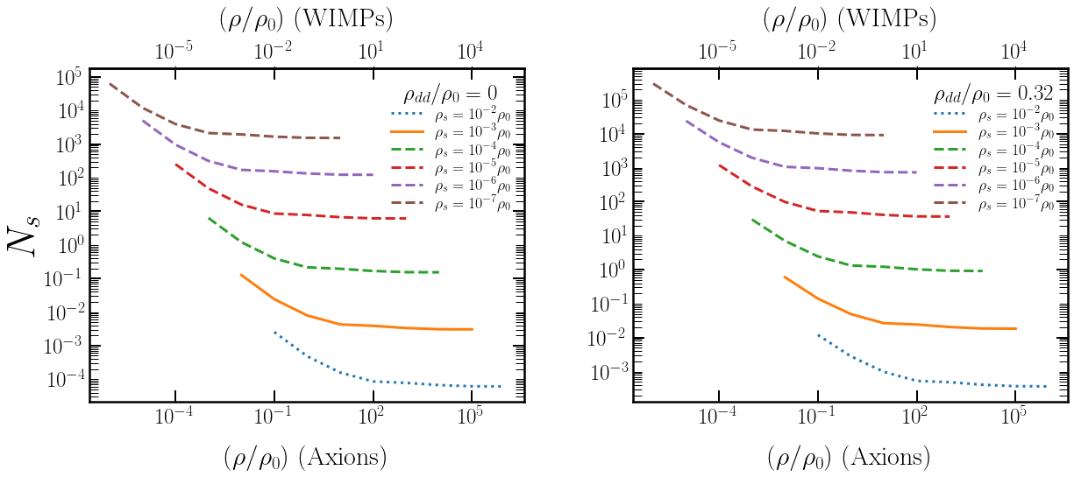
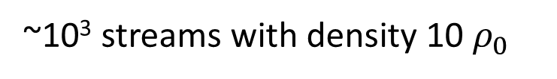
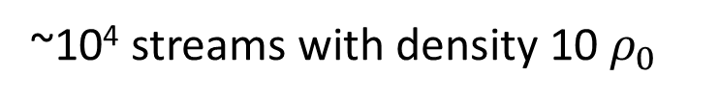
Number of streams with particular density, and amplifications where density enhancements are located within one 5R_{E}
~10³ streams with density 10 $ρ_{0}$
~10⁴ streams with density 10 $ρ_{0}$

Slide 14
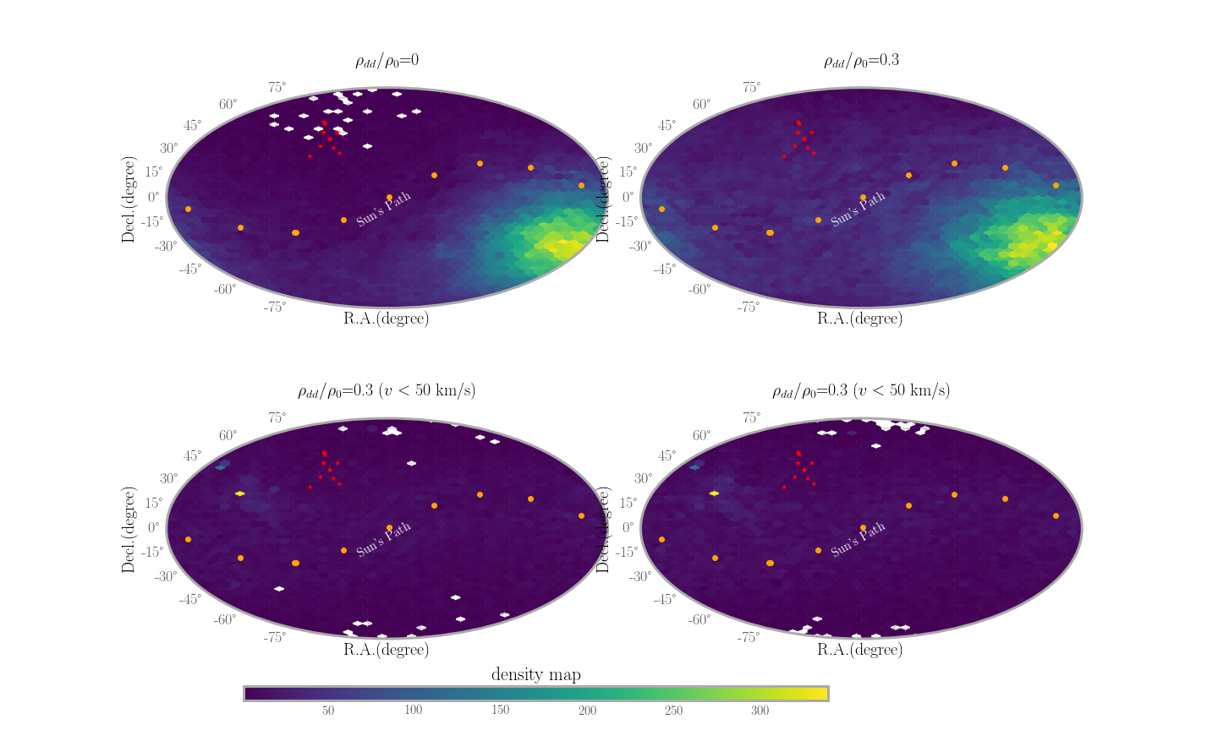
Stream density regions distribution map
All streams
Low speed streams <50 km/s

Slide 15
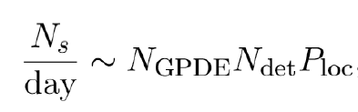
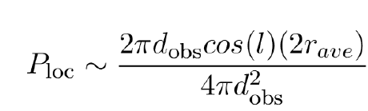
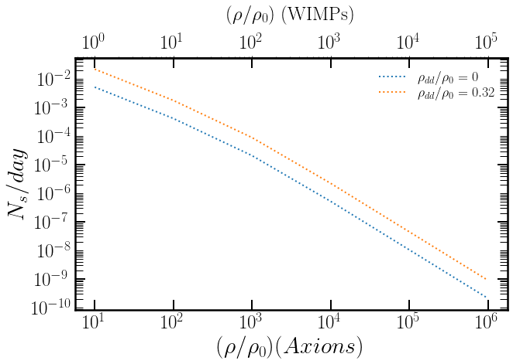
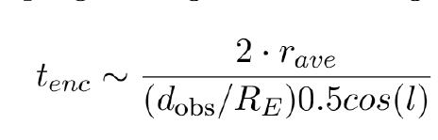
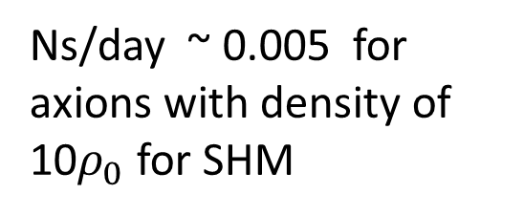

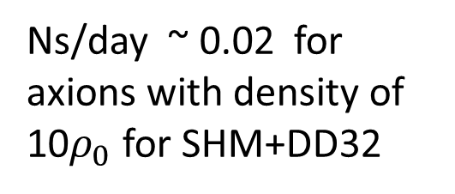
Ns/day ~ 0.02 for axions with density of 10$ρ_{0}$ for SHM+DD32
Ns/day ~ 0.005 for axions with density of 10$ρ_{0}$ for SHM
$$d_{obs}\sim R_{E}$$

Slide 16
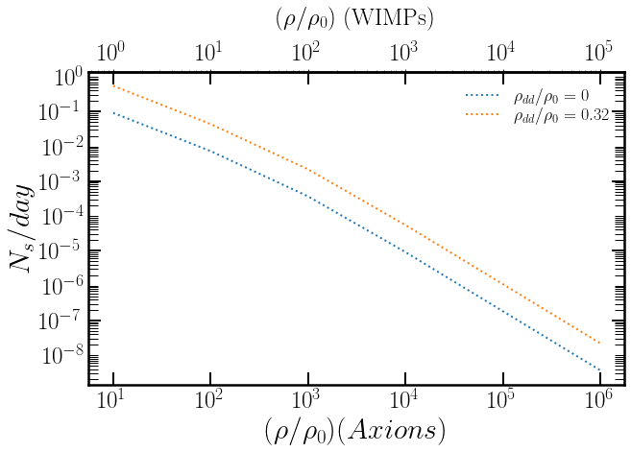

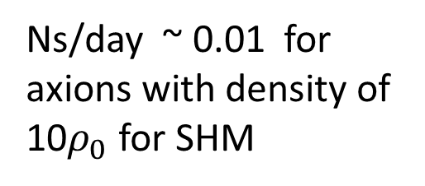
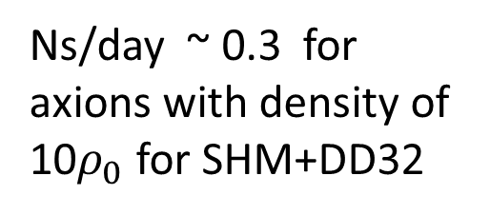
Ns/day ~ 0.3 for axions with density of 10$ρ_{0}$ for SHM+DD32
Ns/day ~ 0.01 for axions with density of 10$ρ_{0}$ for SHM
$$d_{obs}\sim R_{E}$$
$$d_{obs}\sim {5R}_{E}$$

Slide 17
Preliminary Summary & Outlook
Gravitational effects of the Sun and Earth of primordial fine-grained streams have been studies with Sun scrambling direction of streams and Earth producing high density regions around the Earth
High density regions are very sensitive to velocity dispersion of the streams
It is possible to parse the parameter space and discriminate between an Isothermal model and other models as well as single out fine-grained nature
A network of detectors looking for transient signals (~1-10 s) is ideal way to search

Slide 18
Search for fine-grained streams with the ECHO method
Ariel Azra
Abaz Kryemadhi
Konstantin Zioutas

Slide 19

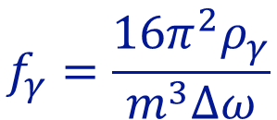
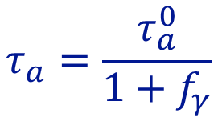
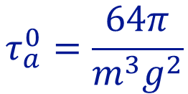





Stimulated axion decay into two photons
$$τ_{a}^{0}=\frac{64π}{m^{3}g^{2}}$$
axion life-time for spontaneous decay
$$m={10}^{−5}\text{eV}$$
$$τ_{a}^{0}∼{10}^{42}\text{yr}$$
$$g={10}^{−15}{\text{GeV}}^{−1}$$
$$τ_{a}=\frac{τ_{a}^{0}}{1+f_{γ}}$$
Actual Axion Life-Time
$$f_{γ}=\frac{16π^{2}ρ_{γ}}{m^{3}Δω}$$
stimulated axion decay
$$ω_{γ}=m/2$$
Let’s suppose a power of 1kWatt with a bandwidth of 1MHz during
a time of 1 second in a volume of 1 meter cube
$$f_{γ}∼{10}^{25}$$

Slide 20



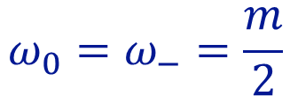

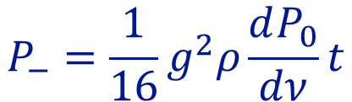









Stimulated axion decay into two photons (The Echo)
$$P_{0}$$
jkkk
jkkk
$$γ_{0}$$
$$a$$
$$P_{0}$$
jkkk
jkkk
jkkk
$$γ_{0}$$
$$γ$$
$$γ$$
ECHO
$$P_{−}=\frac{1}{16}g^{2}ρ\frac{dP_{0}}{dν}t$$
$$ω_{0}=ω_{−}=\frac{m}{2}$$
$$P_{0}=1\text{kW}$$
$$t=1000\text{s}$$
$$Δν=100\text{Hz}$$
Isothermal dark matter model
$$P_{−}∼{10}^{−21}\text{W}$$

Slide 21


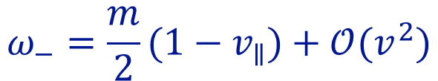

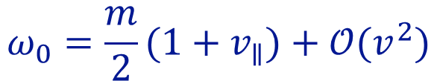



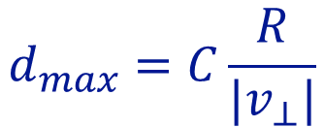
The Echo in a cold flow
$$ω_{0}=\frac{m}{2}(1+v_{∥})+𝒪(v^{2})$$
$$φ$$
$${\overset{⃗}{ω}}_{−}$$
$$ω_{−}=\frac{m}{2}(1−v_{∥})+𝒪(v^{2})$$
$${\overset{⃗}{ω}}_{0}$$
$$φ≃2|v_{⊥}|$$
$$θ$$
$$m\overset{⃗}{v}$$
The detector collects echo coming from distances no larger than
$$d_{max}=C\frac{R}{|v_{⊥}|}$$

Slide 22
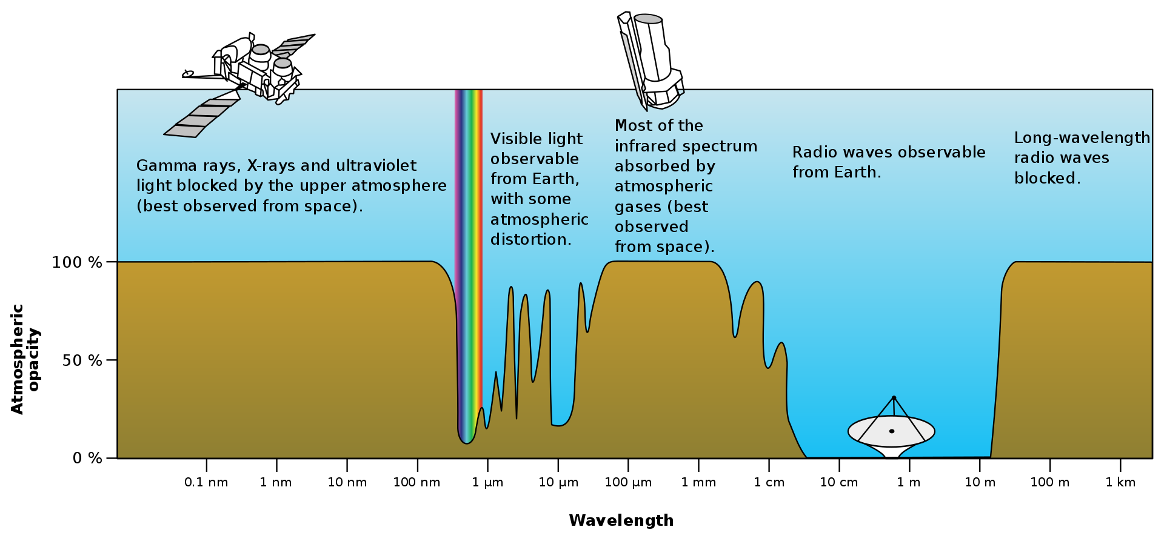
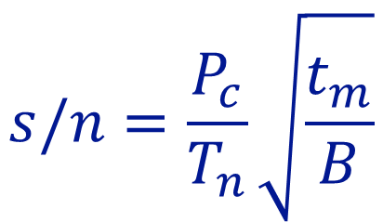
Sensitivity
$$s/n=\frac{P_{c}}{T_{n}}\sqrt{\frac{t_{m}}{B}}$$
Dicke’s radiometer equation

Slide 23
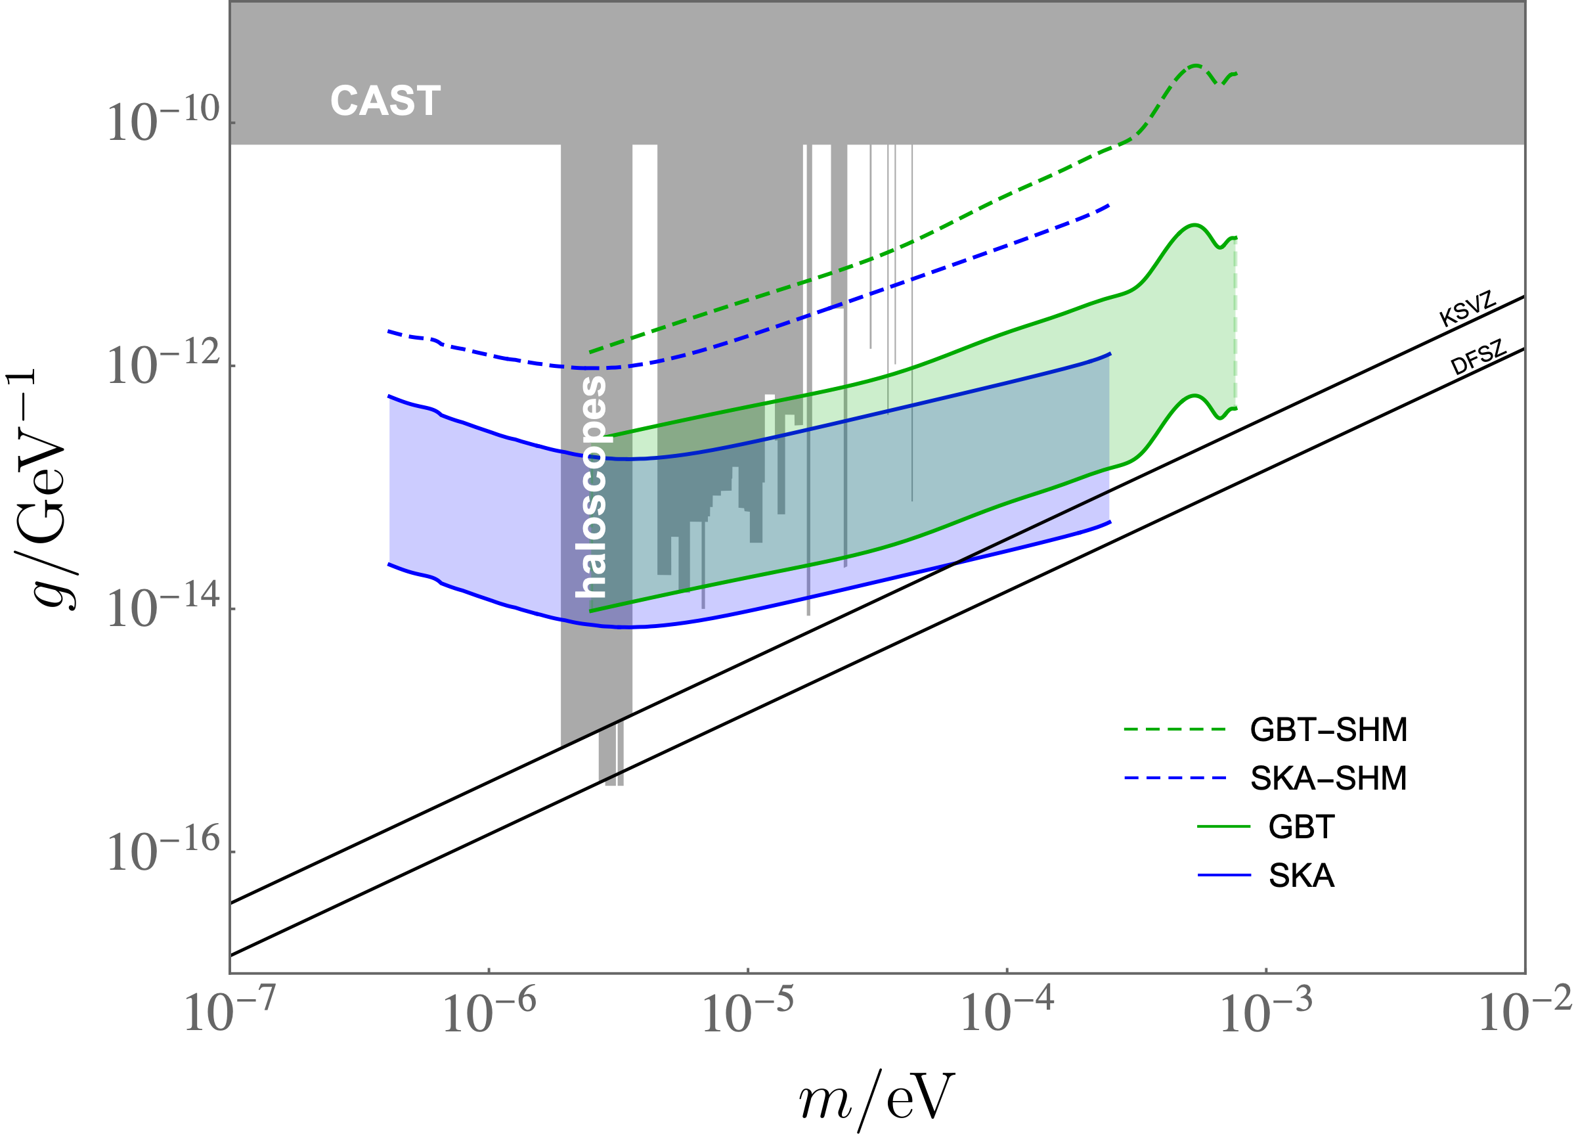
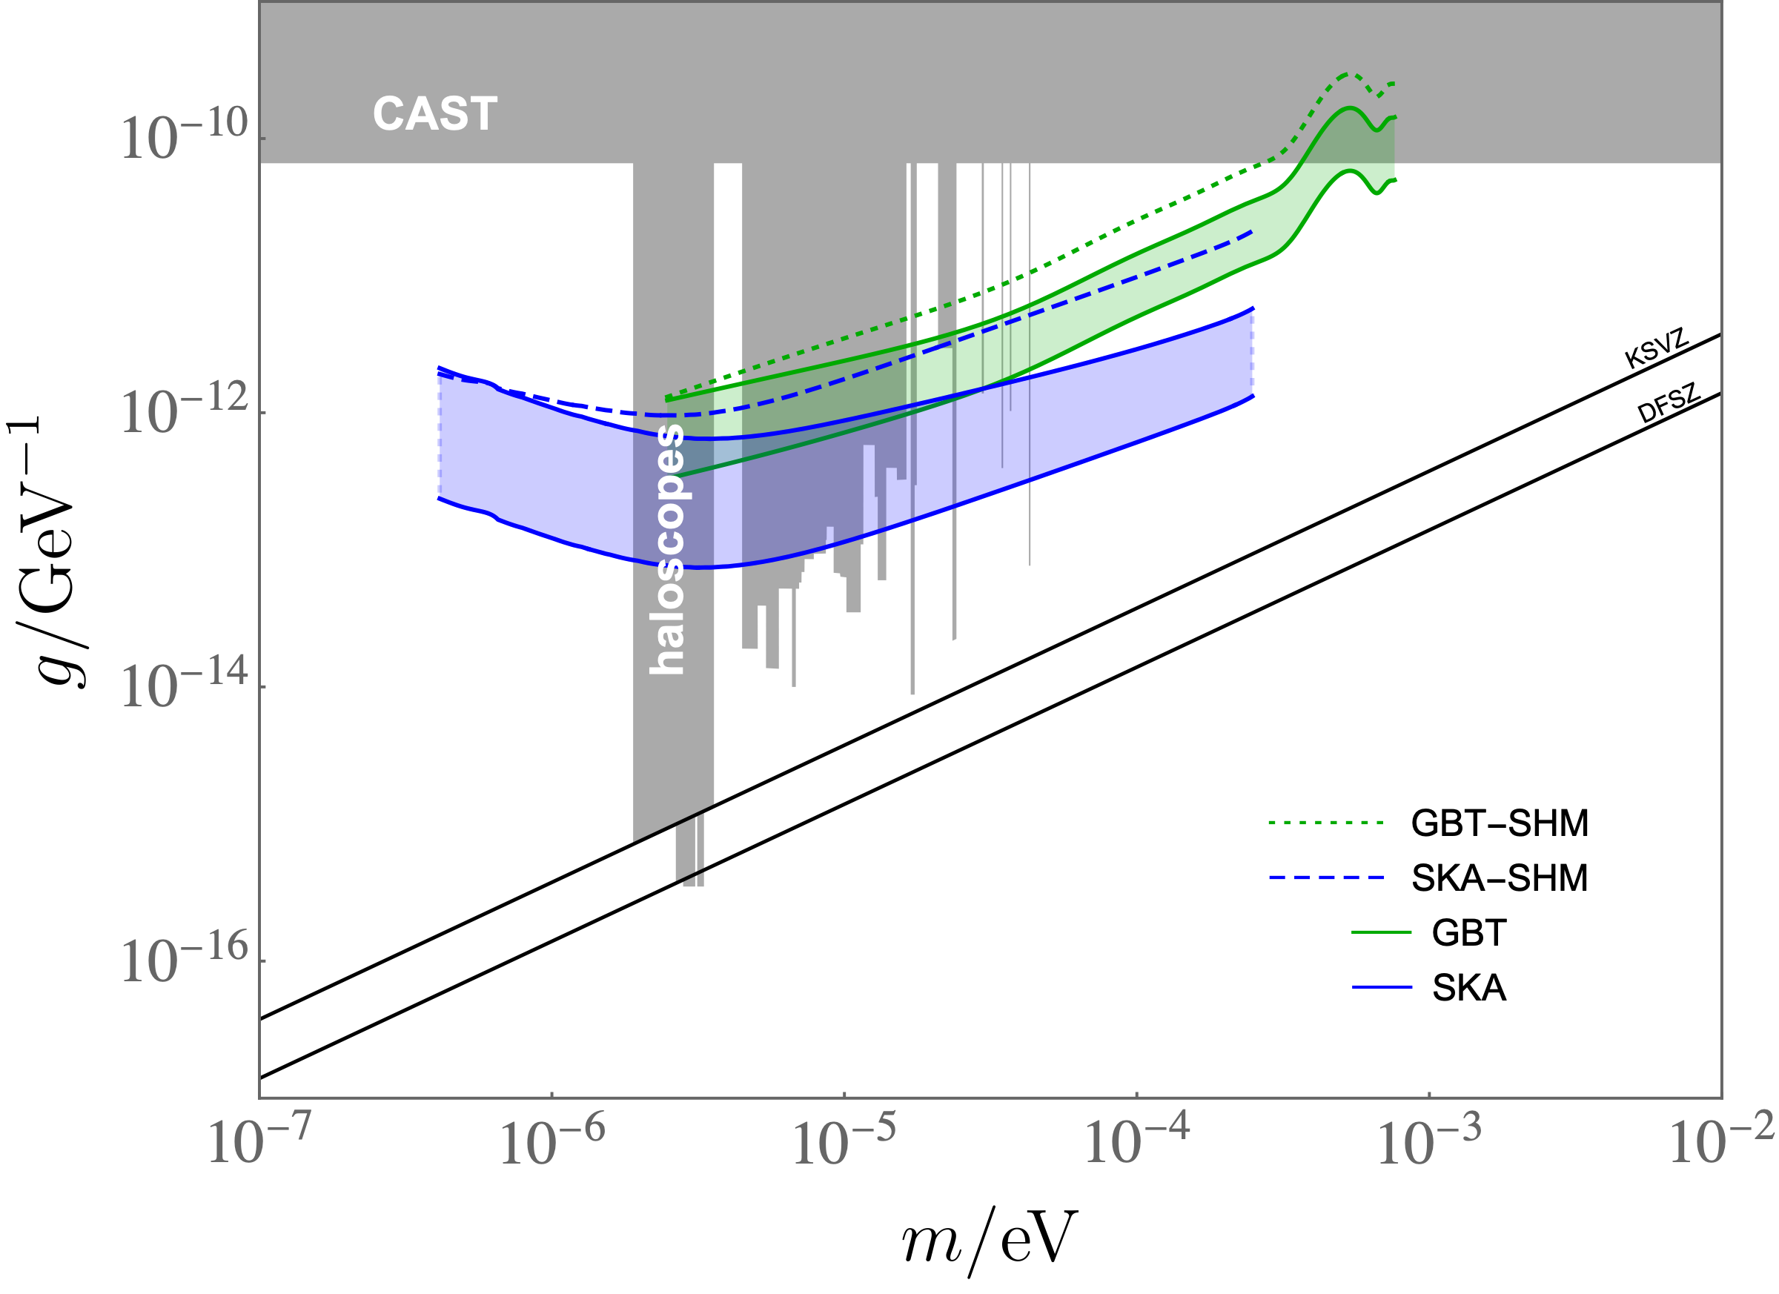
Sensitivity
We assume we spend 10 MW during one year to cover a factor of two in axion mass range
Low density streams
Gravitational hairs
The sensitivity widths for the low density streams plot are related to the uncertainty on the stream direction
The sensitivity widths for the gravitational hairs plot are related to the uncertainty on the hairs location

