Slide 1


Quark Nugget Dark Matter hunter’s guide
08 August 2022
Victor Flambaum and Igor Samsonov
V. V. Flambaum, I. S.,
Phys. Rev. D 106 (2022) 023006
Phys. Rev. D 105 (2022) 123011
Phys. Rev. D 104 (2021), 063042
Notes:
First of all, I would like to thank the organizers for including my talk in the program. Today I’m going to present our results regarding the Quark Nugget model of Dark Matter.

Slide 2
THE MODEL

Slide 3
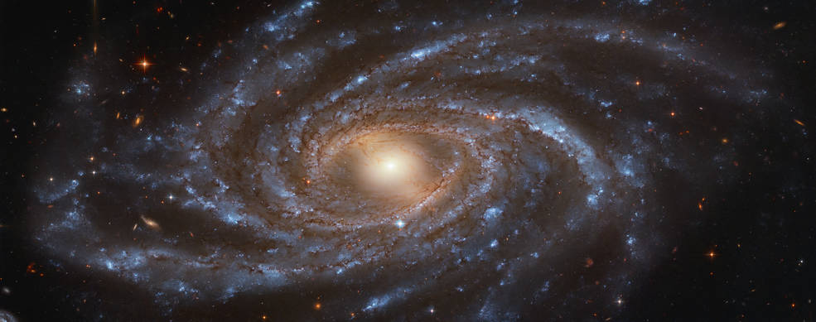
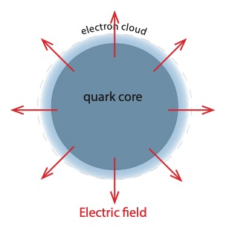
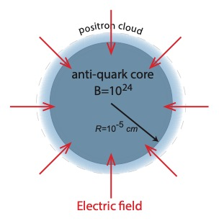
The quark nugget Dark Matter model
A.R. Zhitnitsky, JCAP 10, 010 (2003).
Phys. Rev. D 74, 043515 (2006)
Quark Nugget
Antiquark Nugget

Slide 4
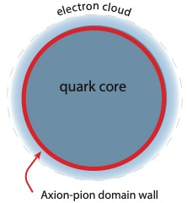
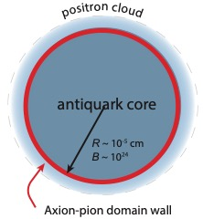
Baryon
matter
Stable quark matter
Strangelet Model
E. Witten, Phys. Rev. D 30, 272 (1984)
E. Farhi and R. L. Jaffe, Phys. Rev. D 30, 2379 (1984)
Quark Nugget
Anti-Quark Nugget
Axion-Quark nugget model
R. Zhitnitsky,
JCAP 2003 (10), 010.
Phys. Rev. D 74, 043515 (2006)
….

Slide 5
Why two phases?
Baryon symmetry of the universe is preserved!
All antimatter is hidden in anti-quark nuggets!
No particles beyond SM are required!

Slide 6
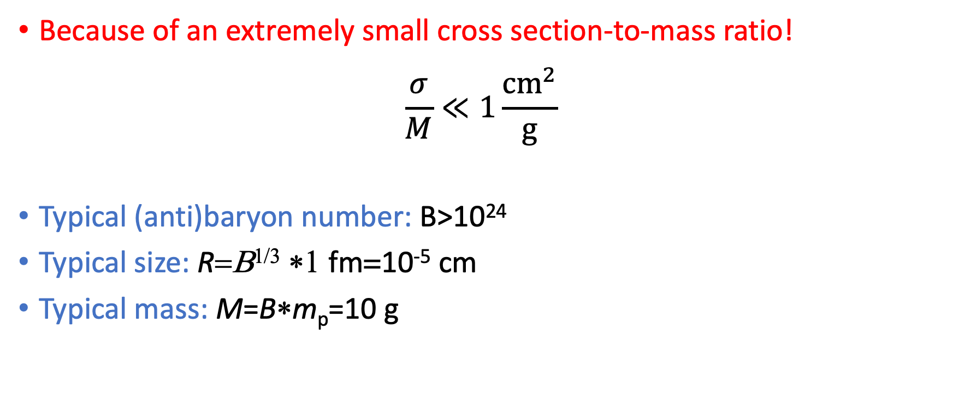
Why are they ``dark?’’
Because of an extremely small cross section-to-mass ratio!
$$\frac{σ}{M}≪1\frac{{cm}^{2}}{g}$$
Typical (anti)baryon number: B>10²⁴
Typical size: R=Β^{1/3} ∗1 fm=10⁻⁵ cm
Typical mass: M=B∗m_{p}=10 g

Slide 7
How to detect (anti)quark nuggets?
Antiquark nuggets strongly interact with visible matter => have better chances to be detected in contrast with QNs.
Anti-QNs hit the Earth and may cause rare seismic (earthquake) and atmospheric (sound waves) events [Budker, Flambaum, Liang, Zhitnitsky, Phys. Rev. D 101, 043012 (2020); Symmetry 14 (2022) 459].
Anti-QNs annihilate with gas and dust in Galaxy => look for specific radiation in our Galaxy => In this work!

Slide 8
Possible astrophysical manifestations of antiquark nuggets

Slide 9
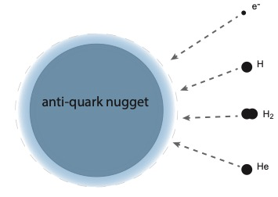
Interstellar gas particles scattering off the anti-quark nuggets
Interstellar gas
Particles of the interstellar gas scatter off the antiquark nuggets, annihilate, and create excitations in the antiQN positron cloud.
The excited antiquark nuggets radiate!
Thermal radiation from positron cloud
Non-thermal radiation from matter-antimatter decay products

Slide 10
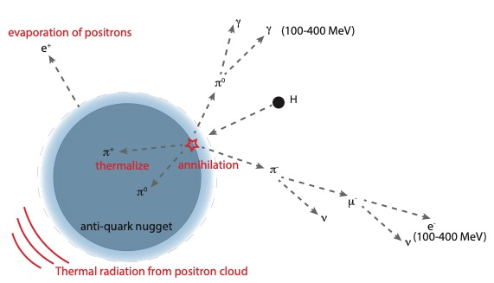
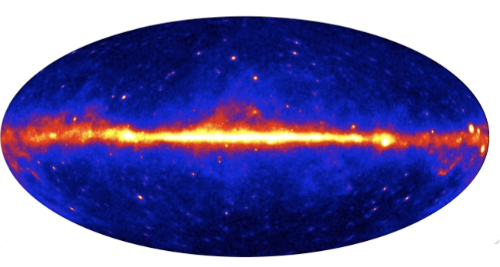
Proton annihilation in the antiquark nugget
Fermi-LAT gamma-ray image
synchrotron radiation
?

Slide 11
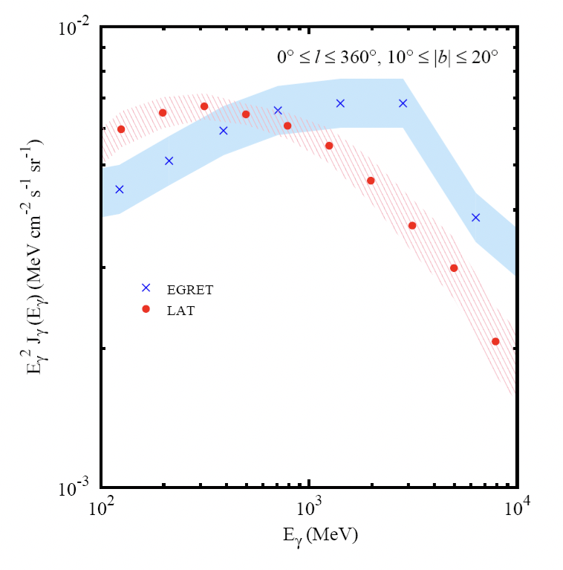
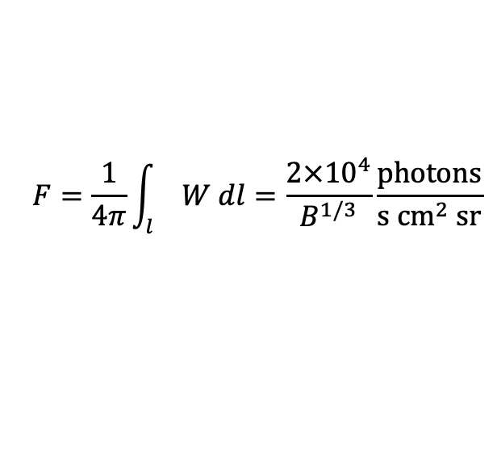




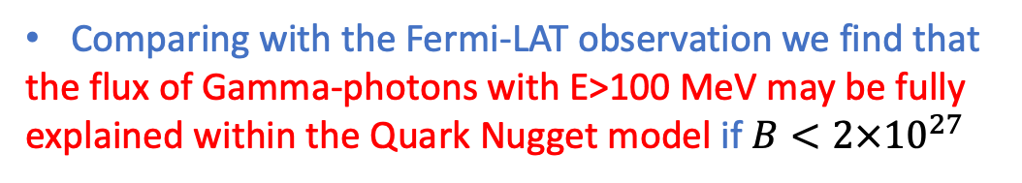
Gamma-rays from neutral π mesons
Anti-QN annihilation rate with interstellar gas:
Observed Fermi-LAT gamma-ray flux
$$W= σ v n_{DM}n_{gas}$$
The flux of γ-photons with E>100 MeV may be fully explained within the Quark Nugget model!
$$σ=πR^{2}=πB^{2/3}{fm}^{2}$$
Annihilation cross section
$$v={10}^{−3}c$$
Velocity of dark matter particles
$$n_{DM}=ρ_{DM}/(B GeV)$$
Photon flux at observation point is given by line-of-sight integral
$$F=\frac{1}{4π}\int_{l}{W dl=\frac{2×{10}^{4}}{B^{1/3}}\frac{photons}{s {cm}^{2} sr}}$$
Comparing with the Fermi-LAT observation we find that
the flux of Gamma-photons with E>100 MeV may be fully explained within the Quark Nugget model if $B<2×{10}^{27}$
P F Michelson, W B Atwood, S Ritz, Rep. Prog. Phys. 73 (2010) 074901

Slide 12
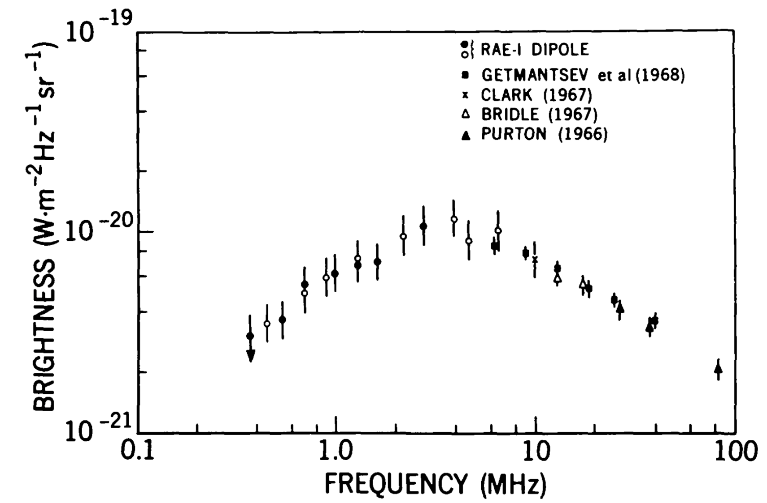
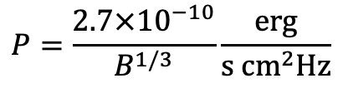
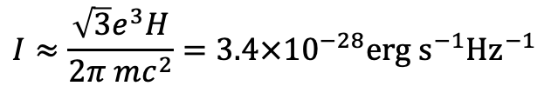

Synchrotron radiation from emitted electrons/positrons
Charged Pi-mesons decay into electrons with energy up to 400 MeV
These electrons produce synchrotron radiation in galaxy when they move in random magnetic fields with H∼10 μG
Maximum of synchrotron radiation at ω=44 MHz
Intensity of radiation from one such electron
Radiation power from all such electrons in the galaxy bulge at the observation point on Earth
Comparing this with the RAE1 satellite observation, we find that
It is plausible that the observed rf radiation from the galactic bulge is partly produced by charged particles emitted from anti Quark Nuggets
with $B<8×{10}^{23}$
It is plausible that the observed rf radiation from the galactic bulge is partly produced by charged particles emitted from anti Quark Nuggets!
$$I≈\frac{\sqrt{3}e^{3}H}{2π mc^{2}}=3.4×{10}^{−28}erg s^{−1}{Hz}^{−1}$$
$$P=\frac{2.7×{10}^{−10}}{B^{1/3}}\frac{erg}{s {cm}^{2}Hz}$$
J. K. Alexander et al, Astrophys. J., Vol. 157, 1969
Notes:
P=

Slide 13
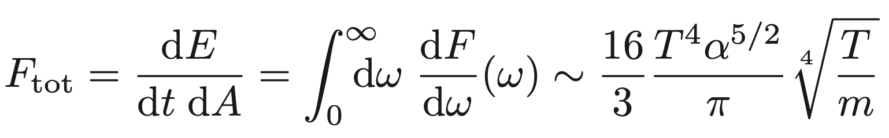

Thermal radiation from anti-QNs
First considered in papers
[M. M. Forbes and A. R. Zhitnitsky, Phys. Rev. D 78, 083505 (2008)]
Radiation comes from a gas of positrons on the surface of quark nugget
Radiation power is estimated as a bremsstrahlung radiation in collisions of positrons in the positron gas. Radiation comes from collisions of individual particles.
This model strongly underestimates the radiation because in macroscopic objects the radiation is a collective effect rather than a two-particle process!

Slide 14
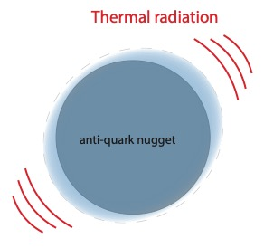
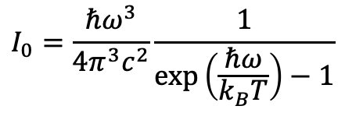

Thermal radiation from anti-QNs
V. V. Flambaum, I. S.,
Phys. Rev. D 105 (2022) 123011
Thermal radiation is produced by density fluctuations in the positron cloud
Antiquark nuggets are considered as spherical particles of radius R and with plasma frequency ω_{p}=2 MeV
Radiation power from each anti-QN:
I₀ is the Planck function
E(ω) is the thermal emissivity, calculated numerically using Mie theory
$$P(ω,T)=πE\left(ω\right)I_{0}(ω,T)$$
$$I_{0}=\frac{ℏω^{3}}{4π^{3}c^{2}}\frac{1}{\exp\left(\frac{ℏω}{k_{B}T}\right)−1}$$

Slide 15
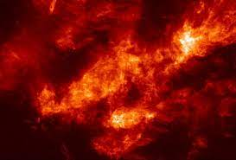
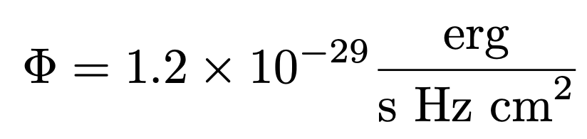

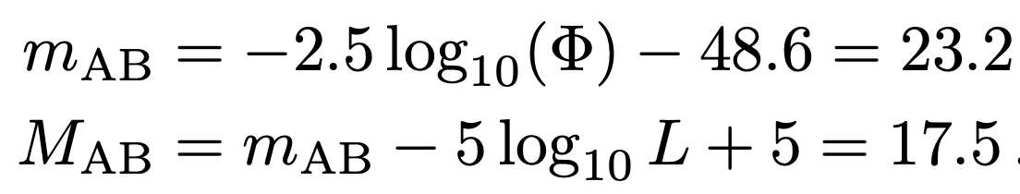
Light from Taurus molecular cloud
Distance to the cloud is L=140 pc
Gas density n=300 to 1000 cm⁻³
Effective QN temperature in the cloud T=0.5eV
Maximum of the thermal radiation from antiquark nuggets is in near infrared to visible light
Estimated energy flux at λ=555 nm
This corresponds to visible and absolute magnitudes
Hubble Space Telescope can, potentially resolve faint objects with m=31.5. Thus, light from anti-QNs in molecular clouds may be observed if resolved from background.
light from anti-QNs in molecular clouds may be observed by modern telescopes if resolved from background!

Slide 16
Summary
Anti-quark nuggets strongly interact with visible matter and radiate
Annihilation of gas particles in the interstellar medium on anti-QNs can create an observable flux of ω>100MeV-range photons (Fermi-LAT telescope)
Charged π mesons decay into ultrarelativistic electrons and positrons, which emit synchrotron radiation when move in the magnetic field in the galaxy. This radiation may represent a significant contribution to the galaxy RF background.
Positrons from the positron cloud annihilate with atoms in the interstellar gas and produce a flux of 511 keV photons. This flux may be observed by the SPI-INTEGRAL satellite.
It is predicted that anti-QNs can radiate in cold molecular clouds in visible light which can be detected.

Slide 17
Thank you!

Slide 18
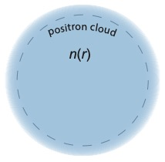
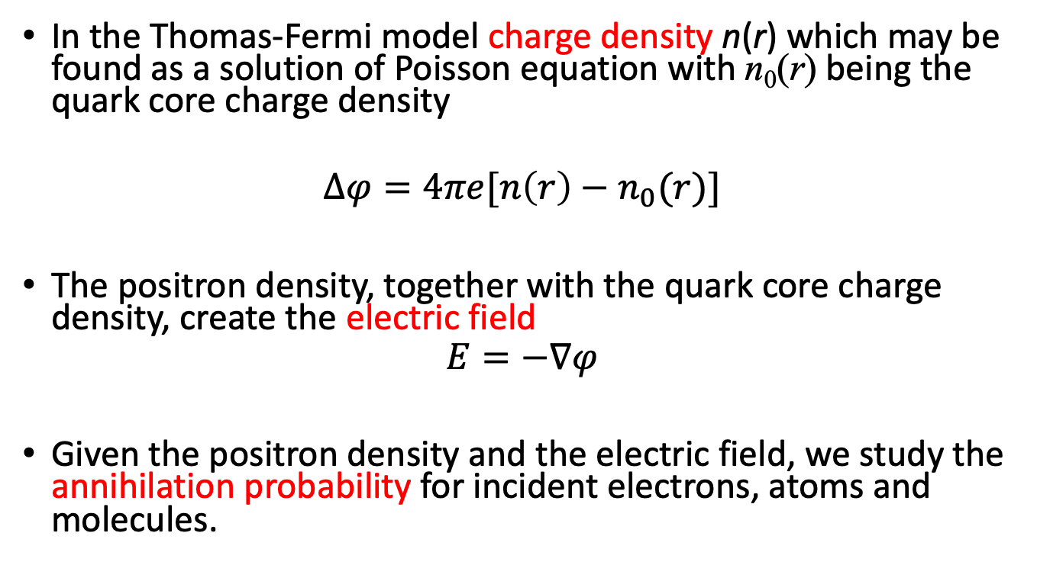
Positron cloud
In the Thomas-Fermi model charge density n(r) which may be found as a solution of Poisson equation with n₀(r) being the quark core charge density
$$∆φ=4πe[n\left(r\right)−n_{0}(r)]$$
The positron density, together with the quark core charge density, create the electric field
$$E=−∇φ$$
Given the positron density and the electric field, we study the annihilation probability for incident electrons, atoms and molecules.
Notes:
The charge density of the positron cloud may be found within the Thomas-Fermi model. Given this charge density, one can find the electric potential and the electric field strength of this object. These parameters will be very important further in the study of the problem of annihilation.

Slide 19
Quark nuggets and solar corona temperature
The solar corona temperature is about T = 10⁶ K that is nearly 100 times higher than that in chromosphere
A. Zhitnitsky speculates that annihilation of antiquark nuggets in the solar corona is responsible for this high temperature [A. Zhitnitsky, JCAP 2017 (10), 050; N. Raza, L. Van Waerbeke, and A. Zhitnitsky, Phys. Rev.D 98, 103527 (2018)]
However, plasma density in the solar corona is very low, n<10¹⁰ cm⁻³.
We show that Zhitnitsky et al strongly overestimated (~10⁸ times) the annihilation cross section of anti-QNs in the solar corona.
Thus, we show that antiquark nuggets are irrelevant to the solar corona temperature paradox.

