Slide 1

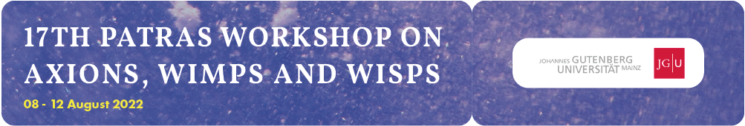



LATEST RESULTS ON DARK MATTER AXIONS WITH CAST-CAPP
Marios Maroudas
on behalf of the CAST Collaboration
10/08/2022

Slide 2


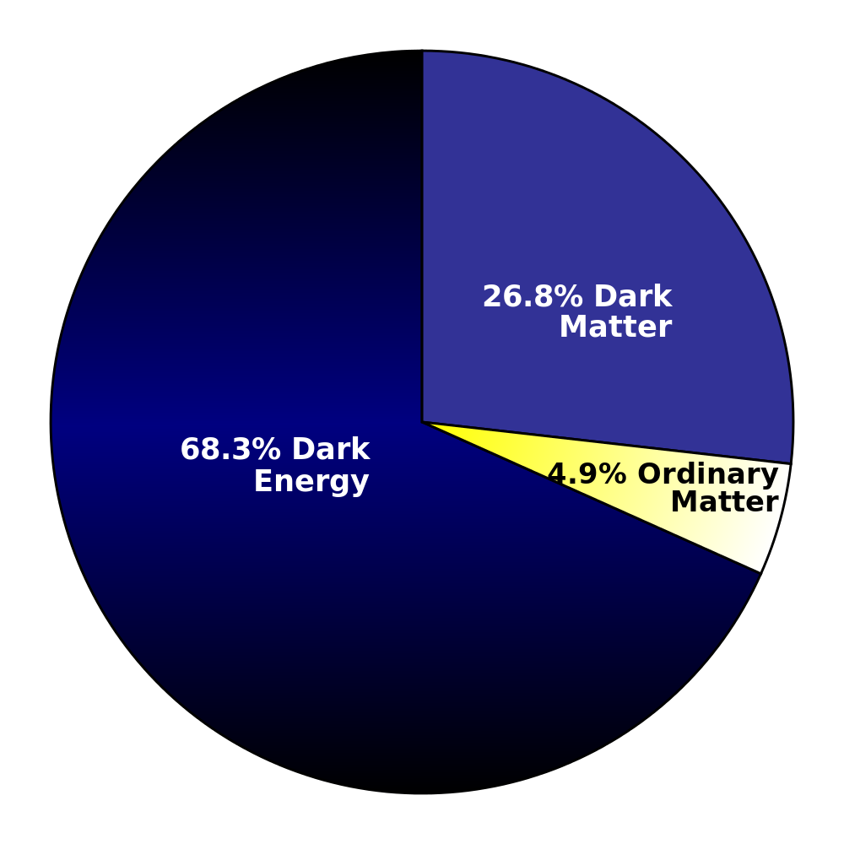
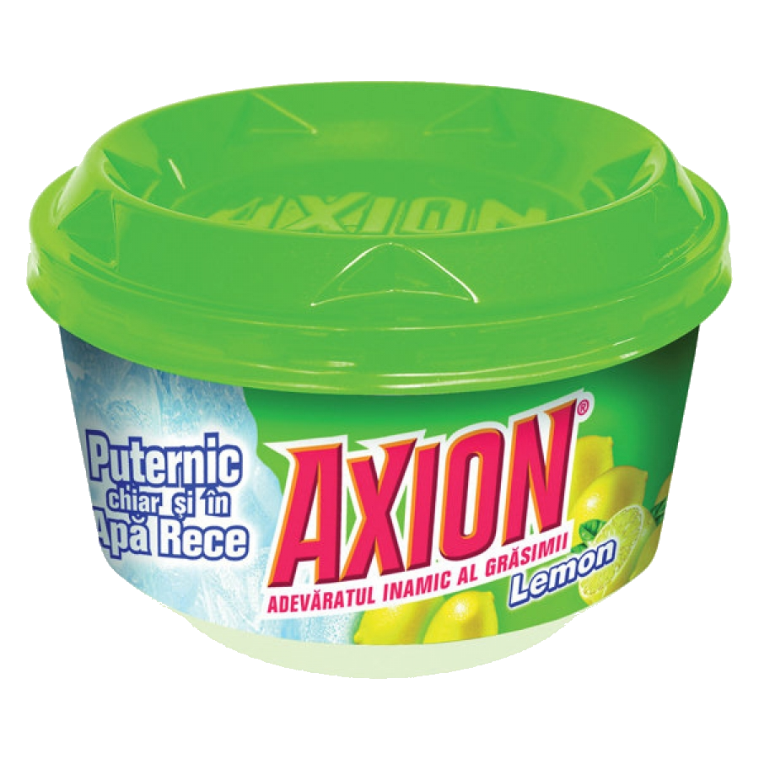
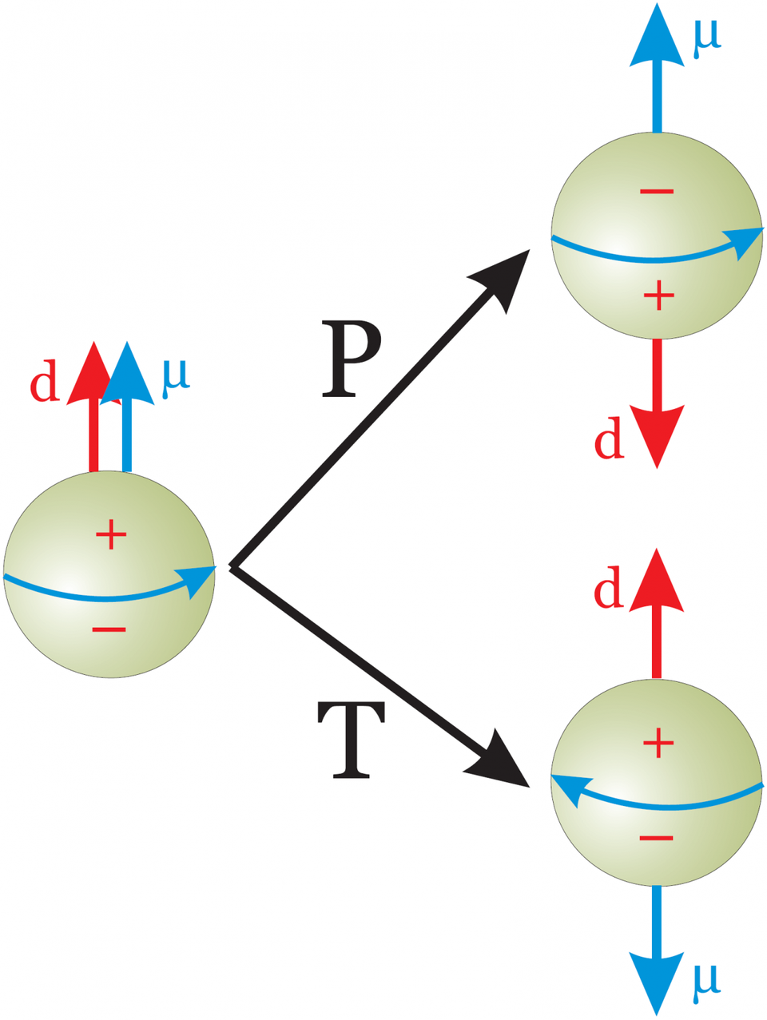
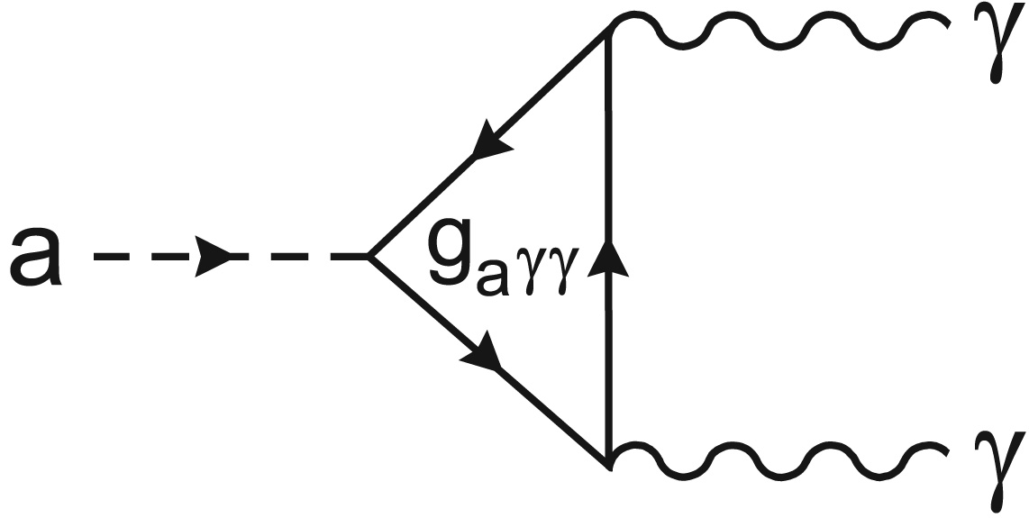
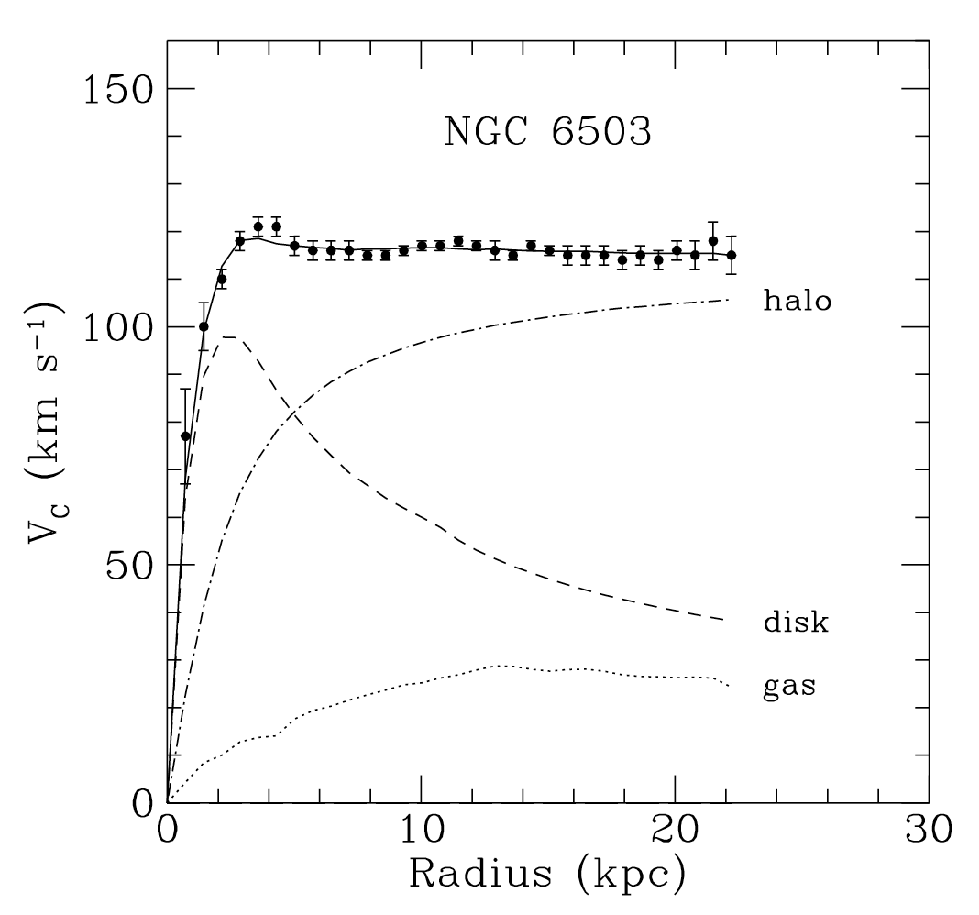
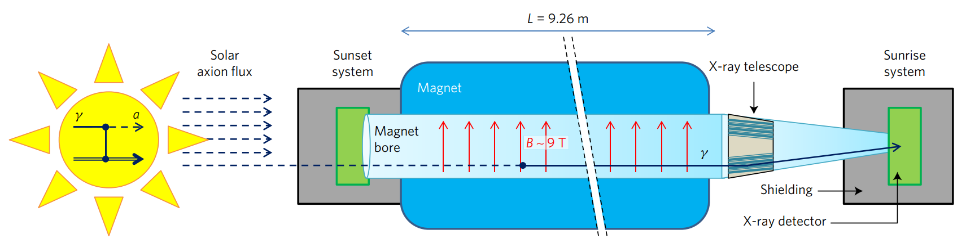
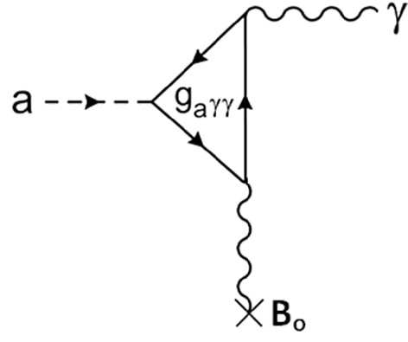
AXIONS
1 / 17
Axion Characteristics:
Pseudo-Goldstone boson.
No charge.
Small mass:
Weakly interacting.
Local density:
Dark Matter
Strong CP prob.
Coupling to photons:
CP problem
Axions convert to photons in a strong magnetic field!
Inverse Primakoff effect:
DM
CAST

Slide 3
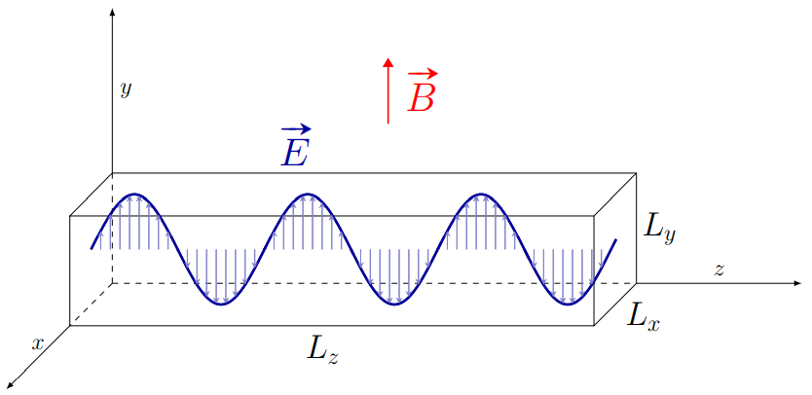
AXION HALOSCOPES a la Sikivie
2 / 17
The on-resonance axion conversion power in a microwave cavity is:
Rectangular Cavities:
Mode frequency:
γ
Higher frequencies
α
smaller cavities
B_{ext}
X
For CAST-CAPP:
P. Sikivie

Slide 4
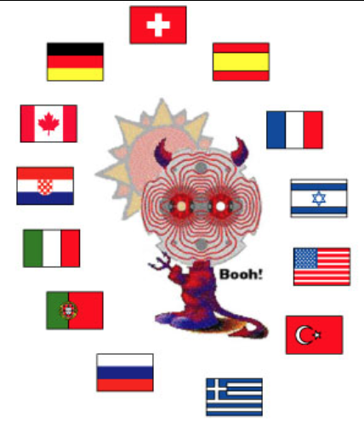
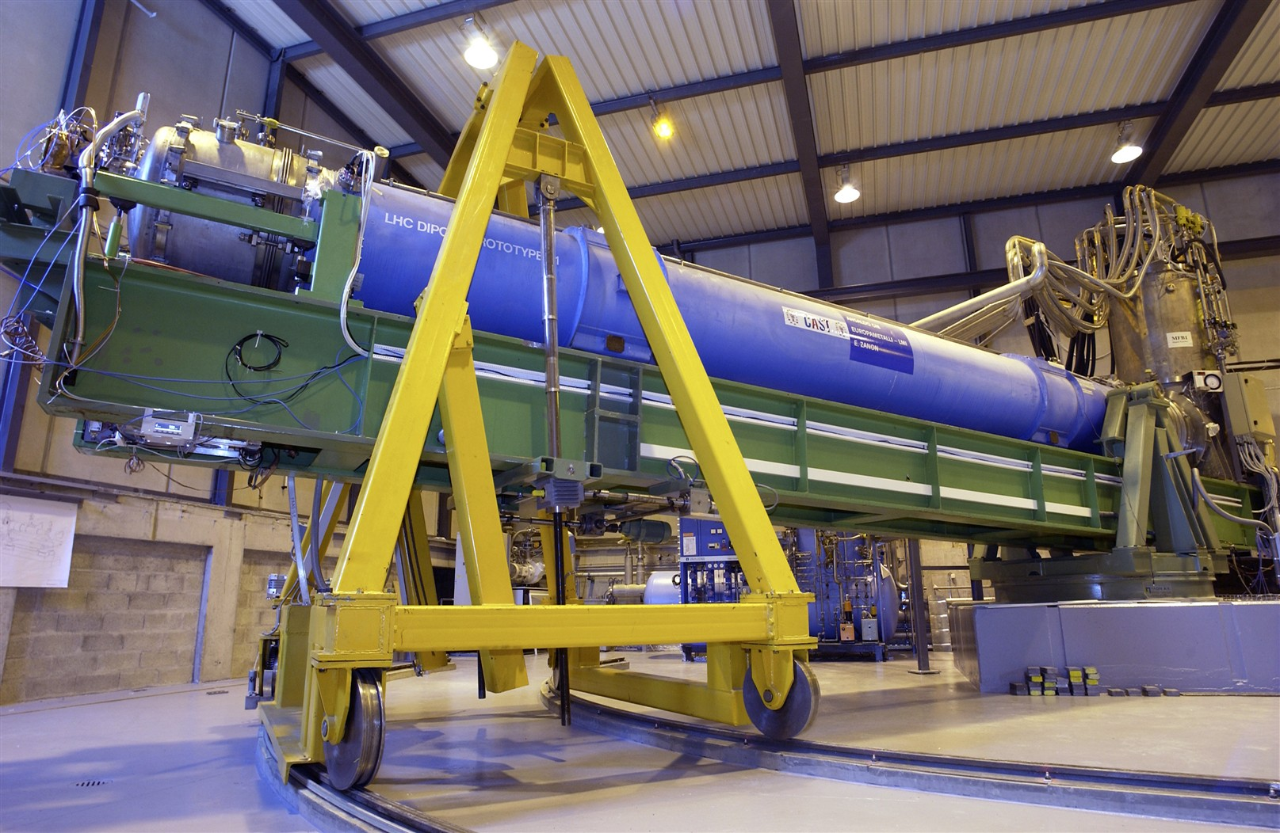
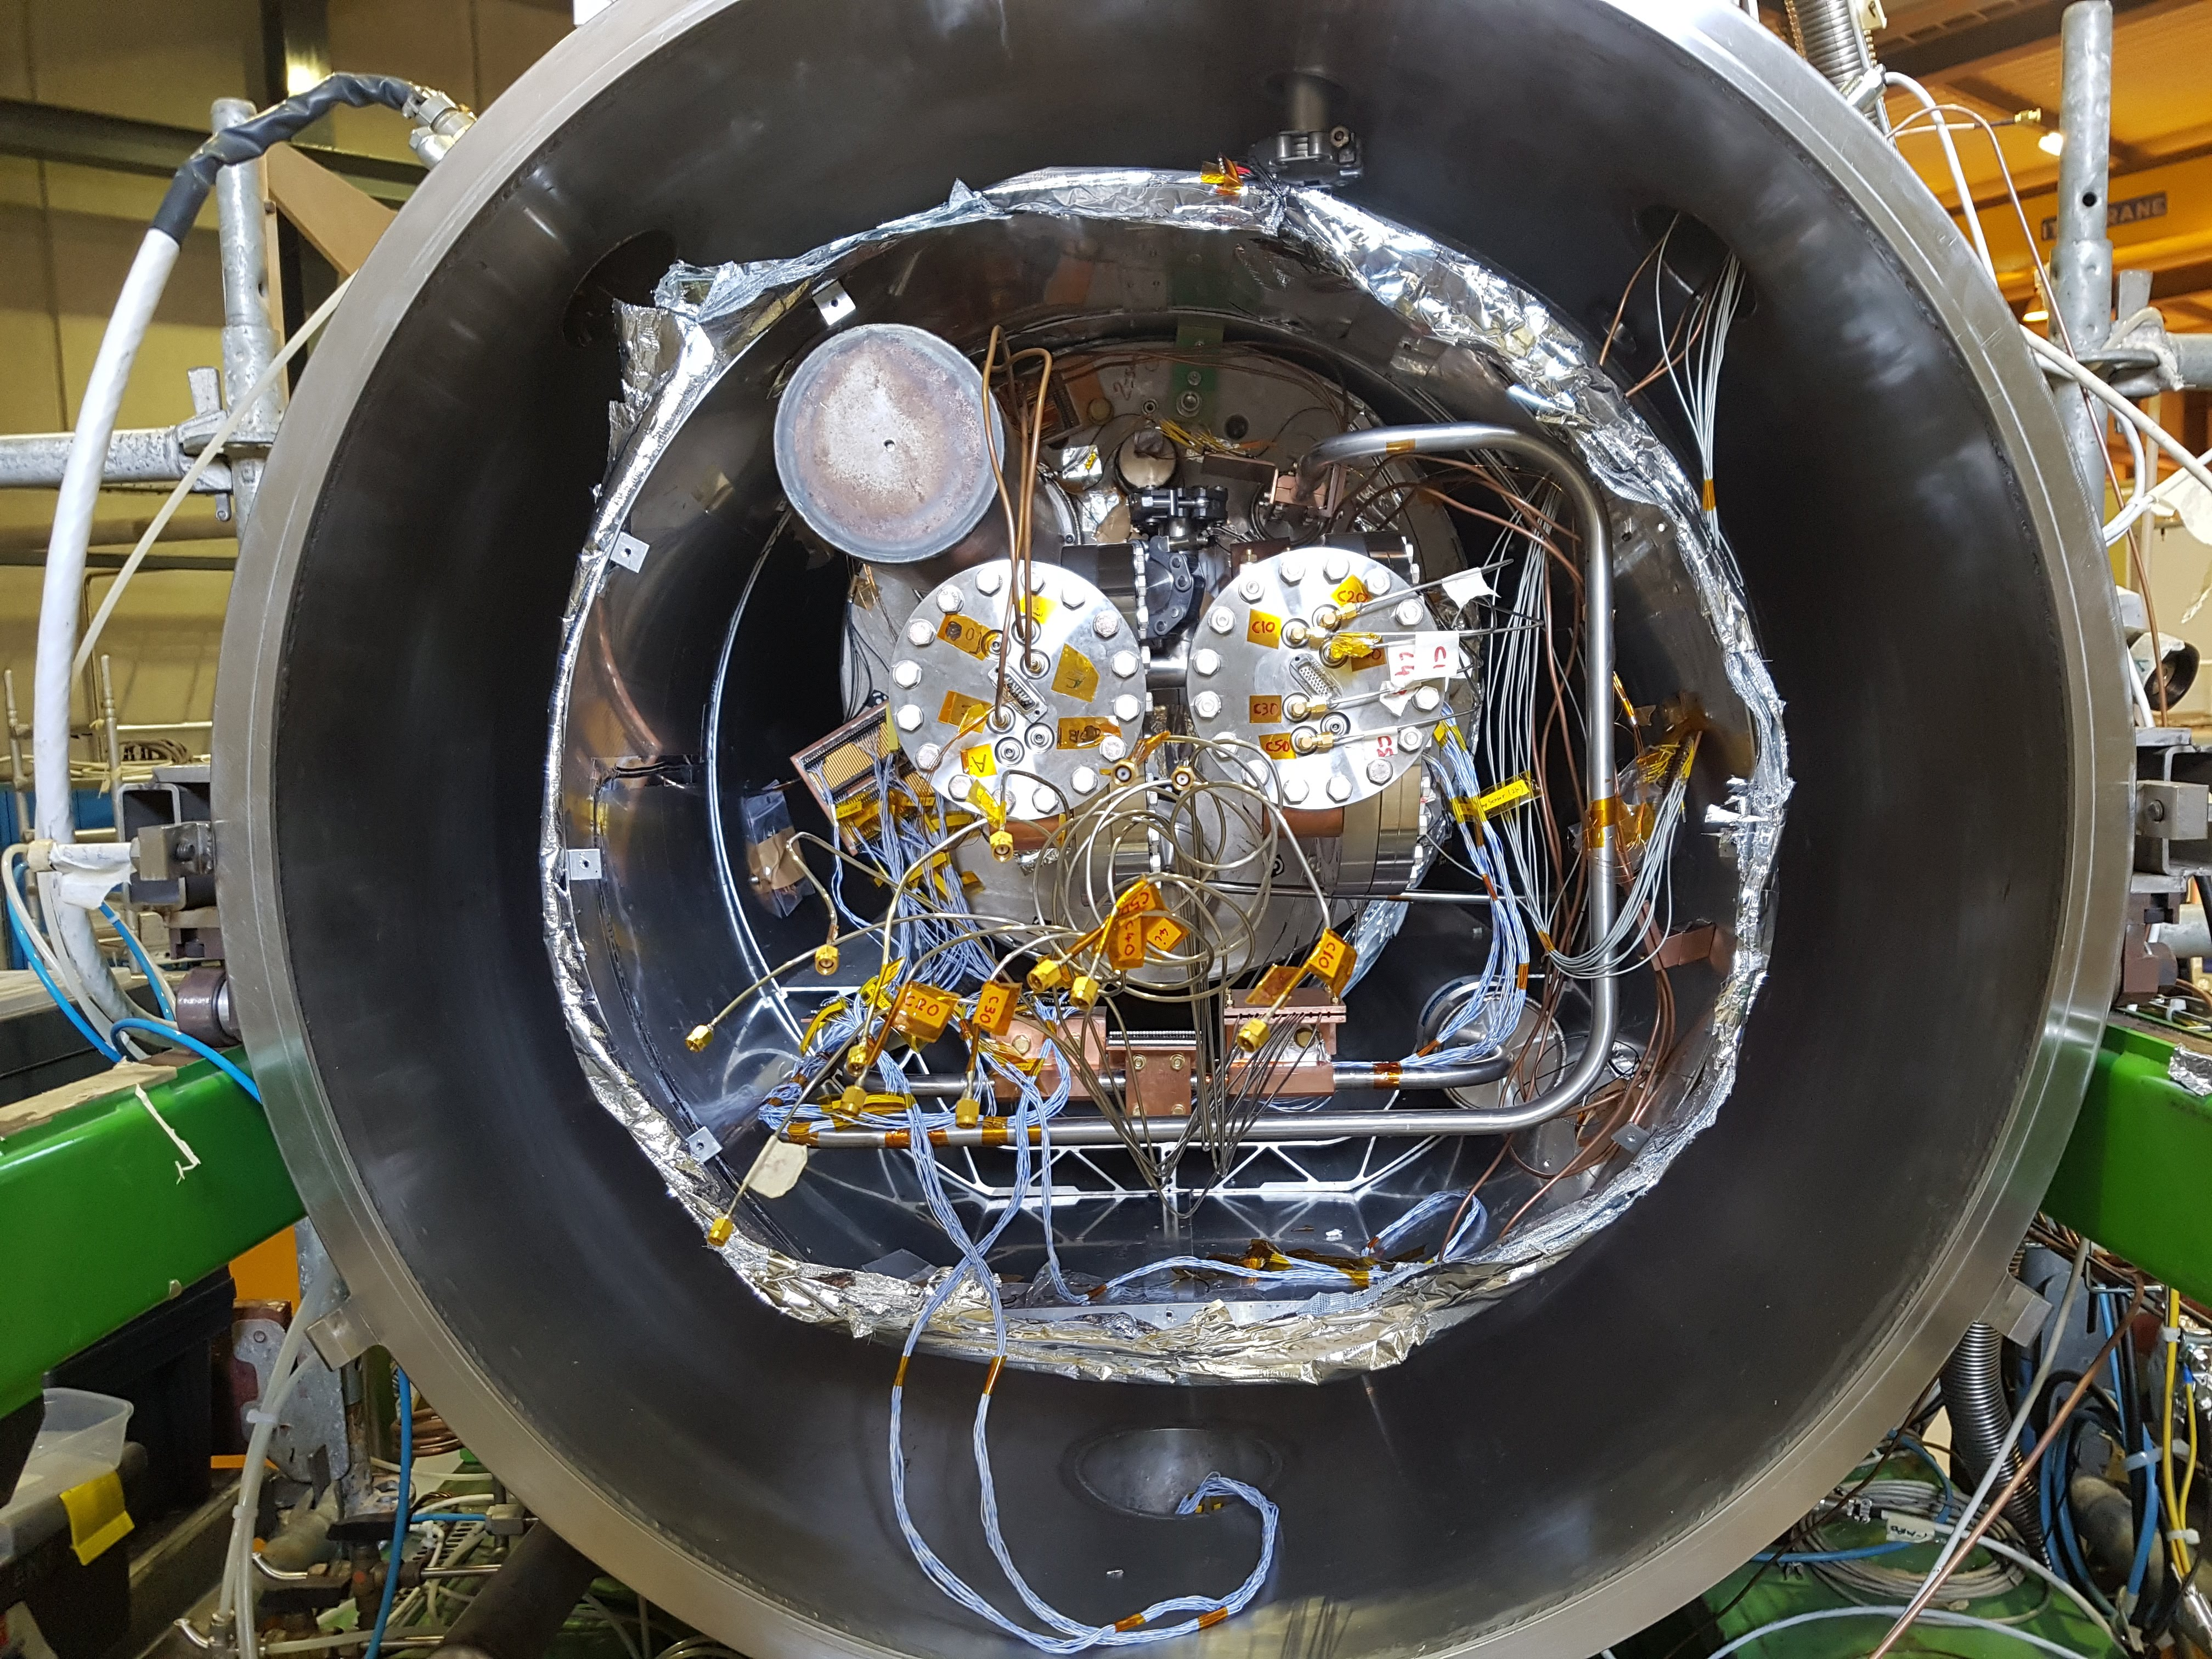
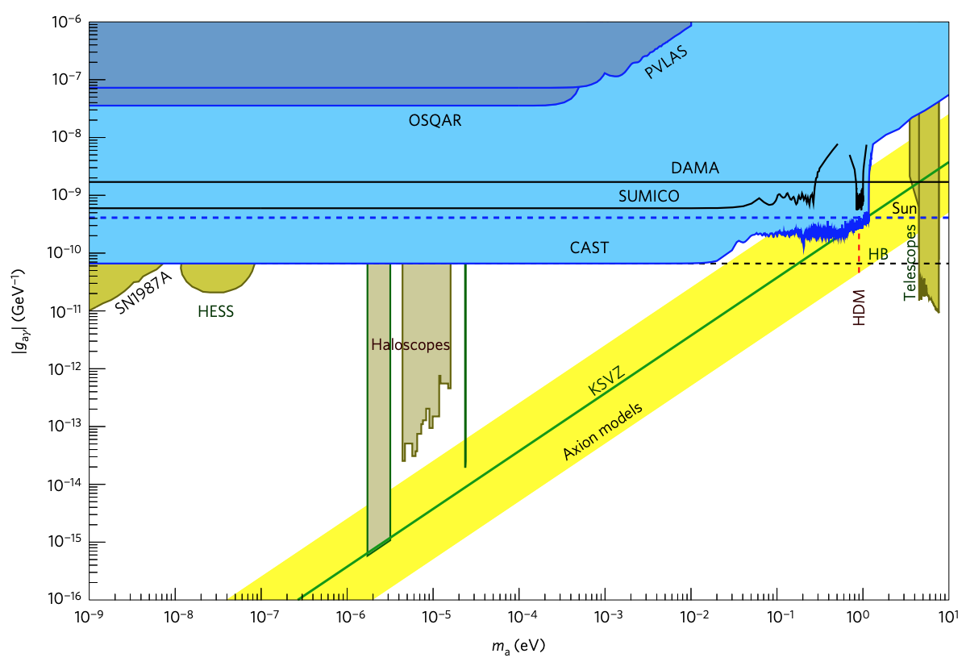
CAST EVOLUTION
3 / 17
Axion Helioscope
(Solar Axions)
2019
Axion Haloscope
(Dark Matter Axions)
LHC prototype
9T magnetic field
α,ch.
1.8K temperature
~43mm twin bores
9.25m magnetic length
γ
Photon detector
(Micromegas)
DM Axion detectors
(CAPP, RADES)
γ_{virtual}
X
Force sensor
(KWISP)
B
CAST-RADES
CAST-CAPP
https://doi.org/10.1038/nphys4109

Slide 5
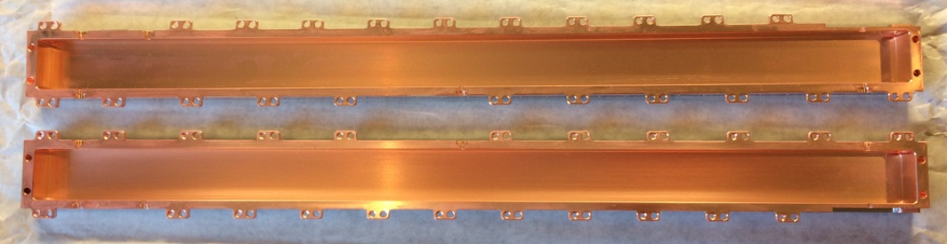
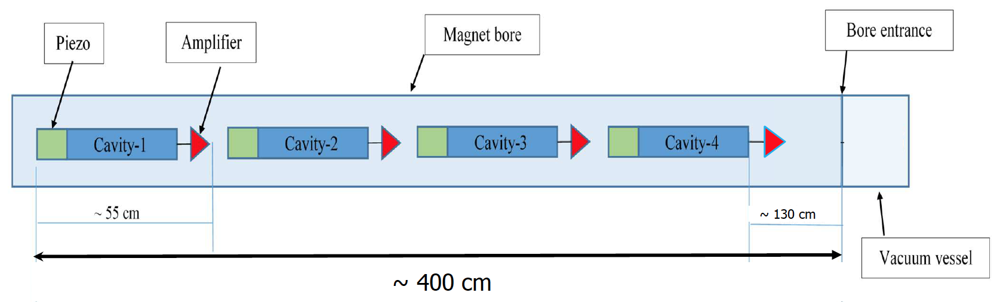
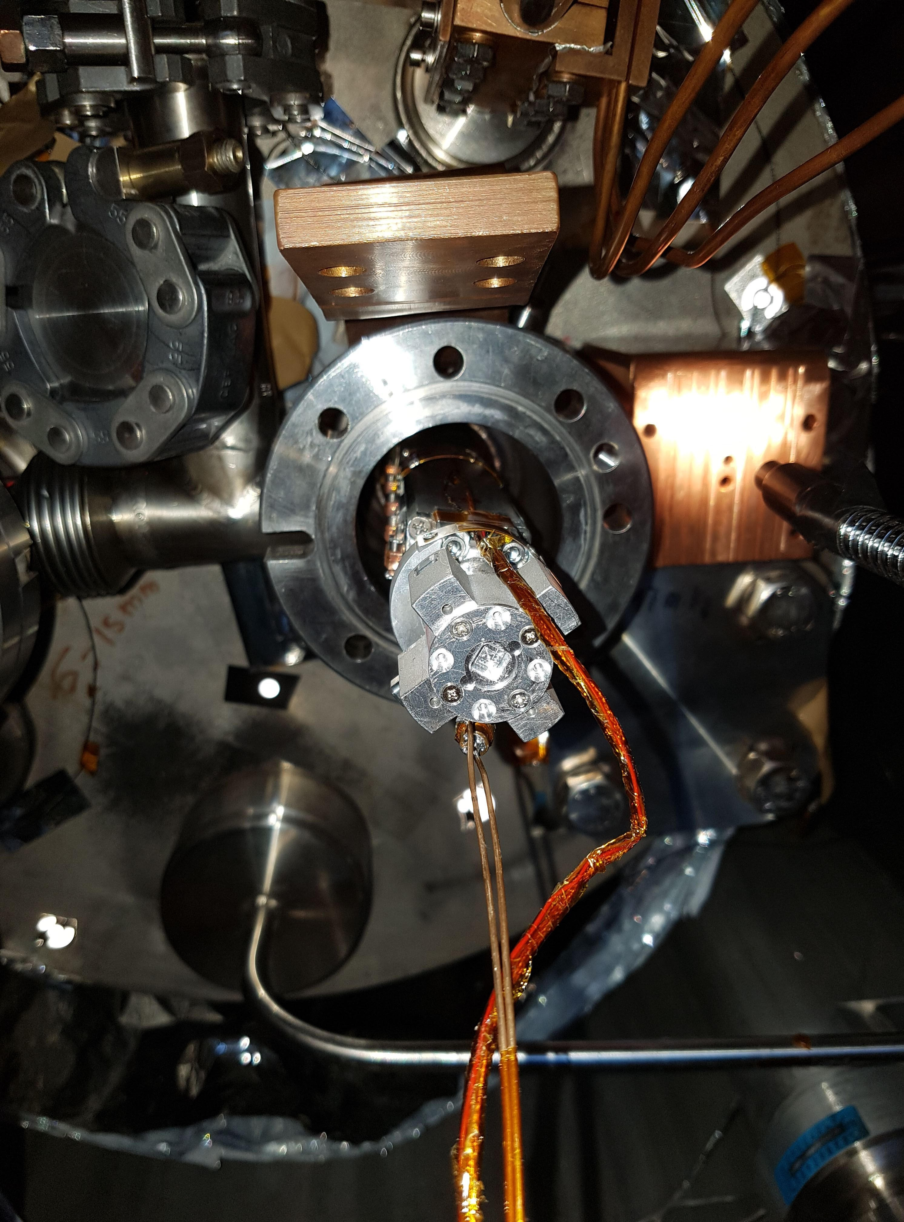
CAST-CAPP cavities
4 / 17
4 identical stainless steel tunable cavities electroplated with ~30μm of copper installed in one of the two twin bores of CAST magnet with the split plane parallel to the magnetic field.
Longitudinally split into two identical halves.
55 cm

Slide 6

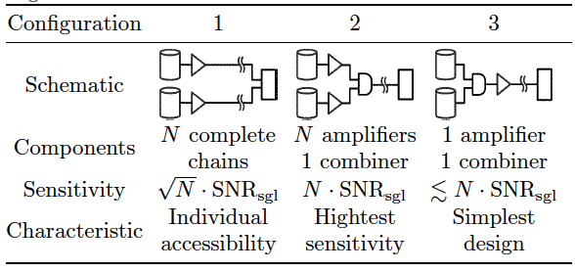
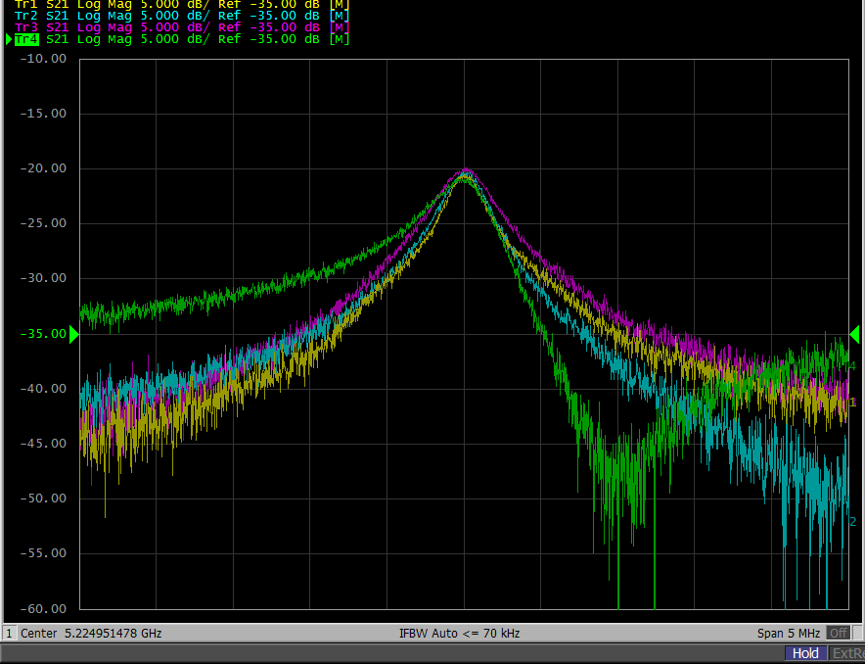


PHASE MATCHING
5 / 17
Increase the sensitivity via coherent combination of the power outputs of each frequency-matched cavity after individual signal amplification.
No phase-matching:
With phase-matching:
$$SNR_{N}=\sqrt{N} ∙ SNR_{single}$$
FIRST & UNIQUELY applied at CAST-CAPP!
$$SNR_{N}=N ∙ SNR_{single}$$
https://doi.org/10.1016/j.astropartphys.2017.10.012
Frequency accuracy: ±10 kHz
Amplitude accuracy: ± 0.25 dB
Phase accuracy: ± 1º
FMT ~ 105 kHz

Slide 7
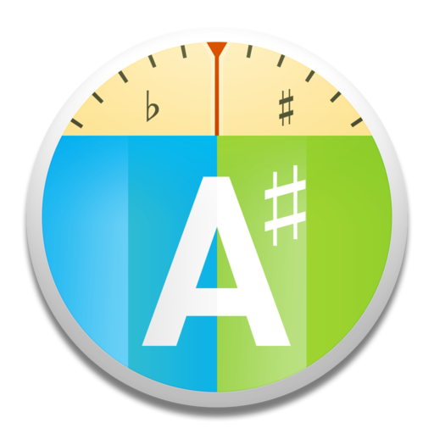
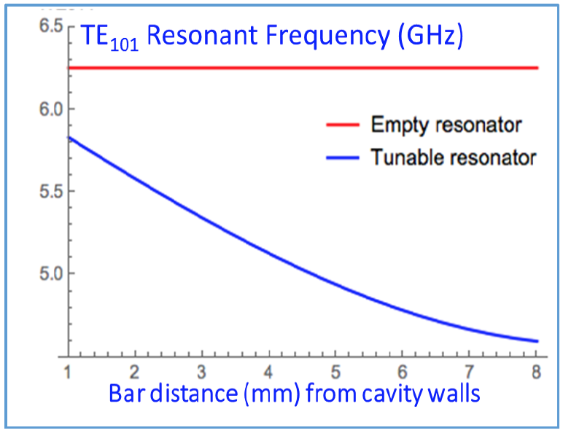
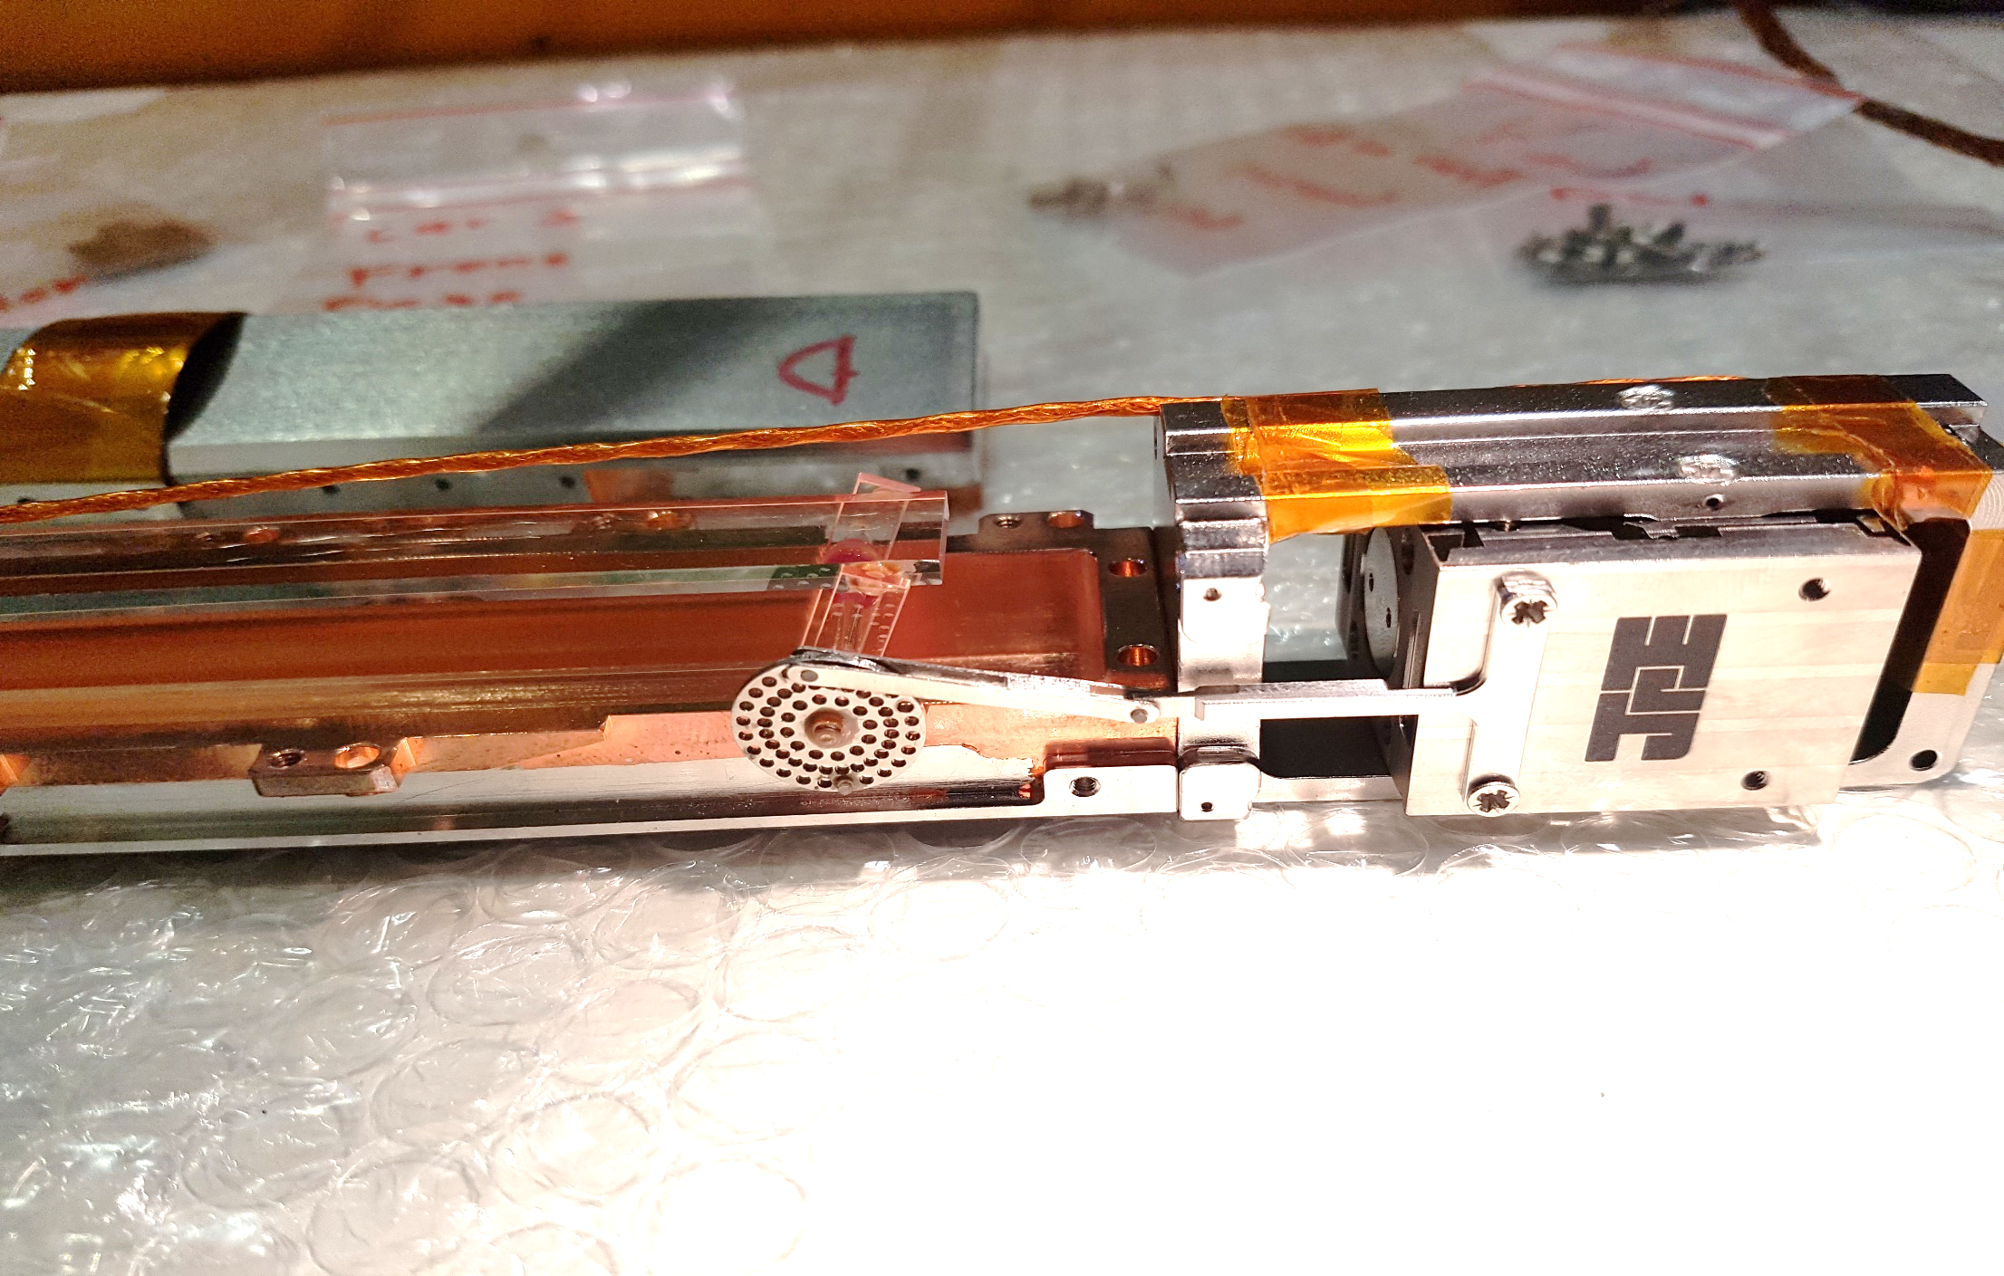
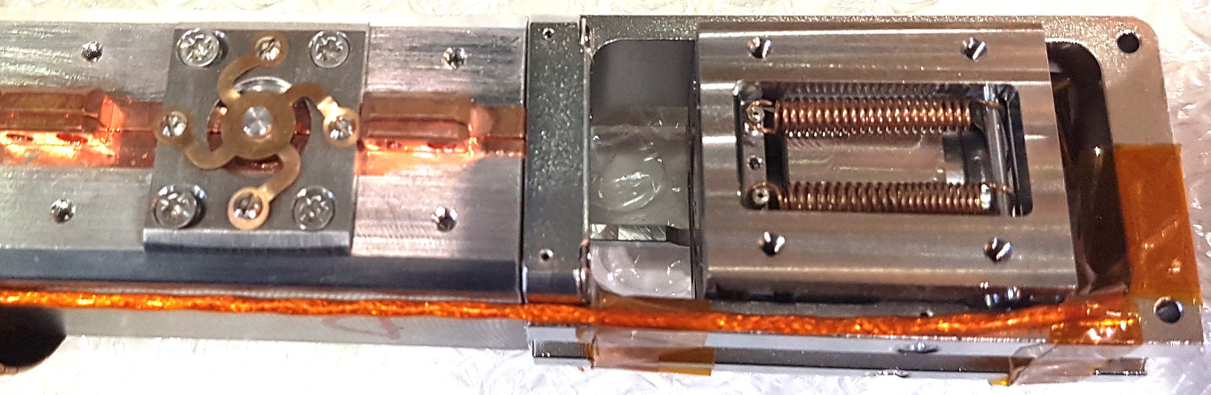
Axion mass unknown → Tuning is required
6 / 17
xion
Tuning mechanism: 2 dielectric sapphire bars symmetrically placed parallel to the longitudinal sides, moving simultaneously towards the center and activated by a piezoelectric motor.
Frequency range: ~4.8 – 5.4 GHz (660 MHz)
Axion mass range: ~19.7 – 22.4 μeV
Resolution: 100 Hz
Max piezo speed: 10 MHz / min
2 Sapphire plates

Slide 8

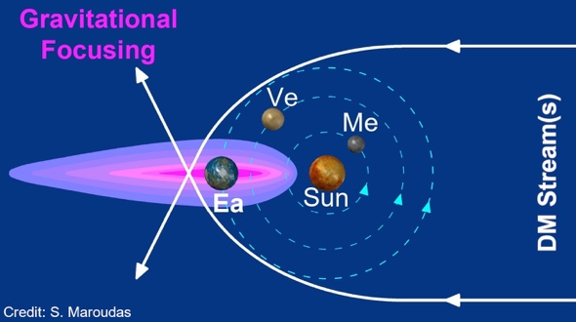
WAIT... There is more!
7 / 17
CAST-CAPP is ALSO sensitive to transient events such as streams, mini clusters etc.
Gravitational (self-)focusing → Flux enhancement!!
(see talks by A. Kryemadhi & K. Zioutas)
Fast scanning
Wide band electronics
Fast analysis & elimination procedures
Maximum duty cycle
Current piezo speed:
(10 MHz / min)
The faster the scanning the shorter axion burst can be probed

Slide 9

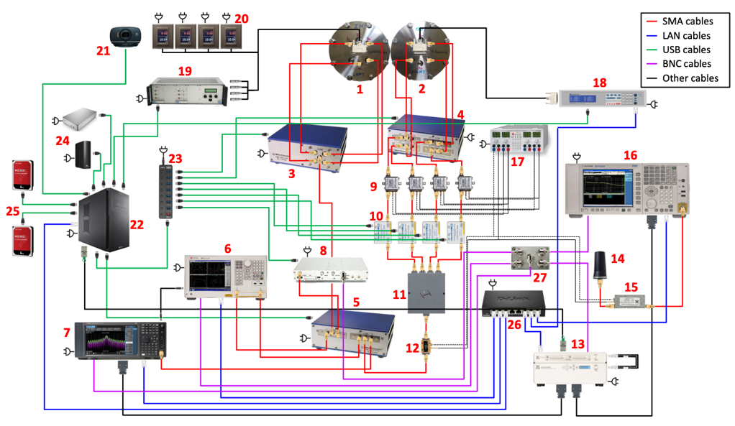
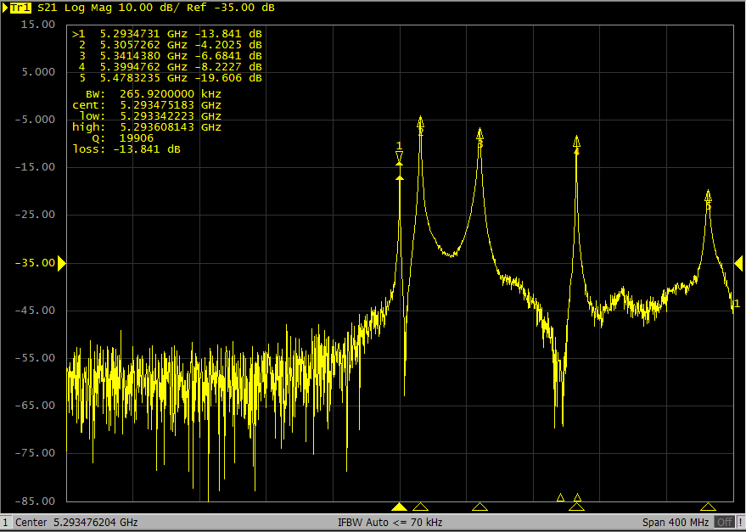
DAQ SYSTEM
8 / 17
Data acquisition system installed on CAST magnet and allows a fast semi-autonomous data-taking for 20 h / day.
1-min measurements
Bandwidth = 5 MHz
Tuning step size = 200 kHz
Size = ~ 3 GB / file !!
Daily offloading/uploading
Daily processing
Daily analysis
CERN Tape Archive (CTA) storage
ONLY 37 instruments!
Transmission measurement through VNA:
TE₁₀₁

Slide 10
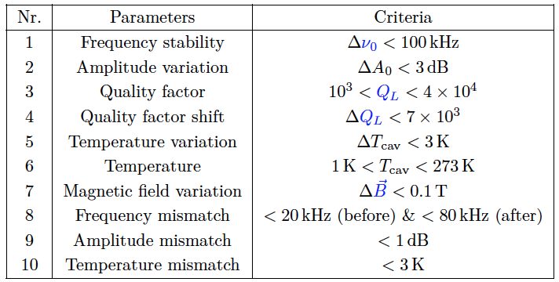
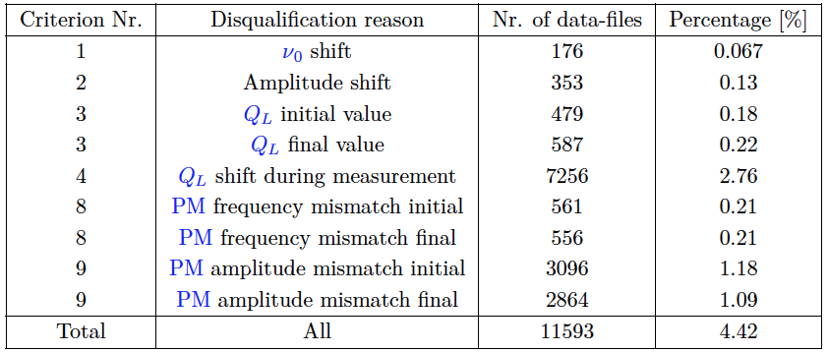
DATA taking Results
9/ 17
RESULTS:
Data-taking time: 4124 h (172 d)
Frequency range: 660.15 MHz
Axion Masses: 4.77 - 5.43 GHz
Data size: ~ 650 TB !!
QUALITY CHECKS:
Phase-matching of all four cavities.
Fast resonance scanning.
Unexplored parameter space.
Total discarded Files: (~4.4%)
Data Processing: FFT
Time domain
I(t), Q(t)
Frequency domain
I(f), Q(f)
RBW = 50 Hz

Slide 11
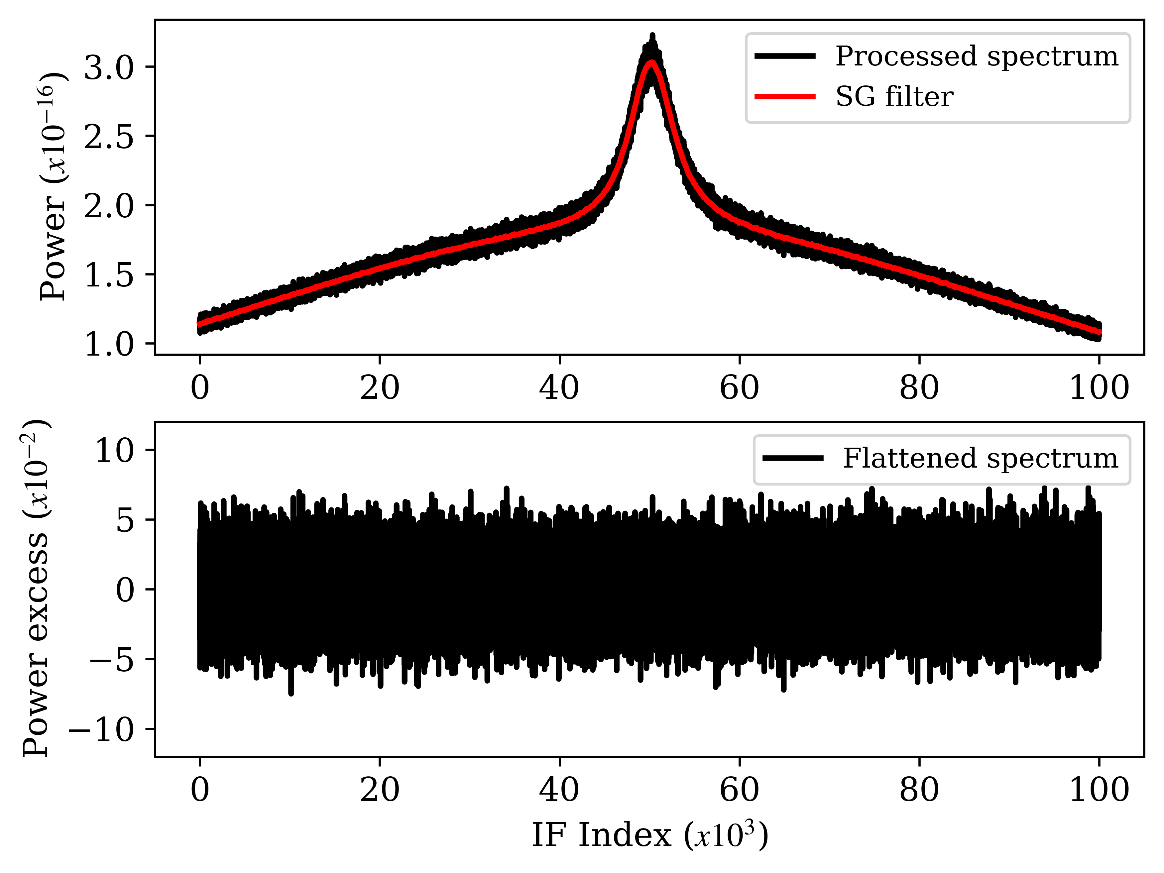
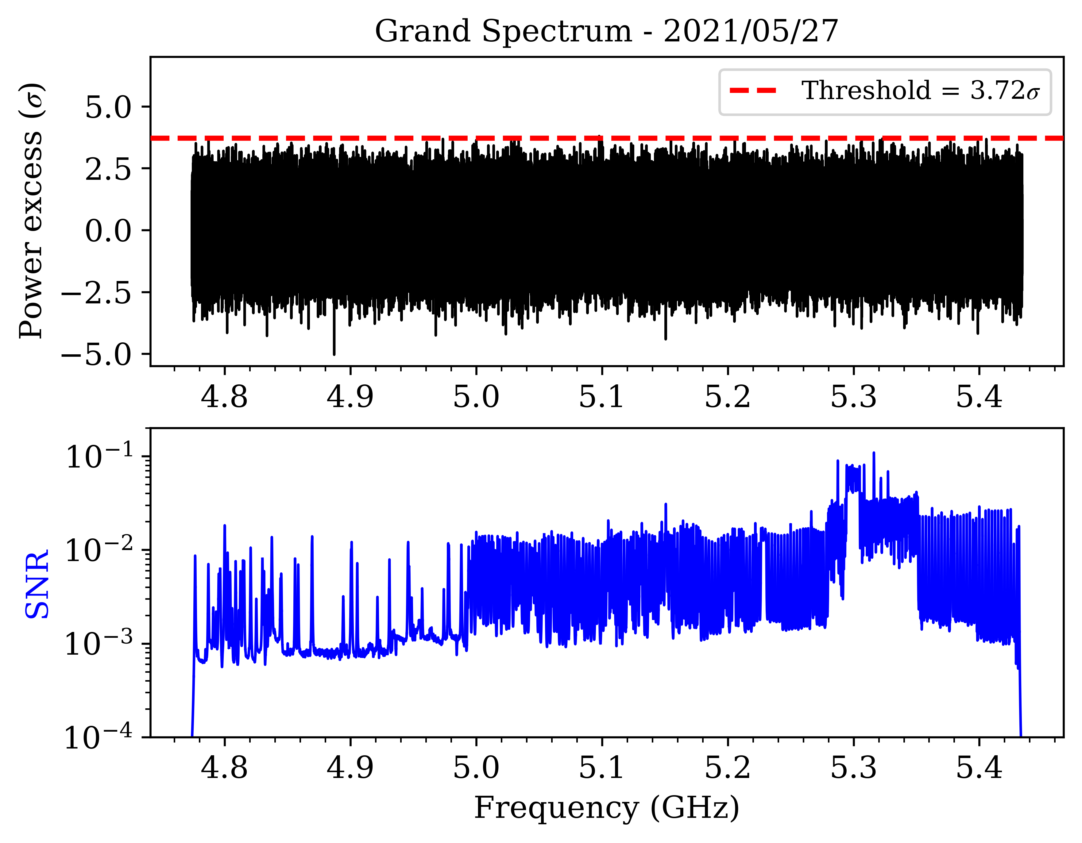
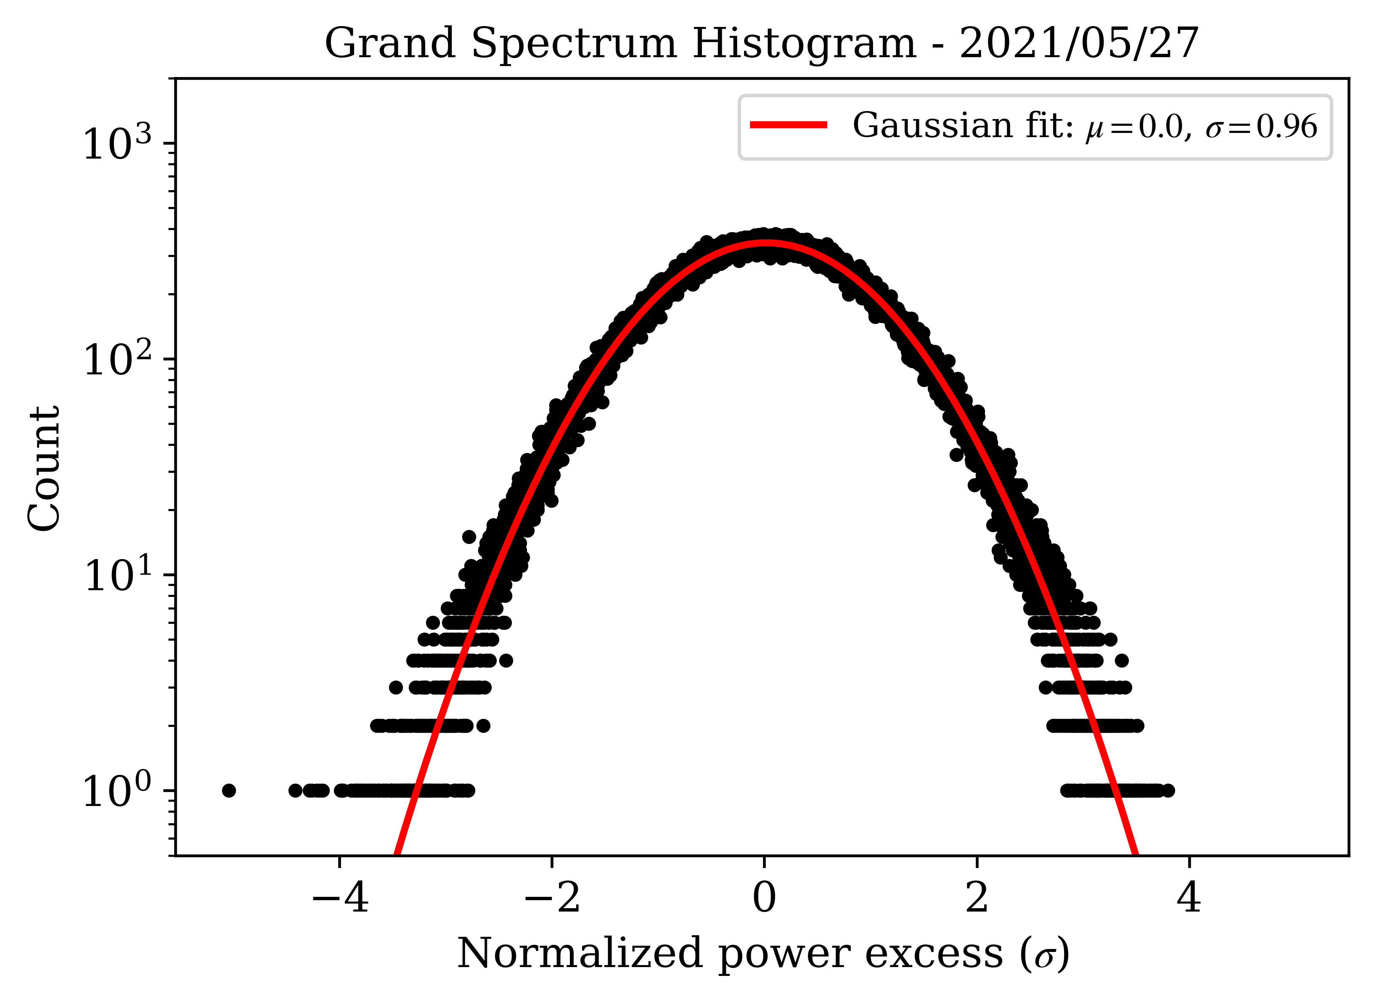
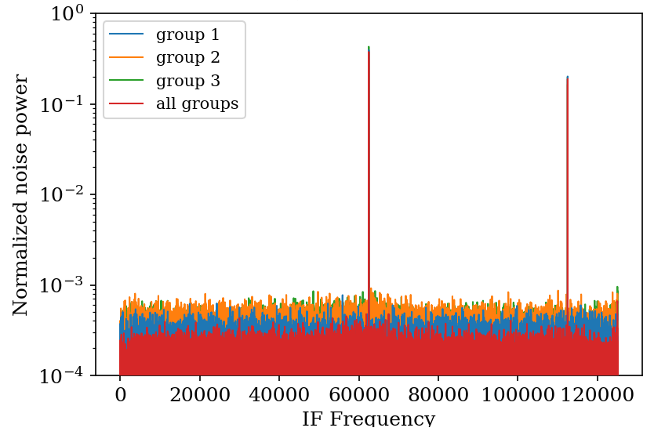
DATA ANalysis
10 / 17
Spectrum Flattening:
Combining multiple spectra:
Divide spectrum by SG filter output to remove noise baseline of processed spectra
Scaling of the spectra by P_{noise}/P_{axion} to get the correct axion SNR according to noise param.
Vertical averaging on RF axis with weights by ML estimates.
Normalization of bins to have μ=0, σ=1.
Rebinned spectrum:
Increase the SNR of an axion signal with the expected linewidth of a 7 kHz axion (5 bins).
Horizontal averaging of 28 adjacent bins with ML weights (50 Hz x 28 = 1.4 kHz).
RBW = 50 Hz
IF interference check:
Grand spectrum:
Constant index, narrow line.
Flagged IF bins are discarded.
Convolution with expected axion signal shape in the lab frame.
RBW = 1.4 kHz

Slide 12
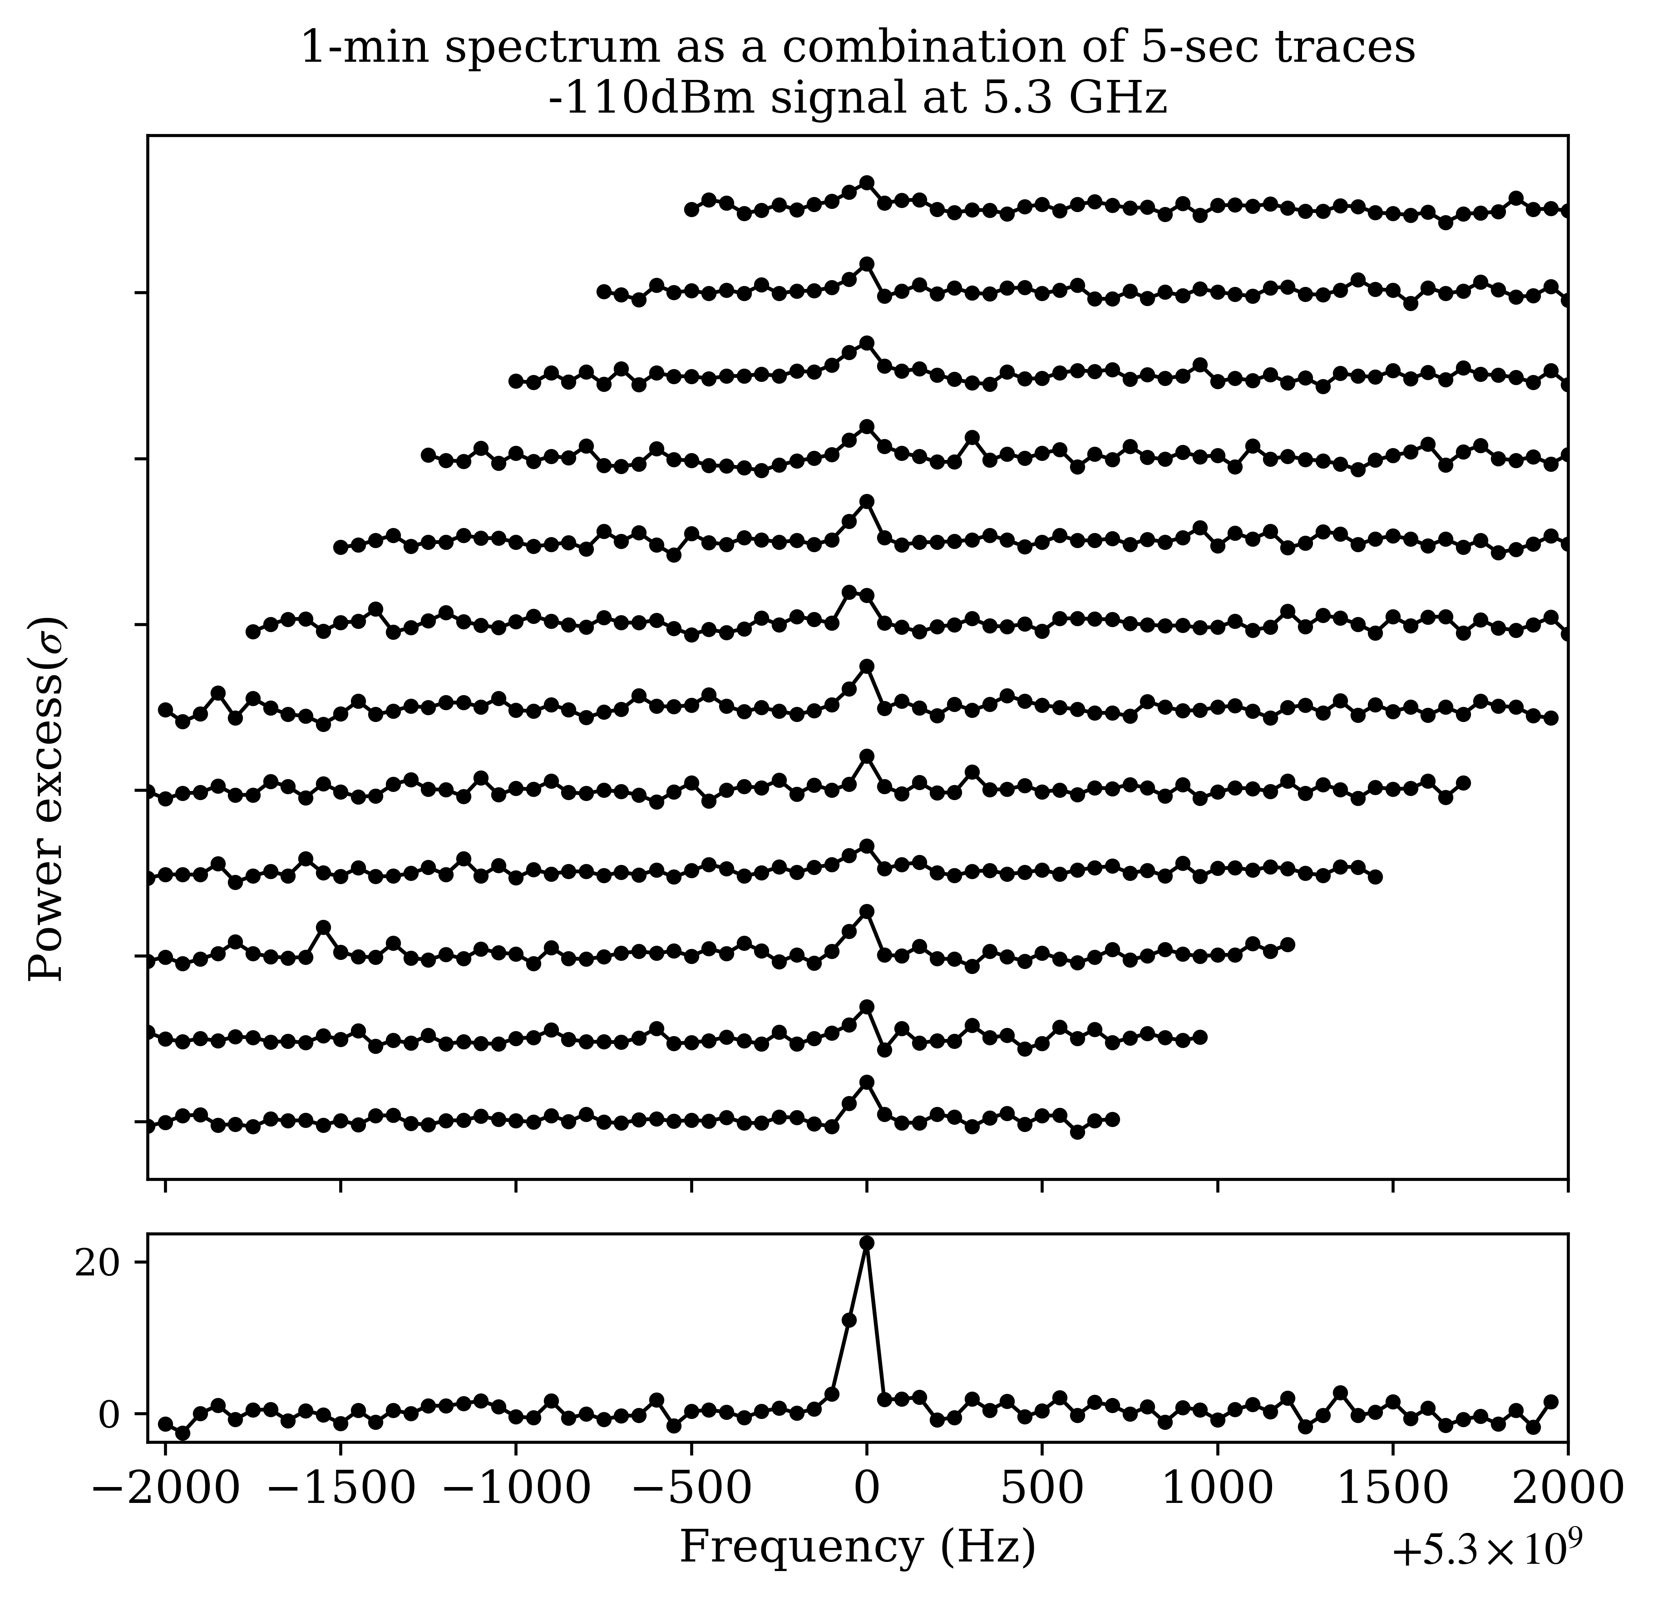
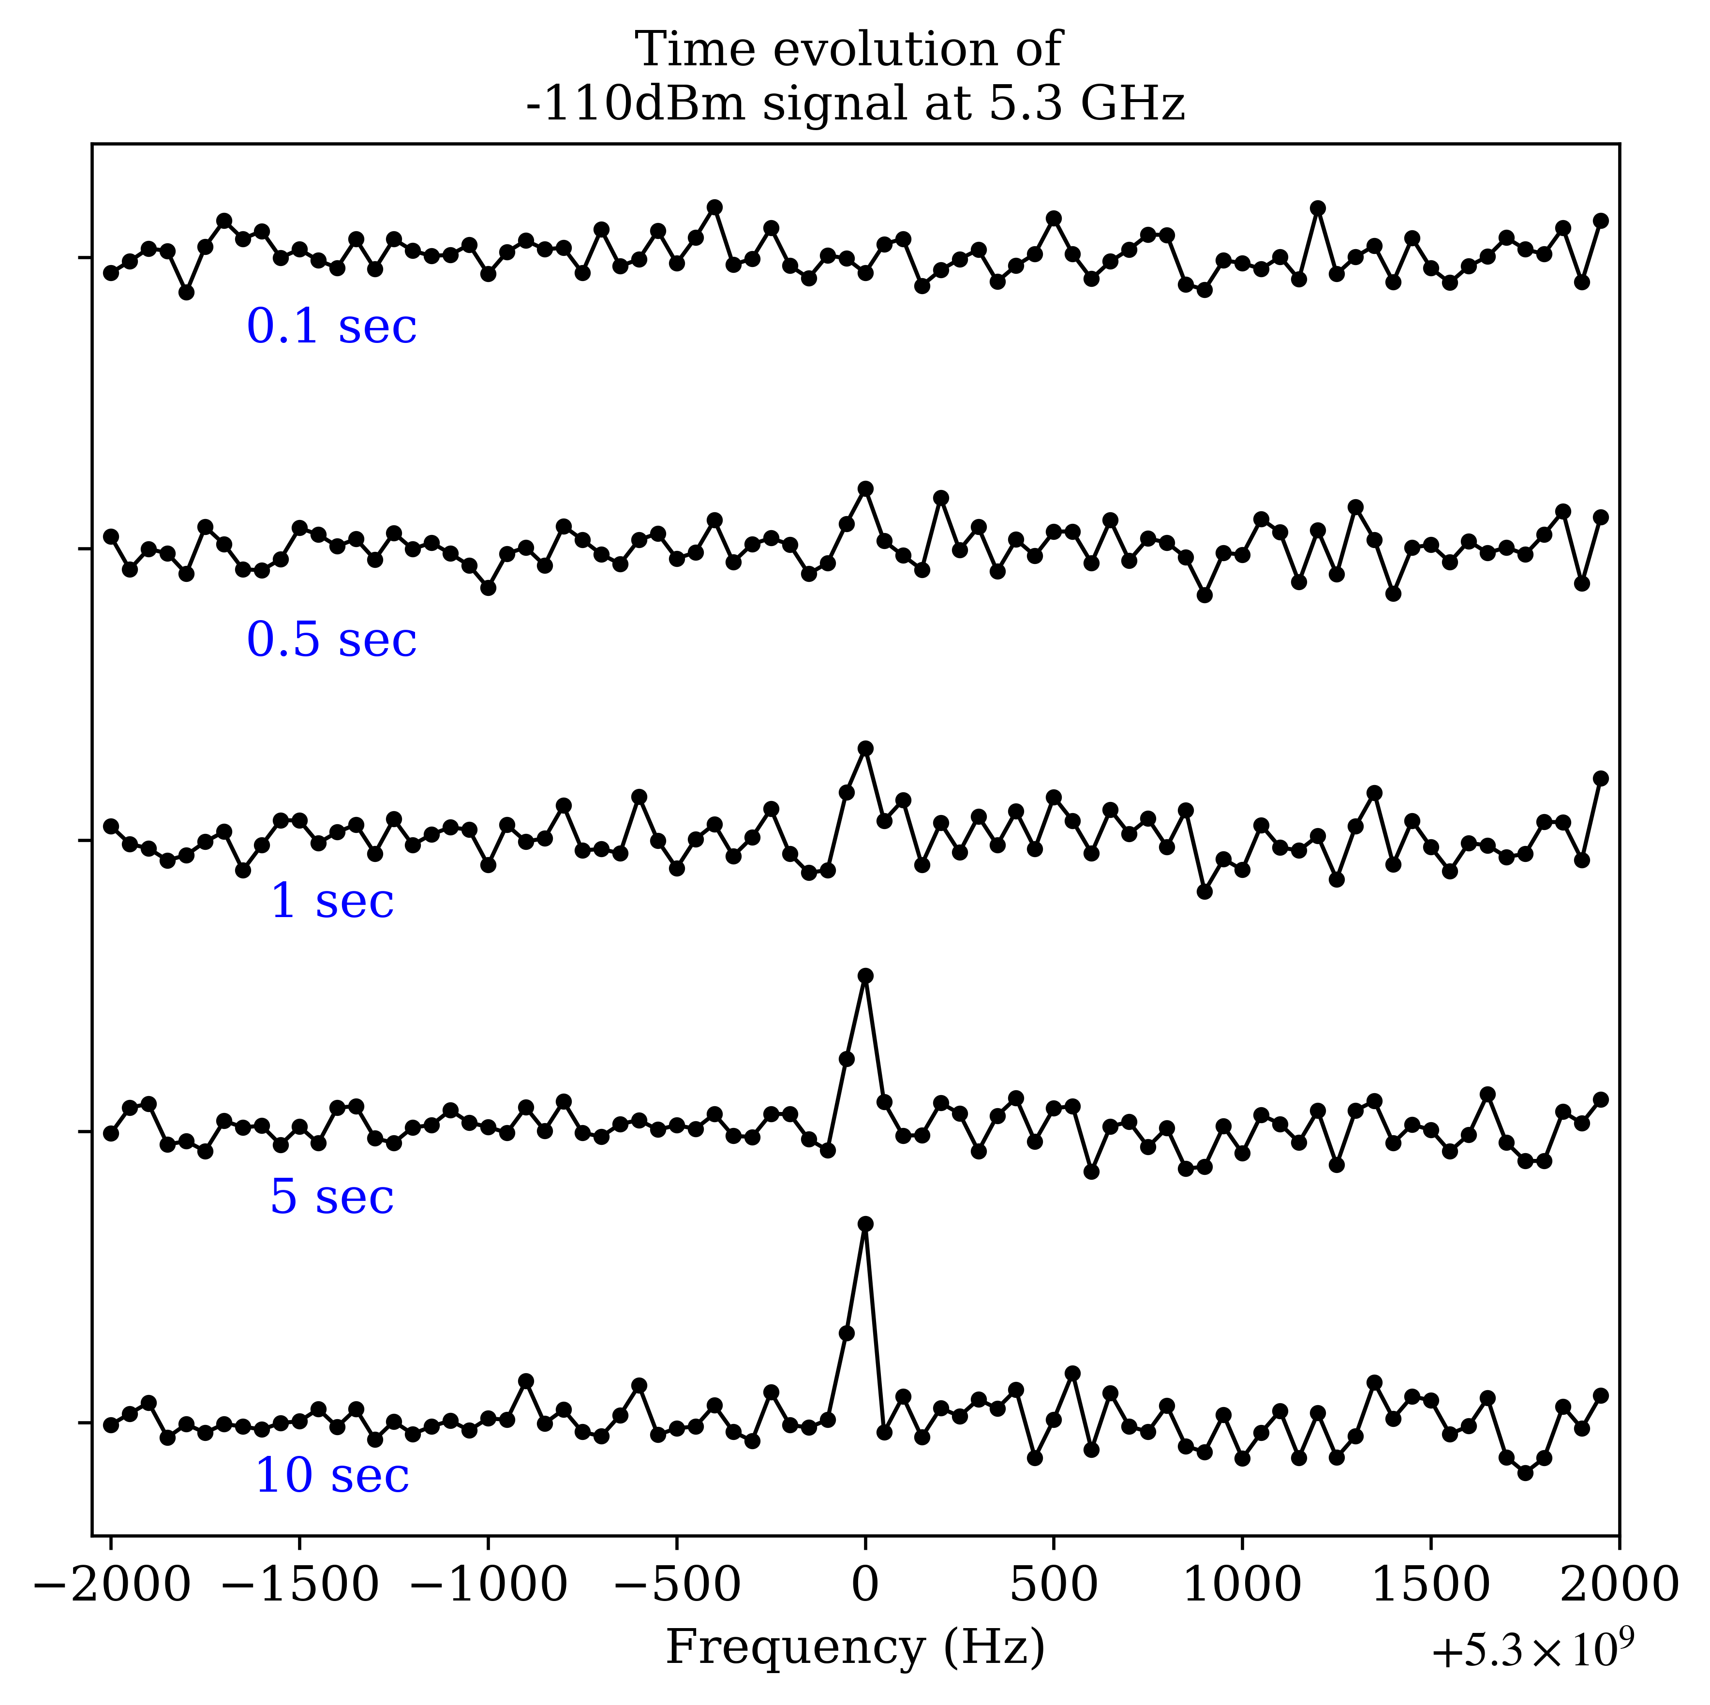
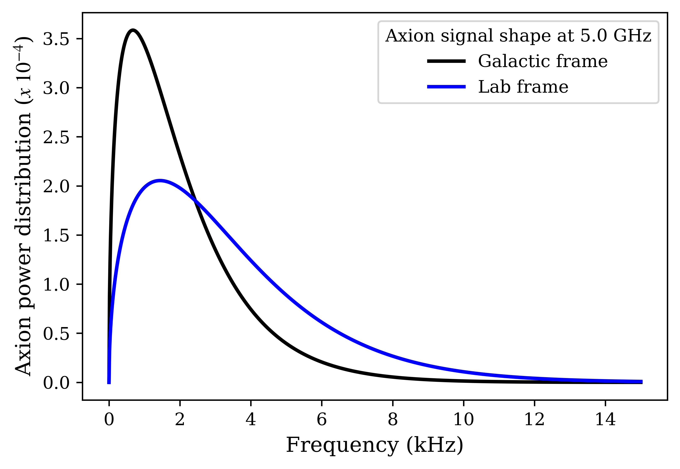
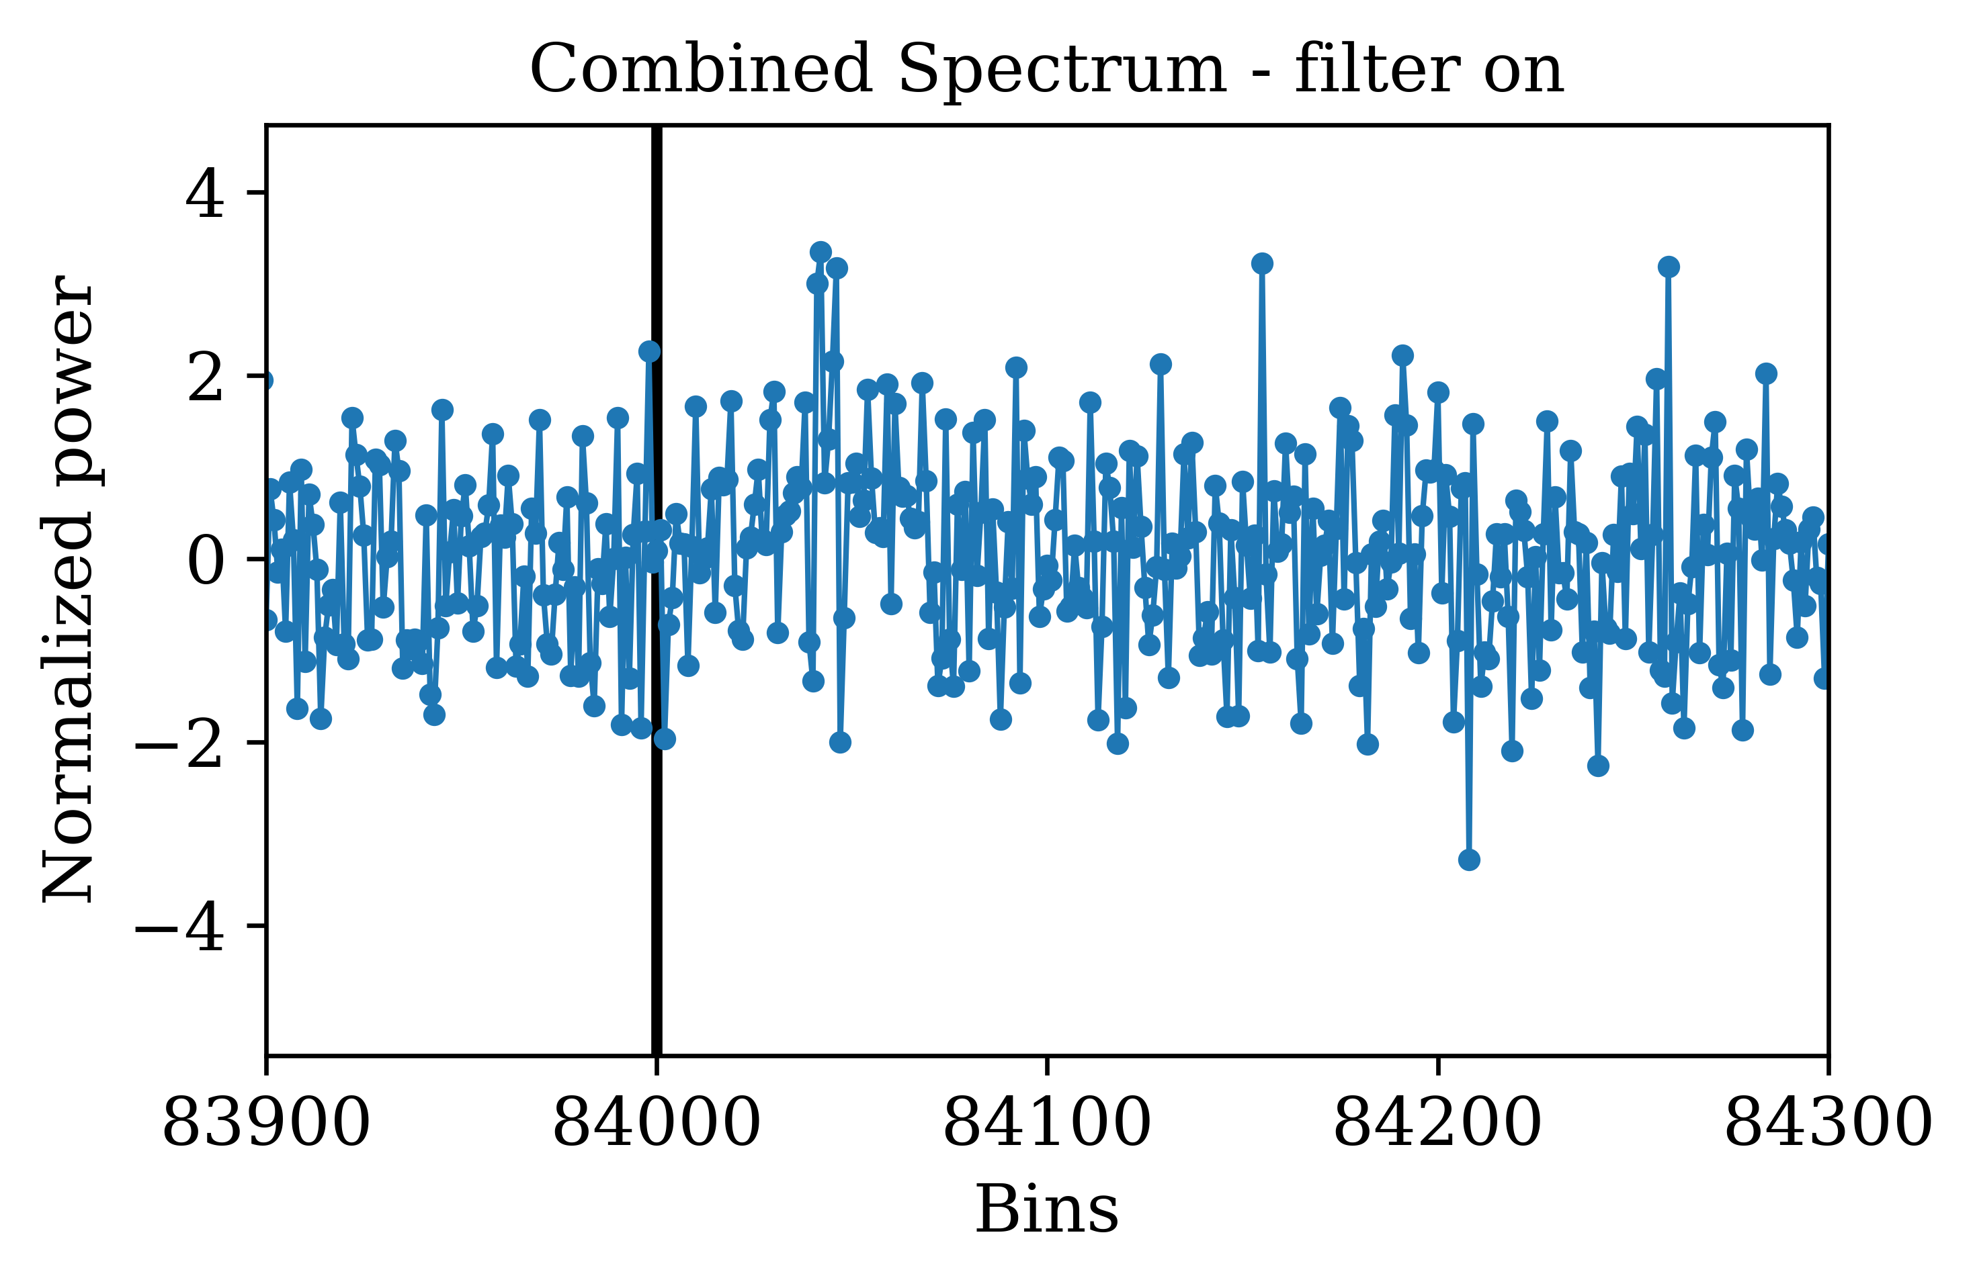
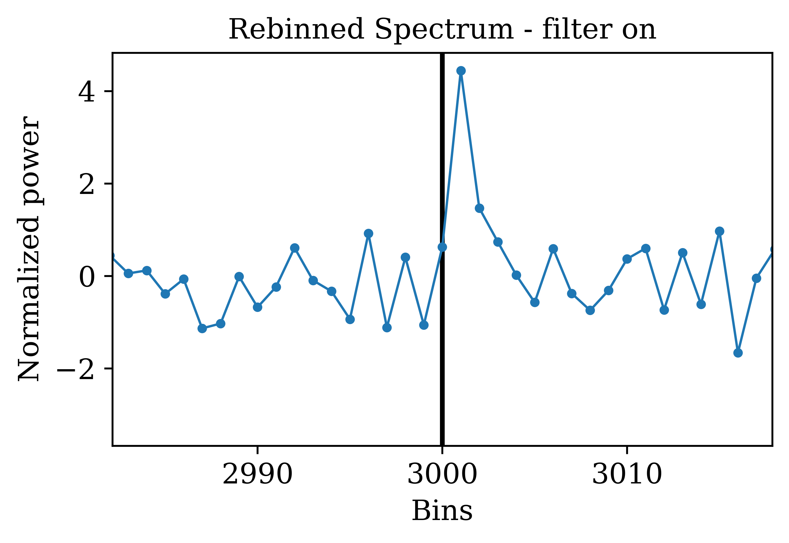
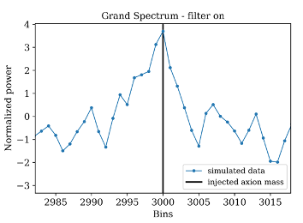
11 / 17
Hardware and software SIGNAL INJECTIONS
Blind injection of well-defined “fake” axion signals.
Identification from analysis + stability and calibration.
Behavior and characteristics as expected.
Hardware Injections:
Injected power:
Should be visible after 90-min averaging
110-min of data generated
Monte Carlo synthetic axion signal:

Slide 13
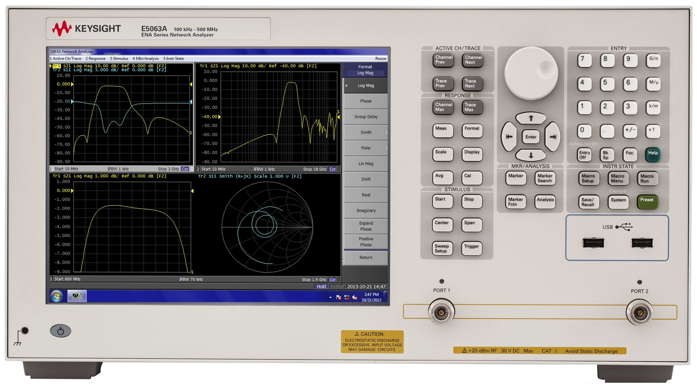
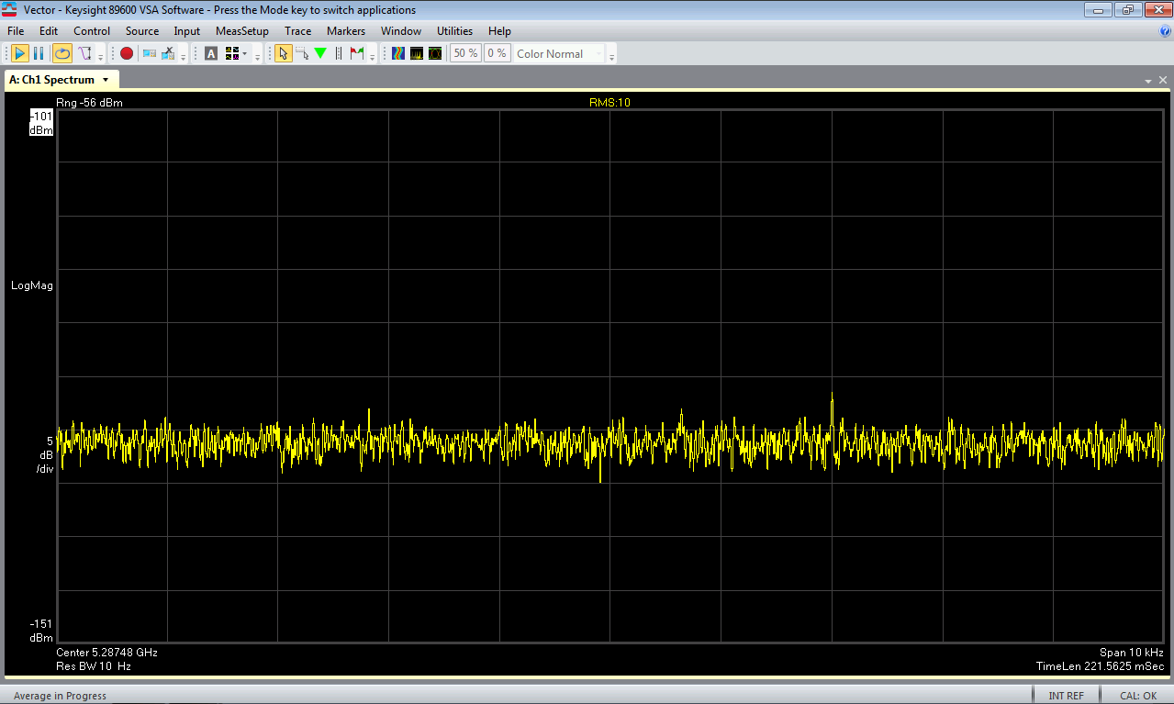



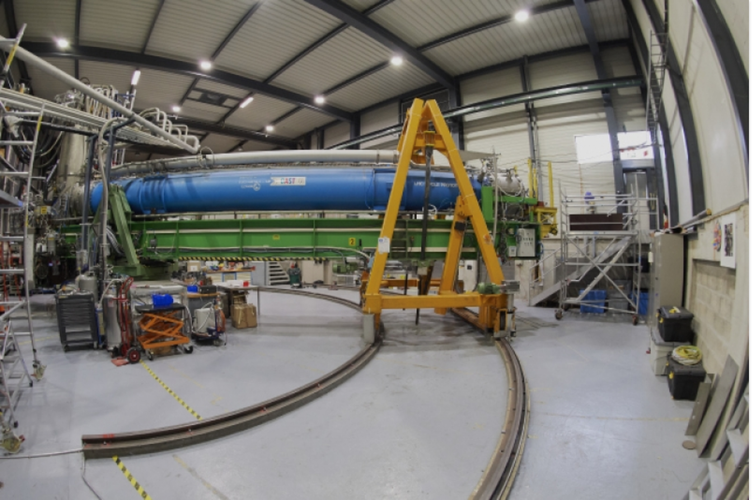
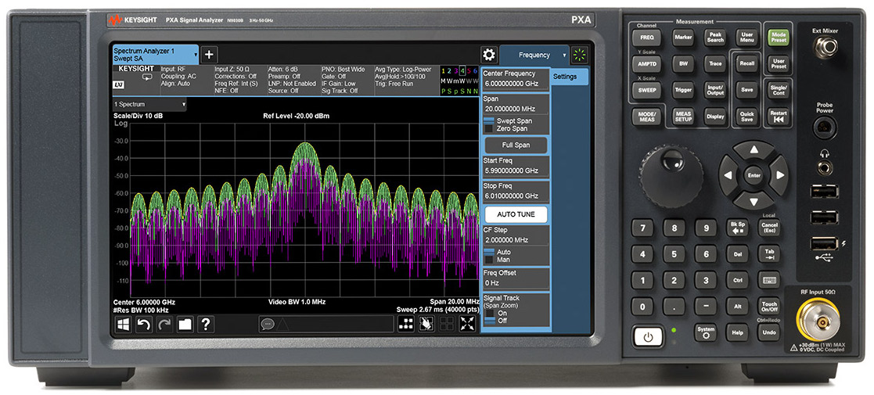
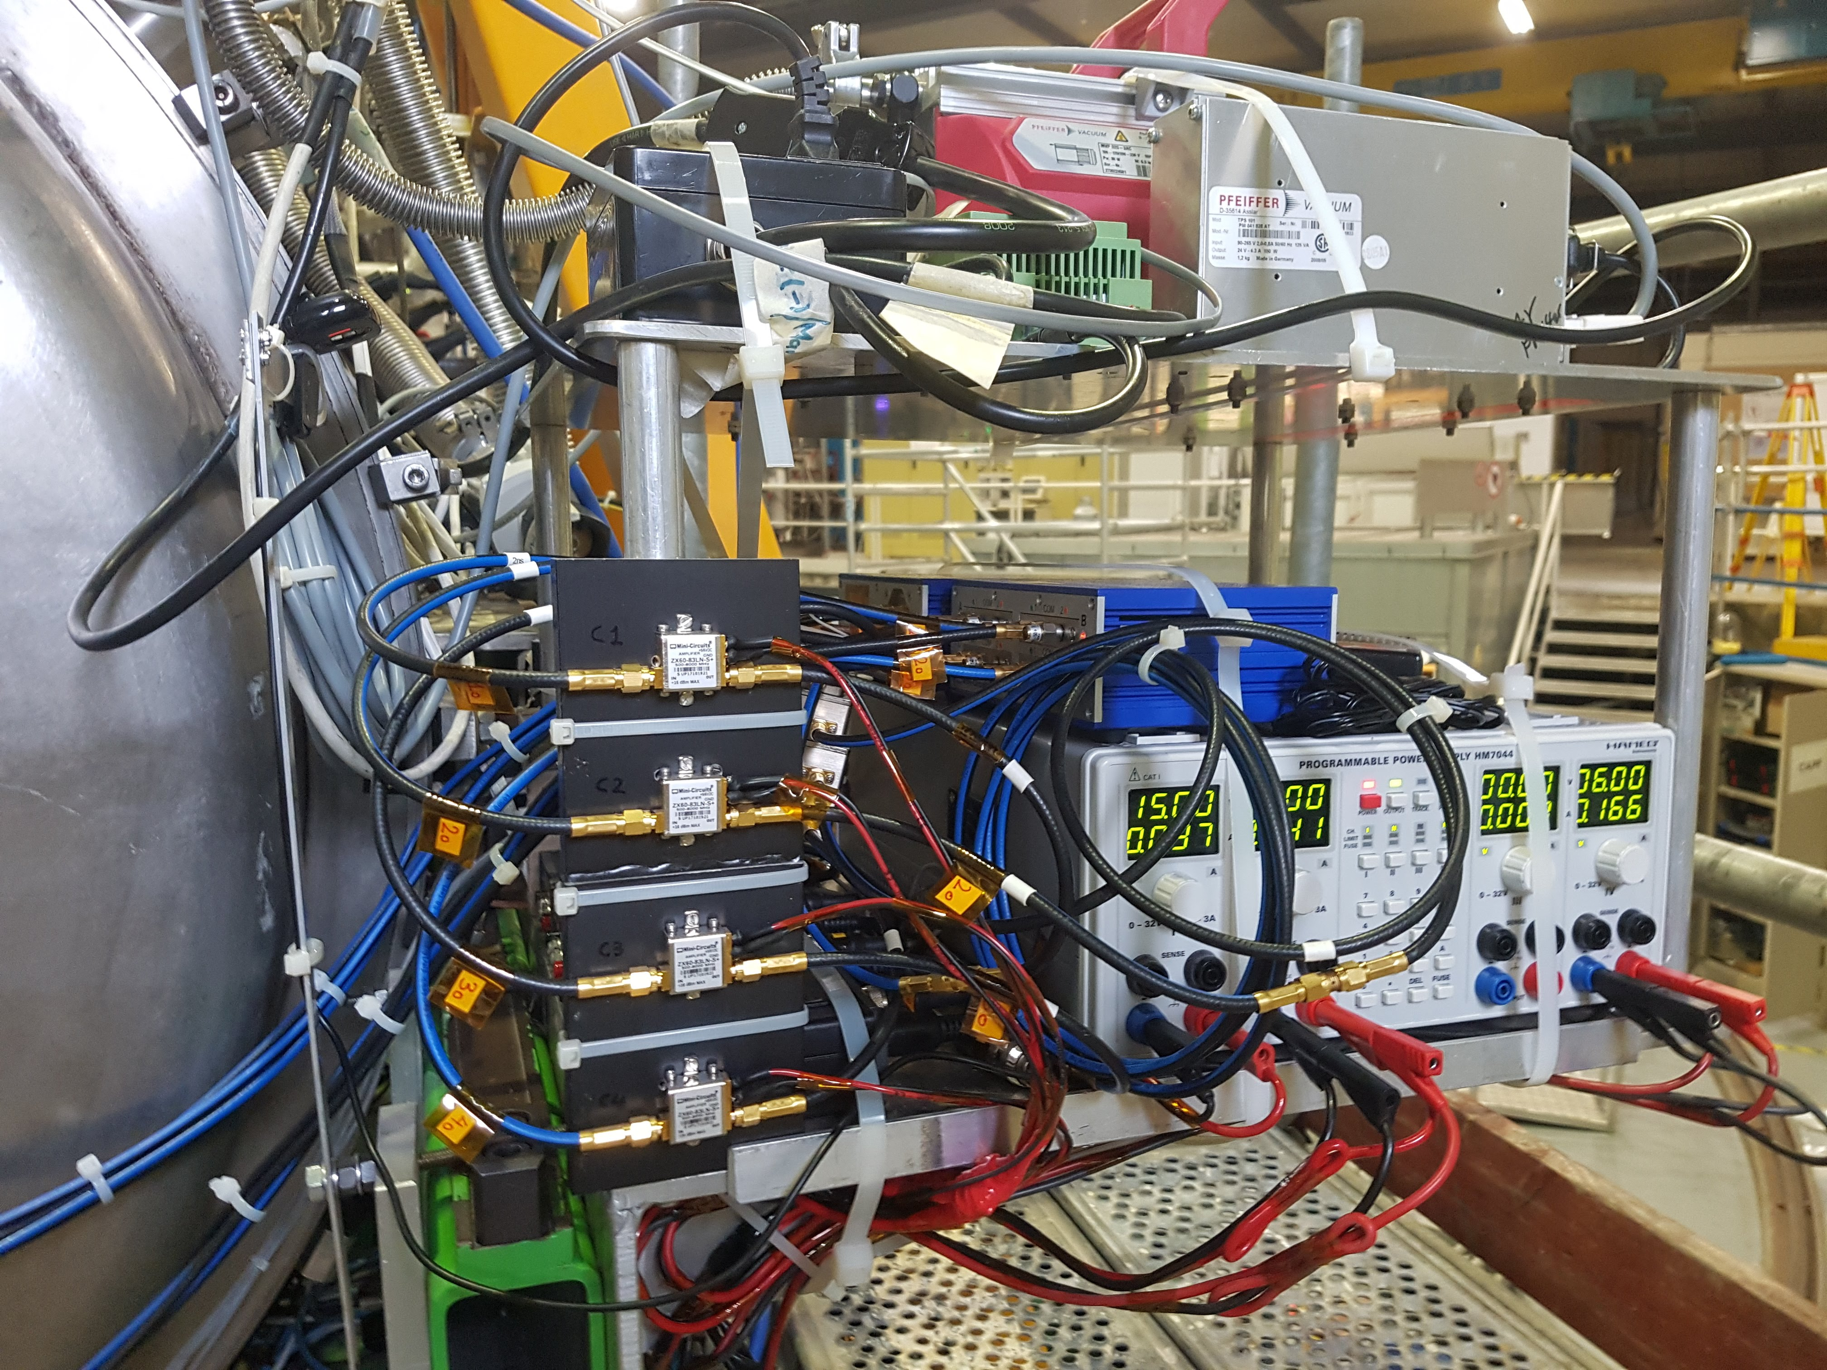
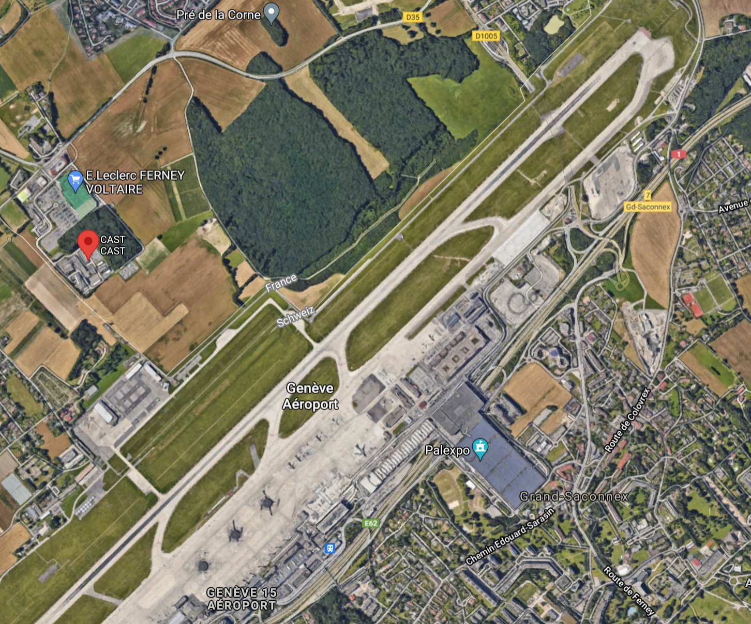
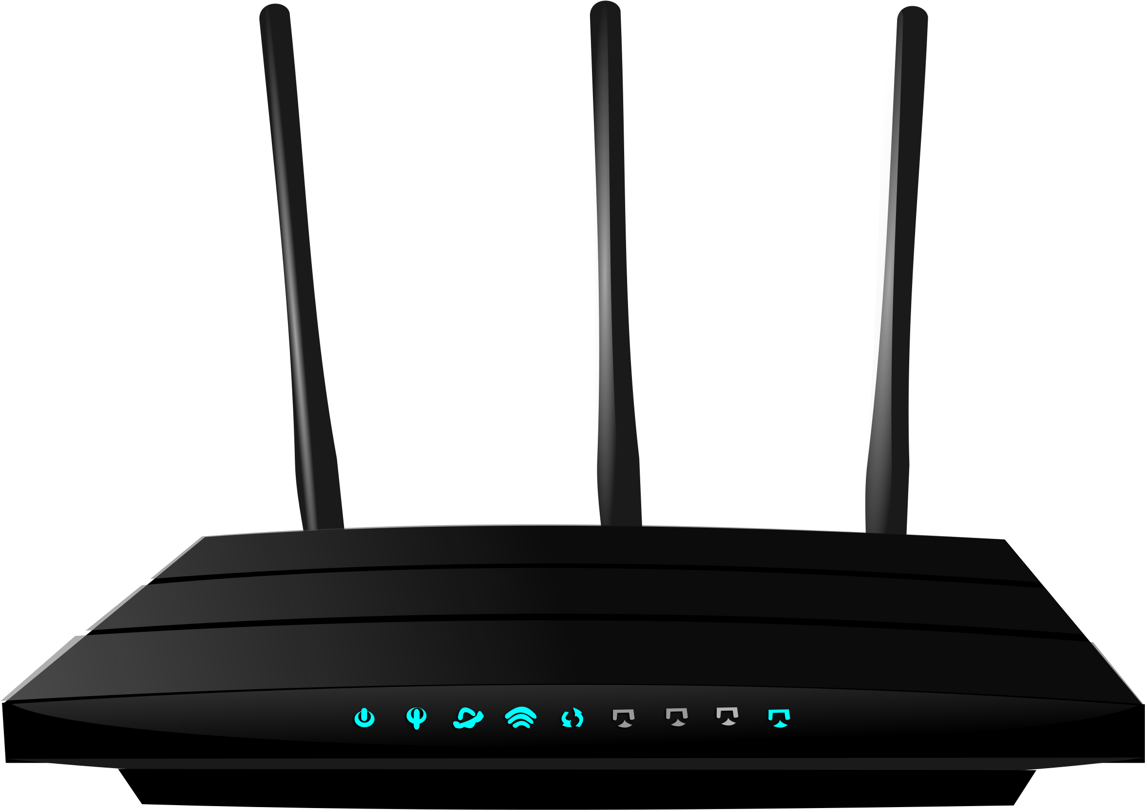


12 / 17
BUT… What about ambient intended/unintended emitters?
Magnet body acts as a Faraday cage.
Outside-the-cryostat connections are unprotected.
GOOD NEWS:
Margin of ~30 dB above the noise!
No signal observed
(see talk by Fritz Caspers)

Slide 14
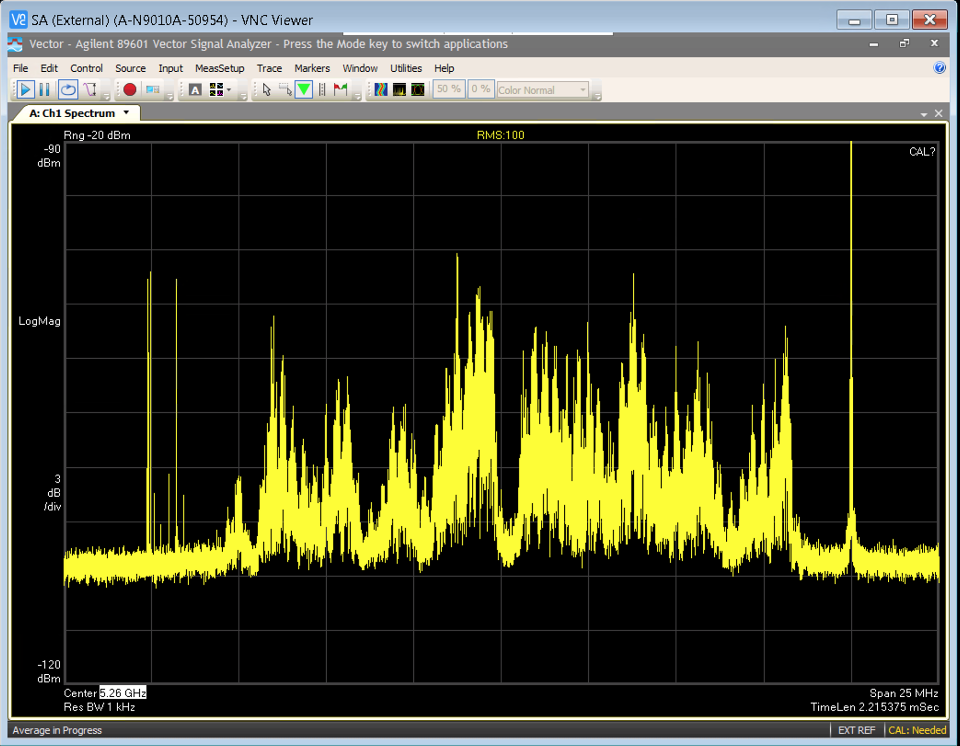
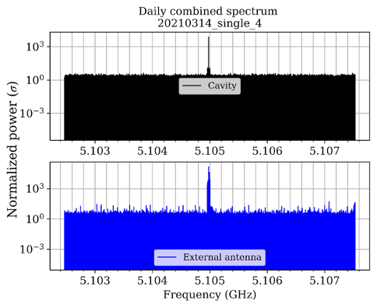
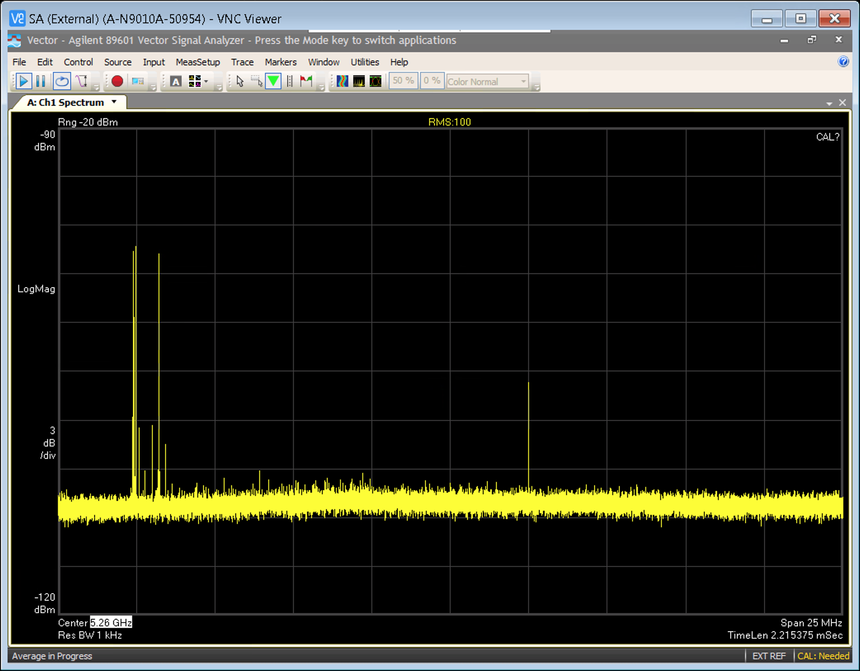
13 / 17
BUT… What about ambient intended/unintended emitters?
Solution A:
Solution B:
Simultaneous measurements at the same frequency band with a second independent channel looking for ambient EMI/EMC signals in the CAST area.
Disabling of intervening WLAN channels in 5GHz band of the surrounding Aps.
Important for signal identification & characterization
BEFORE
(5.25 GHz –> 5.29 GHz)
Second vector spectrum analyzer connected to an omnidirectional antenna
AFTER
(5.25 GHz –> 5.29 GHz)

Slide 15
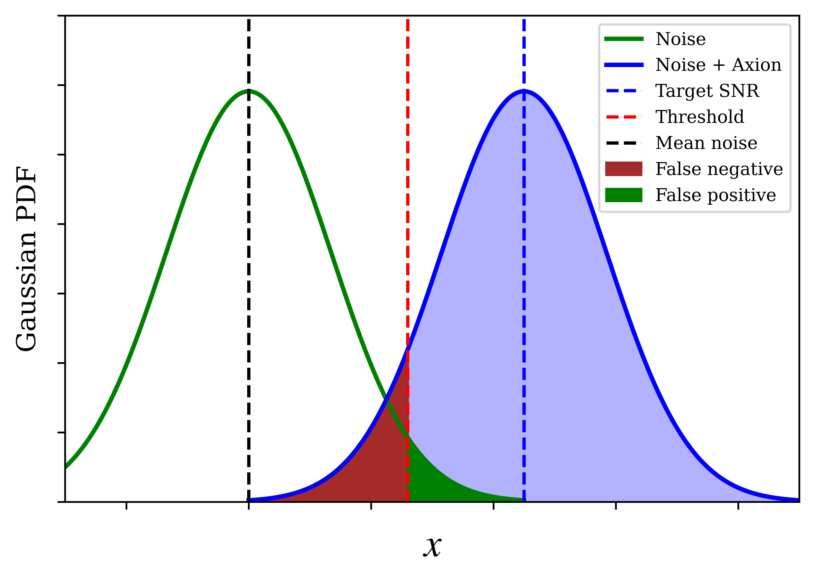
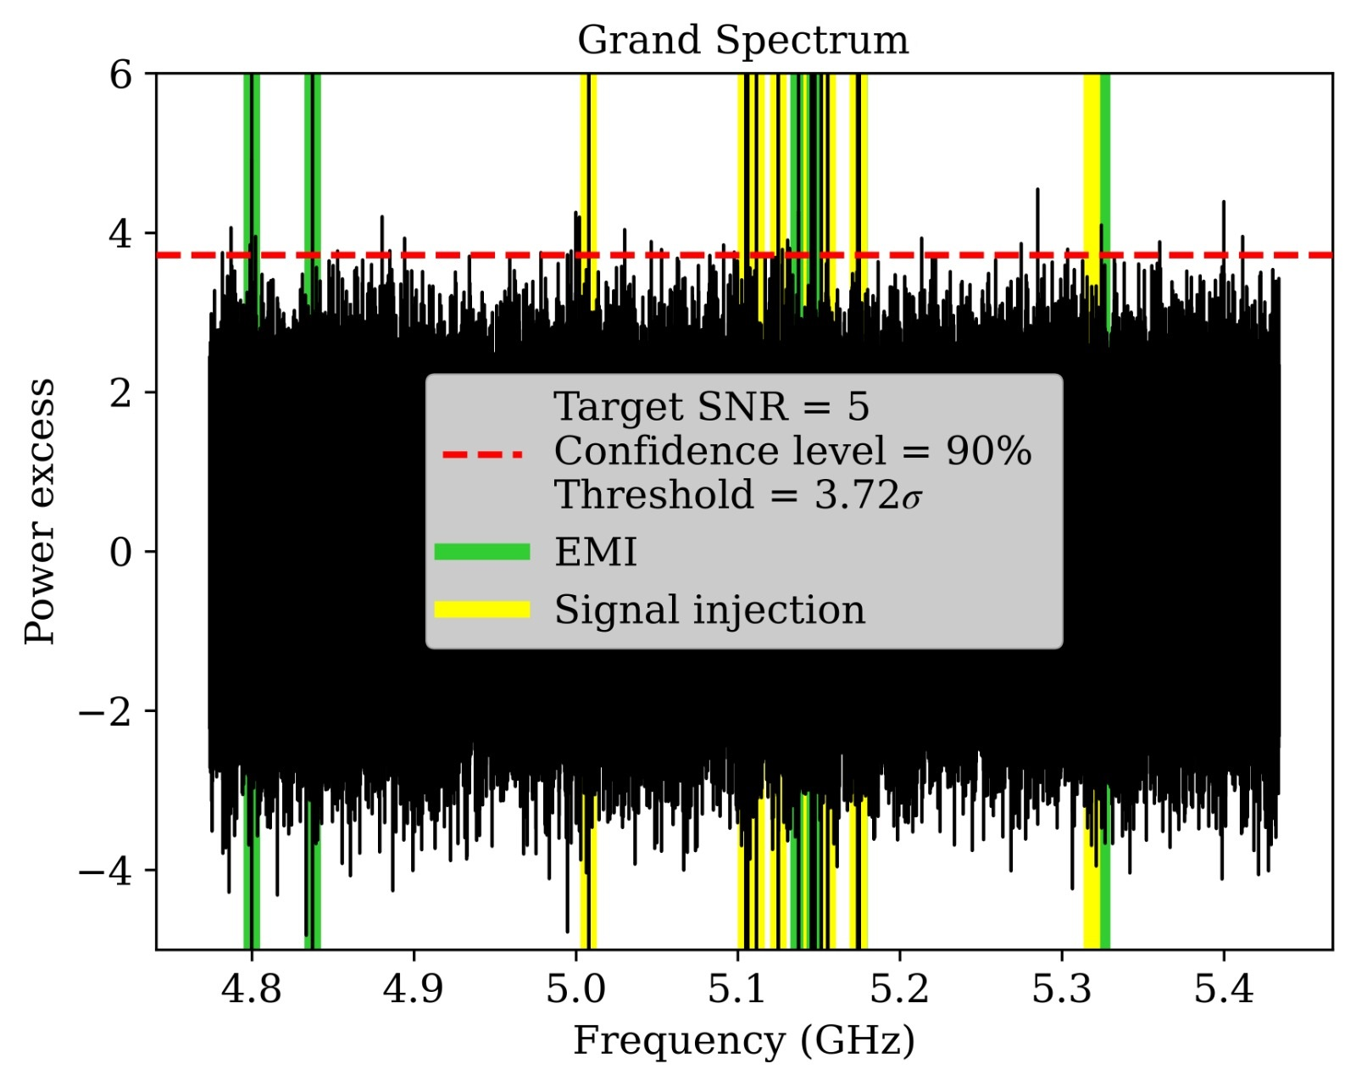
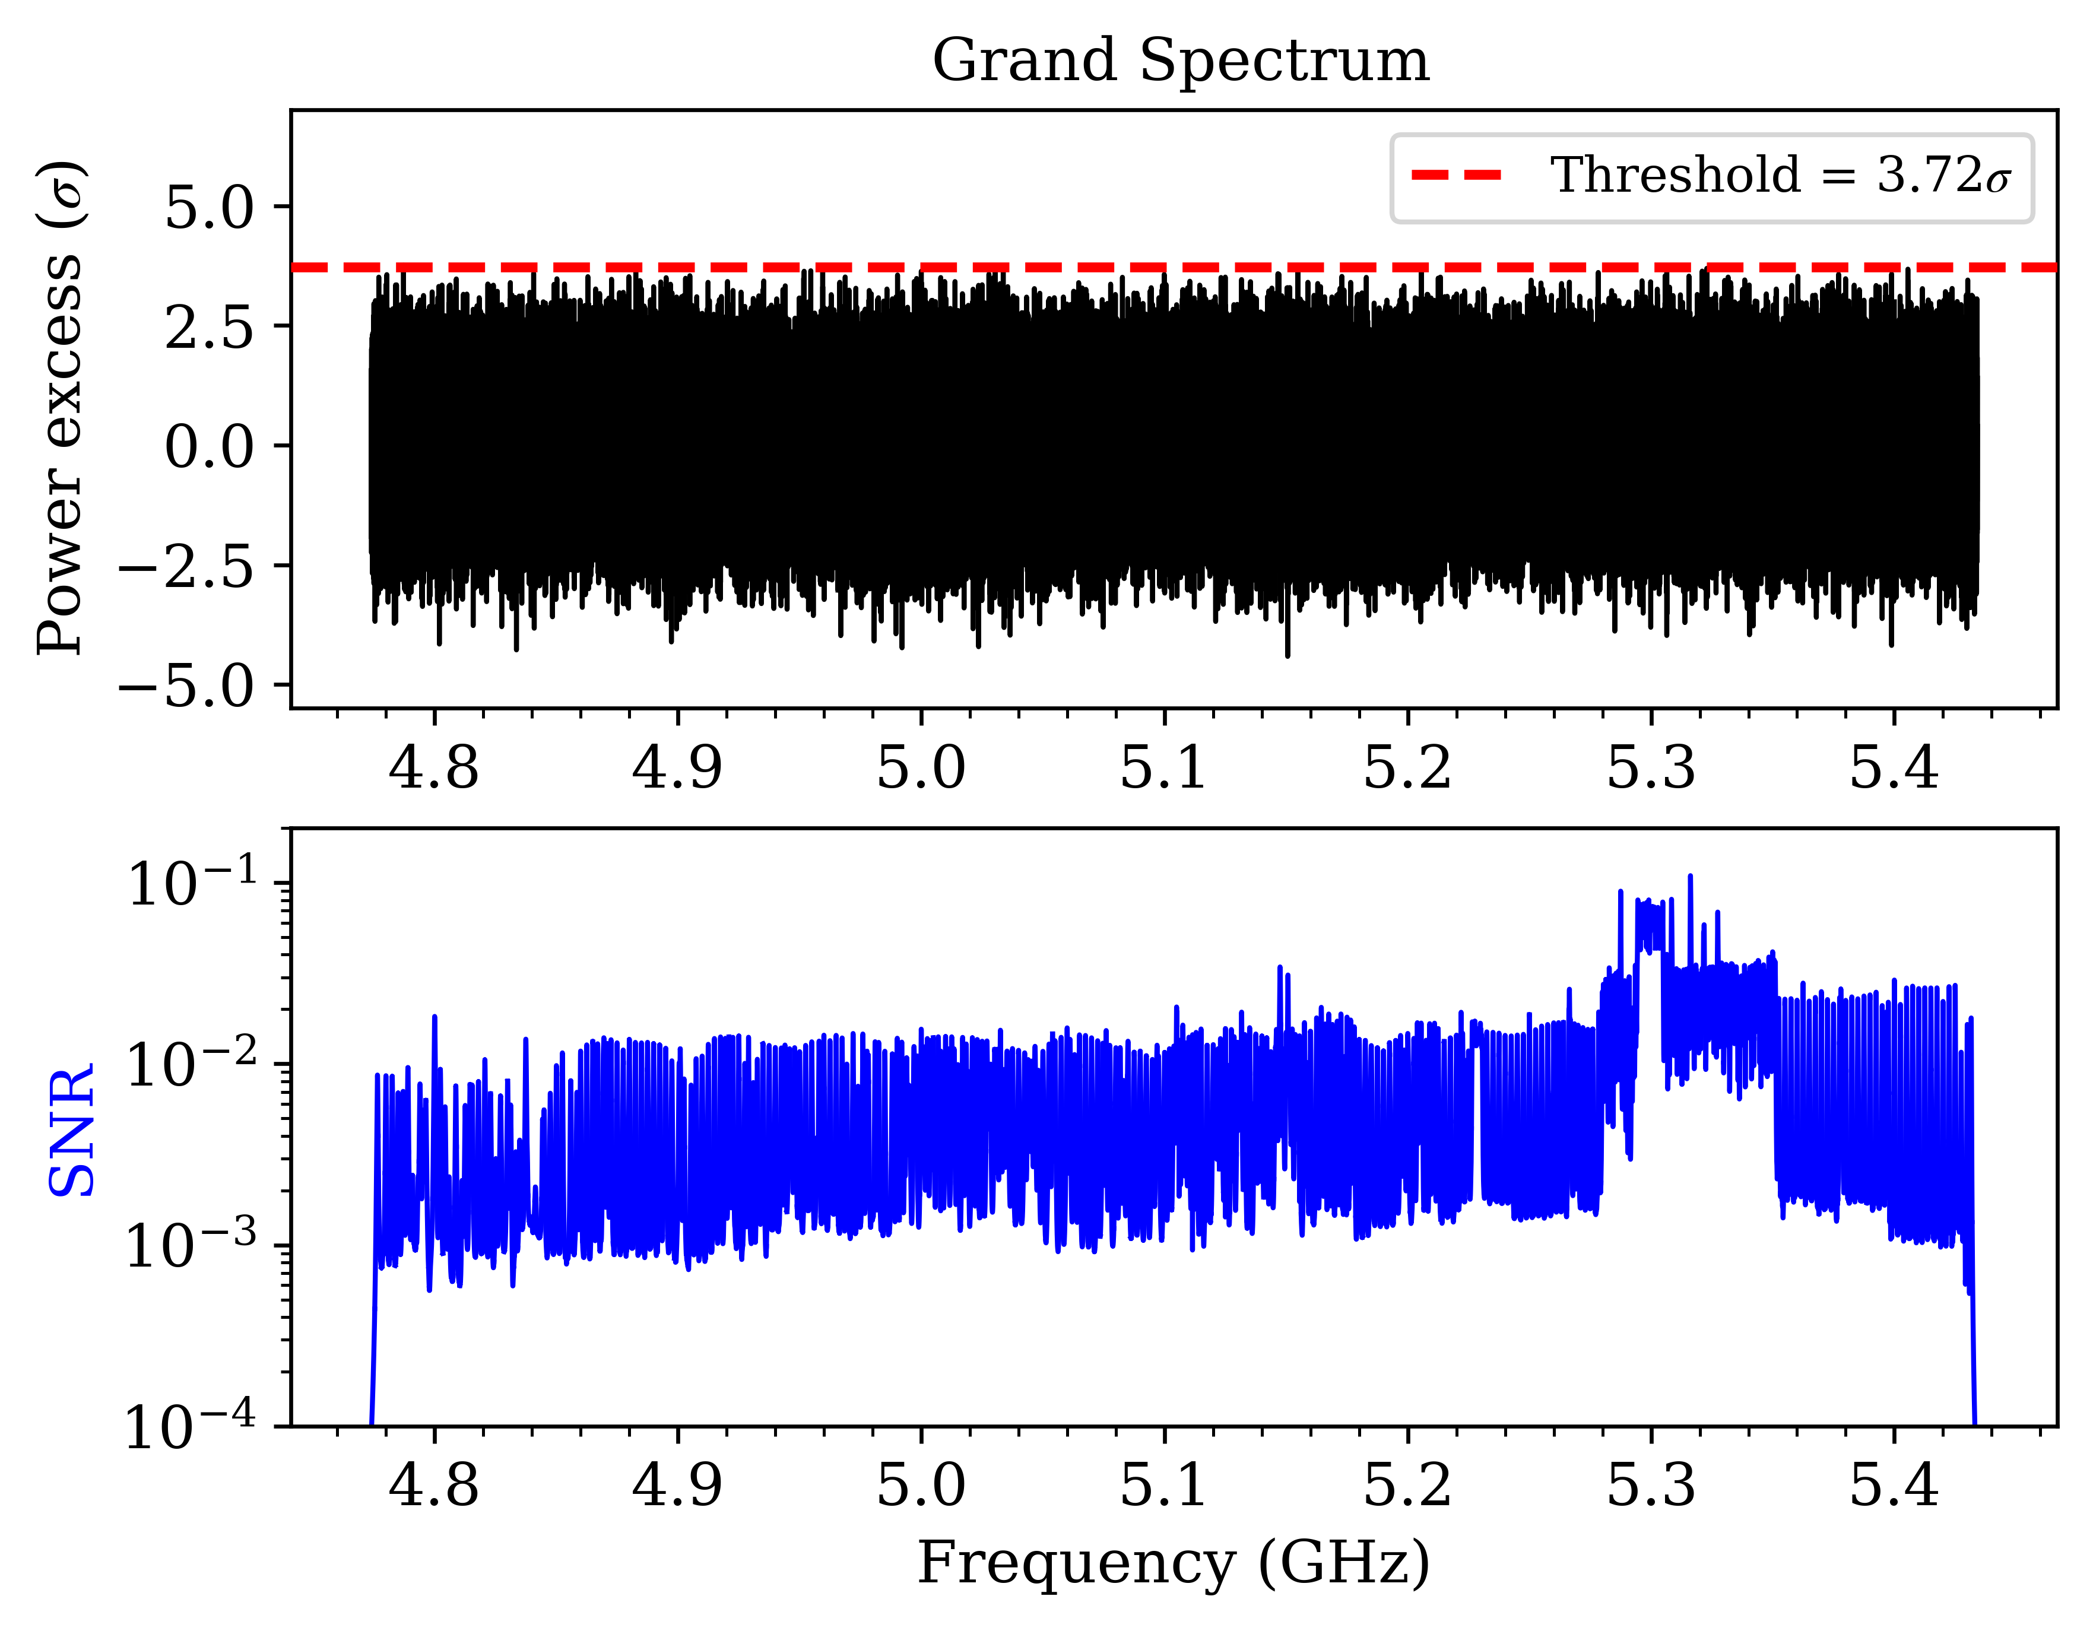
14 / 17
DATA Analysis – hypothesis testing steps
Target SNR = 5 σ
Confidence Level: 90%
Threshold: 3.72 σ
60 outliers
40 statistical outliers (false-positives).
11 verified as blind signal injections.
9 verified as EMI/EMC parasites.
Elimination Procedure:
Blind signal injections?
No EMI/EMC parasite in 2nd channel.
Persistence during re-scanning.
Re-scanning with different cavities.
Tuning to different resonant mode.
Correct axion line shape (5-7 kHz).
Signal ∝ B.
BEFORE
AFTER
No remaining outliers!

Slide 16


15 / 17
DATA Analysis – exclusion plot
Total data-taking time: 4124 h (172 d)
Data size: ~ 650 TB
Frequency range: 660.15 MHz
Axion masses: 19.74 μeV - 22.47 μeV
Present sensitivity:
Confidence level: 90 %
Total uncertainty: 7.4%
No DM halo axions here…

Slide 17


16 / 17
SUMMARY & Novelties
A previously unexplored parameter space has been scanned to extend axion search towards larger rest mass values (19.74 - 22.47 μeV).
Use of a dipole magnet as a DM axion haloscope.
No mode crossings over the entire tuning range for the mode of interest.
Four identical cavities coherently combined through phase-matching to increase SNR for the first time in DM axion search.
State-of-the art tuning mechanism gives a wide mass range (~ 660 MHz) → up to 1 GHz.
Novel fast-scanning technique to investigate transient events and exclude outliers faster.
Introduction of a second simultaneous recording channel for EMI/EMC parasites.
New approach and analysis for transient events and search for signal modulations.
Minimal flux enhancement: 10²
Halo axions:
Streaming axions:

Slide 18



17 / 17
THANK YOU!
corner
AXION HUNTING PERIOD IS STILL ON!!

Slide 19
BACKUP SLIDES

Slide 20

DATA ANalysis
Combining multiple spectra:
Scaling of the flattened spectra by P_{noise}/P_{axion} to account for the fact that an axion signal would not have the same amplitude across the flattened spectrum.
Spectra aligned to RF index = vertical averaging with weights = inverse bin variances.
Normalization of the combined spectrum to have a standard sample distribution. Each bin of the combined spectrum is divided by its standard deviation → μ=0, σ=1

Slide 21


DATA ANalysis
Combined Spectrum

Slide 22


DATA ANalysis
Grand spectrum:
Convolution: Application of a window function with the shape of the expected axion power curve in the lab frame.
Galactic vs. lab frame. 4.3 kHz signal width in galactic frame and 7 kHz in the lab frame.
Variation across the CAST-CAPP frequency range. ~8% variation in signal amplitude and width.

Slide 23

Streaming dark matter
Fine grained streams:
DM could be a superposition of many fine-grained streams.
Consequence from the collisionless character and the coldness of CDM.
Each such stream has a very small velocity dispersion.
~10¹⁴ streams in the solar neighborhood.
Half of the local DM density is comprised of the 10⁶ most massive streams.
The most massive individual stream contributing a 0.1% to the local DM density.

Slide 24



Streaming dark matter
Conventional halo DM:
NO direct detection so far..
Streaming DM: For low-speed ( ) streams aligned with SUN → EARTH:
NEW APPROACH:
Wide frequency range.
Short scanning time per frequency.
Maximum duty cycle.
Streaming DM: Earth’s self-focusing effects due to intrinsic mass:
Streaming DM: Other solar system bodies e.g. the Moon:

Slide 25


Streaming dark matter
New procedure for transient events such as axion streams or axion-mini clusters.
Second measurement channel is decisive for such searches.
Example measurement for 4.5h on 24/11/2020 (19:19 – 23:53 local time).
Fast scanning method over 42 MHz (5.3547 GHz – 5.3967 GHz).
Combined spectrum (RBW = 50Hz) shows no lines above 5σ threshold.
”Local” exclusion plot assuming axion streams with modest flux enhancement 10² – 10⁴.
Future tests with even smaller RBW including also raw IQ data in time-domain.

Slide 26

Streaming dark matter

