Slide 1
Constraining WDM and Pop III stars with the Global 21-cm Signal (PATRAS)
Joshua Hibbard, Jordan Mirocha, David Rapetti, Jack Burns, Neil Bassett, Keith Tauscher
joshua.hibbard@colorado.edu
jack.burns@colorado.edu

Slide 2
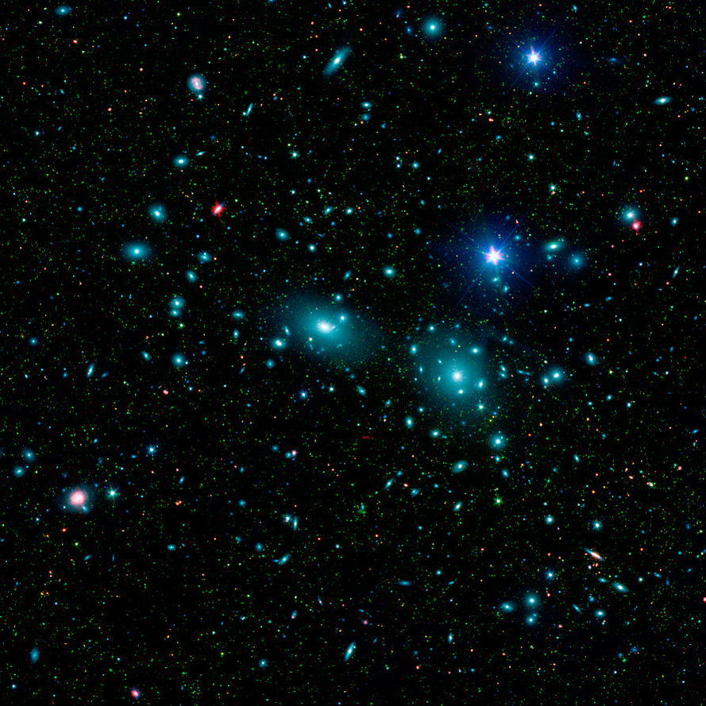
Overview
A Brief History of the Universe
The 21-cm Global Signal
Theory
Observational Challenges
Warm Dark Matter
Overview and Motivations
Constraints using 21-cm Cosmology
21-cm Cosmology Lunar Telescopes
Coma Cluster, SDSS

Slide 3
Recombination
Cosmic Dawn
What is happening to the neutral Hydrogen gas filling the Universe (the IGM) during these Epochs?
Image Credit: JPL
Cosmic Dark Ages
Reionization

Slide 4
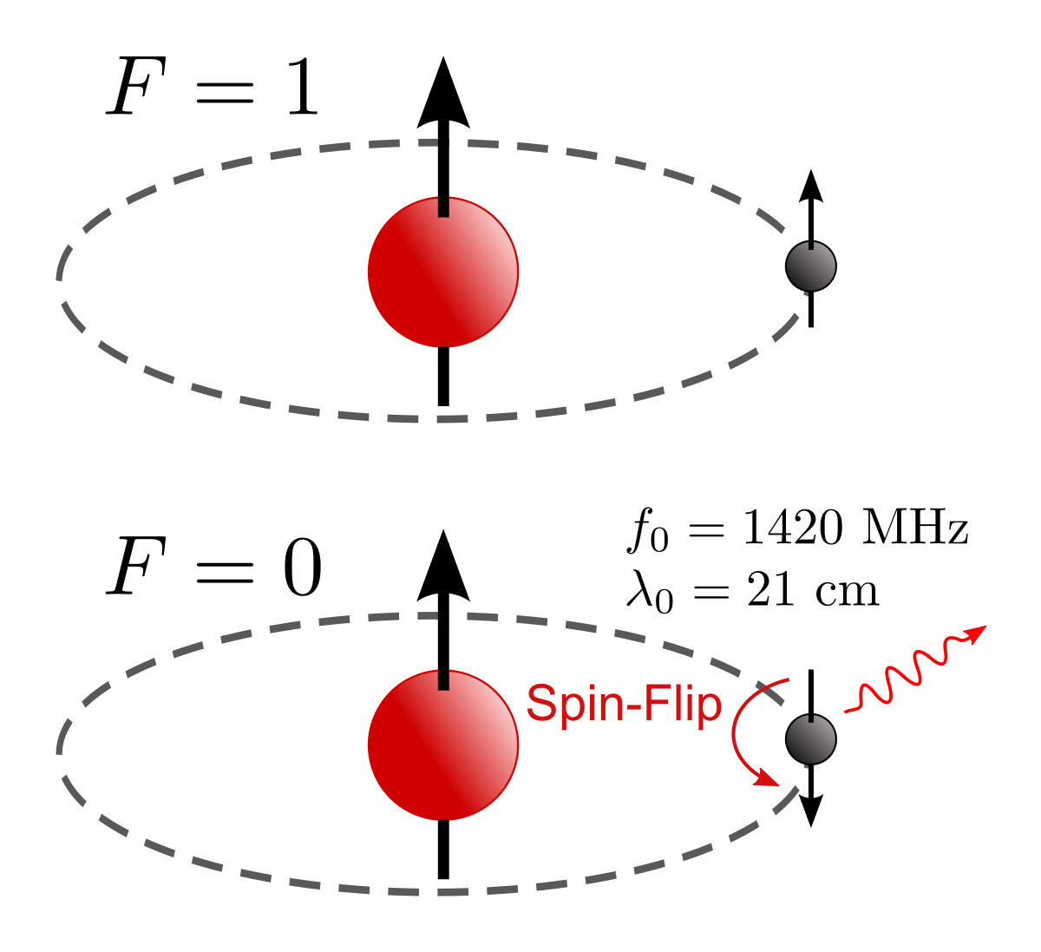
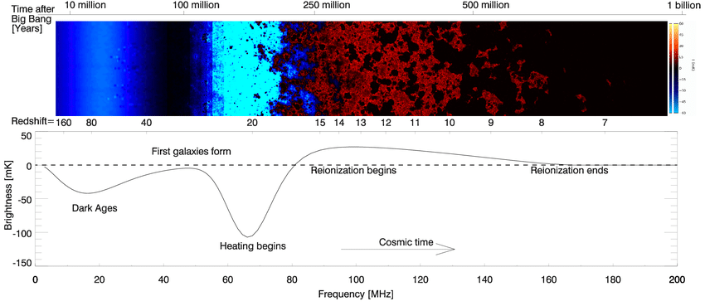
The 21-cm Global Signal: Theory
The highly redshifted, hyperfine 21-cm, spin-flip emission line of HI allows us to map the thermal evolution of the Universe.
Each frequency corresponds to a slice of cosmic time.
Image credit: Wikipedia
Takalana et al. 2019

Slide 5
The 21-cm Global Signal: Theory
The 21-cm Global Signal is the differential spin temperature of the IGM measured against the background brightness of the CMB.
It depends upon the (brightness) Temperature of the CMB, and the kinetic Temperature and neutral fraction of the IGM.
CMB
21-cm Global Signal
Neutral Hydrogen

Slide 6
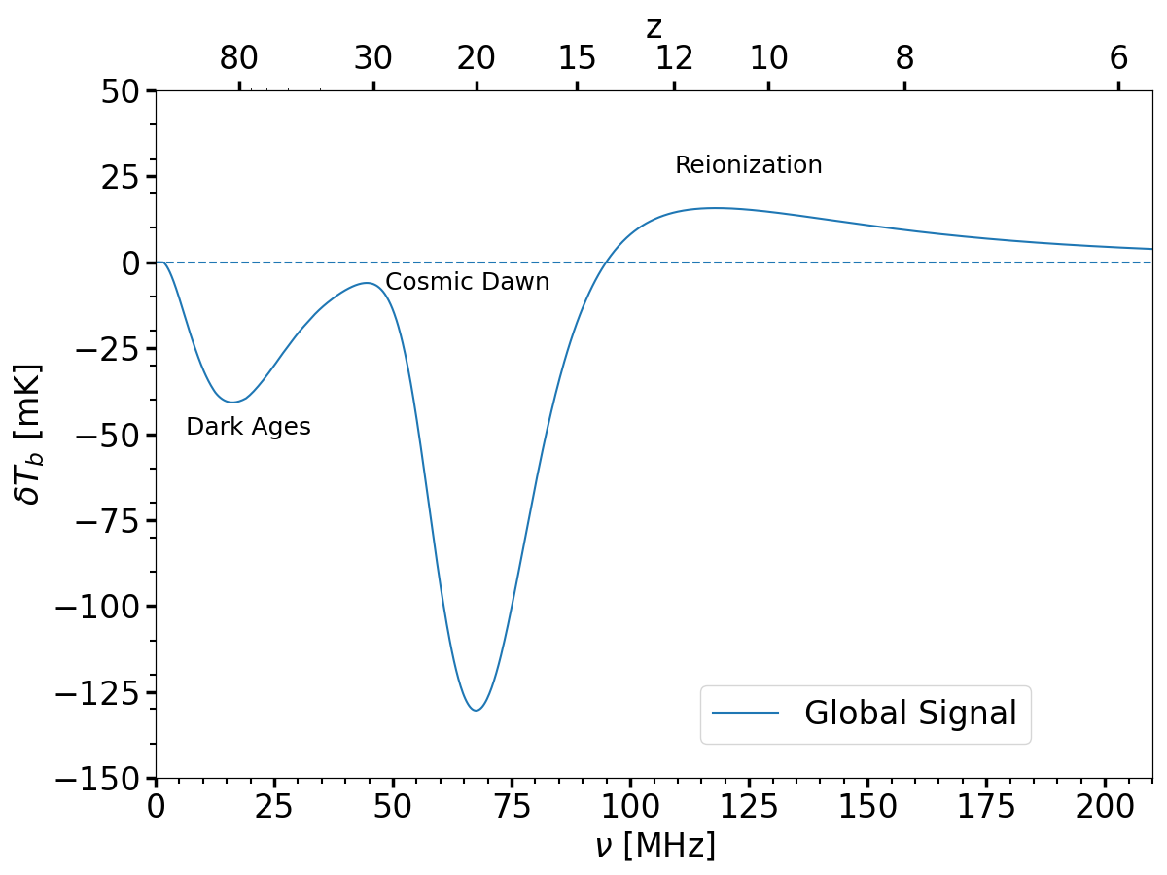
Cosmic Dawn and Reionization
Sources turn on
Cosmic Dawn begins when the first luminous objects “turn on,” releasing
Lyman-alpha photons
X-ray radiation
Ionizing radiation
Reionization then extinguishes the signal.
Heating begins

Slide 7
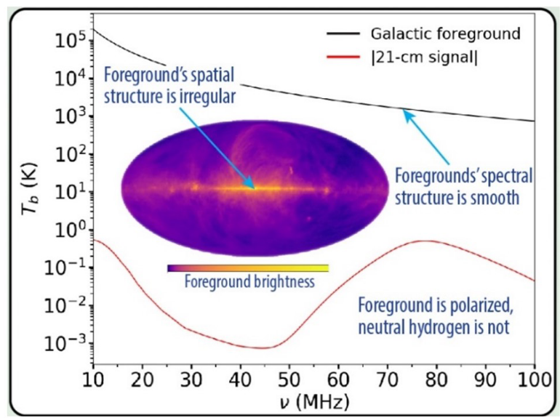
Challenges to observing the Global Signal
Three primary systematics must be overcome:
Bright Foregrounds
Beam Chromaticity
Environmental effects: RFI, the ionosphere, vegetation, local topology, etc.
Image credit: Burns et al. 2019

Slide 8
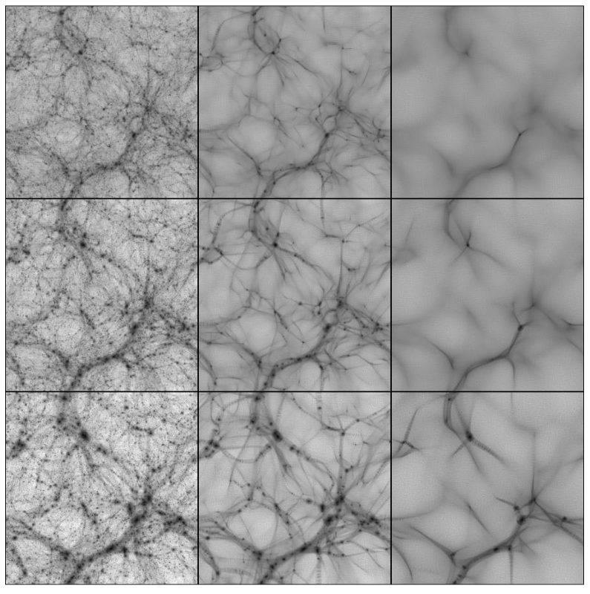
Warm Dark Matter (WDM): Overview
Particles are “warm” (i.e. have a higher relic velocity, or a lower DM mass m_{X}) so they stream freely out of over-dense regions and cause the low-mass fluctuations to diffuse.
Fewer DM halos means fewer stars.
CDM WDM HDM
N-body simulation for various DM masses. From Bode & Ostriker 2018.

Slide 9
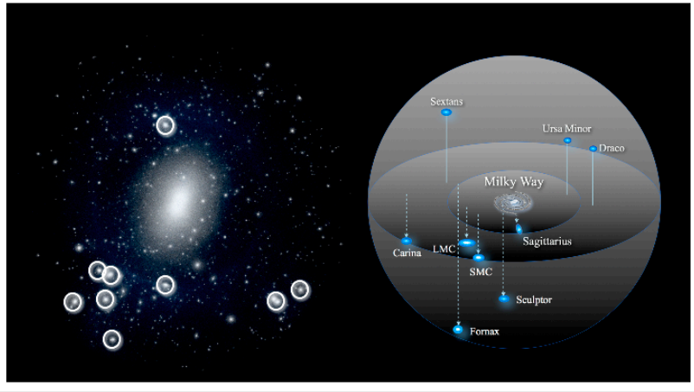
Observational Motivations for WDM vs. CDM
The motivations are all related to the apparent lack of small-scale structure predicted by CDM:
Missing satellites
Too-big-to fail
Lack of halo structure between cosmological filaments.
Could unmodelled baryonic processes explain these?
Image Credit: Astrobites

Slide 10
A New Way to Test DM
DM Halos
As WDM is primarily a theory about the abundance and turnover of low-mass halos, its effects will be readily apparent in the high-redshift Universe, before the largest DM halos have formed.
A measurement of the global signal allows us to place constraints on DM in epochs which entertain exquisite sensitivity to small-scale structure.
CDM
Infalling neutral Hydrogen
DM Halos
Small Halos “diffused”
WDM

Slide 11
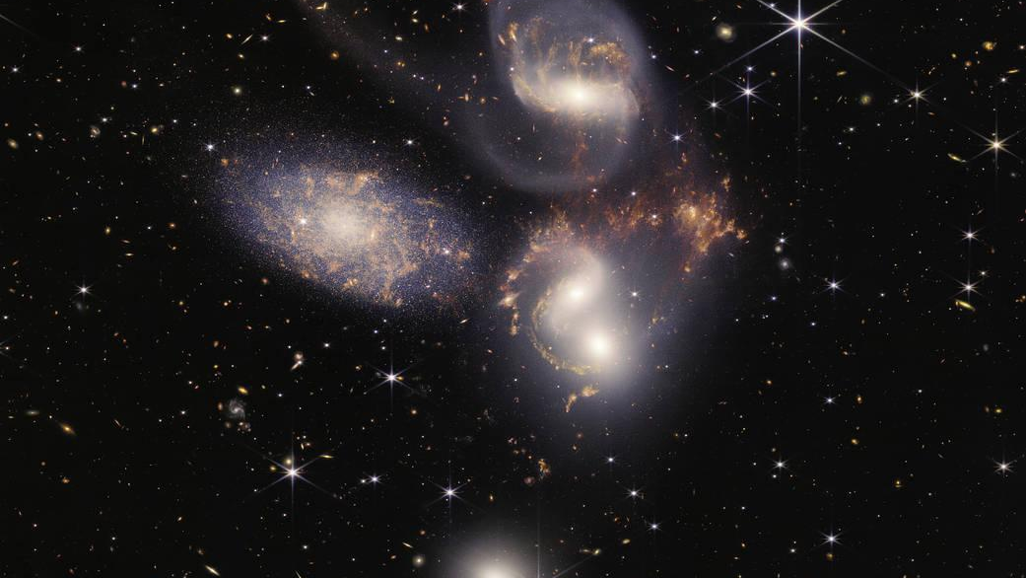
Big Question:
Can we put constraints upon the DM mass--and thus structure formation--when including the (messy) astrophysics of star-formation?
Image credit: JWST

Slide 12
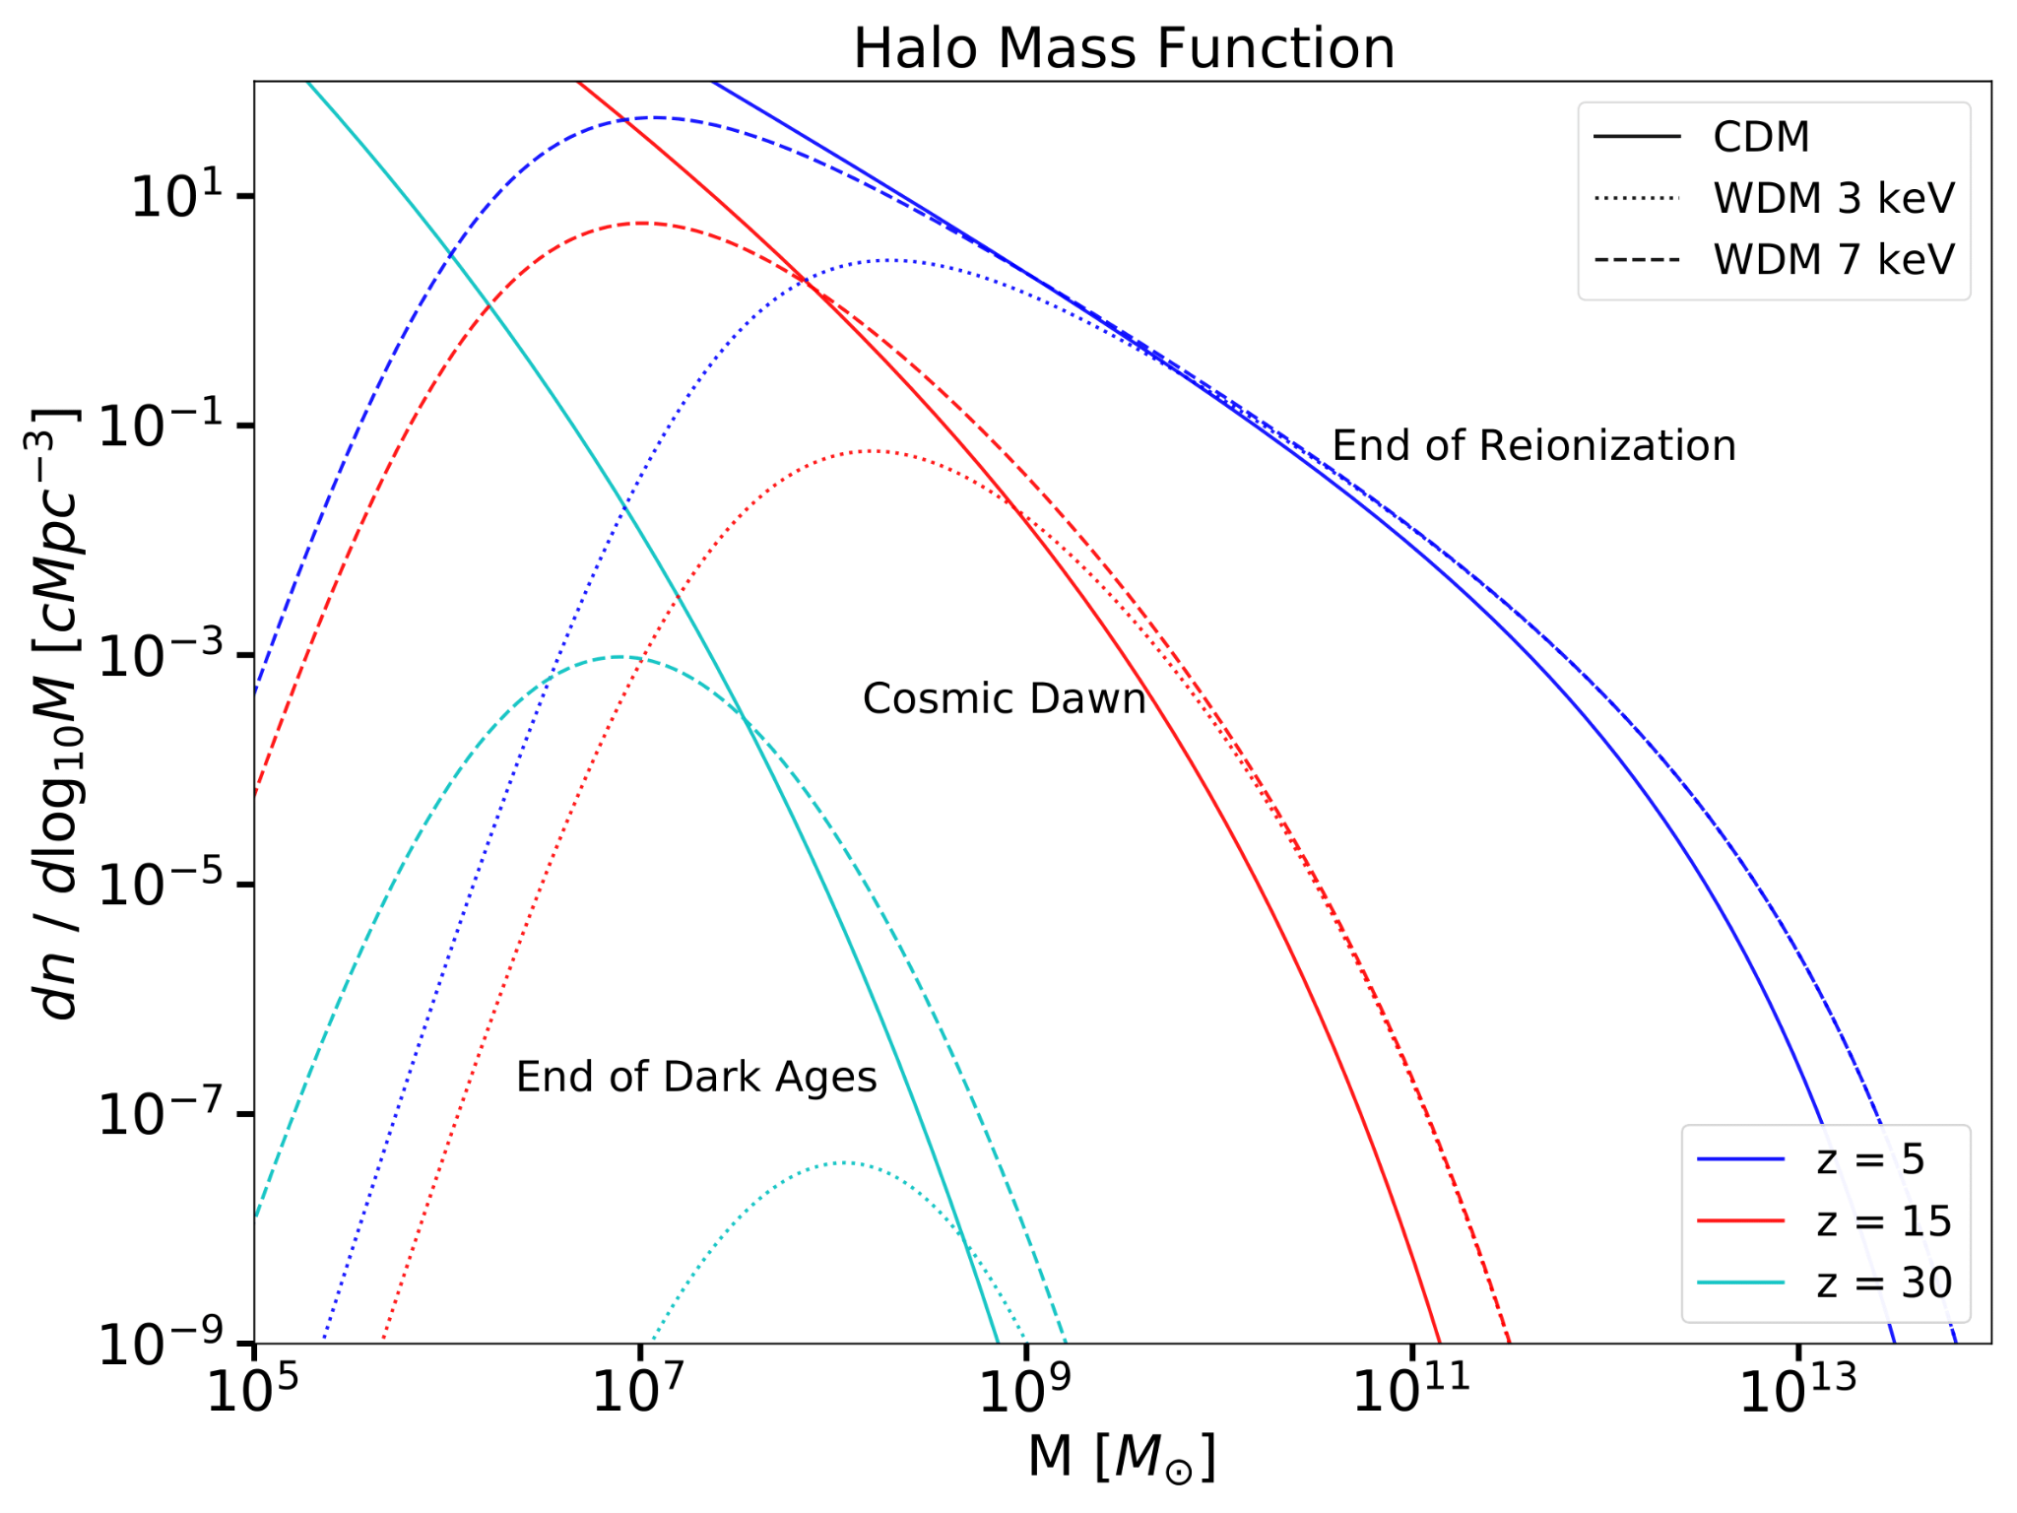
First Things First: Add WDM to our Simulations!
To incorporate WDM, we must change the Halo Mass Function (HMF), or the number of halos of mass M+dM per co-moving volume.
We modified existing codes (e.g. ARES¹: Accelerated Reionization Era Simulations, HMF²) to enable all these calculations.
1 https://github.com/mirochaj/ares
2 https://github.com/halomod/hmf
Figure from Hibbard et al. 2022.

Slide 13
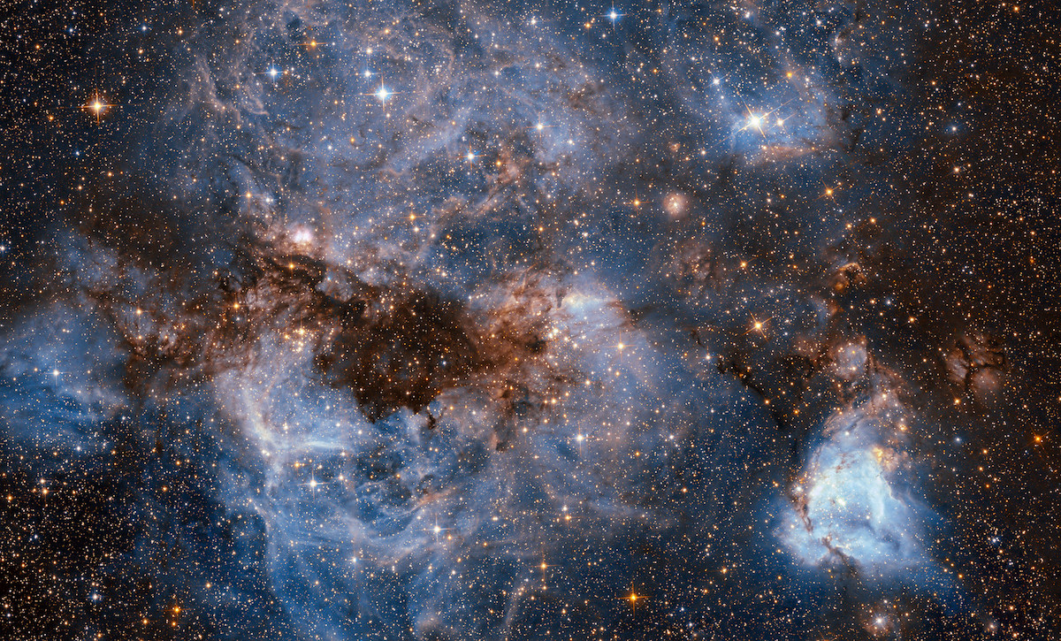
Next: Star-Formation Models
We need to know:
Where do stars form, and how many?
How much light do they produce?
We assume all DM halos host star-formation.
Number of photons in each band, and how many of these photons escape the halos.

Slide 14
Two Different Star Formation Parametrizations
A simple model... ...and a (more) realistic one:
Collapse Fraction Model
Star-Formation is
→ proportional to the total amount of matter in DM halos, with
→ 4 parameters to describe photon production, and star-formation efficiency (SFE) is a constant.
Double-Power Law (DPL) Model
Star Formation is
→ different for Low-mass versus High-mass halos.
→ 6 parameters to describe SFE and photon production.

Slide 15
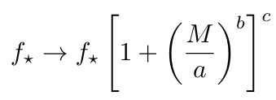
Including additional astrophysics:
Pop III Stars
Form in low-mass halos, in metal-poor environments, and release lots of photons!
Could be potentially degenerate with WDM and change the signal.
Also, we’ll include...
DPL Extended Model
A phenomenological model that allows us to include the possibility of unmodelled physics at high-redshift.
Here a, b, and c are nuisance parameters.

Slide 16
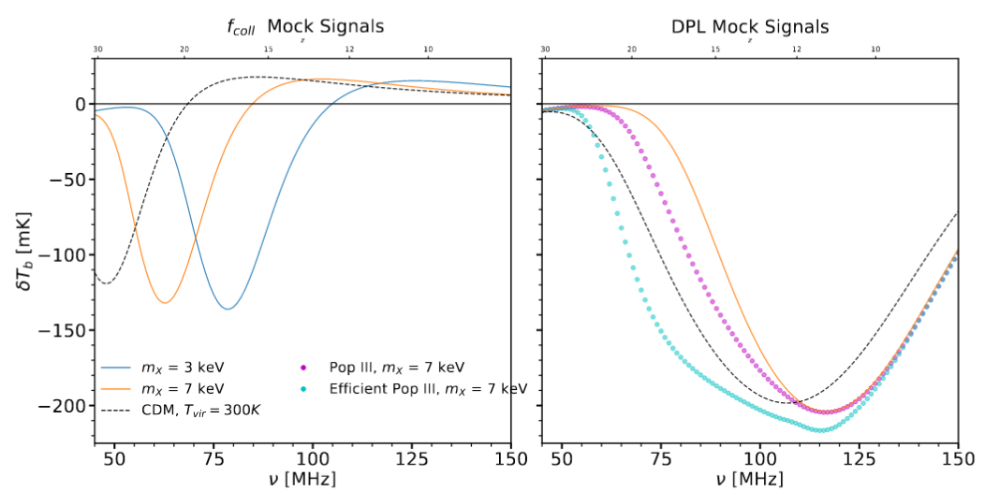
4 star-formation parameters + 1 WDM parameter
6 star-formation parameters + 1 WDM parameter

Slide 17
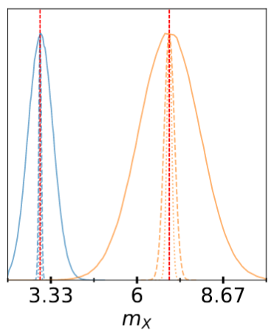
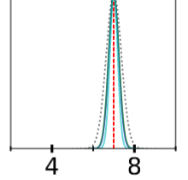
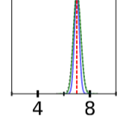
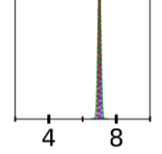
WDM Constraints Summary (95% confidence level)
Collapse Fraction Models
DPL Models
Pop II mock signal:
Pop III mock signal:
Efficient Pop III mock signal:
For fiducial thermal mass 7 keV:
Figures from Hibbard et al. 2022.

Slide 18
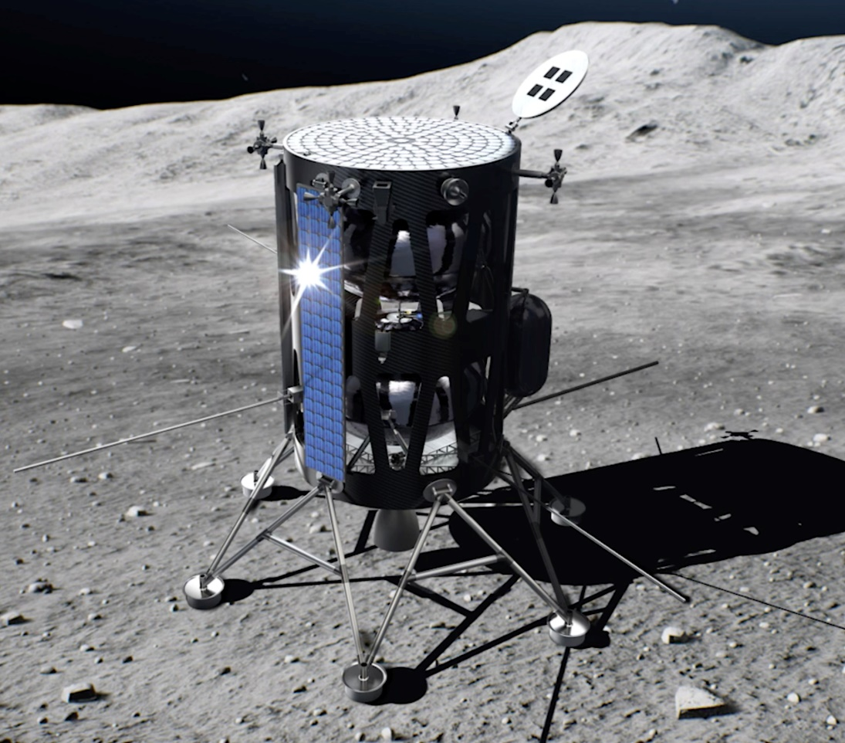
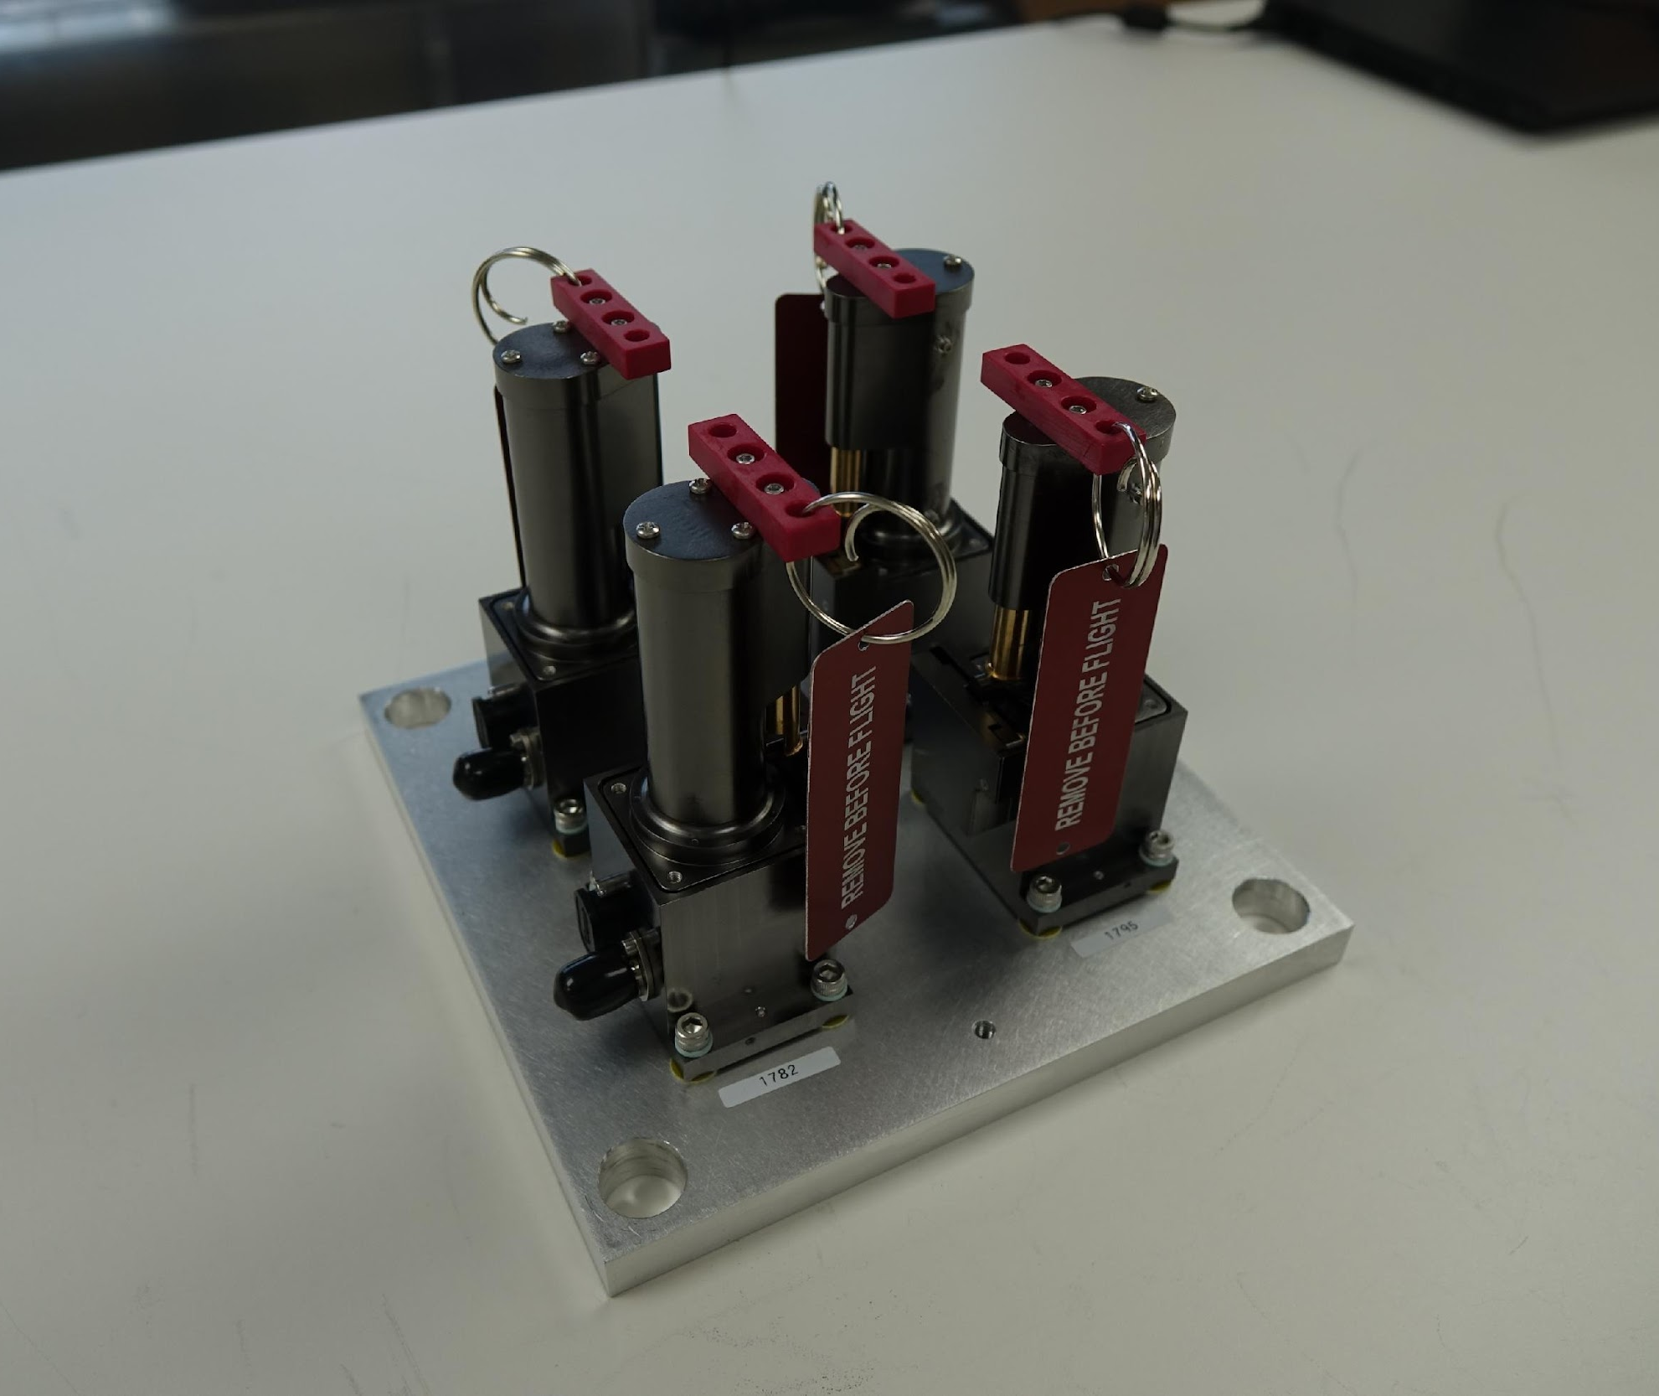
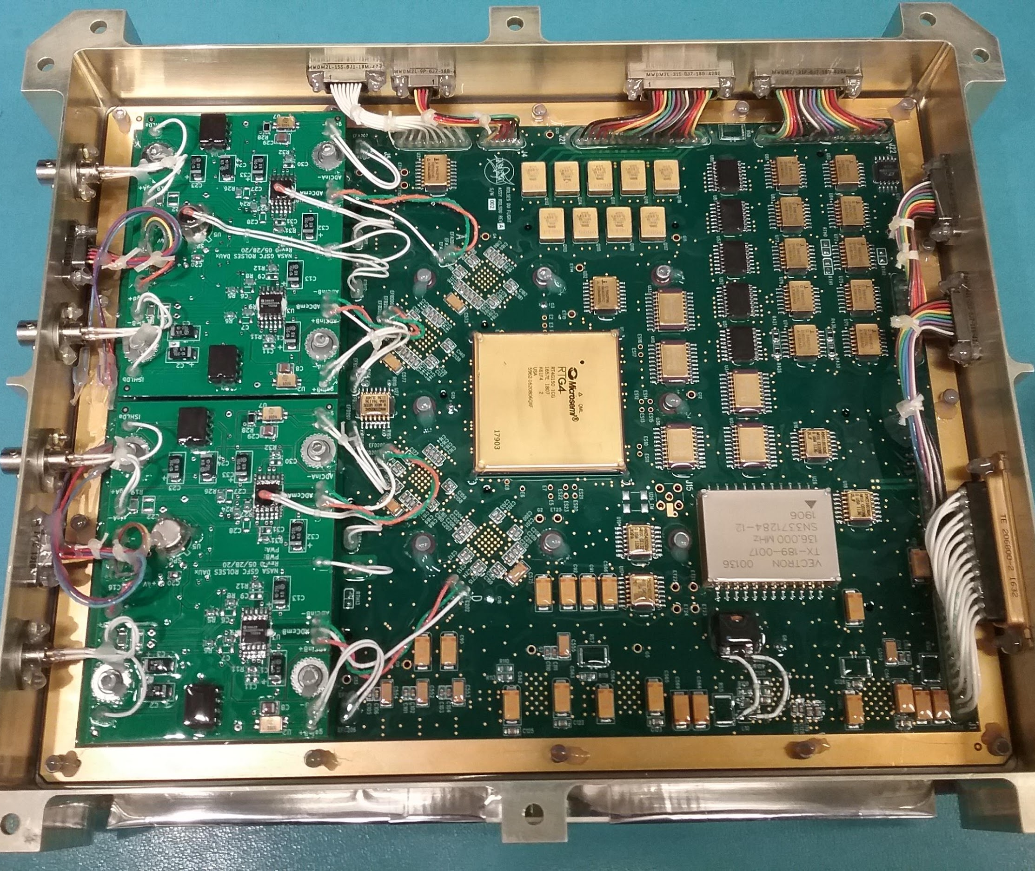
Radio wave Observations at the Lunar Surface of the photo-Electron Sheath (ROLSES)
IM-1 with ROLSES antennas deployed
Stowed STACER antennas
ROLSES spectrometer board
ROLSES Instrument Team: Robert MacDowall (PI), William Farrell, Jack Burns, Damon Bradley, Nat Gopalswamy, Michael Reiner, Ed Wollack, David McGlone, Mike Choi, Scott Murphy, Rich Katz, Igor Kleyner.
ROLSES instrument is a new build with heritage from STEREO/SWAVES & SMAP:
Four 2.5-m monopoles forming cross-dipole antennas.
Radio spectrometer with 2 bands: 10 kHz – 1 MHz and 300 kHz – 30 MHz.
Scheduled to land on lunar nearside using Intuitive Machines (IM-1) Nova-C.

Slide 19
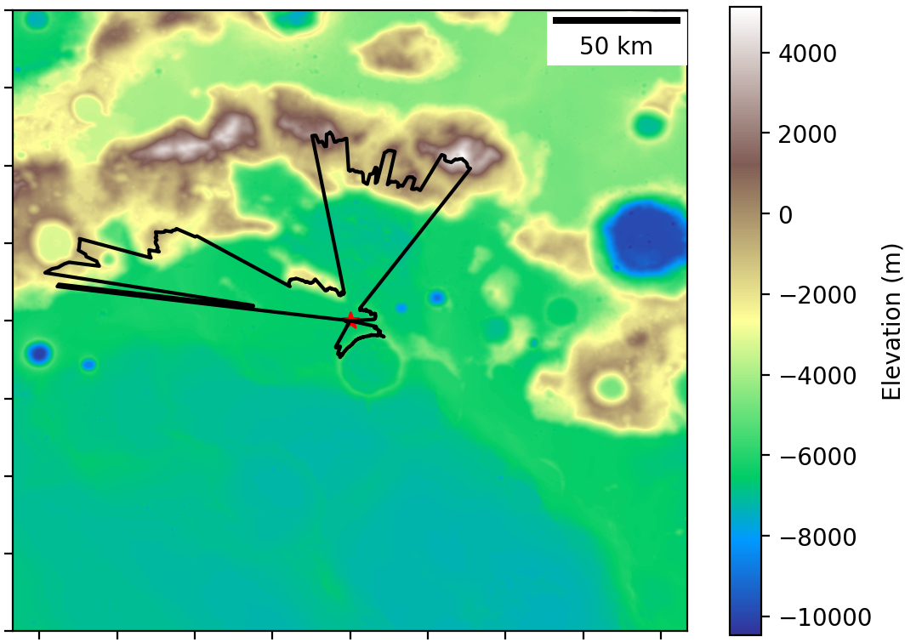
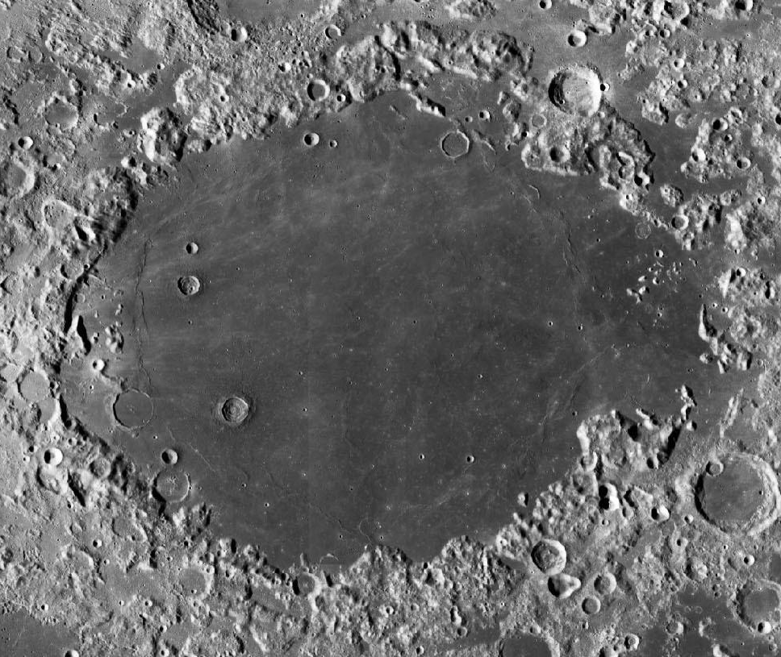
Landing Site for IM-1: Mare Crisium
Horizon code developed from SSERVI funding: Bassett et al. 2021, ApJ, 923, 33.

Slide 20
ROLSES Science Goals
Determine the photoelectron sheath density from ~1 to ~3 m above the lunar surface by measuring electron plasma frequency.
Demonstrate detection of solar, planetary, & other radio emission from lunar surface.
Measure Galactic spectrum at <30 MHz.
Aid development of lunar radio arrays.
Measure the local EM environment, including that from the lander.
Measure reflection of incoming radio emission from lunar surface and below.

Slide 21
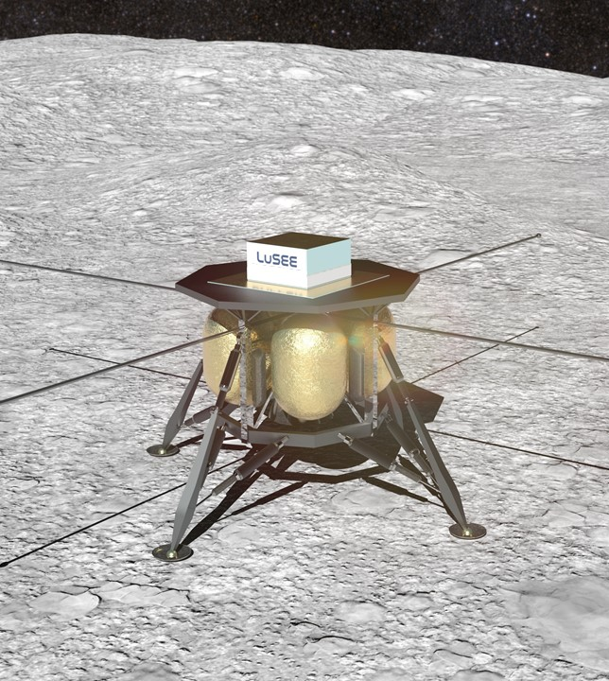
The Lunar Surface Electromagnetics Experiment (LuSEE)
Stuart D. Bale (PI), Keith Goetz, Peter Harvey, John Bonnell, Jack Burns, Thierry Dudok de Wit, Bob MacDowall, David Malaspina, Marc Pulupa, Anze Slosar, Aritoki Suzuki + a big LuSEE science team

Slide 22
Overview

Slide 23
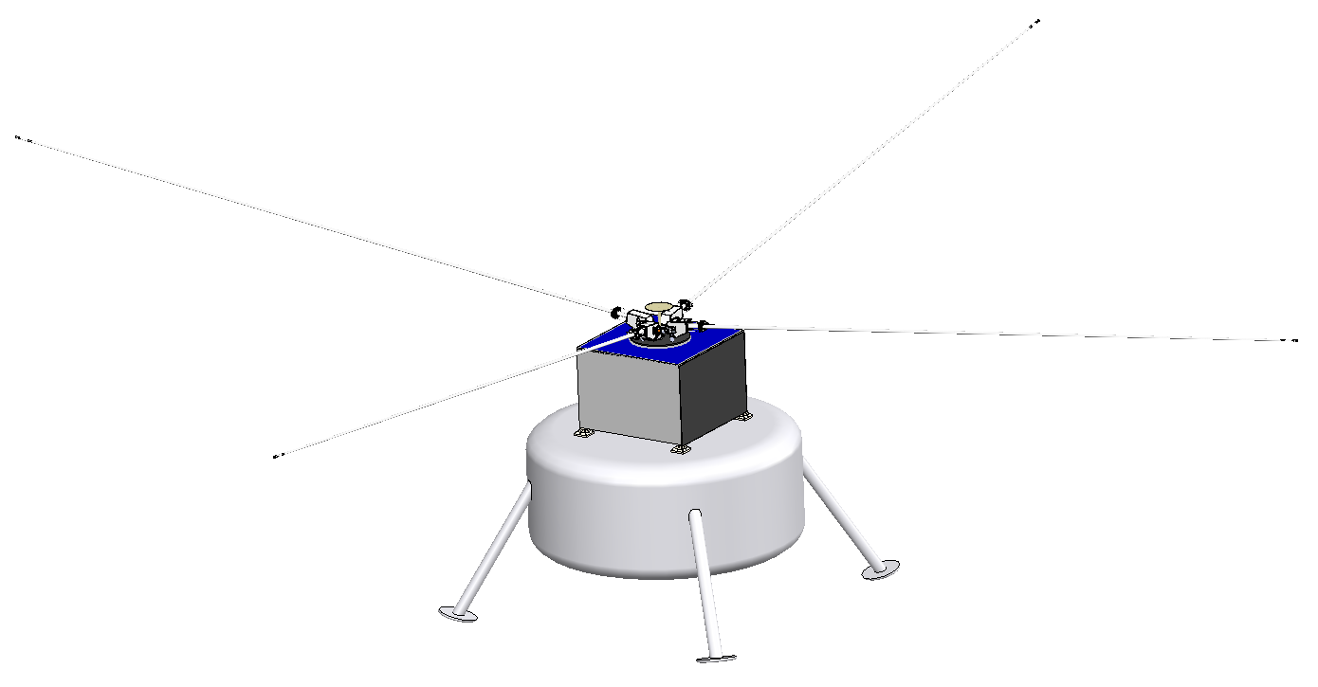
LuSEE ‘Nite’ Design
Major involvement from US DOE (BNL and LBL)
Deployable stacer antennas (STEREO/WAVES)
2-6m TBD
Turntable to change orientation
~ 50 MHz bandwidth (TBD)
On CS-3 CLPS mission with ESA Lunar Pathfinder Relay
Early 2025 landing
Lander will DIE after commissioning
No spacecraft EMI!
Landing site under study
Mid-latitudes
Far side
Slightly south?
Standalone system
Instrument electronics
Battery
Comms (JPL User Terminal)
PRISM FSS-like thermal design

Slide 24
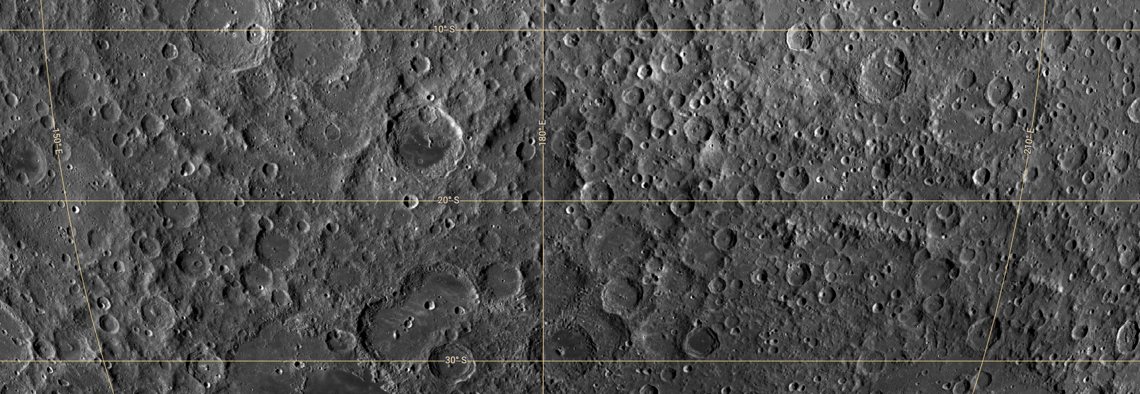
LuSEE-Nite Landing Site: ~10°S- 30°S latitude, 150 °E to 210°E longitude
Location 1:
Location 3:
Regions of Interest:
Location 2:
LROC Wide Angle Camera (WAC) basemap
Low slopes (<10 degrees)
Low likelihood of hazards (e.g. craters and boulders >~1-2 meters in scale)
Low surface roughness
Avoid locations within craters
Maximize amount of visible sky
Not considering a landing site on the floor of a large crater
Location 3:

Slide 25
Summary and Conclusions
DM has an effect upon the thermal evolution of the high-redshift Universe.
A measurement of the global signal would thus allow us to characterize DM in epochs never before tested where its effects should be quite apparent.
We can constrain the WDM thermal mass to reasonable limits, even including multiple source populations and star formation parametrizations.
The stronger the effects of Pop III stars, the better the constraints on the WDM thermal mass.
Two radio telescopes are going to the Moon within the next five years as part of the NASA CLPS program to make the first lunar observations of the 21-cm signal and characterize the lunar systematics.

Slide 26
EXTRA SLIDES

Slide 27
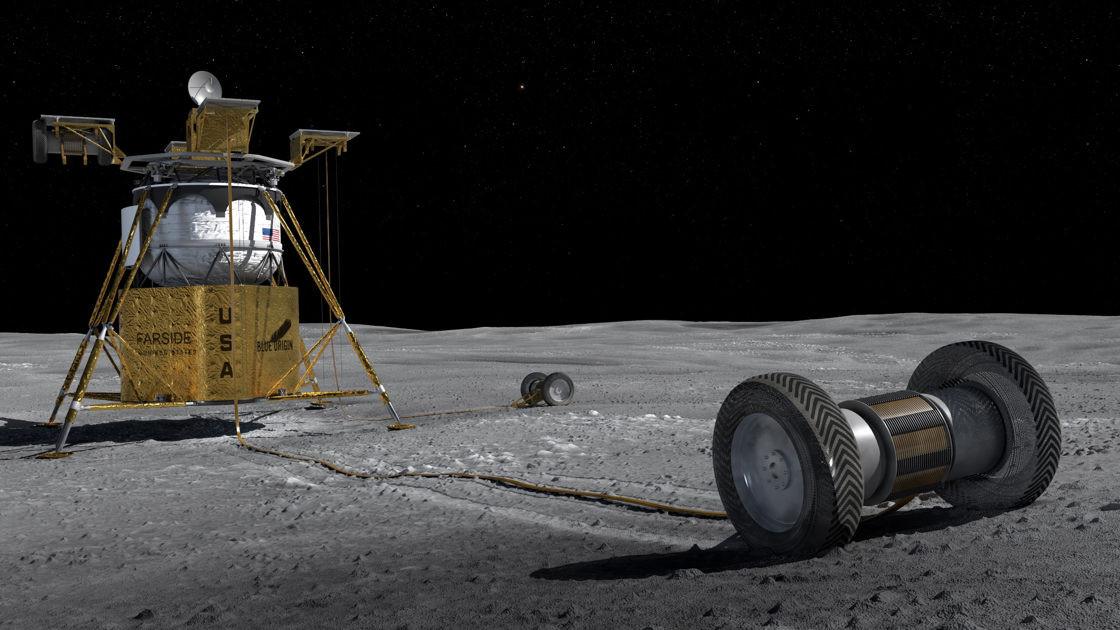
FARSIDE: Farside Array for Radio Science Investigations of the Dark ages and Exoplanets
Principal Investigator:
Deputy P.I.:
Design Lead:
Jack Burns, University of Colorado Boulder
Gregg Hallinan, Caltech
Lawrence Teitelbaum, JPL
Illustration: P. McGarey, JPL
Image courtesy of Blue Origin, Inc.

Slide 28
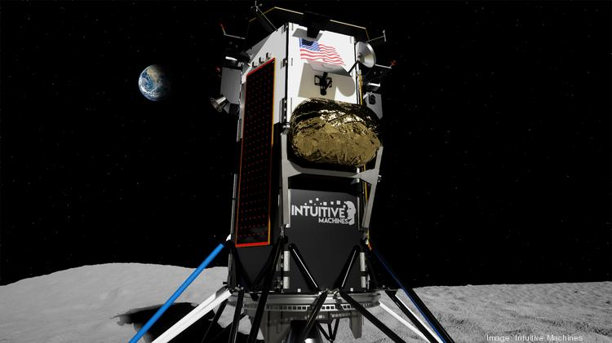
The Path Forward
NASA’s CLPS program is a high risk/high reward program that could be a game-changer with regular access to the lunar surface 2-3 times per year.
The first NASA radio science payload, ROLSES, is planned to land on the near side later this year. It will measure the photo-electron sheath near the surface, the Galaxy spectrum at <30 MHz, and the EM interaction with the dielectric lunar subsurface.
LuSEE is planned for a landing on the far side in 2025. Batteries will allow operation during the lunar night for the first time. Observations from 1-100 MHz, corresponding to the early Universe’s Dark Ages and Cosmic Dawn, are planned.
These CLPS radio science missions will prepare the way for a future array of low frequency radio antennas on the lunar surface.

Slide 29
NASA Commercial Payload Services (CLPS)
“NASA’s Commercial Lunar Payload Services (CLPS) initiative allows rapid acquisition of lunar delivery services from commercial companies for payloads that advance capabilities for science, exploration or commercial development of the Moon…under the Artemis approach”
Delivery Timeline
Astrobotic will carry 11 payloads to Lacus Mortis, a larger crater on the near side of the Moon.
Intuitive Machines will carry six payloads, including our ROLSES radio science experiment, to Mare Crisium on the lunar near side with landing expected by end of the year.

Slide 30
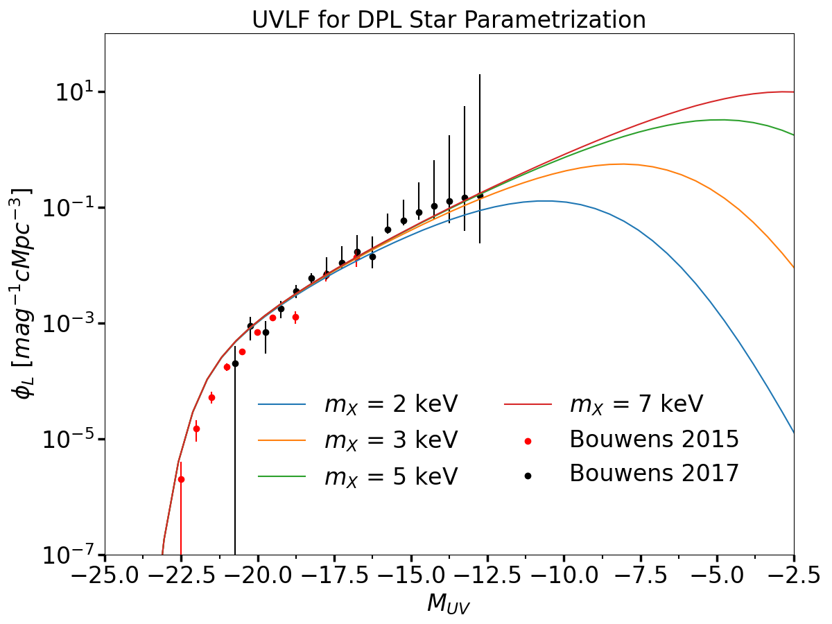
DPL UV-Luminosity Functions
We can use the observations of high-redshift (z ~ 6), Pop II UVLFs to help constrain the SFE of the DPL model.
Figure from Hibbard et al. 2022

Slide 31
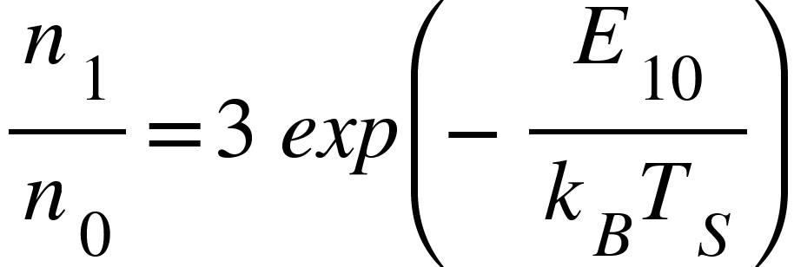
The Spin Temperature T_{S}
Quantifies the number of states in the triplet versus singlet state.
Depends upon things like collisions and the background radiation field.
HI
HI
HI

