Slide 1


Proposals for searches of scalar field dark matter using cavity resonators
08 August 2022
Victor V. Flambaum, Ben McAllister, Igor B. Samsonov, and Michael E. Tobar
arXiv: 2207.14437

Slide 2
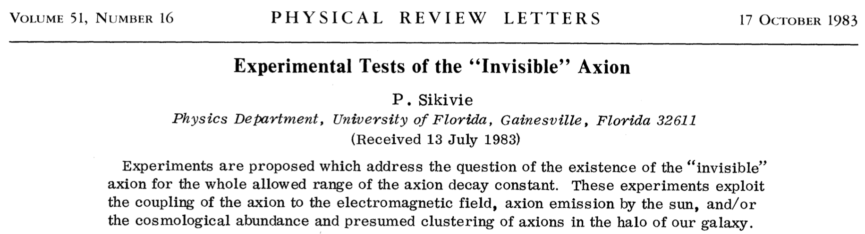
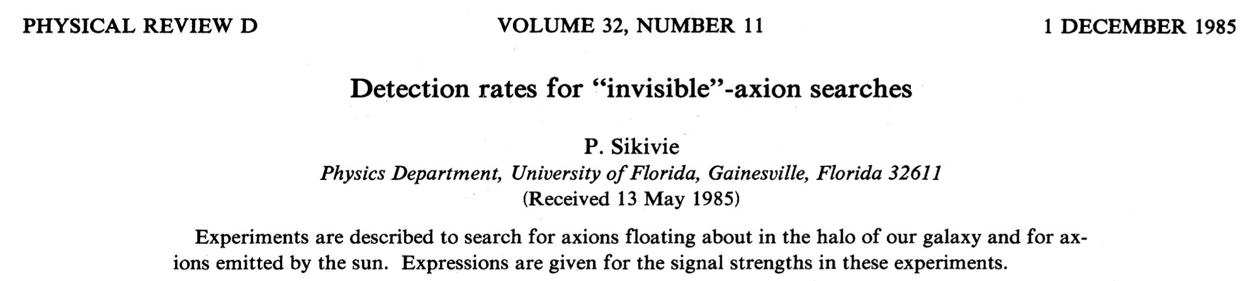
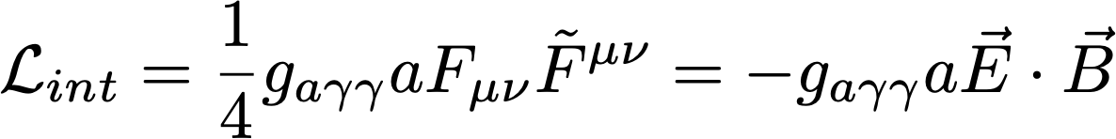
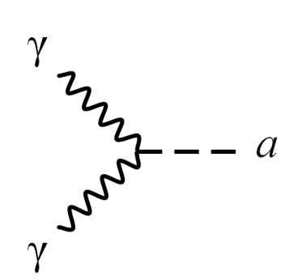
Introduction: The axion story
axion-photon coupling constant

Slide 3
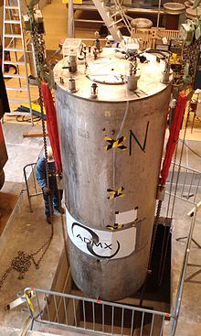
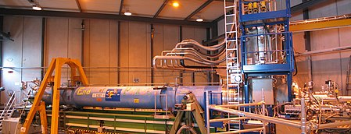
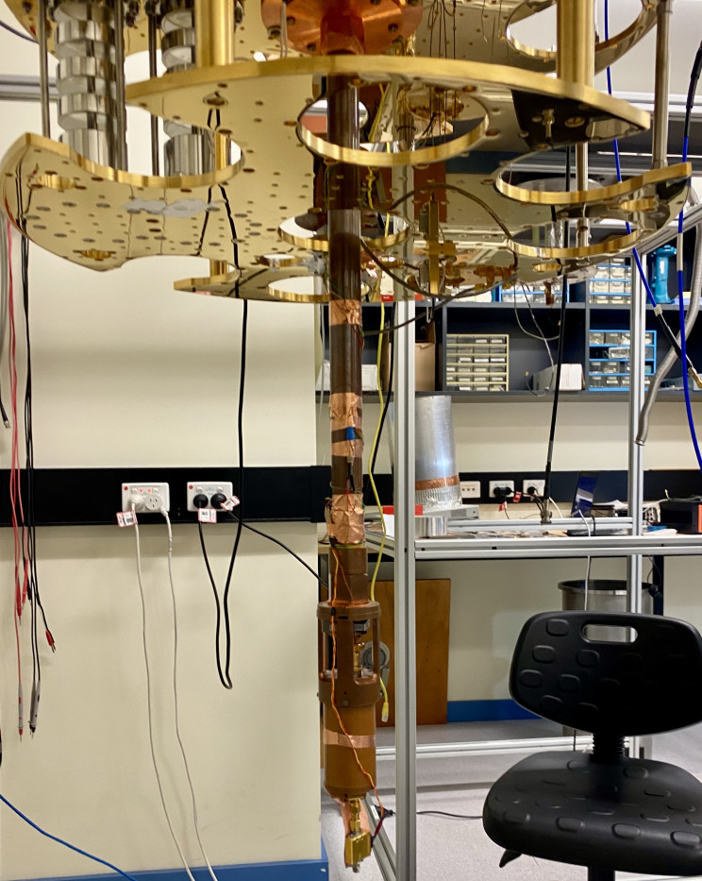
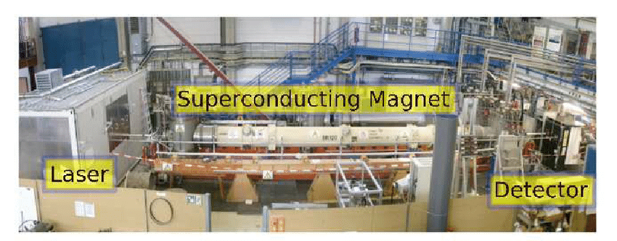
Introduction: Axion detection experiments
ADMX
CAST
ORGAN
Light shining through a wall
And others…

Slide 4
Introduction: scalar field dark matter
scalar-photon coupling constant
φ is a dilaton-like scalar field motivated by e.g. string theory
Are axion-search experiments sensitive to the scalar-photon coupling g_{φγγ}?
How to maximize the sensitivity of these experiments to g_{φγγ}?
New experimental techniques for searching scalar dark matter with the dilaton-like interaction?

Slide 5
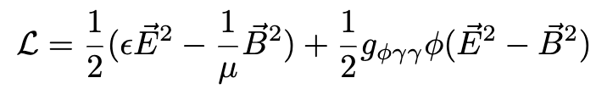

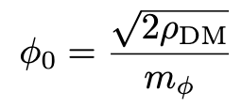
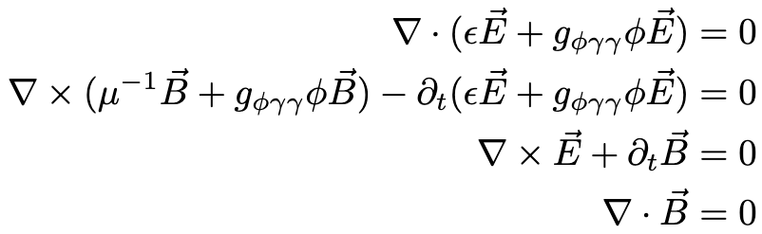
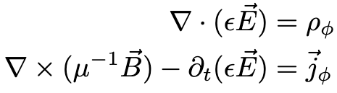
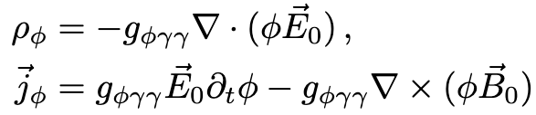
Theory: scalar-photon interaction
local DM density
dielectric
constant
magnetic
susceptibility
plane-wave solution
scalar photon
interaction
scalar field mass
Modified Maxwell equations
E₀ and B₀ are static background electric and magnetic fields
effective charge and current densities

Slide 6
Theory: Scalar-photon transformation
Photon signal power
Compare with the power of axion-photon transformation
[P. Sikivie, Phys. Rev. D 32, 2988 (1985)]

Slide 7
Theory: Scalar-photon transformation (E₀=0)
β=10⁻³ is the velocity of DM particles
β²=10⁻⁶ is the suppression; sin²θ is responsible for signal modulation
CAST experiment searches for axions produced in the Sun with β=1
CAST experiment is equally sensitive to both axions and scalars thermally produced in the Sun!

Slide 8
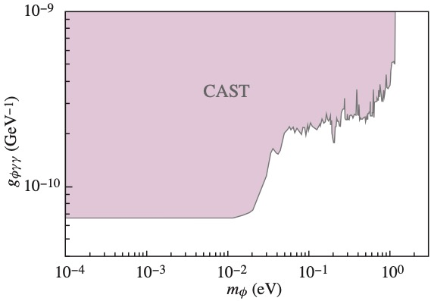
Results: Limits from CAST Experiment
Derived from Ref. [CAST Collaboration, Nature Physics 13, 584 (2017)] with a graphical accuracy

Slide 9
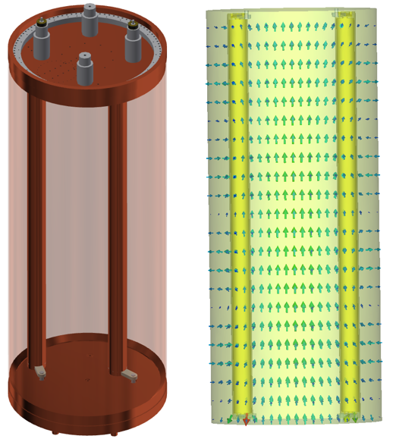
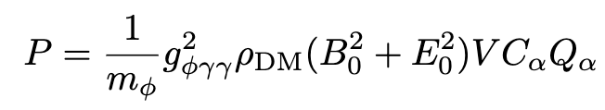
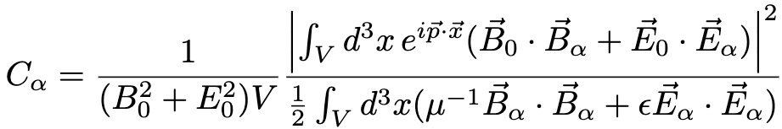
Theory: Transformation in a resonant cavity
Scalar field signal power in a cavity
with electric E₀ and magnetic B₀ fields
Axion signal
[Sikivie 1985]
B₀
Q_{α} is quality factor and C_{α} is the form factor
Signal power
volume
Form factor
quality factor
Ε_{α} and B_{α} are eigenmodes of electric and magnetic fields in the cavity

Slide 10
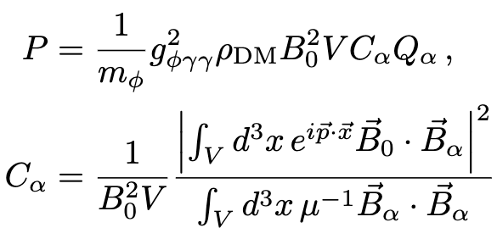
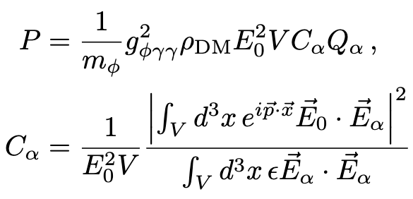
Theory: Transformation in a resonant cavity
Cavity permeated by magnetic field B₀
Cavity permeated by electric field E₀

Slide 11


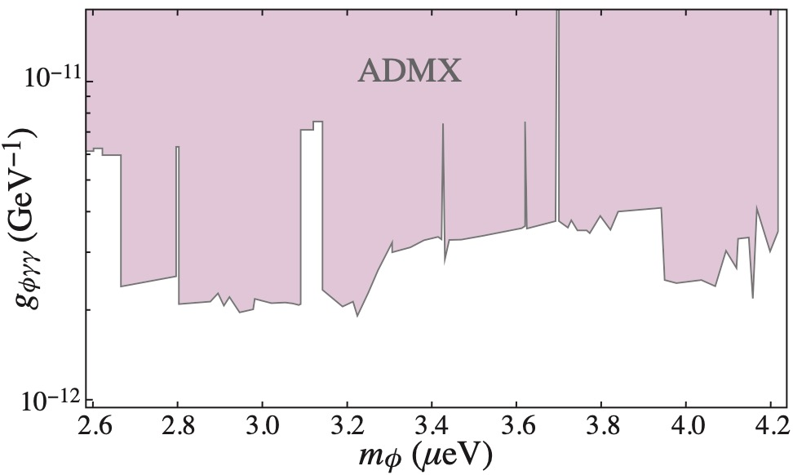
Results: Constraints from ADMX
ADMX cavity scalar field form factor
ADMX sidecar scalar field form factor
Upper limits on the scalar-photon coupling constant

Slide 12
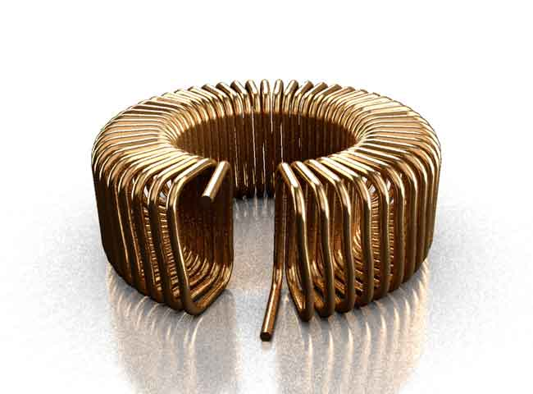
Results: Cavity resonators proposals with maximized form factors to the scalar field DM

Slide 13
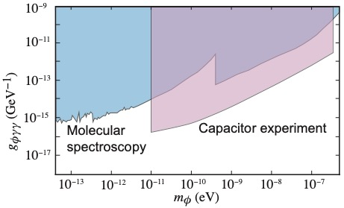
Results: Proposal for a broadband detection with a capacitor
Estimated sensitivity of such experiment
Effective polarization
Signal is AC voltage
Applied voltage
R. Oswald et al. arXiv:2111.06883 [hep-ph].

Slide 14
Summary
Calculated the power of photon signal from scalar photon transformation in a resonant cavity
New limits on the scalar-photon coupling constant from re-purposing the results of CAST and ADMX experiments
Proposals for cavity experiments with maximized sensitivity to the scalar field dark matter
A capacitor-based broadband experiment is proposed

