Slide 1
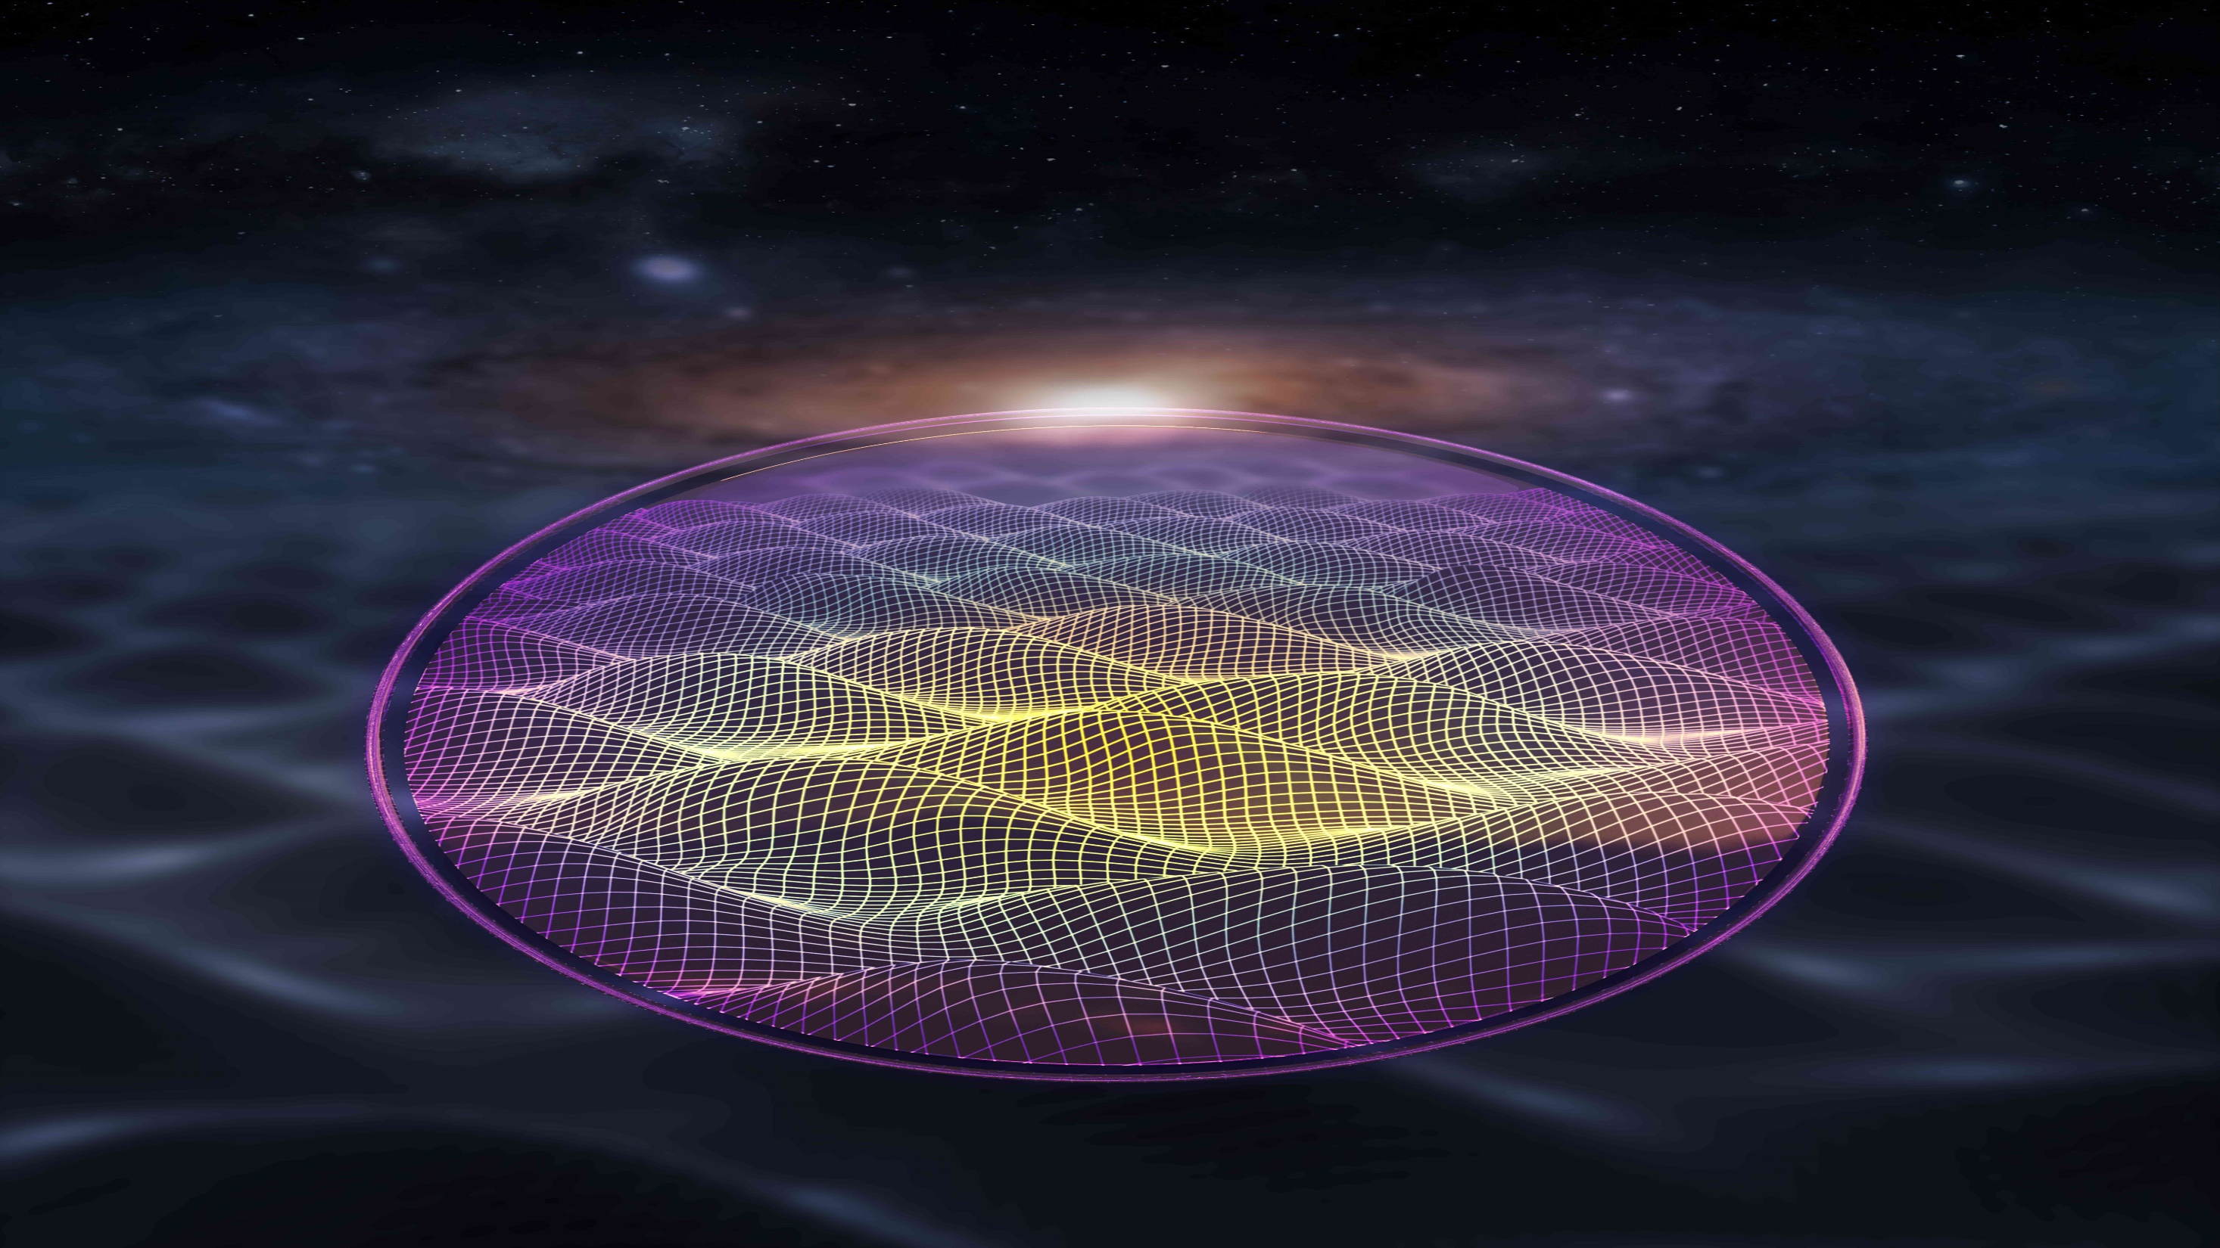
The quantum limits on magnetic resonance searches for axion-like dark matter
Alex Sushkov, for the CASPEr collaboration

Slide 2
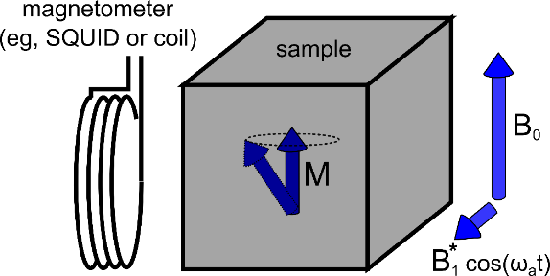
Main points and a promise
▪ magnetic resonance searches for axion-like dark matter use spin ensembles as transducers → flexibility to maximize sensitivity
▪ first-generation CASPEr searches are operating at design sensitivity
▪ CASPEr experiments are moving towards spin projection noise-limited sensitivity
▪ achieving QCD axion sensitivity is feasible with 10cm-scale CASPEr-e experiment
spin squeezing may enable reaching QCD axion sensitivity with a smaller-scale experiment
[A. Gramolin et al., Phys. Rev. D 105, 035029 (2022)]
[A. Gramolin et al., Nature Physics 17, 79 (2021)]
[D. Aybas et al., Quant. Sci. Tech. 6, 034007 (2021)]
[G. Centers et al., Nature Comms 12, 7321 (2021)]
[D. Aybas et al., Phys. Rev. Lett. 126, 160505 (2021)]
[A. Garcon et al., Sci. Adv. 5, eaax4539 (2019)]

Slide 3
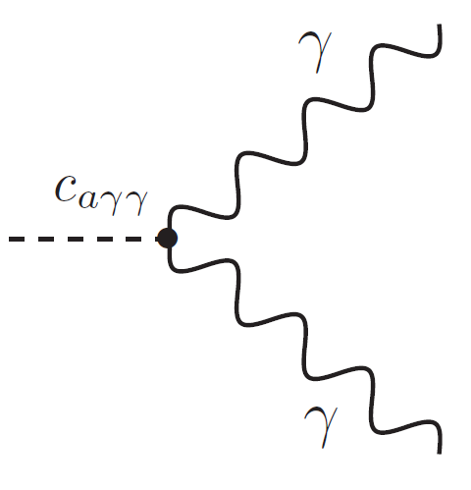
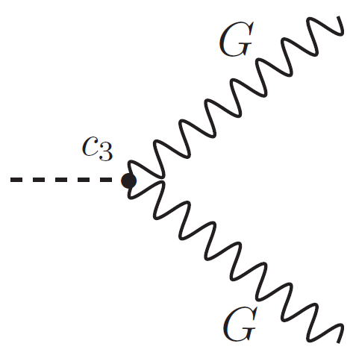
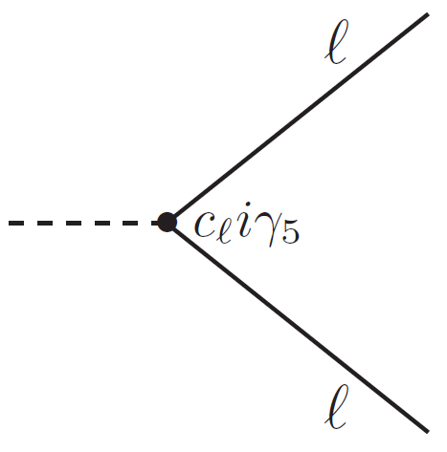
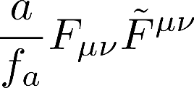
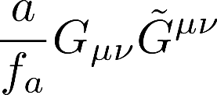
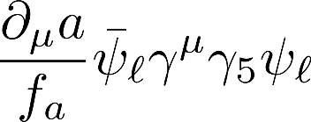
Magnetic resonance searches for axion-like dark matter
Pseudoscalar light particle: spin = 0, wide range of possible masses
Proposed to solve the strong CP problem of Quantum Chromodynamics
Axion-like particles (ALPs) arise naturally in string theories, symmetries broken at GUT (10¹⁶ GeV) or Planck (10¹⁹ GeV) scales
Well-motivated and thoroughly-studied dark matter candidate:
Only 3 possible (non-gravitational) interactions with standard model particles:
[Phys. Rev. D 98, 035017 (2018)]
[Phys. Rev. Lett. 38, 1440 (1977)]
interaction with photons:
interaction with gluons:
(defines QCD axion)
interaction with leptons:
ALP field amplitude
symmetry breaking scale
→ ALP ↔ photon conversion in a magnetic field → precision electromagnetic sensors
→ nuclear spin interacts with an oscillating electric dipole moment (EDM) in presence of
effective electric field .
→ nuclear spin interacts with an effective magnetic field .
co-magnetometers force mediator → ARIADNE electron spin → QUAX
ADMX, HAYSTAC, DMradio, SHAFT, ABRA, ALPS, CAST, IAXO, CAPP, ORGAN, BREAD, SLIC, LC circuit, MADMAX, KLASH, BRASS, many others
EDM re-analysis, srEDM
CASPEr-electric
CASPEr-gradient
[Rev. Mod. Phys. 93, 015004 (2021)]
[arXiv:2203.14923 (2022)]

Slide 4
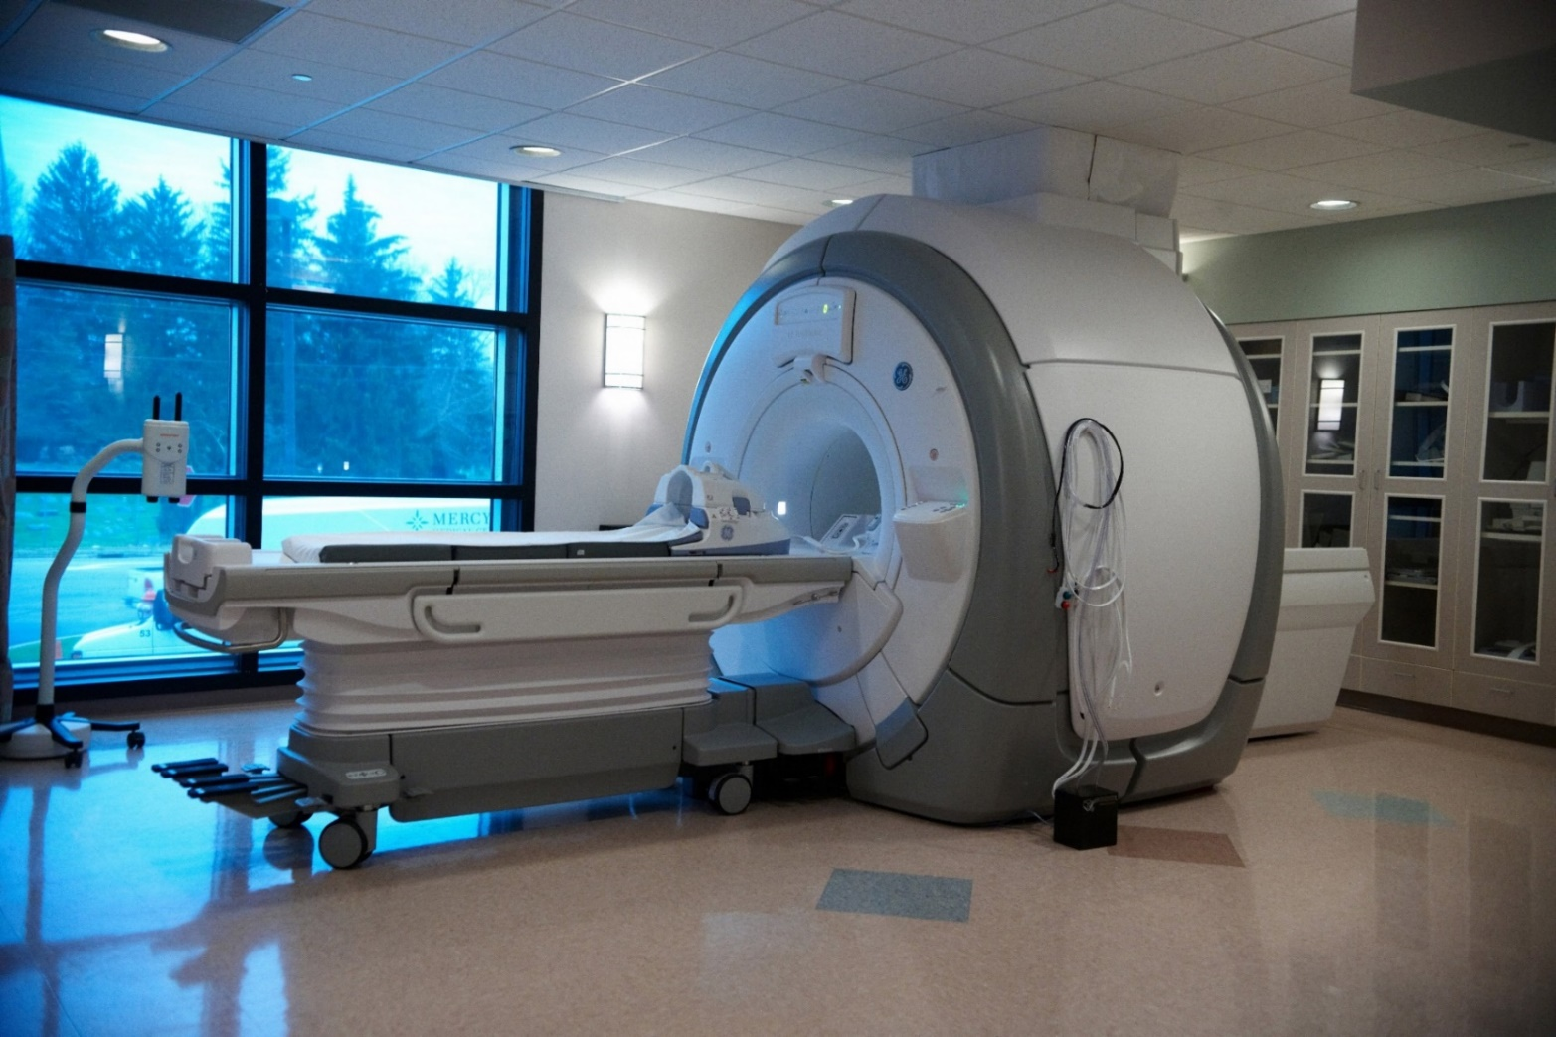
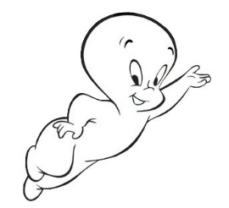
Aside: magnetic resonance
CASPEr is similar to NMR
MRI scanner

Slide 5
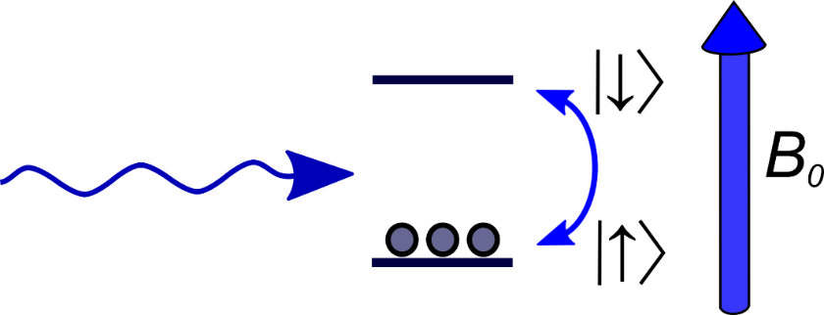
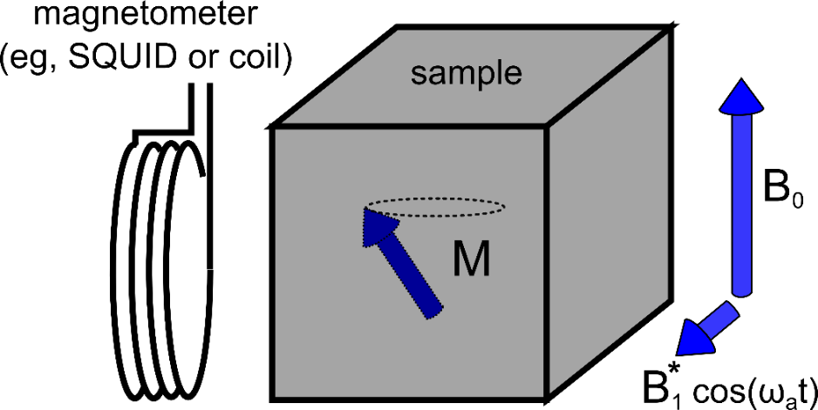
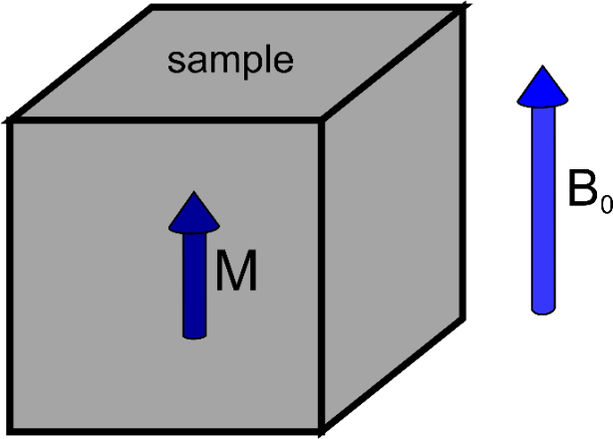
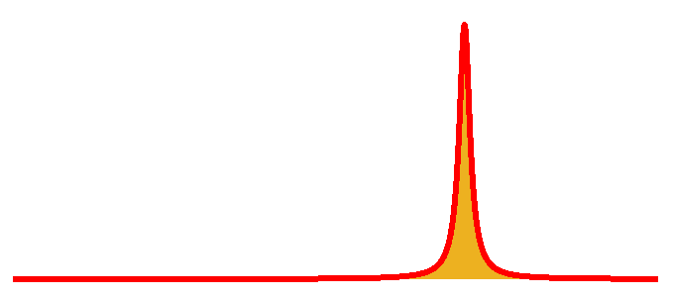
Aside: magnetic resonance
(nuclear gyromagnetic ratio)
CASPEr is similar to NMR
interaction:
constant bias magnetic field B₀
radiofrequency (RF) magnetic field B₁cosω₀t
1) place a spin-1/2 into an external magnetic field splits the spin states by
2) spin polarization (thermal or optical) in a cm³ sample
3) resonance:
RF magnetic field can now flip spins!
sample magnetization tilts and precesses
4) a magnetometer next to the sample detects the magnetic field created by this precessing magnetization
signal spectrum
a tool for non-invasive imaging (MRI, EPR) and studying molecular structure (NMR)
frequency

Slide 6
Axion-like dark matter → pseudo-magnetic field
CASPEr-electric
CASPEr-gradient
axion (or ALP) field
→ ALP Compton frequency
→ dark matter density
effective magnetic field due to ALP dark matter
oscillating at ALP Compton frequency
nuclear spin
[D. Budker et al., Phys. Rev. X 4, 021030 (2014)]

Slide 7
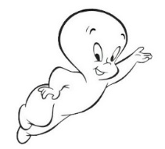
Searching for axionic coupling to spin with magnetic resonance
effective interaction:
constant bias magnetic field B₀
spin-axion interaction plays the role of the RF field B₁
1) placing a spin-1/2 into an external magnetic field splits the spin states by
2) spin polarization (thermal or optical) in a cm³ sample
3) resonance:
axion-spin interaction can now flip spins!
sample magnetization tilts and precesses
4) a magnetometer next to the sample detects the magnetic field created by this precessing magnetization
5) search for unknown frequency by sweeping bias magnetic field , look for resonance
signal spectrum
[D. Budker et al., Phys. Rev. X 4, 021030 (2014)]
an NMR experiment with no RF magnetic field, instead axion-like dark matter flips spins
frequency

Slide 8
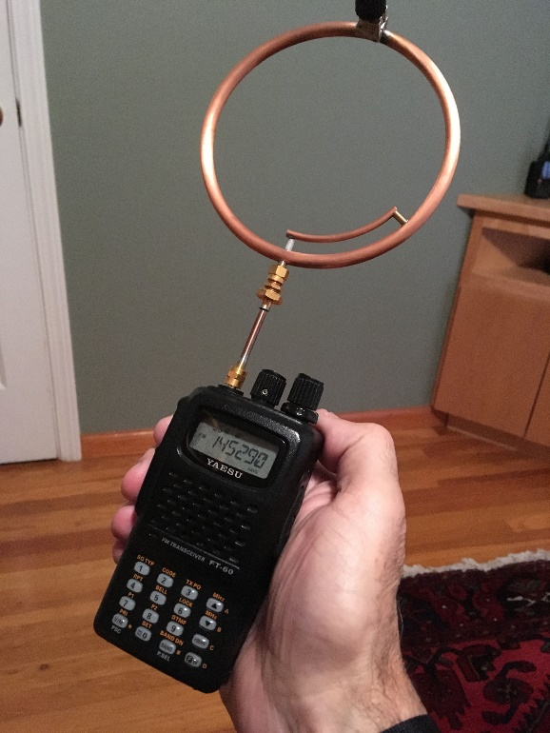
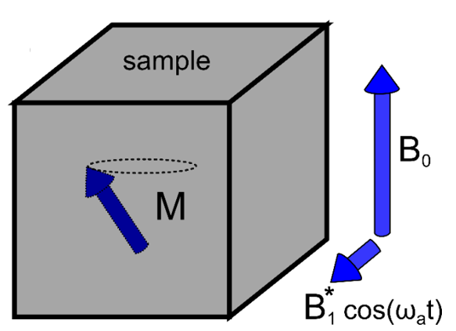
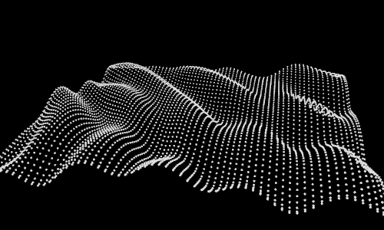
Spin ensemble as the transducer for axion-like dark matter
spin ensemble acts as the transducer
electromagnetic sensor measures spin ensemble evolution
axion-like dark matter
flexibility to optimize spin ensemble parameters to optimize transducer efficiency → maximize sensitivity
[A. Gramolin et al., Phys. Rev. D 105, 035029 (2022)]
[A. Gramolin et al., Nature Physics 17, 79 (2021)]
[D. Aybas et al., Quant. Sci. Tech. 6, 034007 (2021)]
[G. Centers et al., Nature Comms 12, 7321 (2021)]
[D. Aybas et al., Phys. Rev. Lett. 126, 160505 (2021)]
[A. Garcon et al., Sci. Adv. 5, eaax4539 (2019)]
[D. Budker et al., Phys. Rev. X 4, 021030 (2014)]

Slide 9
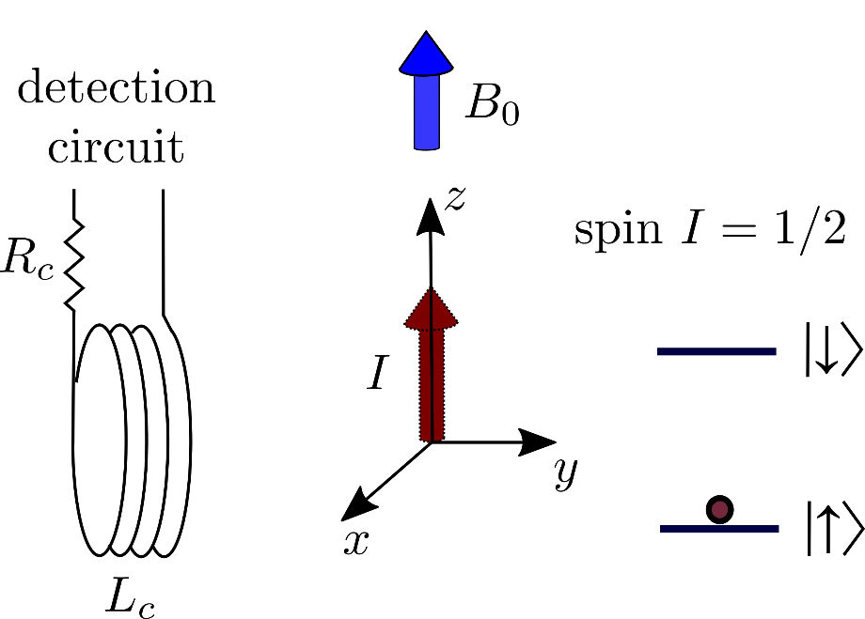
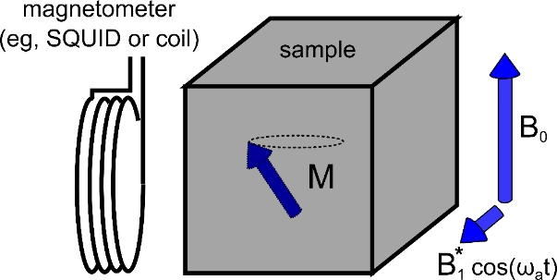
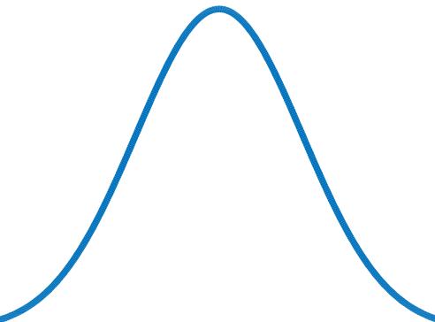
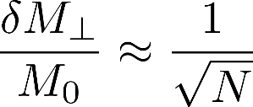
Fundamental quantum noise: spin projection noise (standard quantum limit)
detected spectrum with a noiseless detection circuit
magnetization
probability
frequency
spin projection measurement uncertainty
standard quantum limit (SQL):
spin projection noise has been detected in NMR experiments
[T. Sleator et al., Phys. Rev. Lett 55, 1742 (1985)]
[M.A. McCoy, R.R. Ernst., Chem. Phys. Lett. 159.5, 587 (1989)]
S_{y} spin projection
[M. Gueron, J. L. Leroy., J. Mag. Res. 85.1, 209 (1989)]
how to build an NMR experiment with sensitivity limited by spin projection noise?
[F. Bloch, Phys. Rev. 7-8, 460 (1946)]

Slide 10
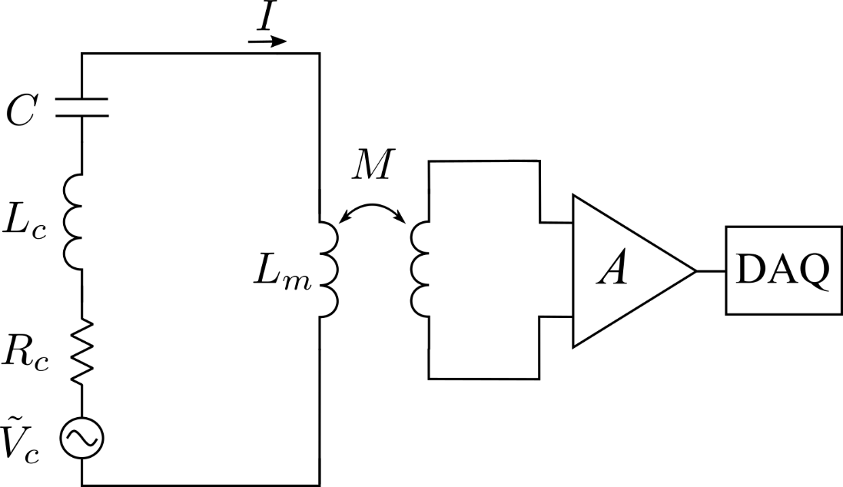
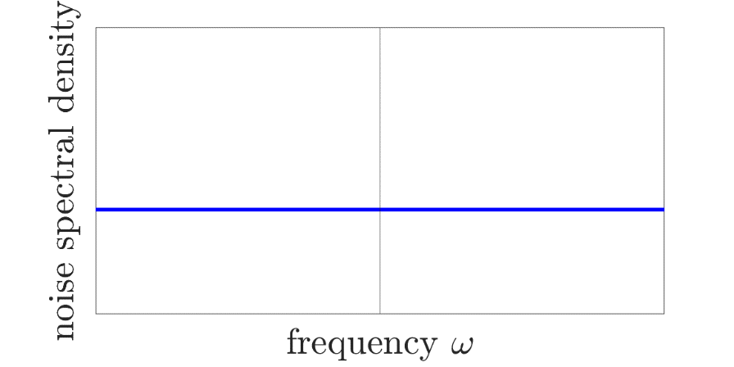
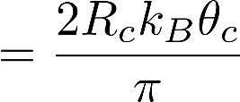
What do we need to do to build an NMR experiment limited by spin projection noise?
resonant detection circuit with a noiseless amplifier:
circuit Johnson noise
Johnson noise in circuit resistor:
circuit temperature
noise spectral density
[D. Aybas et al., Quant. Sci. Tech. 6, 034007 (2021)]

Slide 11
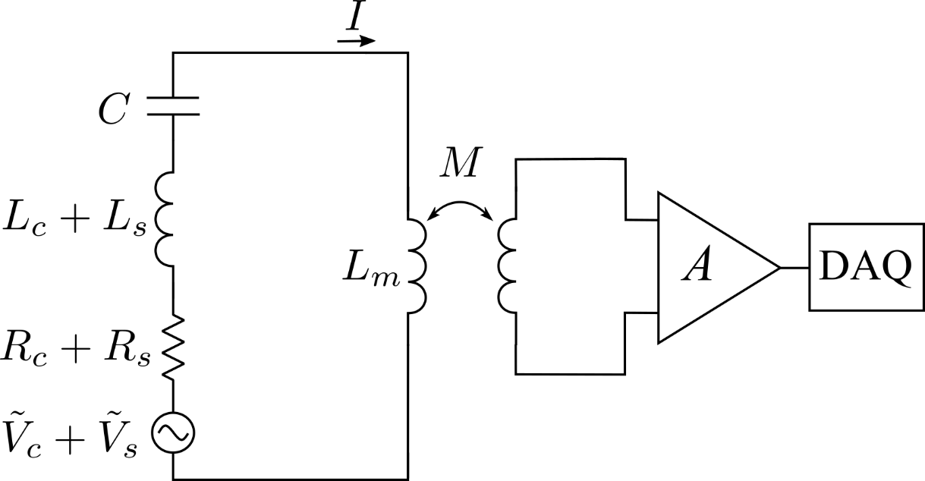
What do we need to do to build an NMR experiment limited by spin projection noise?
NMR sample + resonant detection circuit with a noiseless amplifier:
circuit Johnson noise
Johnson noise in circuit resistor:
circuit temperature
noise spectral density

Slide 12
What do we need to do to build an NMR experiment limited by spin projection noise?
NMR sample + resonant detection circuit with a noiseless amplifier:
circuit Johnson noise
Johnson noise in circuit resistor + spin projection noise:
spin temperature
filling factor

Slide 13
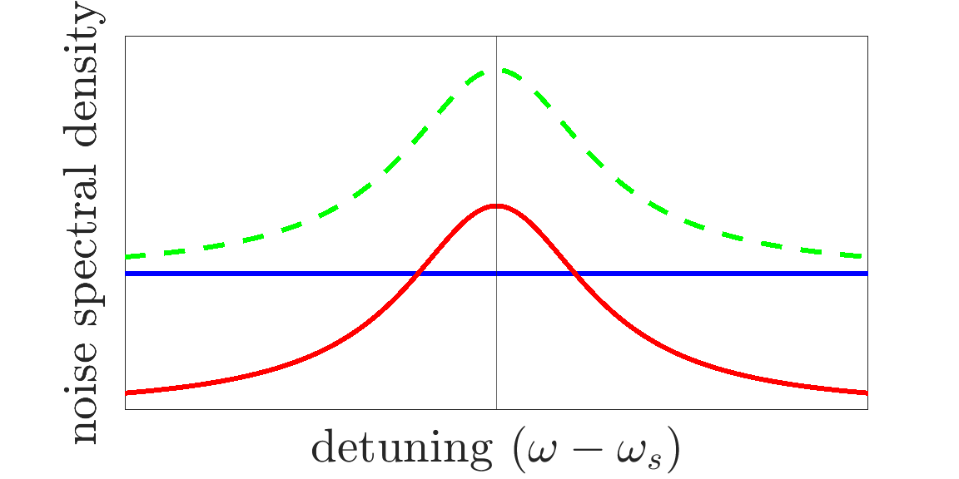
What do we need to do to build an NMR experiment limited by spin projection noise?
NMR sample + resonant detection circuit with a noiseless amplifier:
total noise
circuit Johnson noise
spin projection noise
spin Larmor frequency:
condition for an experiment limited by spin projection noise:
Johnson noise in circuit resistor + spin projection noise:
spin temperature
CASPEr-gradient at Mainz
filling factor
[D. Aybas et al., Quant. Sci. Tech. 6, 034007 (2021)]

Slide 14
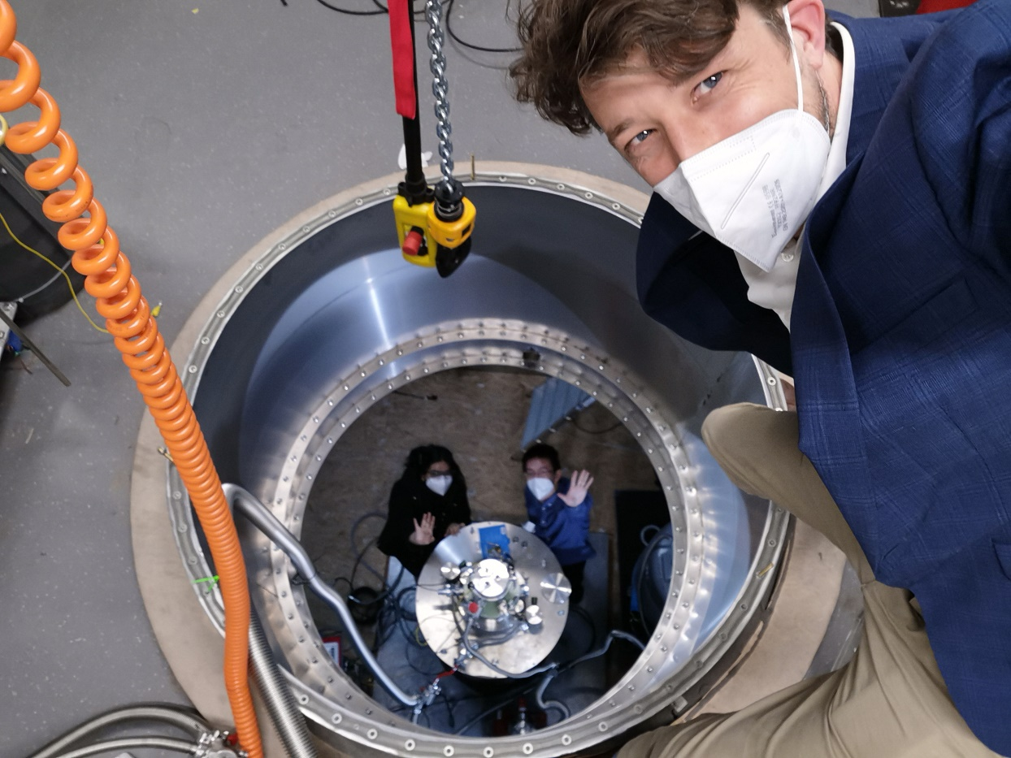
Mainz CASPEr-gradient search for the gradient coupling
CASPEr-gradient at Mainz
total noise
circuit Johnson noise
spin projection noise
spin Larmor frequency:
condition for an experiment limited by spin projection noise:
liquid ¹²⁹Xe NMR apparatus in a high-homogeneity magnet
CASPEr-gradient at Mainz
[D. Aybas et al., Quant. Sci. Tech. 6, 034007 (2021)]

Slide 15
What do we need to do to build an NMR experiment limited by spin projection noise?
NMR sample + resonant detection circuit with a noiseless amplifier:
total noise
circuit Johnson noise
spin projection noise
spin Larmor frequency:
condition for an experiment limited by spin projection noise:
Johnson noise in circuit resistor + spin projection noise:
spin temperature
CASPEr-electric at Boston
filling factor
[D. Aybas et al., Quant. Sci. Tech. 6, 034007 (2021)]

Slide 16
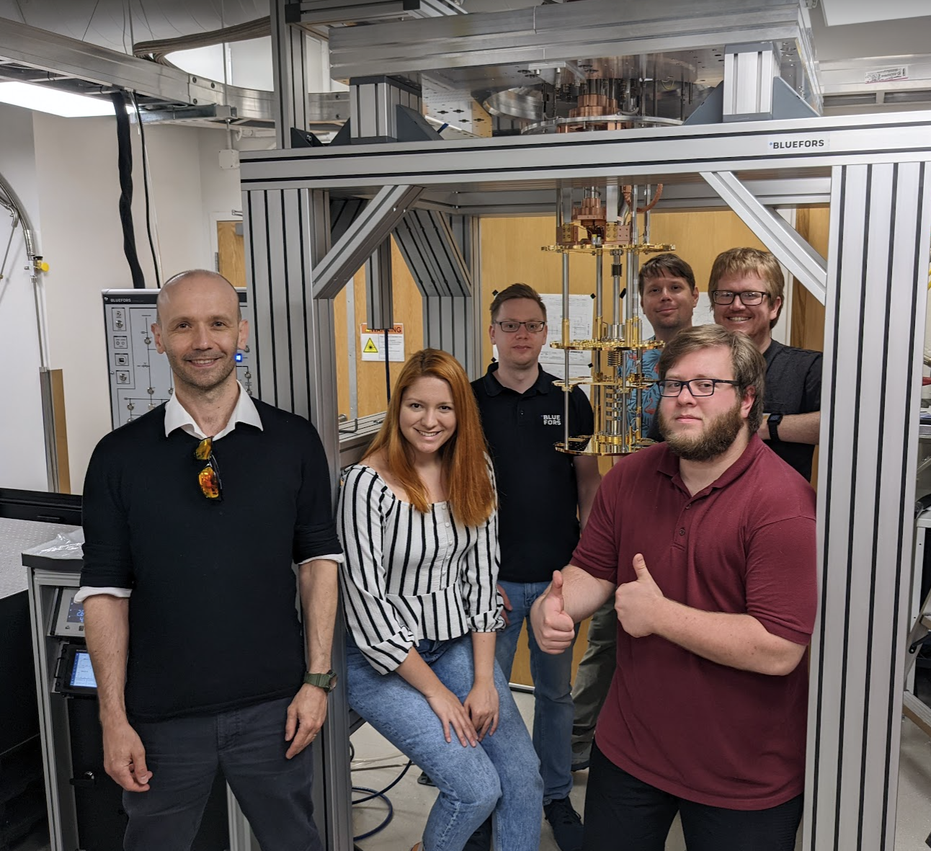
Boston CASPEr-electric search for the EDM coupling
CASPEr-electric at Boston
total noise
circuit Johnson noise
spin projection noise
spin Larmor frequency:
condition for an experiment limited by spin projection noise:
solid-state NMR apparatus in a BlueFors dilution refrigerator
spin projection noise-limited NMR search for axion-like dark matter
CASPEr-electric at Boston
[D. Aybas et al., Quant. Sci. Tech. 6, 034007 (2021)]

Slide 17
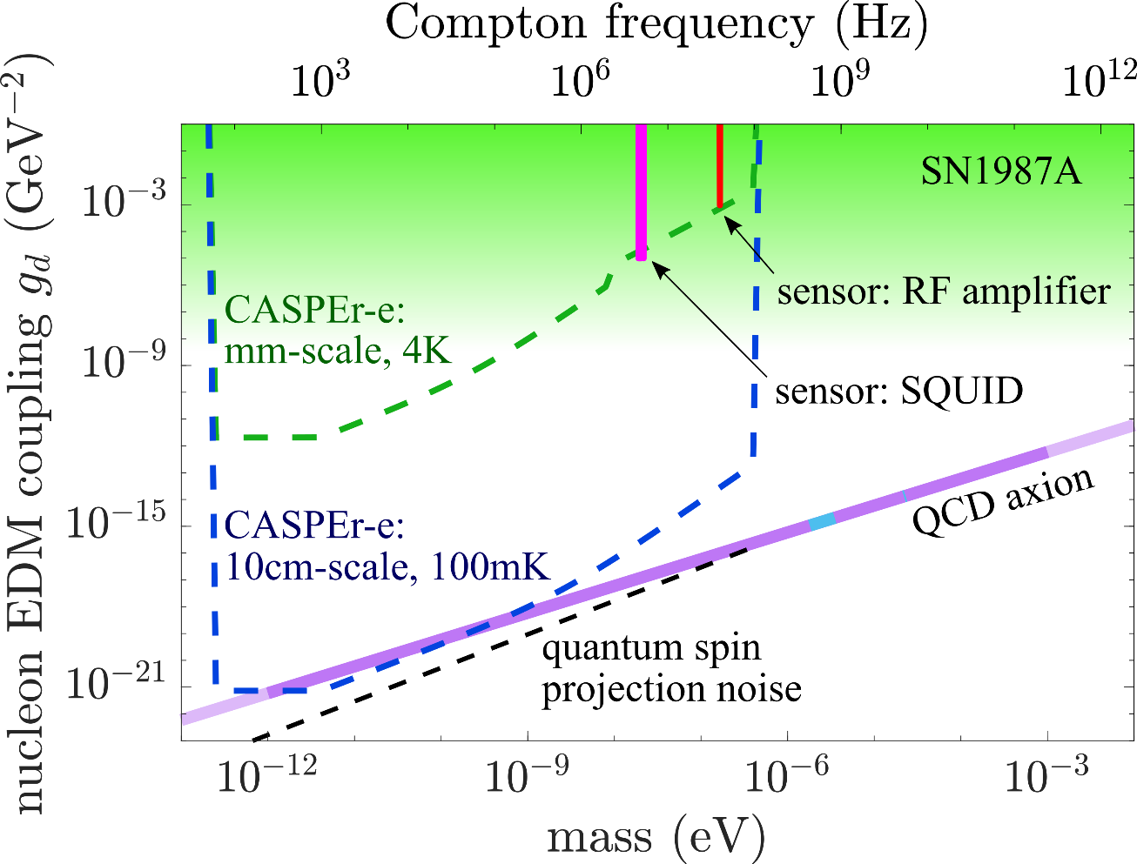
Boston CASPEr-electric search for the EDM coupling
solid-state NMR apparatus in a BlueFors dilution refrigerator
spin projection noise-limited NMR search for axion-like dark matter
[D. Aybas et al., Quant. Sci. Tech. 6, 034007 (2021)]

Slide 18
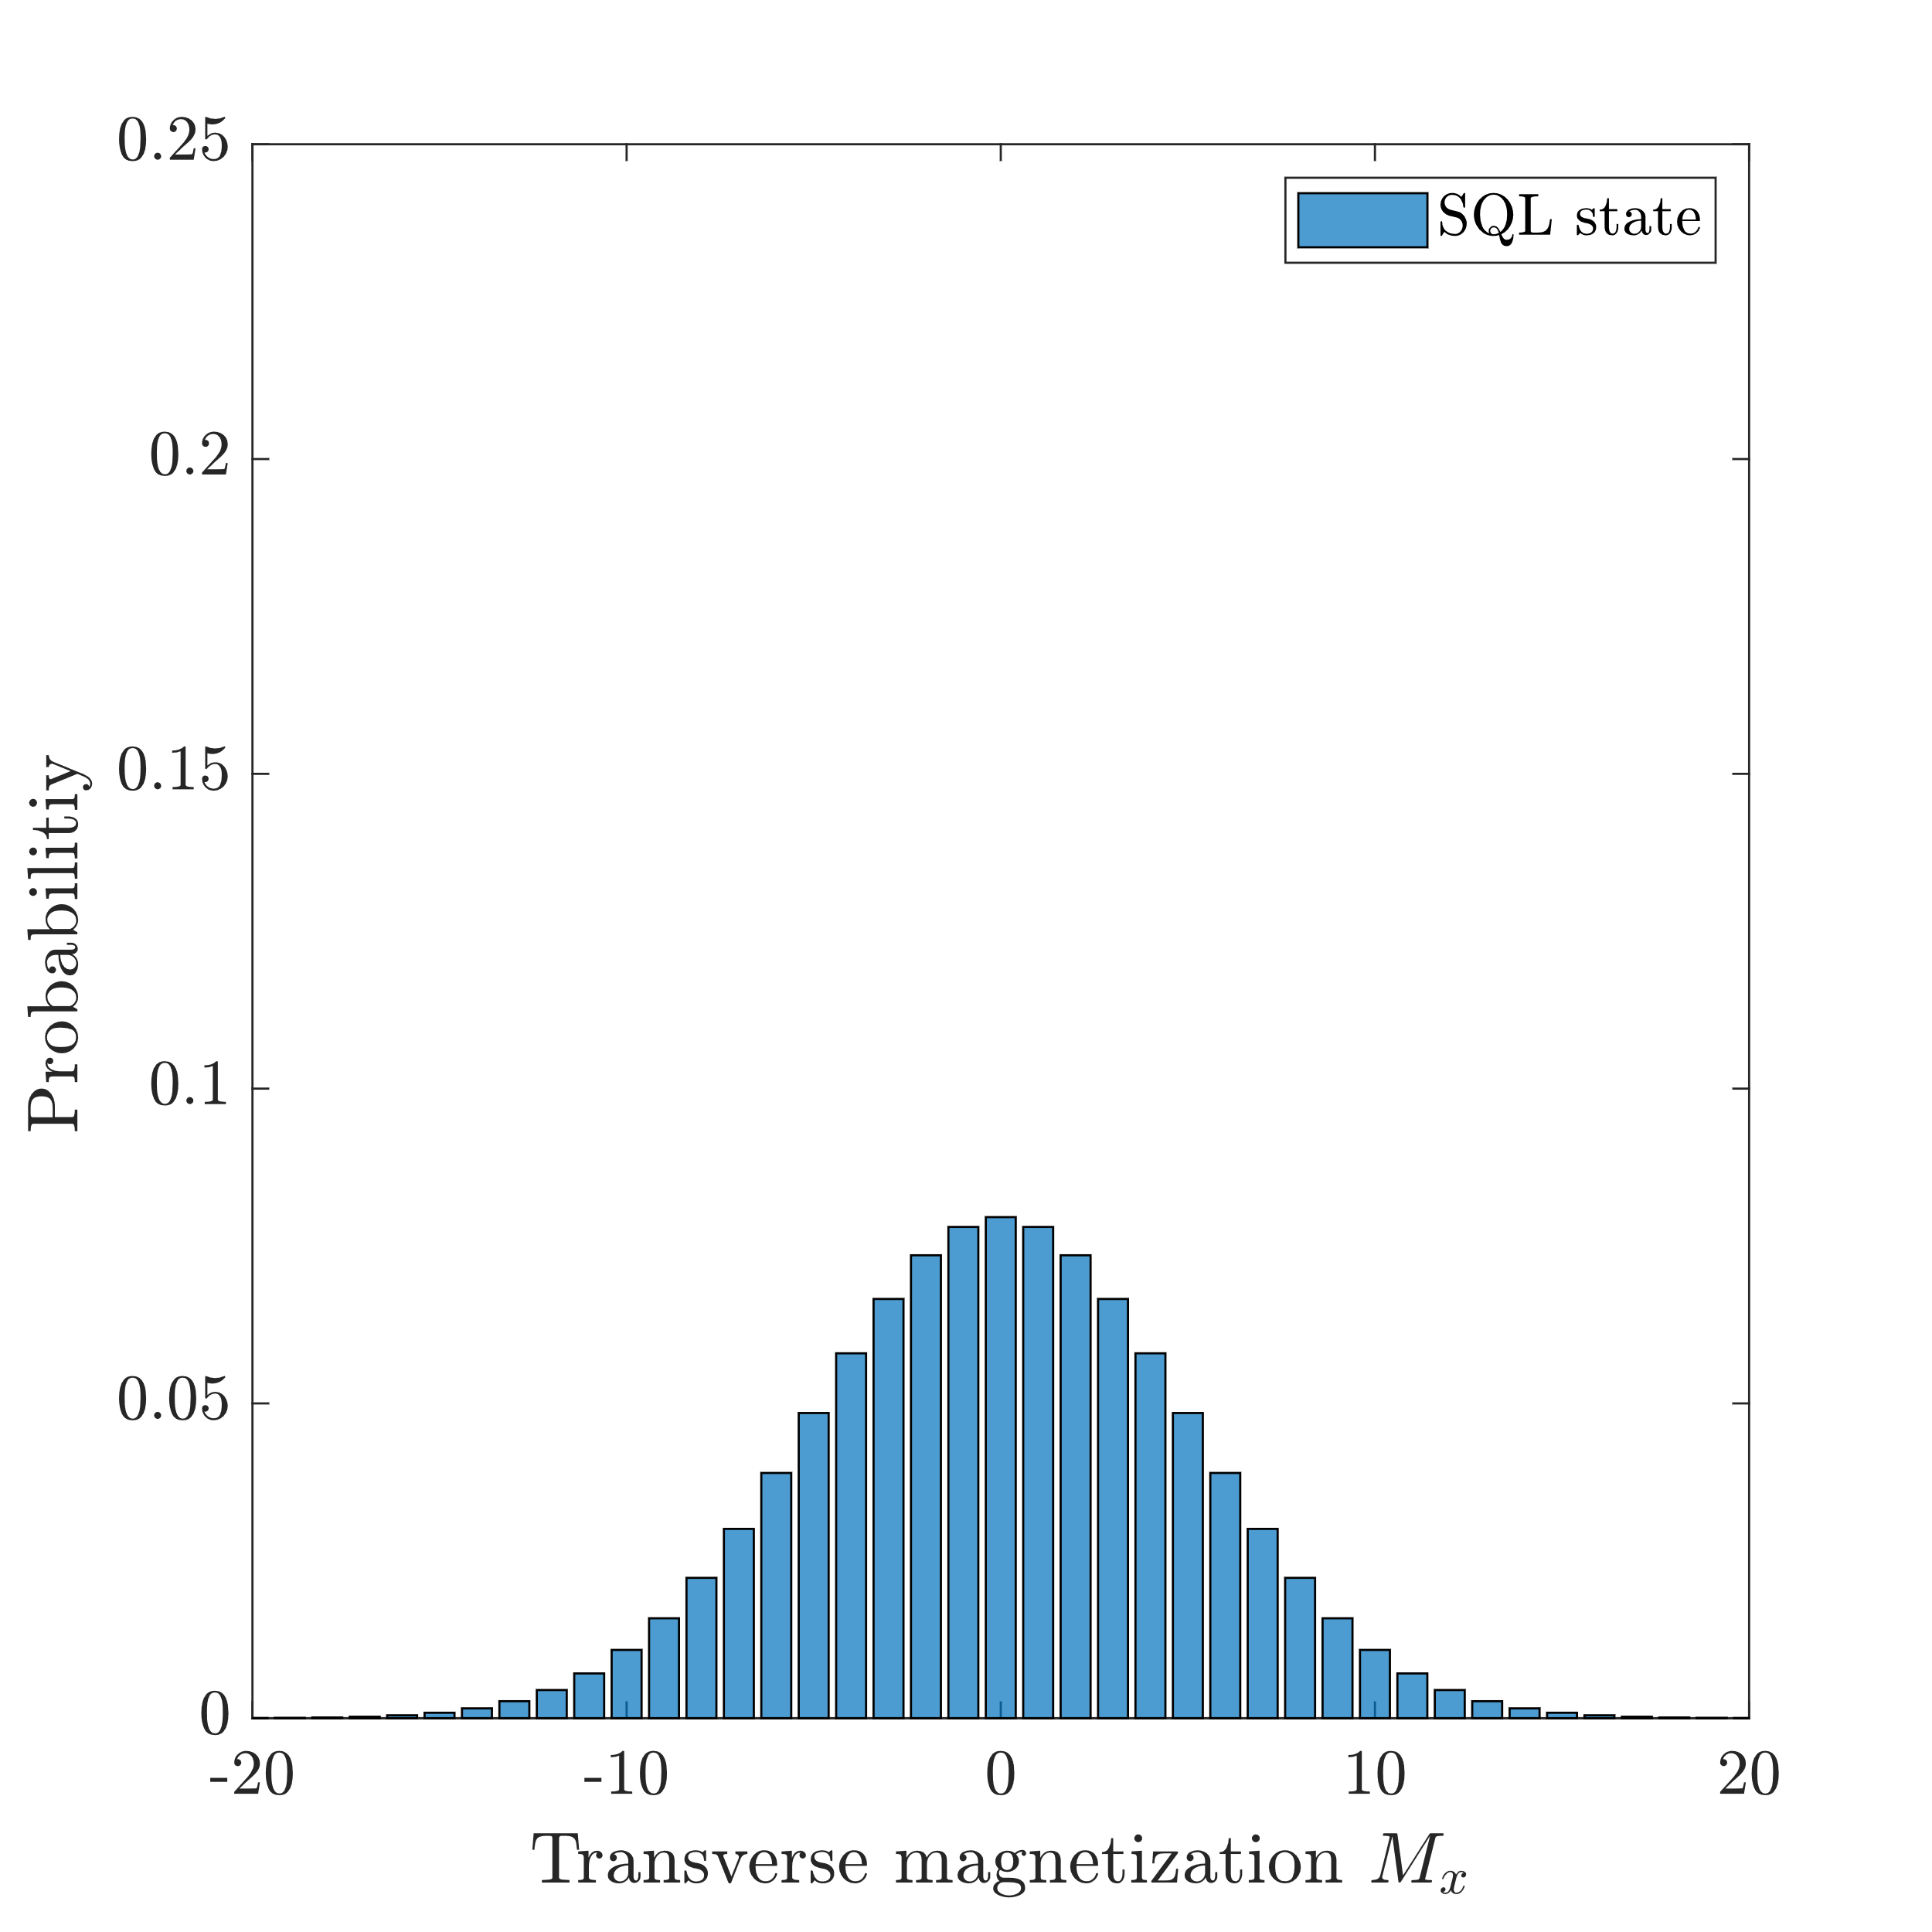
Spin squeezing
standard quantum limit (SQL):
[Phys. Rep. 509, 89 (2011)]

Slide 19
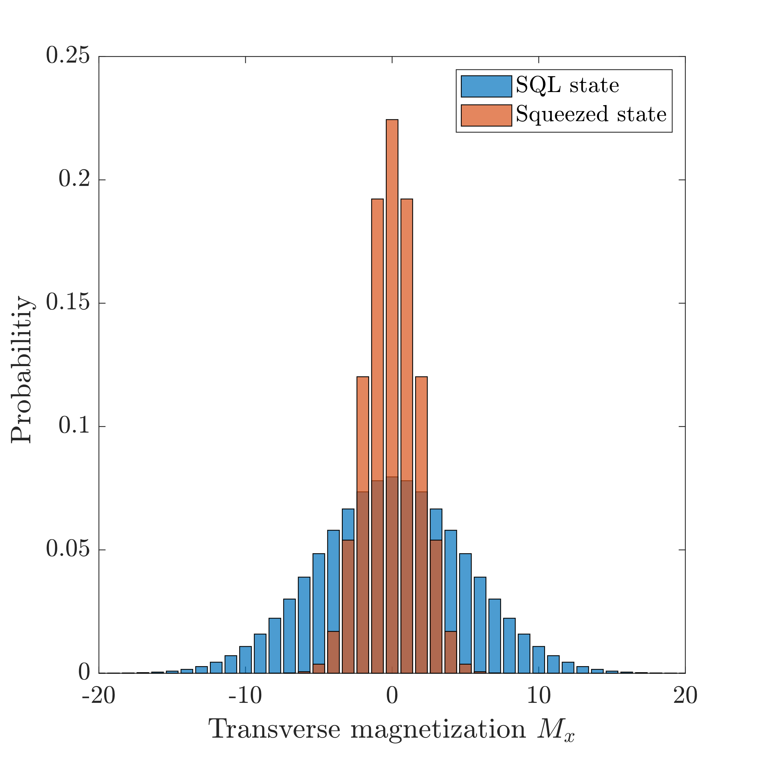
Spin squeezing
standard quantum limit (SQL):
spin squeezing may give us sensitivity better than quantum spin projection noise
squeezing
[Phys. Rep. 509, 89 (2011)]
[K. Backes et al., Nature 590, 238 (2021)]

Slide 20
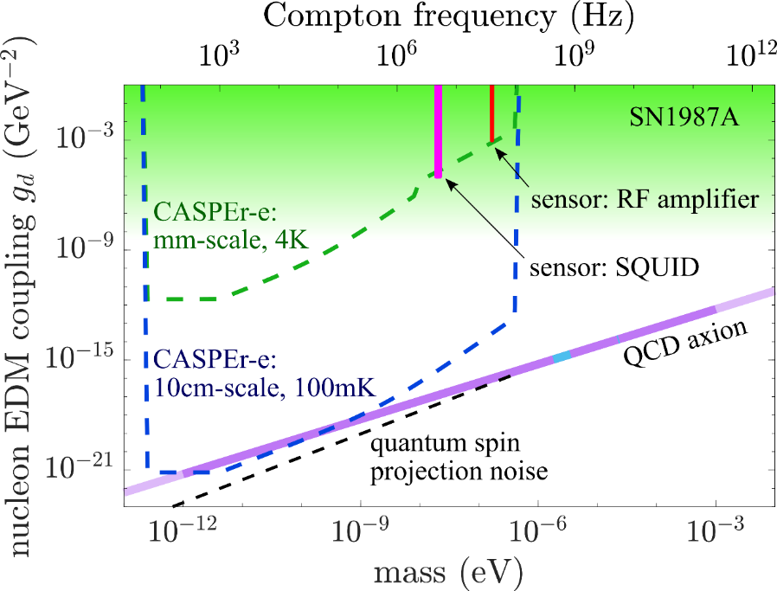
Alex Sushkov (Boston University): quantum limits on magnetic resonance searches for axion-like dark matter
interaction with gluons (strong-CP)
defining QCD axion coupling:
interaction with leptons:
CASPEr-electric (BU)
CASPEr-gradient (Mainz)
using spin ensembles to search for axion-like dark matter gives flexibility to optimize experimental parameters
CASPEr searches (mm-scale) are currently operating at projected sensitivity, limited by thermal spin polarization and sensor noise
CASPEr experiments are moving towards spin projection noise-limited sensitivity
achieving QCD axion sensitivity is feasible with 10cm-scale CASPEr-e experiment
spin squeezing may enable reaching QCD axion sensitivity with a smaller-scale experiment
[A. Gramolin et al., Phys. Rev. D 105, 035029 (2022)]
[A. Gramolin et al., Nature Physics 17, 79 (2021)]
[G. Centers et al., Nature Comms 12, 7321 (2021)]
[D. Aybas et al., Phys. Rev. Lett. 126, 160505 (2021)]
[D. Aybas et al., Quant. Sci. Tech. 6, 034007 (2021)]
[A. Garcon et al., Sci. Adv. 5, eaax4539 (2019)]

Slide 21
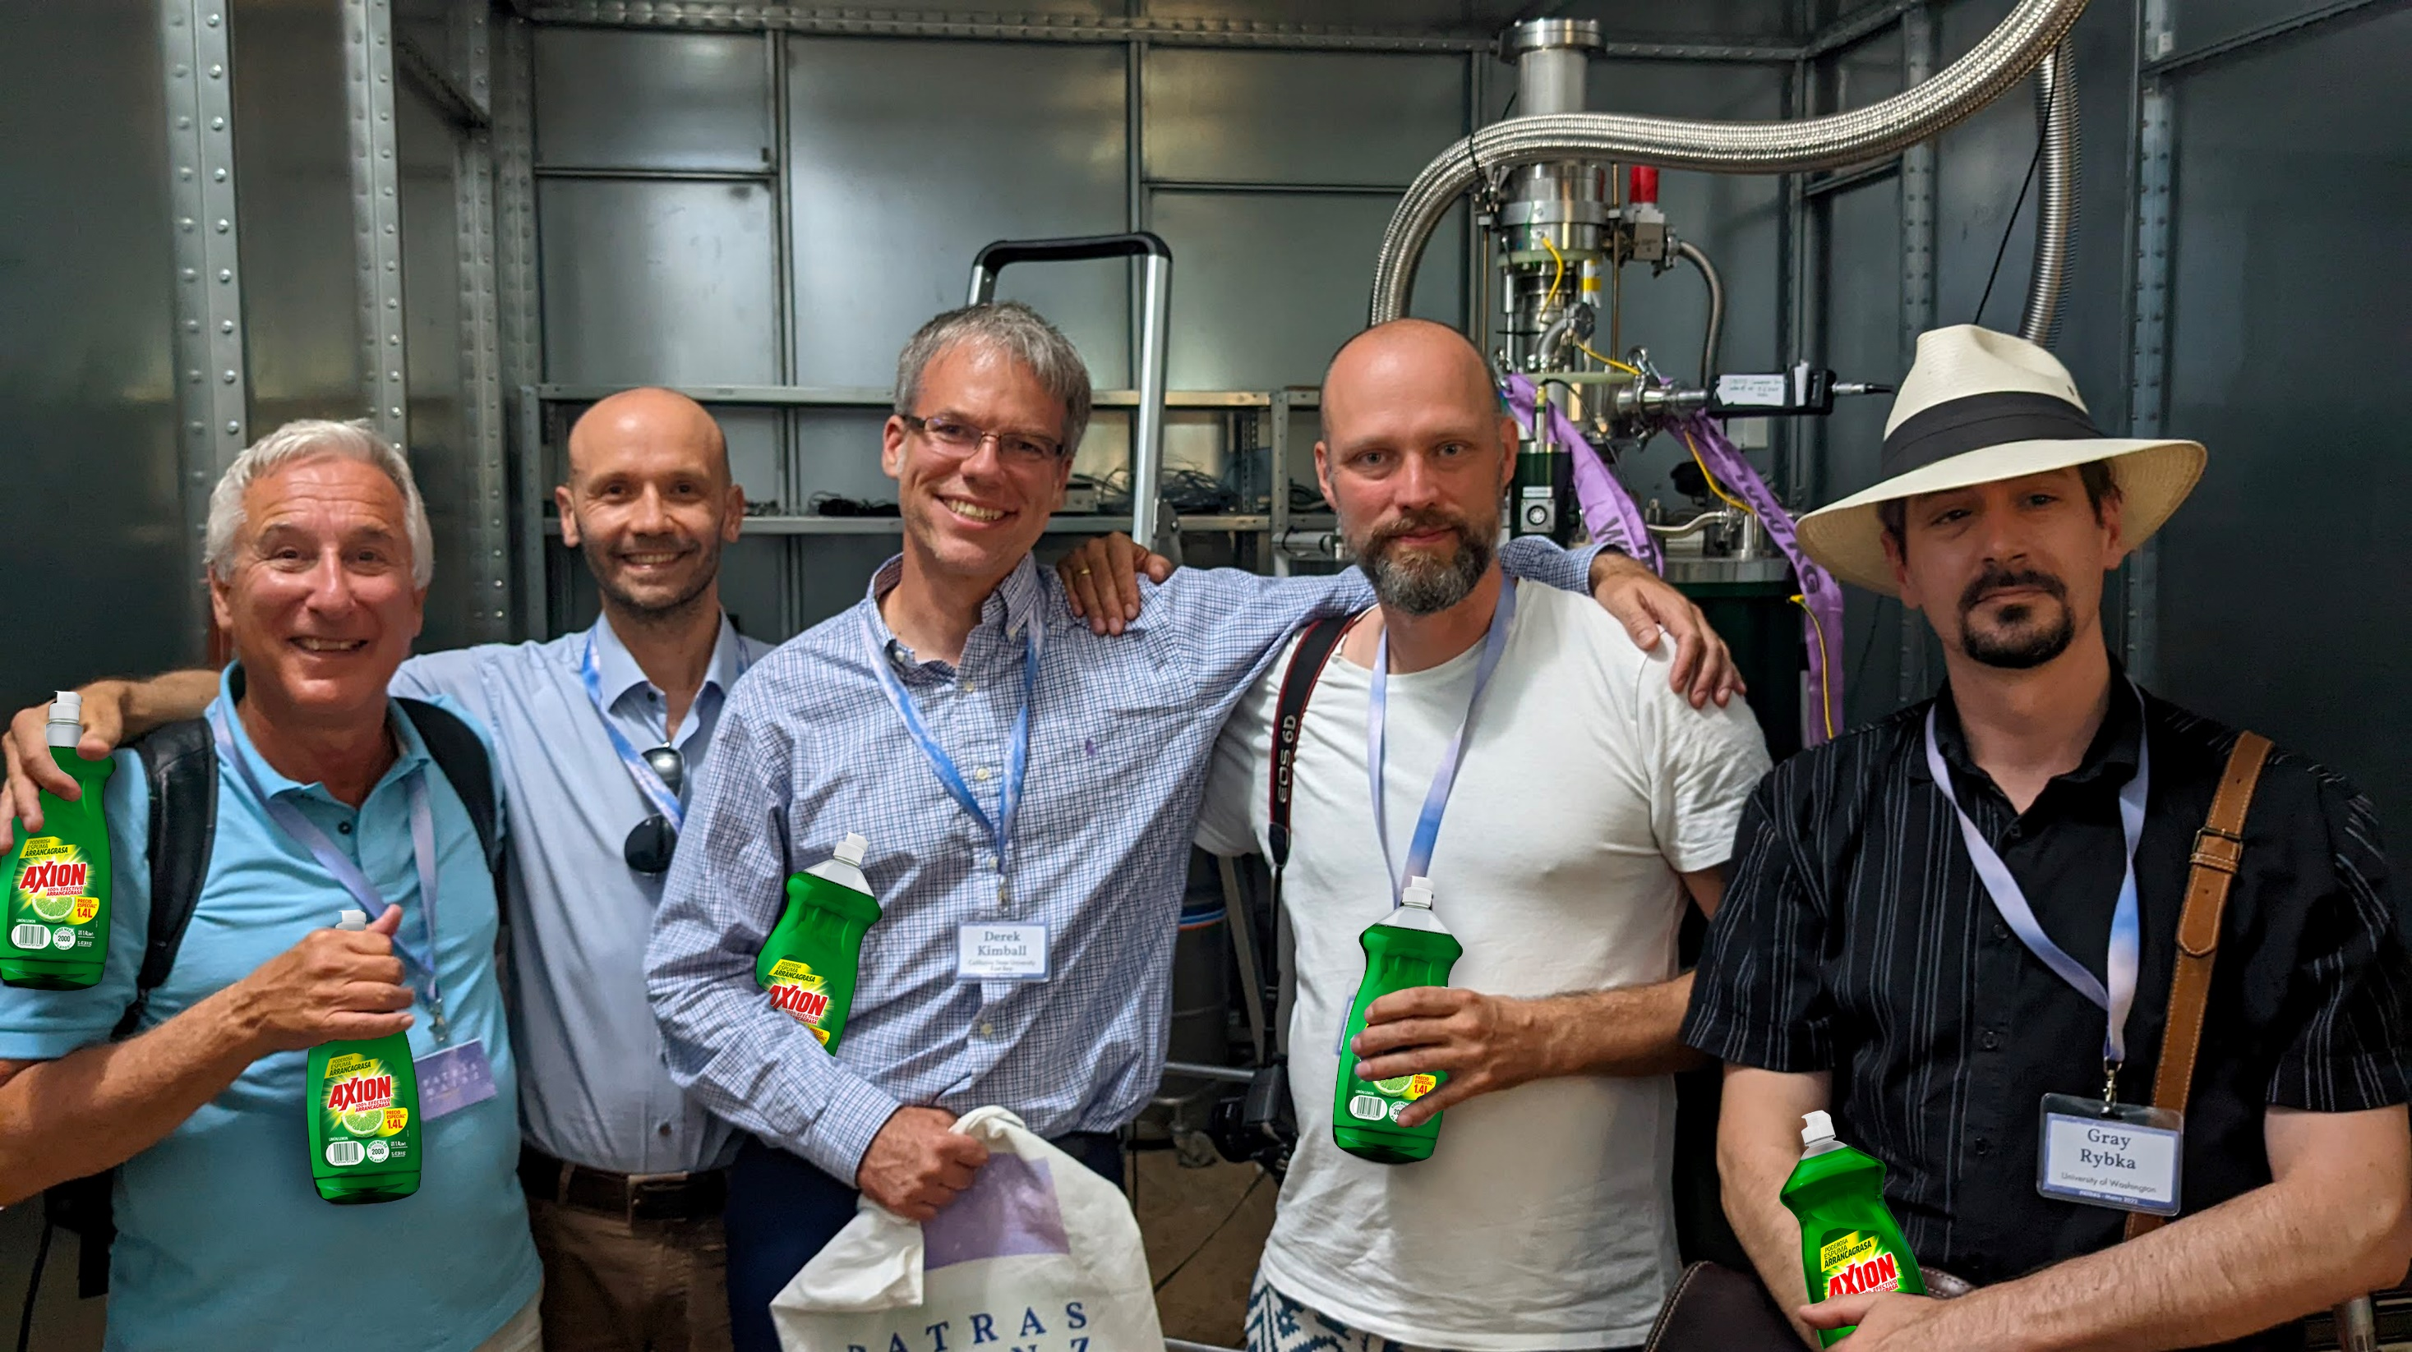

Slide 22
Alex Sushkov (Boston University): quantum limits on magnetic resonance searches for axion-like dark matter
interaction with gluons (strong-CP)
defining QCD axion coupling:
interaction with leptons:
CASPEr-electric (BU)
CASPEr-gradient (Mainz)
using spin ensembles to search for axion-like dark matter gives flexibility to optimize experimental parameters
CASPEr searches (mm-scale) are currently operating at projected sensitivity, limited by thermal spin polarization and sensor noise
CASPEr experiments are moving towards spin projection noise-limited sensitivity
achieving QCD axion sensitivity is feasible with 10cm-scale CASPEr-e experiment
spin squeezing may enable reaching QCD axion sensitivity with a smaller-scale experiment
[A. Gramolin et al., Phys. Rev. D 105, 035029 (2022)]
[A. Gramolin et al., Nature Physics 17, 79 (2021)]
[G. Centers et al., Nature Comms 12, 7321 (2021)]
[D. Aybas et al., Phys. Rev. Lett. 126, 160505 (2021)]
[D. Aybas et al., Quant. Sci. Tech. 6, 034007 (2021)]
[A. Garcon et al., Sci. Adv. 5, eaax4539 (2019)]

Slide 23
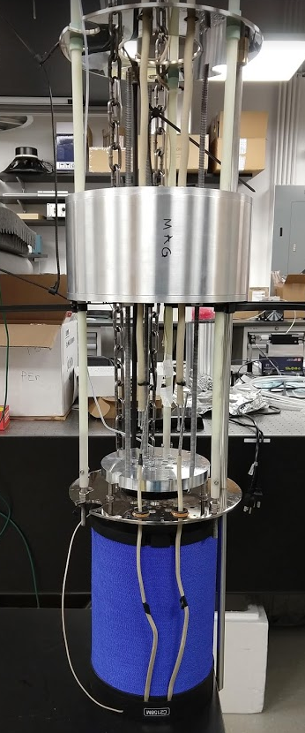
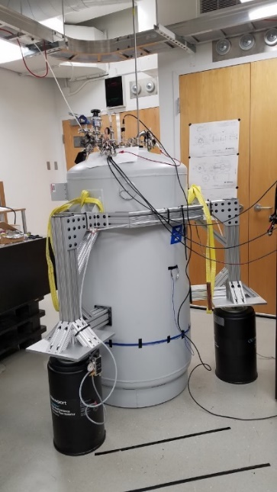
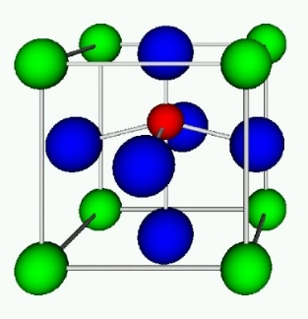
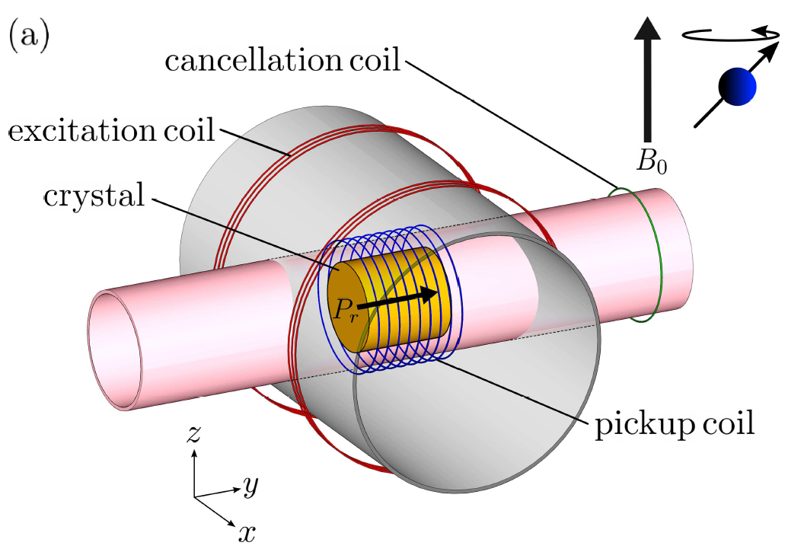
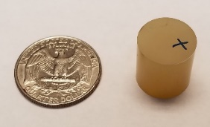
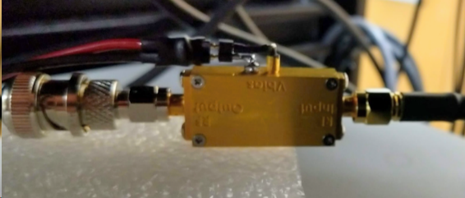
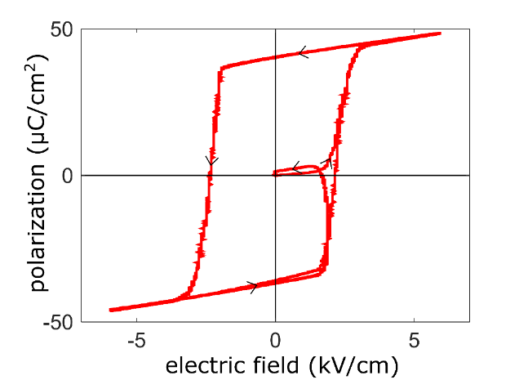
CASPEr-e: experimental details
sample: 4mm
sensor:
NMR calibration
liquid helium (4 K) bath cryostat with 9T magnet
²⁰⁷Pb nuclear spins in ferroelectrically-polarized PMN-PT
low-noise radiofrequency amplifier
crossed excitation and pickup coils
SQUID
millimeter-scale CASPEr-e search based on nuclear magnetic resonance
similar to a polar molecule
[D. Aybas et al., Phys. Rev. Lett. 126, 160505 (2021)]
ACME [Science 343, 269 (2013)]
[J. Adam et al., manuscript in preparation]
[Nature 562, 355 (2018)]

Slide 24
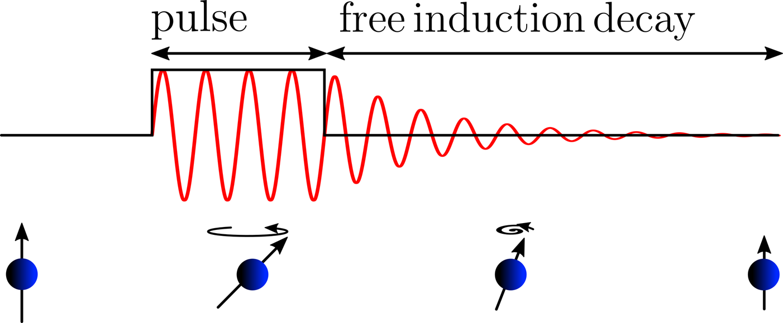
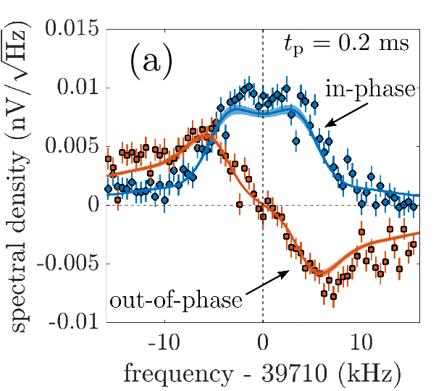
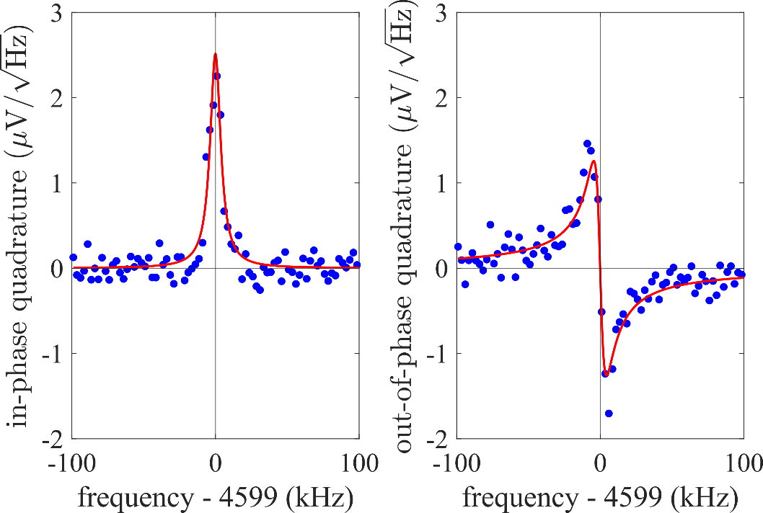
²⁰⁷Pb NMR: sensitivity calibration, characterization of PMN-PT
²⁰⁷Pb NMR: free induction decay (FID) after small-tip angle pulses (we use small-tip angle pulses so that spin polarization is not diminished after FID acquisition)
²⁰⁷Pb NMR calibration with RF amplifier →
²⁰⁷Pb NMR calibration with SQUID →
successful modeling of spin dynamics and FID data using Bloch equations
measurement of nuclear spin coherence time →
calibration of sensitivity to axion-like dark matter by measuring FID after small-tip angle pulse
[D. Aybas et al., Phys. Rev. Lett. 126, 160505 (2021)]
[J. Adam et al., manuscript in preparation]

Slide 25
Millimeter-scale CASPEr-e axion-like dark matter search
CASPEr-e limits on nucleon EDM and gradient interactions of axion-like dark matter
→ limits on oscillation amplitudes of neutron EDM and θ_{QCD}:
experiment performs at projected sensitivity
[D. Aybas et al., Phys. Rev. Lett. 126, 160505 (2021)]
[D. Aybas et al., Quant. Sci. Tech. 6, 034007 (2021)]
[J. Adam et al., manuscript in preparation]

Slide 26
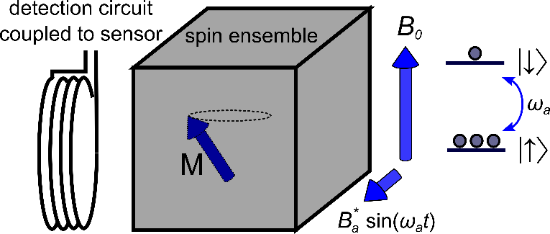
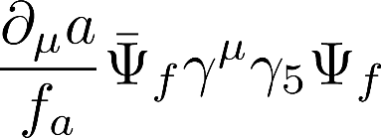
NMR approach to searching for axion dark matter (CASPEr) at BU
1. NMR can search for EDM and gradient couplings of axion dark matter
2. precision magnetic resonance approach using nuclear spin ensembles
defining interaction of QCD axion
3. NMR approach is uniquely broadband and flexible → allows sensitivity improvement via choice of material
4. proof-of-principle searchs completed at design sensitivity:
sensors → RF amplifier, DC SQUID: magnetic field sensitivity 150 aT/√Hz
thermal polarization of nuclear spin ensemble at 4.2 K
5. current work: quantum approach:
sensor → integration with resonant quantum upconverter (RQU) developed by Irwin group (SLAC)
quantum state purification of nuclear spin ensemble
6. goal → probe the QCD axion band for mass ≈ 10⁻¹² to 10⁻⁹ eV
[1] D. Aybas et al., Phys. Rev. Lett 126, 160505 (2021)
[2] A. Gramolin et al., Nature Physics 17, 79 (2021)]
[3] D. Aybas et al., Quant. Sci. Tech. 6, 034007 (2021)]
[4] A. Gramolin et al., Phys. Rev. D 105, 035029 (2022)

Slide 27
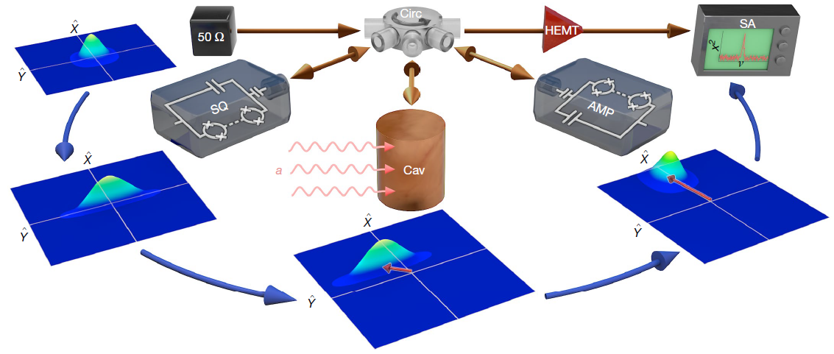
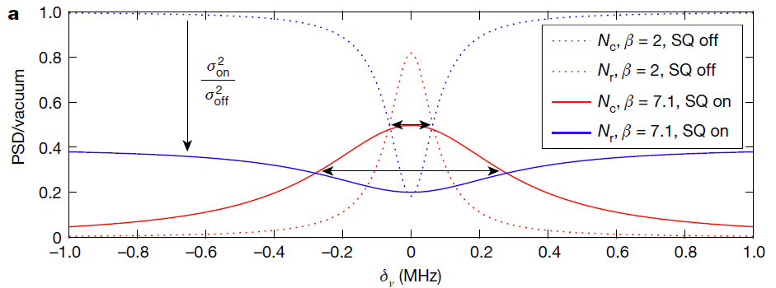
HAYSTAC: the quantum-enhanced search for the electromagnetic interaction of axion dark matter
injection of squeezed vacuum (4 dB):
goal: search for electromagnetic coupling of axion-like dark matter at GHz frequencies
interaction with photons:
ALP field amplitude
symmetry breaking scale
→ ALP ↔ photon conversion in a magnetic field → precision electromagnetic sensors
if axion Compton frequency is near cavity resonance → photons are generated and detected (≈ 10⁻²³ W)
scanning through axion mass range is done by tuning the cavity (≈ 4 GHz)
SQL → zero-point fluctuations of electromagnetic field
[K. Backes et al., Nature 590, 238 (2021)]

