Slide 1
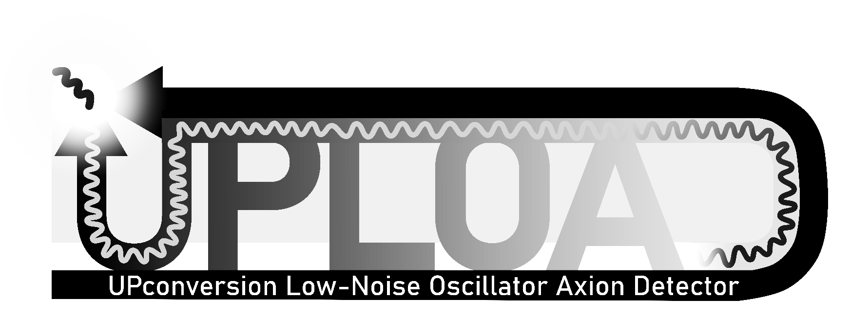
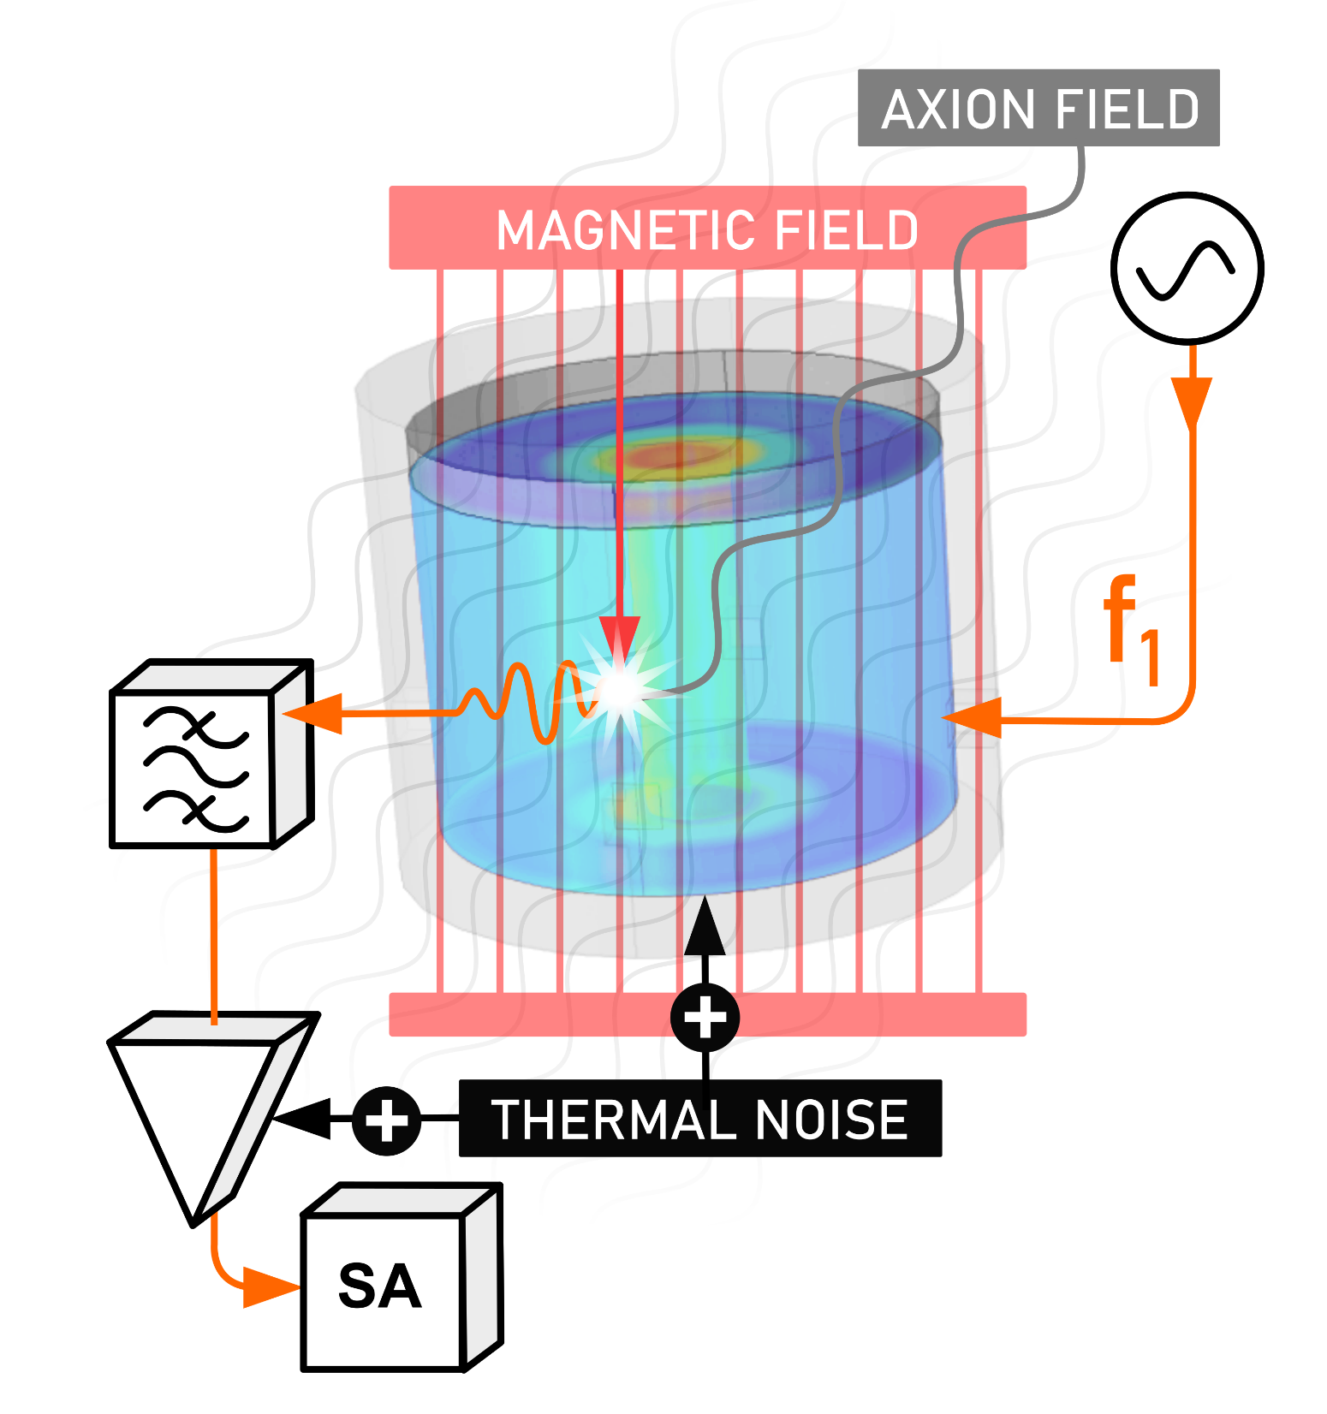
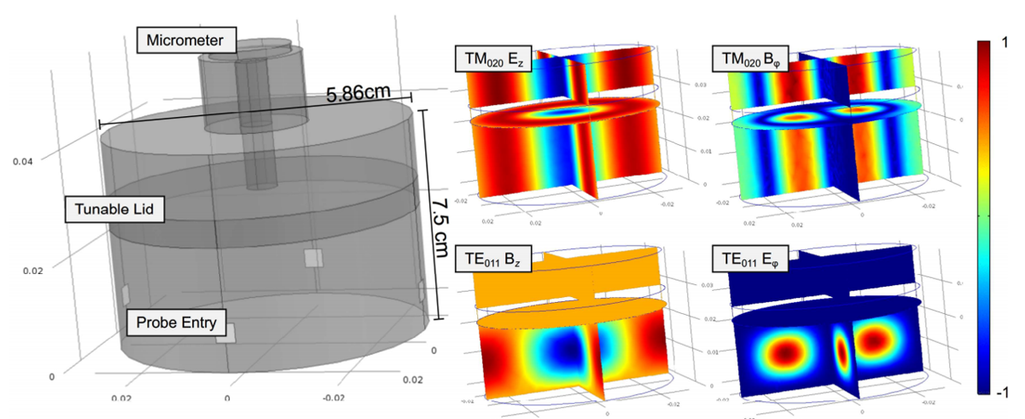
Catriona Thomson, the University of Western Australia
Prof Mike Tobar, Dr Maxim Goryachev
DC HALOSCOPE
“AC HALOSCOPE”

Slide 2
