Slide 1
Storage Cell Tests for the
Polarized Target at LHCb
30.09.2022 I Ralf Engels for the Spin@LHCb collaboration
FZ Jülich / GSI Darmstadt

Slide 2
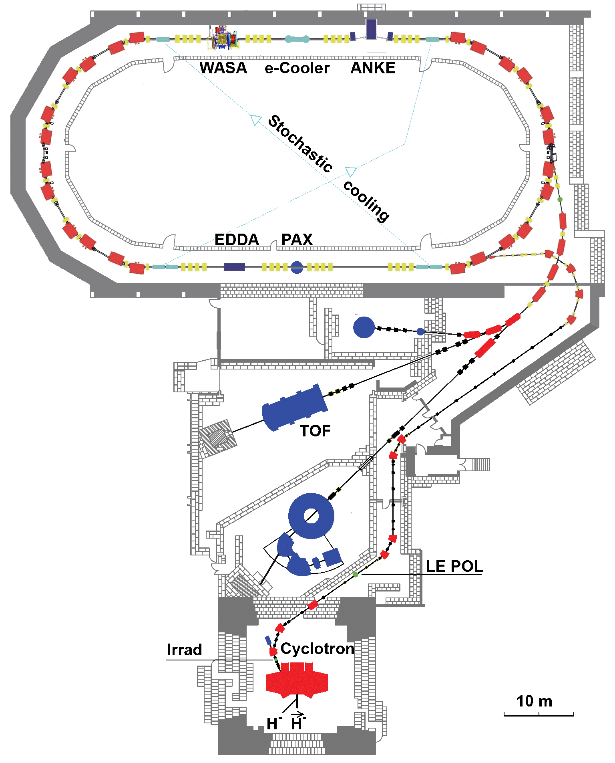
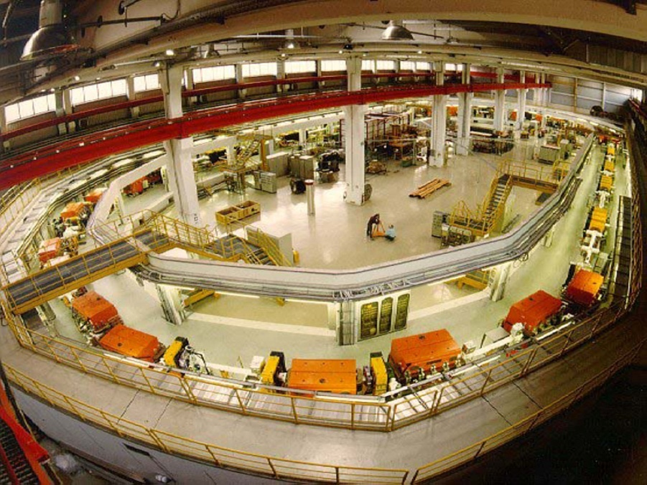
PIT@ANKE
p, p, d, d
with momenta up to 3.7 GeV/c
internal experiments –
with the circulating beam
external experiments –
with the extracted beam

Slide 3
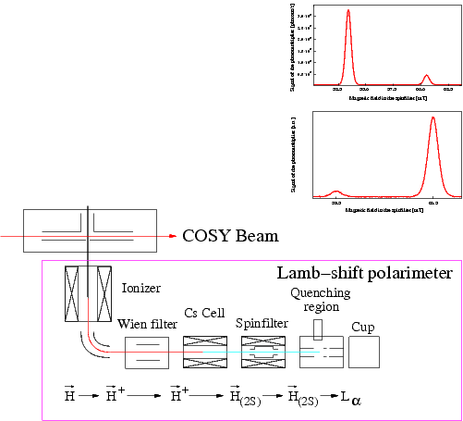
ABS and Lamb-shift polarimeter
6-pole
magnet
N₋
rf-transition
6-pole
magnet
N₊

Slide 4
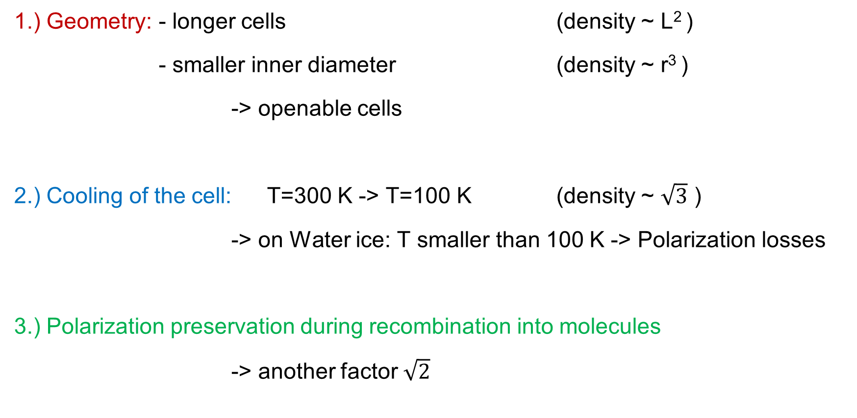
How to increase the target density
1.) Geometry: - longer cells (density ~ L² )
- smaller inner diameter (density ~ r³ )
-> openable cells
2.) Cooling of the cell: T=300 K -> T=100 K (density ~ $\sqrt{3}$ )
-> on Water ice: T smaller than 100 K -> Polarization losses
3.) Polarization preservation during recombination into molecules
-> another factor $\sqrt{2}$

Slide 5
Possible Surface Materials
1.) Water (ice): + nearly perfect polarization preservation: P ~ 0.9
(HERMES)
+ no recombination down to 100 K
- partial pressure -> problems with vacuum experts at CERN
2.) Al(O₂), Ti(O₂) + polarization about P ~ 0.75 / 0.8
(FZJ)
+ no recombination (chemically very inert ceramics)
- conductor / secondary electron yield -> problems with beam experts
3.) Teflon: + polarization about P ~ 0.75
(FZJ)
+ no recombination
- isolator / wake field problems -> problems with beam experts
-> CERN supposed: Getter Material (?!) or Carbon

Slide 6

Literature:
● direct recombination is
not possible due to
energy and momentum
conservation
● 3-particle interactions are
very rare at these densities
● recombination on a
carbon surface as catalyser ?

Slide 7
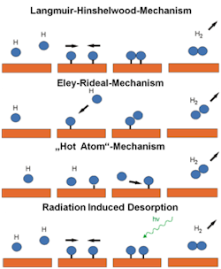
Hydrogen Recombination in the Universe
Possible Recombination Mechanism
WWU Münster; Phys. Institute,
Prof. H. Zacharias
-> C-H Bond (~ 4.3 eV) is so strong that it will not allow the recombination
-> H-H Bond: ~ 4.5 eV
Radiation induced Desorption

Slide 8
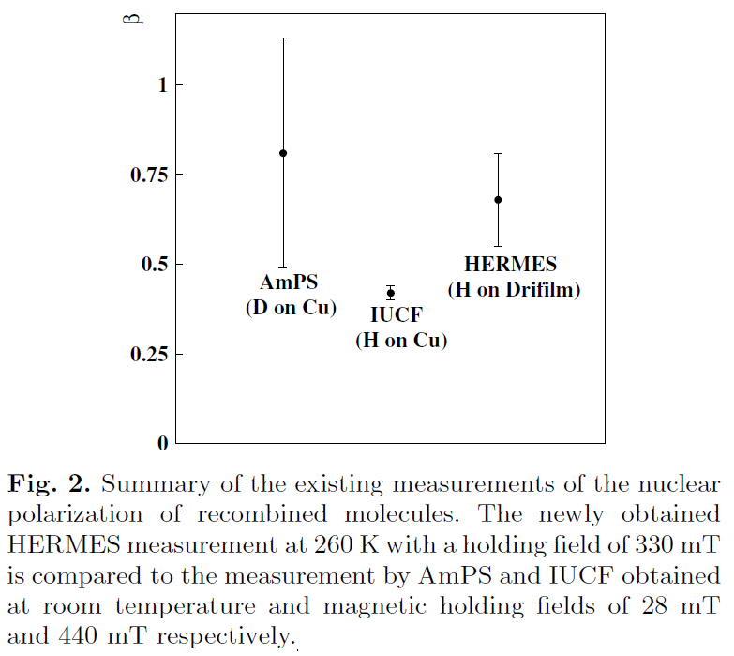
Polarized H₂ Molecules
Measurements from NIKHEF, IUCF, HERMES show that recombined molecules retain fraction of initial nuclear polarization of atoms!
P_{m}
P_{a}
β=
P_{m} = ½ P_{a}
The HERMES Collaboration; Eur. Phys. J. D 29, 21–26 (2004)
DOI: 10.1140/epjd/e2004-00023-5

Slide 9
Polarized H₂ Molecules
Eley-Rideal Mechanism
P_{m} = 0.5 P_{a}
Is there a way to increase P_{m} P
(surface material, T, B etc)?

Slide 10
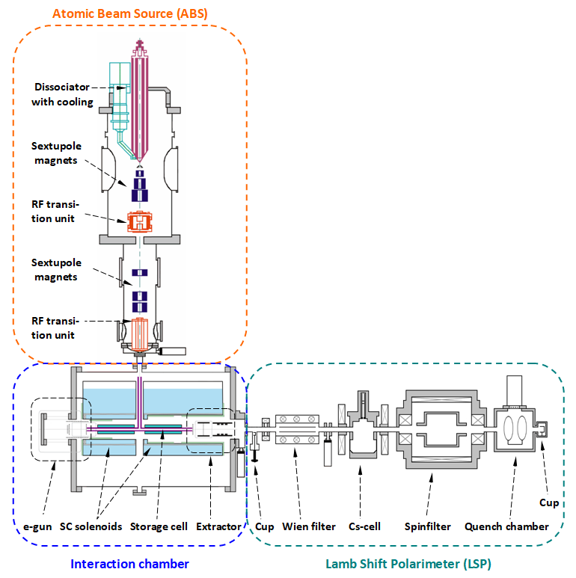
The Experimental Setup
ABS
H, D or
H+D
H₂⁺, D₂⁺
HD⁺, H₃⁺
p, d

Slide 11
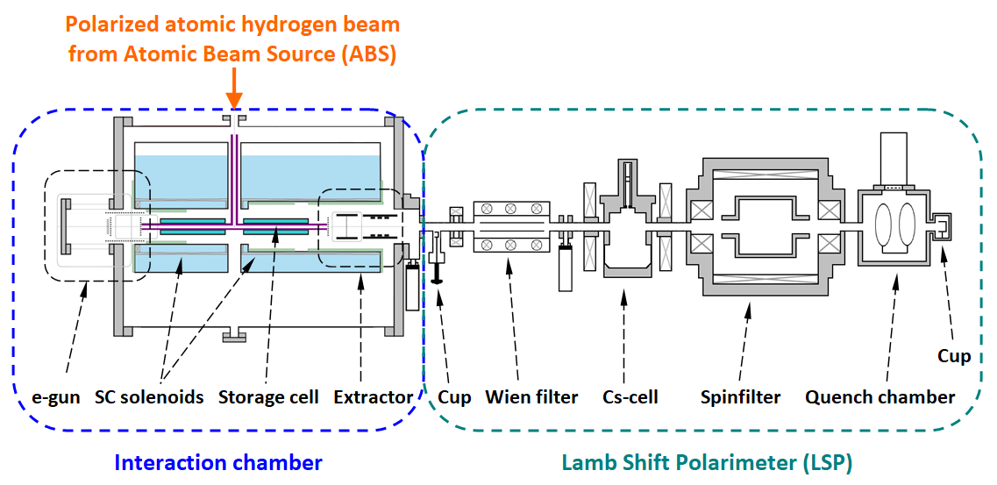
The Experimental Setup

Slide 12
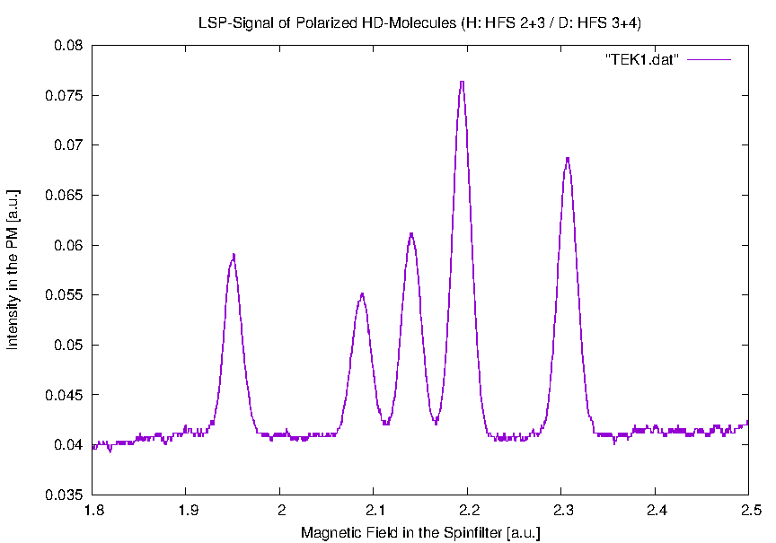
HD Molecules
(Surface: Gold / T = 80 K / B = 0.528 T / E = 2 keV)
P_{z} (D) = -0.3
P_{zz} (D) = 0.12
m_{I}=-1
P_{z} (H) = -0.21
m_{I}=0
m_{I}=+1
m_{I}=1/2
m_{I}=-1/2
D
H
H

Slide 13
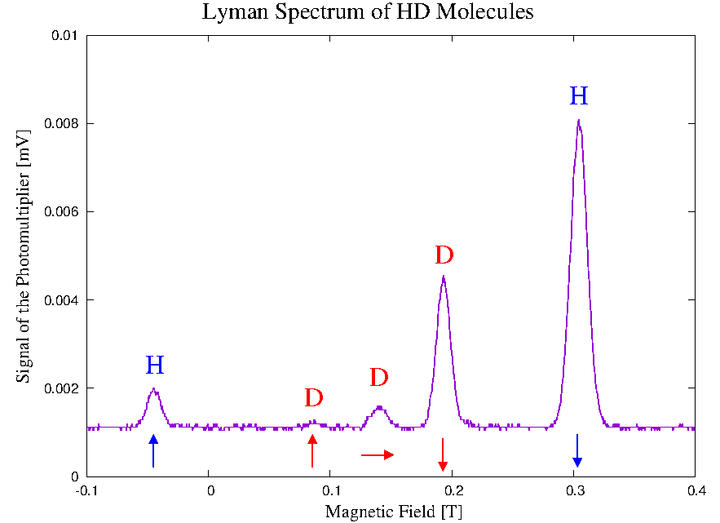
HD Molecules
Surface: Fomblin on Fused Quarz
T = 80 K / B = 0.528 T / E = 0.3 keV
P_{z} (H) = - 0.77
P_{z} (D) = - 0.79
P_{zz} (D) = + 0.69
Signal of the Photomultiplier [a.u.]
R. Engels et al., Phys. Rev. Lett. 124 113003 (2020)

Slide 14
Experimental results
Measurements on Fomblin Oil (Perfluoropolyether PFPE)
HFS 3
T_{Cell} = 100 K
P_{m} = -0.87
P_{m}(n,B) =
1
P_{m}
0
1+(B_{c}/B)² ∙ n/ln 2
P_{m} = - 0.81 ± 0.02
n = 174 ± 19
c = 0.993 ± 0.005
p
2
_
B_{c}
B
( )
- n
~ P_{m} e
0
+
P_{m} = - 0.84 ± 0.02
n = 277 ± 31
B_{c}(H) = 5.4 mT
H
2
R. Engels et al., Phys. Rev. Lett. 115 113007 (2015)

Slide 15
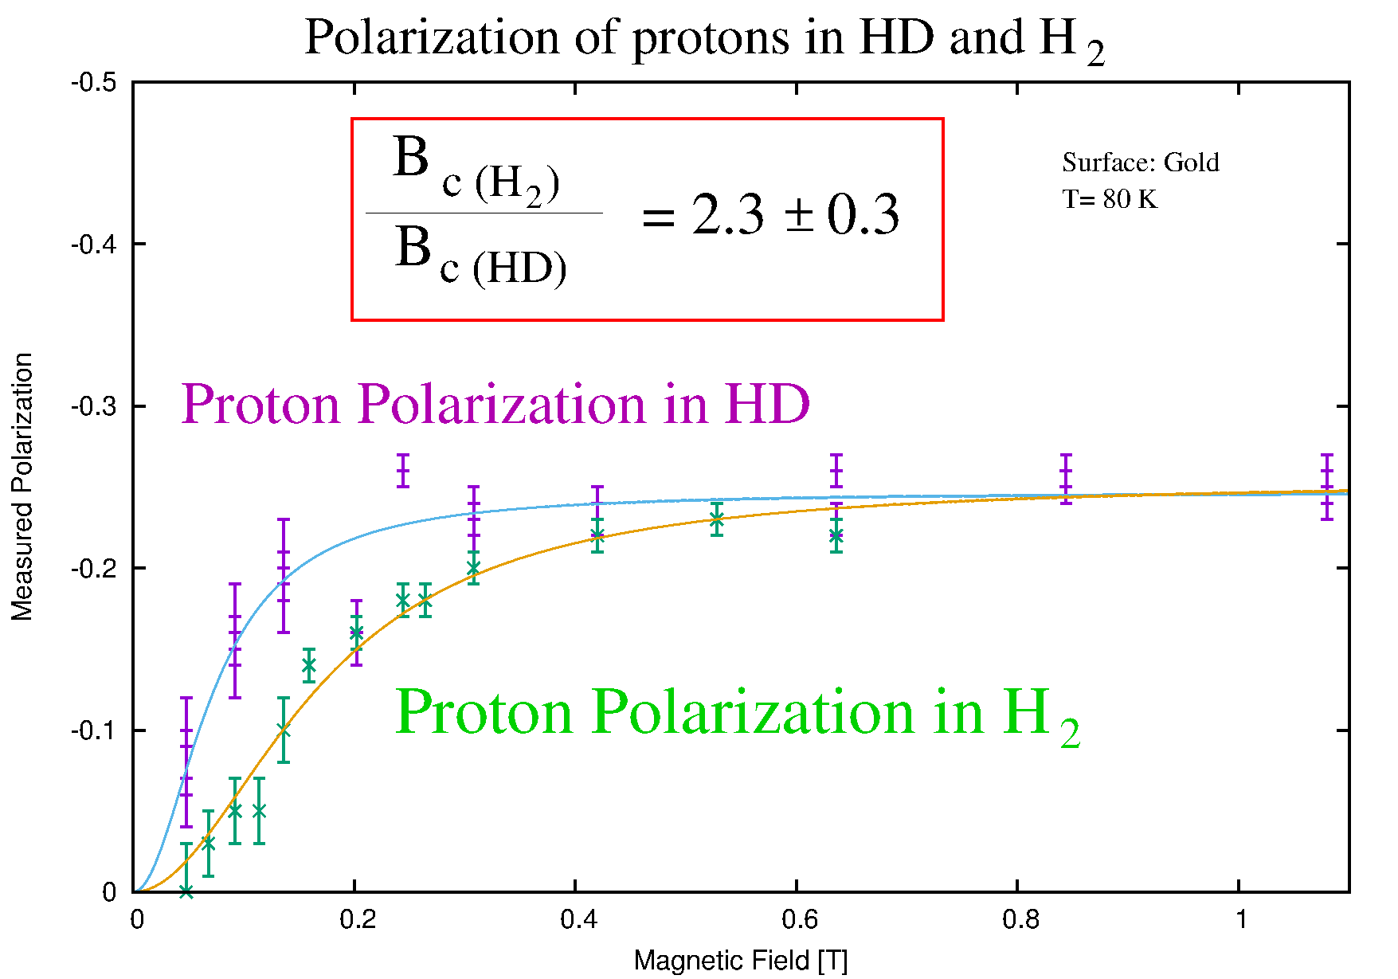
HD Molecules

Slide 16
LHCSpin project
Storage cell Investigation of
storage cell in Jülich
● critical component, where the
beam interacts with the gas 1. polarisation preservation
inside the storage cell
● due to the LHC beam effects the
cell should be carbon coated on 2. formation of hydrogen
the inside molecules on carbon
surface
● carbon coated storage cells
have never been used in such
an experiment
● In principal, no recombination
expected ….

Slide 17
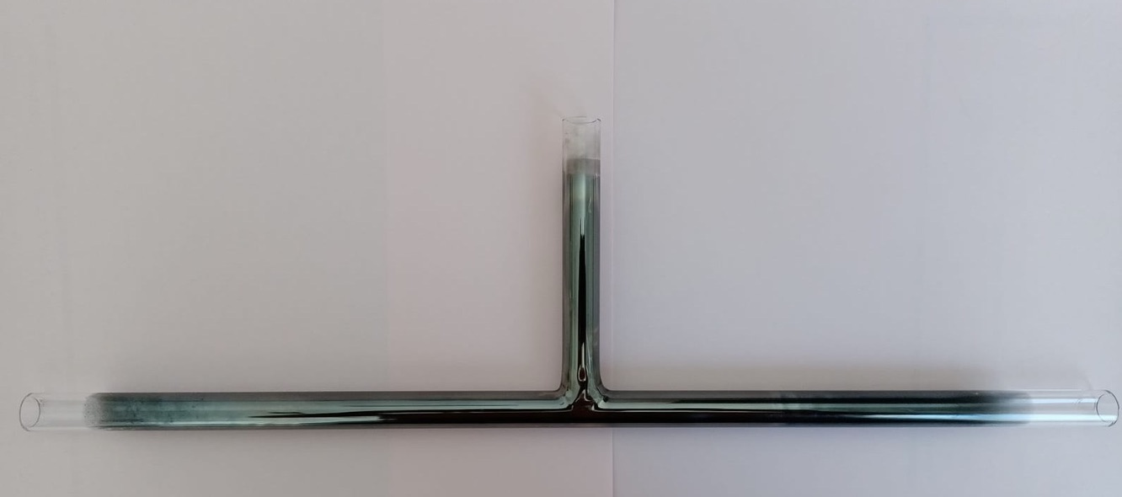
Self-Made Storage Cell
Produced by heating of Aceton or Ethanol inside the cell with a hydrogen flame
-> depending on the temperature cristaline or amorphe surfaces are possibe

Slide 18
New Observation at BINP in Novosibirsk
DFG Project
BU 2227/1-1
ABS / MBS
D. Toporkov et al.
LSP
Huge Lyman-α background
(n=2 -> n=1 : 10.2 eV)
Source: Plasma in Dissociator
Balmer (n=3 -> n=2) light is very bright !
Estimate amount: ~ 10¹⁸ Ph/s

Slide 19
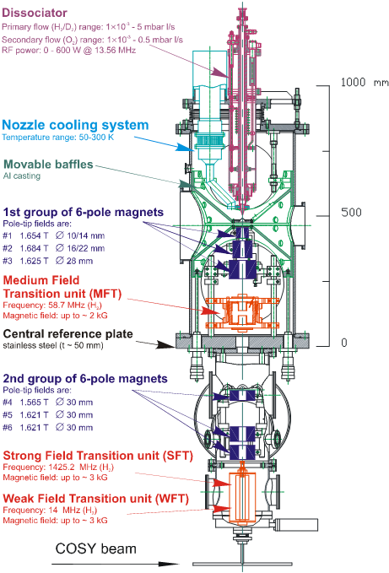
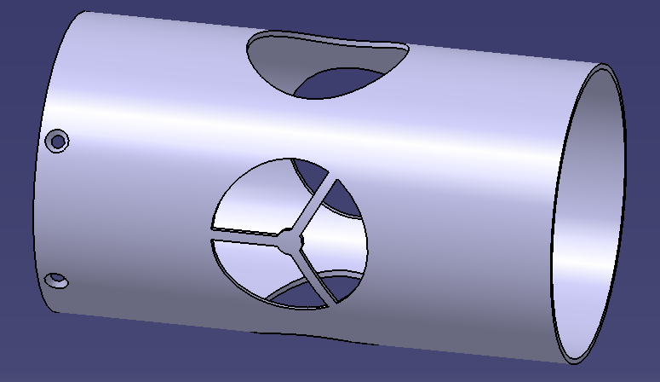
Possible Solution for the LHCb pol. Target
New Chopper with 3 Options:
Beam can pass completely
Beam is blocked
Ballistic trajectories are blocked only

Slide 20
First Results (Bachelor Thesis of O. Bilen, HHU)
1.) Cell cooled for 4 days to 100 K
-> No molecules observed in the ion beam
-> Reason: Cold surface catched water from residual gas
2.) Cell heated for a short time
-> molecules are dominating, recombination rate 80 - 90%
-> water is mostly vaporized
Hydrogen Atoms recombine on a Carbon surface
3.) New Chopper used
-> total flux of atoms decreased by ~40 % / no change of recombination rate

Slide 21
The Lyman-α Measurement

Slide 22
First Results
1.) Cell cooled for 4 days to 100 K
-> No molecules observed in the ion beam
-> Reason: Cold surface catched water from residual gas
2.) Cell heated for a short time
-> molecules are dominating, recombination rate 80 - 90%
-> water is mostly vaporized
Hydrogen Atoms recombine on a Carbon surface
3.) New Chopper used
-> total flux of atoms decreased by ~40 % / no change of recombination rate
4.) Tests with new chopper and Aluminium mirrors inside the cell and the LSP
-> Lyman-α photons reduced by 85 %
-> don‘t we stop enough photons???
5.) Chopper completely closed
-> Still 2 % of the Lyman-α photons reach the storage cell …

Slide 23
First Results
Problems:
No polarization measurement possible !!!
Old spinfilter (Built in 1967 at Los Alamos!) was not working any more,
i.e. the homogeneity of the magnetic field was not good enough,
two shortcuts in the coils identified.
Next steps:
- Wait for dedicated cells from CERN
Maintanance of the spinfilter nearly finished (M. Westphal)
New student: Tarek El-Kordy, Master Thesis at FH Aachen
-> More tests in near future ….

Slide 24
Storage Cell Coating
Why have other materials worked for coating ?
1.) Aluminium cells -> reflects Lyman-α photons
2.) Teflon cells -> transmission through the surface ?
3.) Water ice -> reflects Lyman-α photons / transmission through the surface ? (O-H: ~ 4.8 eV > H-H: 4.5 eV)
Do not forget the Lyman-α radiation on storage cell surfaces?
CERN: If Lyman-α photons can be avoided, maybe Carbon is
a possible solution for storage-cells coatings !!!

Slide 25
Idea for LHCb
Advantages:
„Short“ ABS
Lyman-α Photons are separated
„High Field Seeker“ are guided into
pump
Deuterium: P_{z} ~ +/- 2/3
P_{zz} ~ -1 are possible
3 4
Stern-Gerlach
Dipole Magnet
Into pump
1 2
WFT: 1 -> 3
Catcher for Lyman-α
SFT: 2 -> 4
WFT on: 2 + 3 -> P ~ -1
SFT on: 1 + 4 -> P ~ +1
Into storage cell

