Slide 1

Testing neutrino properties with KATRIN: status update
Programme Meeting
Matter and the Universe
Mainz, 12-13 Dec., 2018

Slide 2
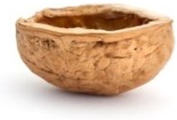

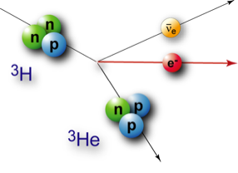
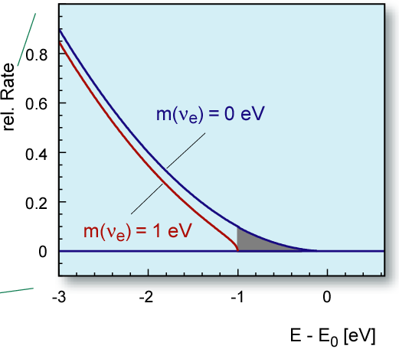
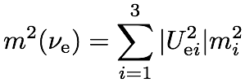
KATRIN in a nutshell
Karlsruhe Tritium Neutrino Experiment
Next-generation direct ν-mass experiment
using precision spectroscopy of ³H β-decay
Sensitivity on m(ν_{e}): 2 eV/c² ➜ 0.2 eV/c²
➜ will exhaust “degenerate” ν-mass regime
Method:
Purely kinematic measurement
Agnostic w.r.t. Dirac/Majorana nature
Effective “electron neutrino mass” square:
3 yrs, 90% CL

Slide 3
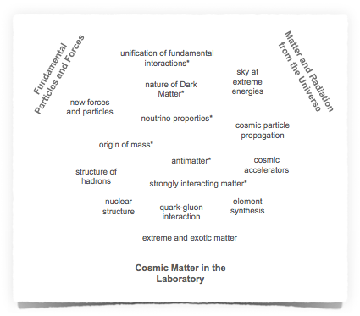

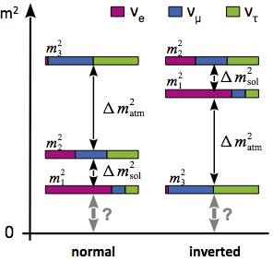

KATRIN & MU Programme Landscape
T1
T3
T2

Slide 4

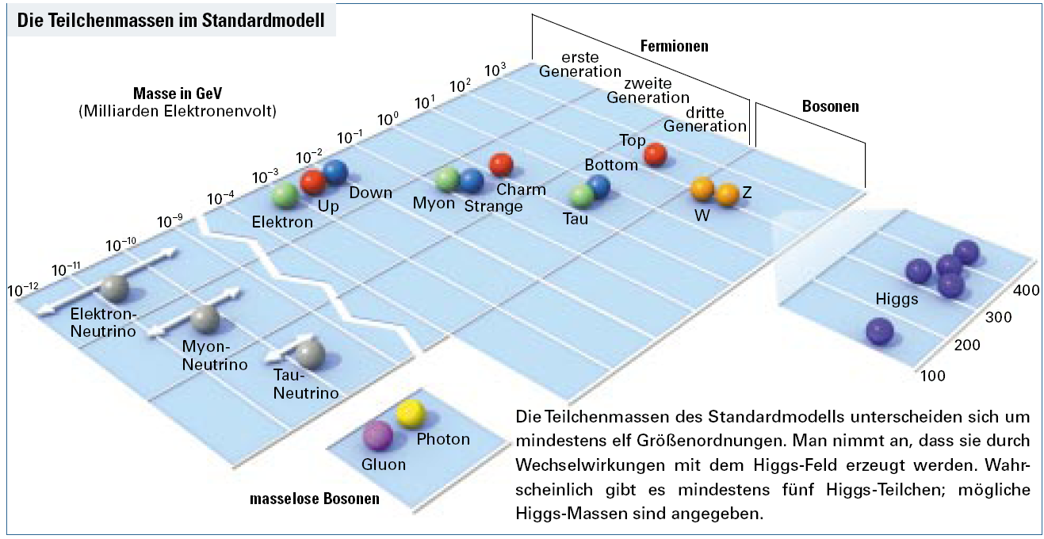


KATRIN & MU Programme Landscape
T1
T3
νν
T2
SM

Slide 5


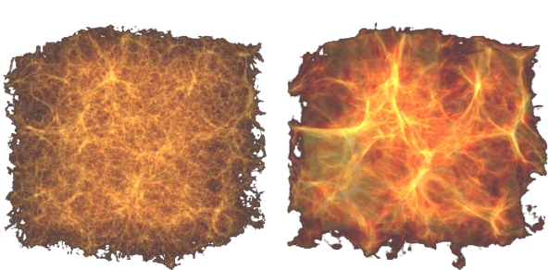

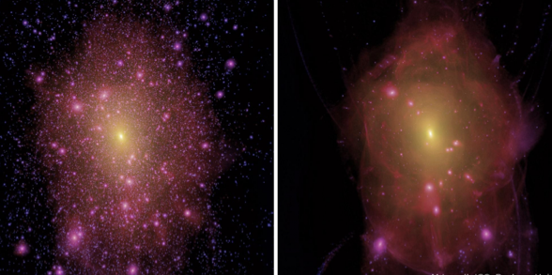

KATRIN & MU Programme Landscape
T1
T3
Light ν HDM component?
- tight constraints from structure formation
T. Haugbølle, Aarhus
Σ m_{i} = 0 eV
Σ m_{i} = 6.9 eV
KeV-scale sterile ν as viable WDM candidate
T2
M. Lovell, ICC Durham
CDM
WDM

Slide 6
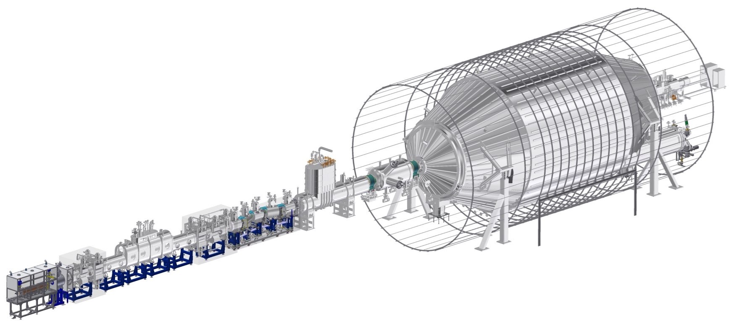
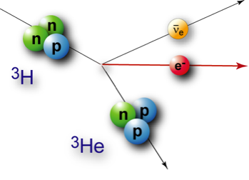
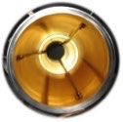


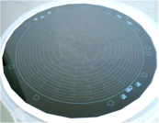
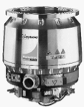
KATRIN overview: 70 m beamline
tritium
pumping
tritium
source
diagnostics
electron
counting
integral
energy
analysis
(MAC-E filter)
tritium
pumping

Slide 7
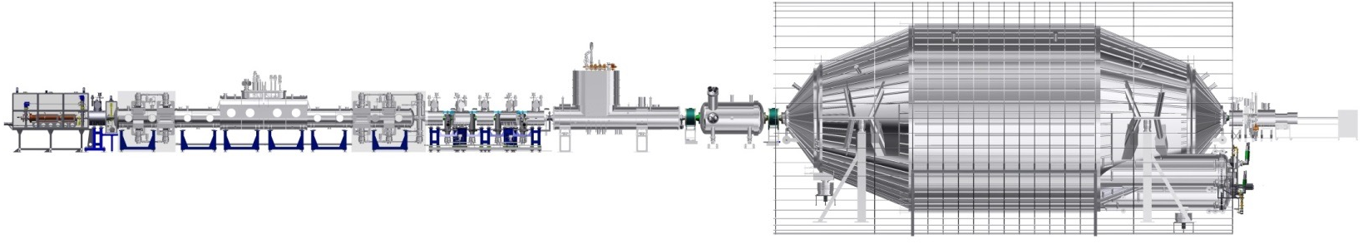
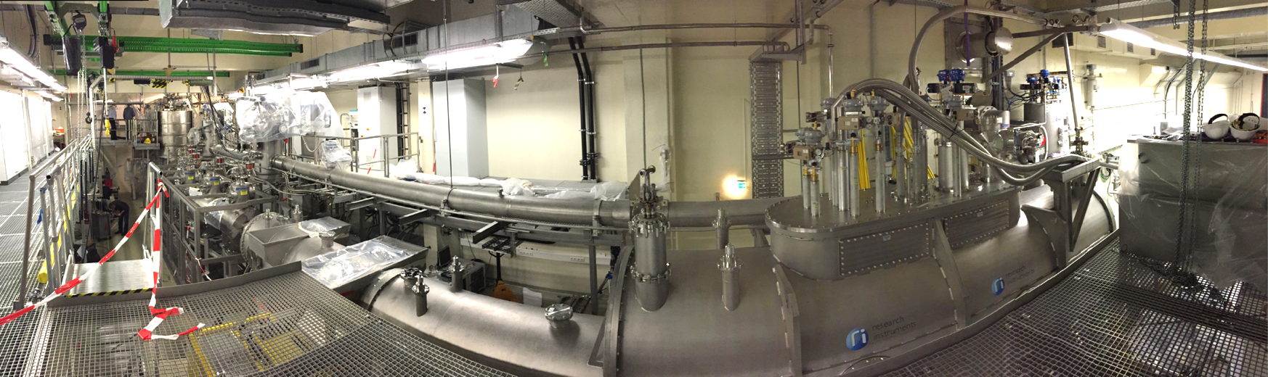

Status of system integration and commissioning
14th Oct. – 30th Nov. 2016
First Light+ Measurement Campaign

Slide 8
Content
Update on KATRIN commissioning
Informal Report from First Light+
Sensitivity on standard neutrino mass
Searches beyond standard neutrino masses
  Update on sensitivity on keV sterile neutrinos
  Recent investigations of exotic CC in beta-decay

Slide 9


Content
Measurement campaign with whole beam line Oct & Nov ’16 in 24/7 operation
First common vacuum operation of 70 m beamline and common magnet operation of 24 s.c. solenoids
Hugh amount of data to check for and demonstrate design requirements, quantify systematics …
{
Update on KATRIN commissioning
Informal Report from First Light+
Sensitivity on standard neutrino mass
Alignment, electron transport, ion suppression, search for penning traps, reliability, backgrounds, stability (source temperature, high voltages, tritium purities…) , cryo trap performance, …
1. Hendrik Seitz (YIG Valerius) The thermal behaviour of the WGTS of KATRIN
2. Florian Heizmann (YIG Valerius) The first light measurements of KATRIN
3. Carsten Röttele et al.: Performance of the Cryogenic Pumping Section
Poster Session

Slide 10
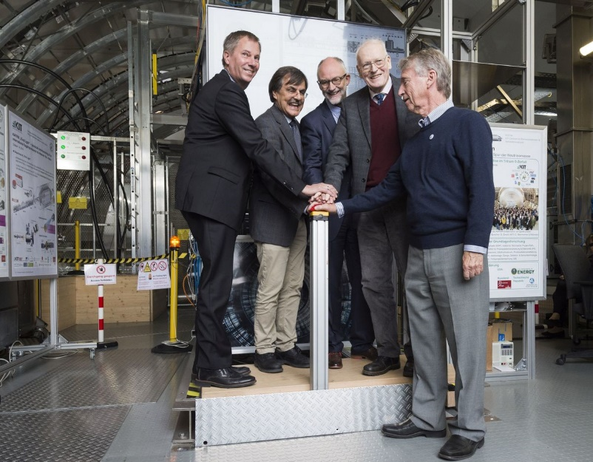
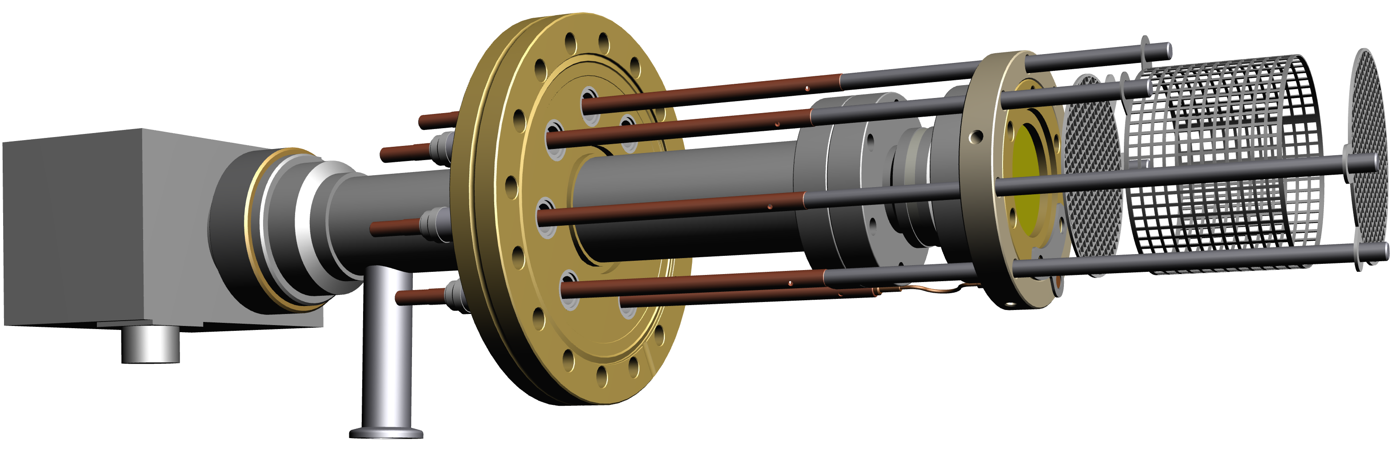
KATRIN First Light & Alignment
Shift of beam trajectories +- 45 mm
possible with magnetic dipoles
Technical inauguration,
October, 14, 2016
Wide range illumination with electrons
with diam. up to maximal
geometry given by source beam tube
Electron or ion (H+) beam
with diam. ~3 mm

Slide 11
KATRIN First Light & Alignment
without any magnetic dipole corrections !
(Center Source – Center Detector): (2.x +- 0.y) mm
Detailed analysis in progress, very good engineering practice,
expect full transport of flux tube from source to detector

Slide 12

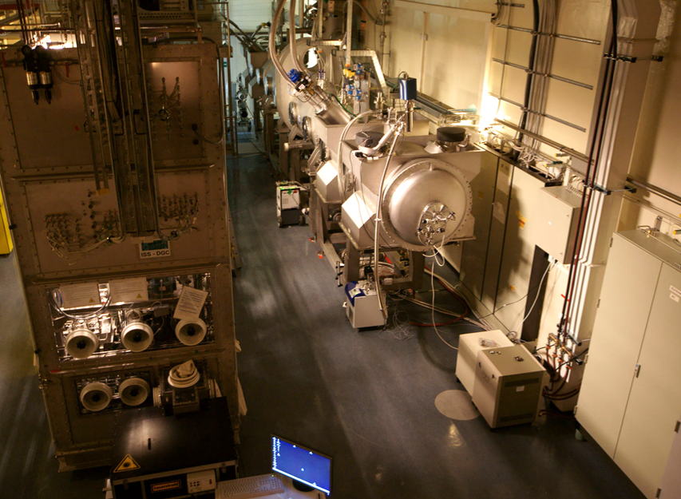
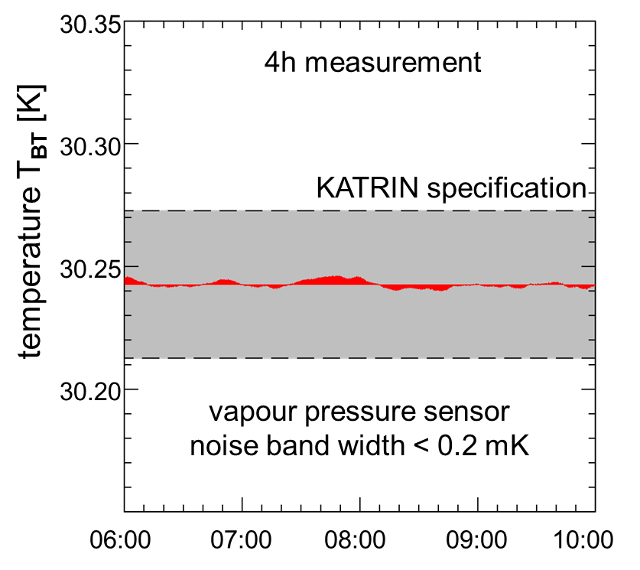
Challenges on stability
Column Density of T2
Δρd/ρd < 10⁻³
required: source fluctuation: ΔT/T < 10⁻³
R&D Demonstrator Results (2011)

Slide 13
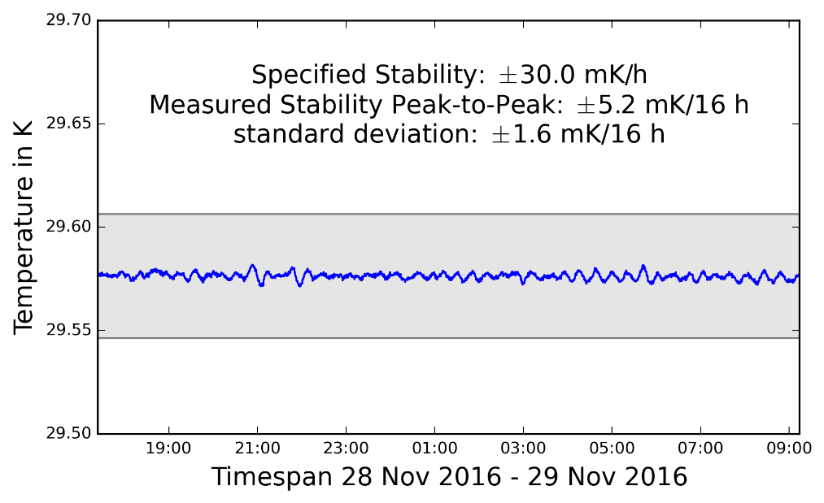
Challenges on stability
„As built“ WGTS integrated into cryo-infrastructure under full load confirms R&D results.
Better than a factor of 10 compared to specs
Column Density of T2
Δρd/ρd < 10⁻³
required: source fluctuation: ΔT/T < 10⁻³

Slide 14
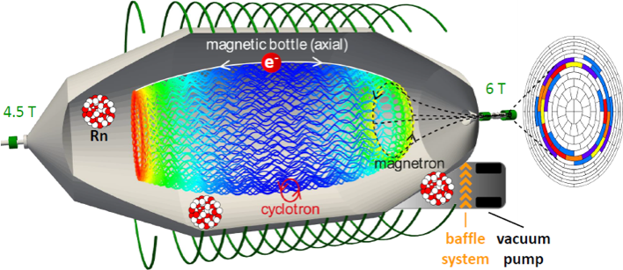
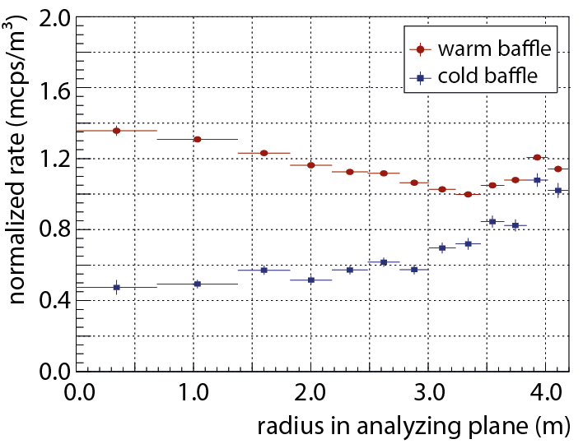
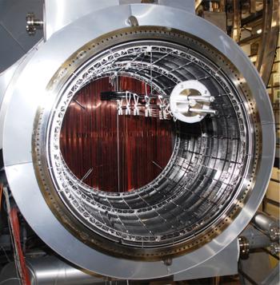
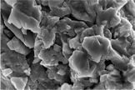
Background investigations
Characterisation of backgrounds
Very efficient magnetic & electrostatic shielding,
but only for charged particles (e⁻ and H⁻)
Neutral, unstable atoms (^{219, 220}Rn, H*) can
penetrate into inner flux tube
→ further measures required, e.g. passive shielding
against Rn-induced secondaries
preliminary
LN₂-cooled baffles
NEG strips
preliminary
477 ± 3 mcps background level achieved

Slide 15
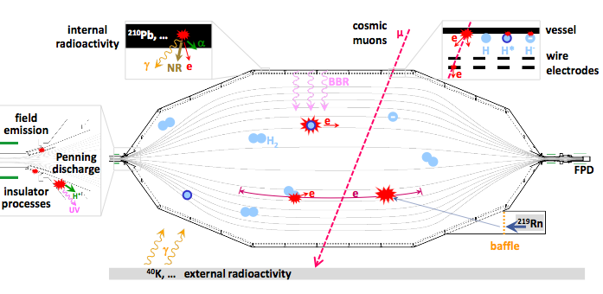
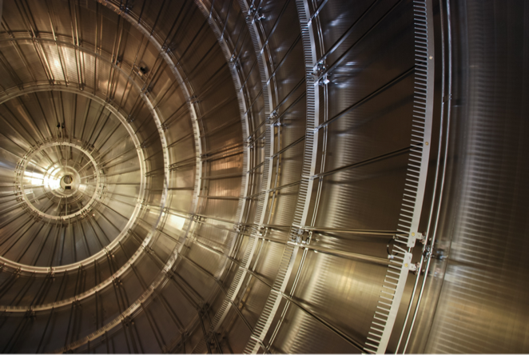
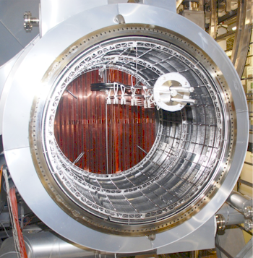
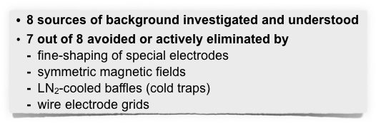
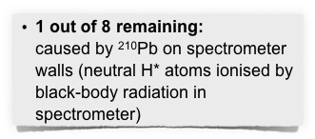
KATRIN spectrometer status: background
(✓)

Slide 16
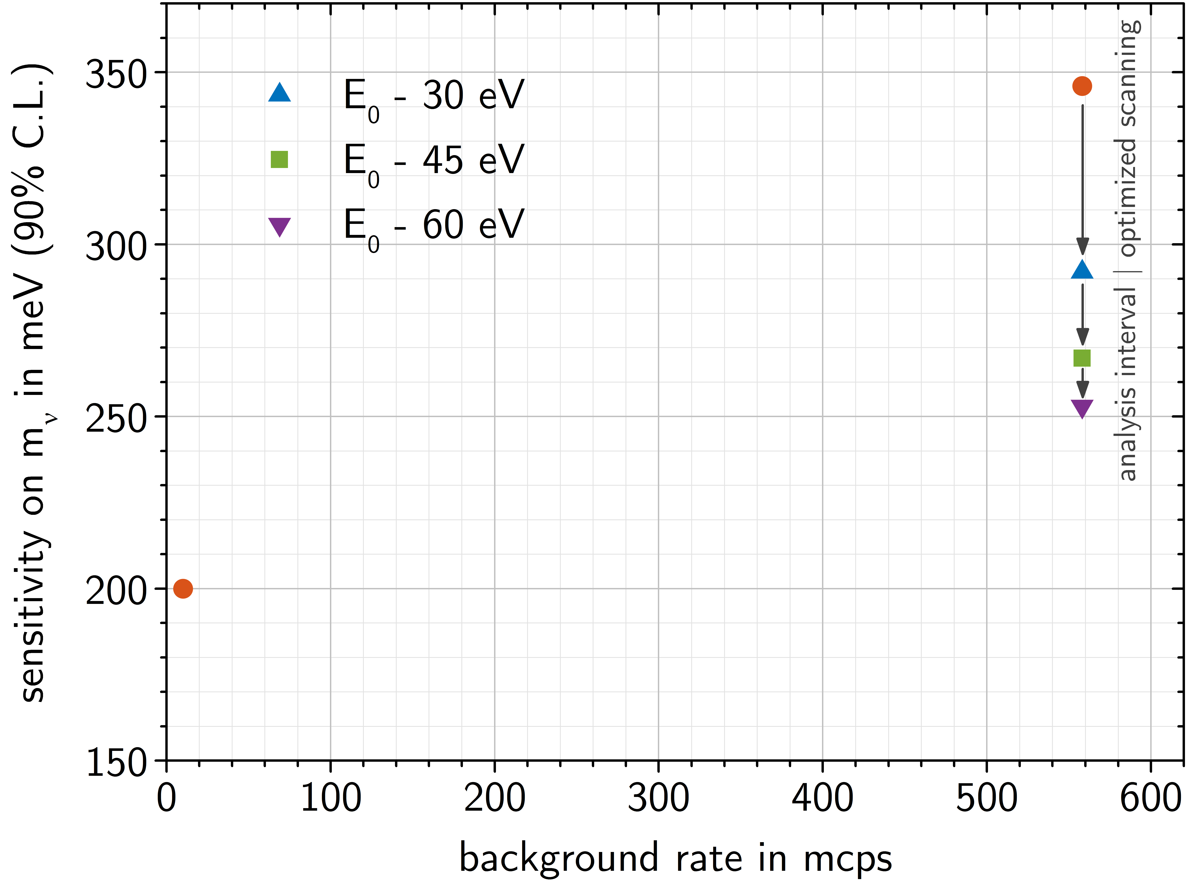
Further background reduction measures being studied
In addition: several mitigation strategies currently under investigation:
558 mcps
non-optimized
preliminary
~290 meV
optimized scanning
range of spectral analysis
flux tube compression by increasing B
TDR 2004
optimized for
10 mcps

Slide 17


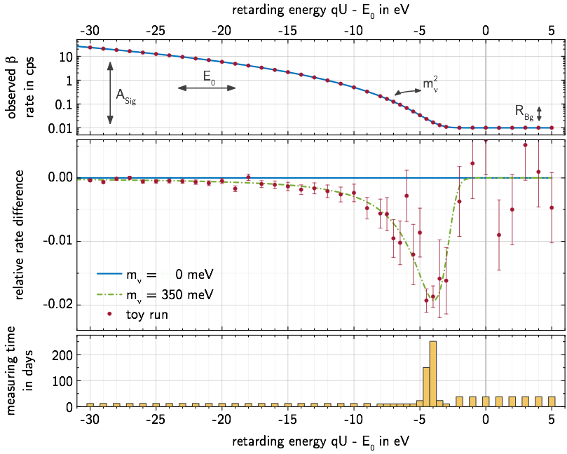

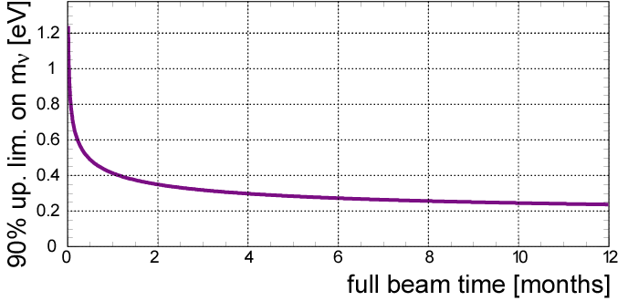

Relative shape measurement
of integrated β spectrum
4 fit parameters:
m²_{ν} , E₀ , A_{S} , R_{Bg}
count rate (s⁻¹)
3 yrs (5 cal. yrs) to balance statistics and systematics
rel. difference
_{at design parameters:}
1200
1000
800
600
400
200
200 meV: 90% CL
300 meV: 3σ
350 meV: 5σ
sensitivity 90% CL [meV]
meas. time (d)
optimal m²_{ν} sensitivity at S/B ≈ 2 [E. Otten, 1994]
0 2 4 6 8 10 12
full beam time [months]

Slide 18
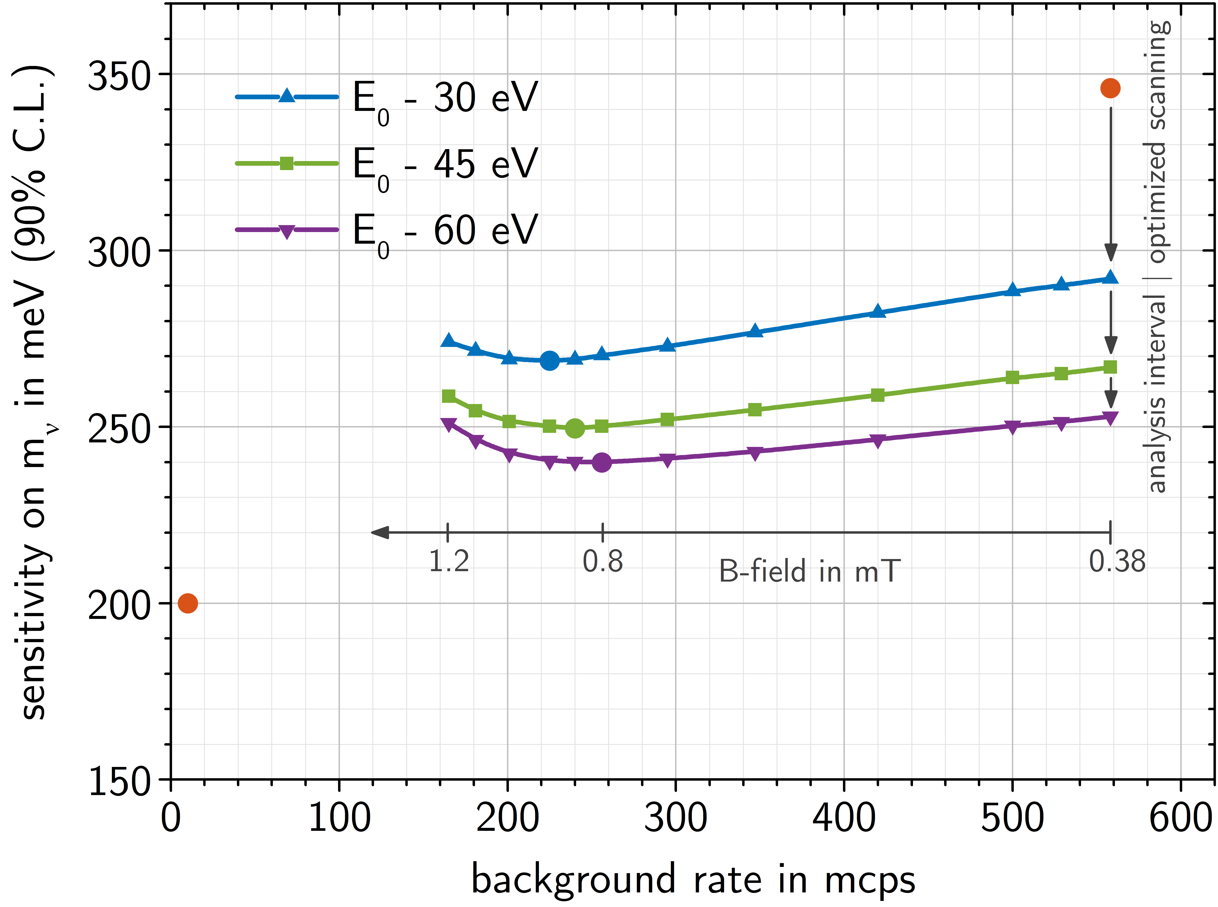
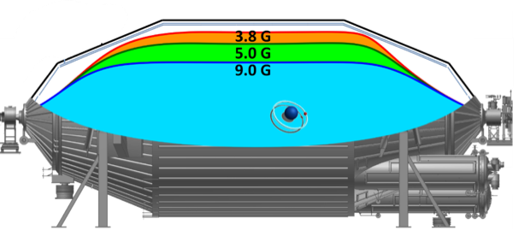
Further background reduction measures being studied
In addition: several mitigation strategies currently under investigation:
558 mcps
non-optimized
558 mcps
non-optimized
preliminary
~290 meV
optimized scanning
range of spectral analysis
~240 meV
ΔE ~ 2.5 eV
flux tube compression by increasing B
TDR 2004
optimized for
10 mcps
TDR 2004
optimized for
10 mcps
0.38 mT
0.50 mT
0.80 mT

Slide 19
Content
Update on KATRIN commissioning
Informal Report from First Light+
Sensitivity on standard neutrino mass
Searches beyond standard neutrino masses
  Update on sensitivity on keV sterile neutrinos
  Recent investigations of exotic CC in beta-decay

Slide 20
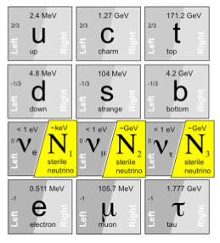
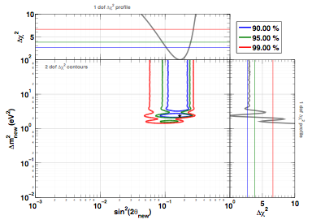

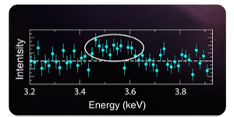
Why sterile neutrinos?
Hints of eV-scale sterile neutrinos?
Hints of keV-scale sterile neutrinos?
May explain anomalous oscillation results from
Short baseline accelerator experiments
Gallium experiments
Reactor experiments
Well motivated as natural extension of Standard Model (νMSM)
[e.g., Canetti, Drewes,
Shaposhnikov (2013)]
In agreement with cosmological observations from small to large scales
[e.g., Shi & Fuller (1999)]
[Bulbul et al. (2014),
Boyarski et al. (2014)]
Recent indirect hints
from X-ray astronomy?
3.5 keV line?
[G. Mention et al. (2011), updated in White Paper (2014)]

Slide 21

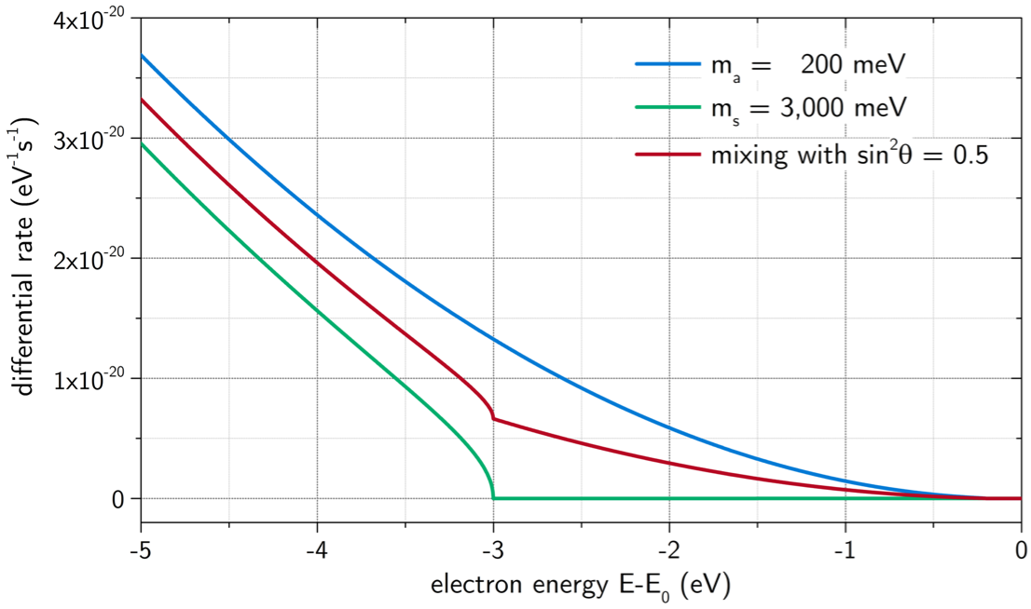
Imprint of sterile neutrinos on β spectrum
Shape modification below E₀ by active (m_{a})² and sterile (m_{s})² neutrinos:
additional kink in β spectrum
at E = E₀ – m_{s}
example:
light sterile ν
m_{s} = 3 eV

Slide 22
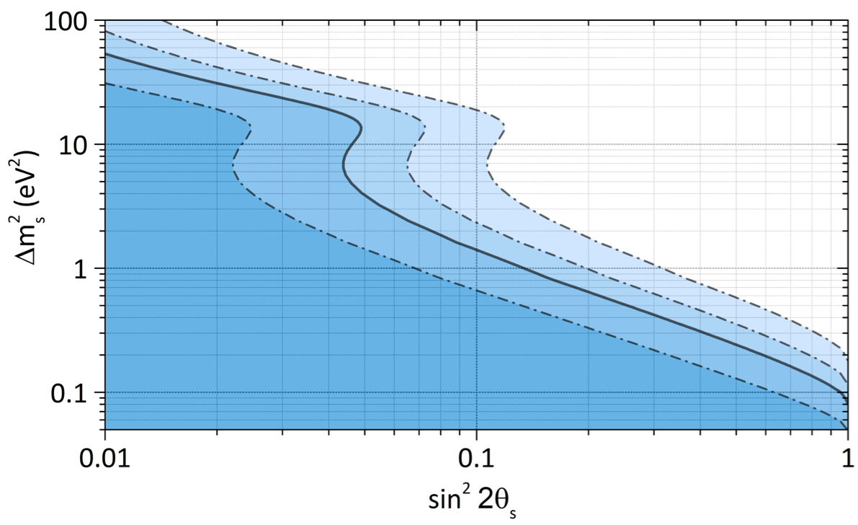

Search for eV-scale sterile ν with KATRIN
“Reactor antineutrino anomaly”:
Favoured parameter space can be probed by KATRIN:
Reactor anomaly (90% CL)
G. Mention et al., PRD 83 (2011) 073006
M. Kleesiek, PhD thesis, 2014
KATRIN exclusion
(3 net years, 90% CL)
3σ
5σ
1σ
See also
Formaggio & Barrett, PL B706 (2011) 68;
Sejersen Riis & Hannestad, JCAP02 (2011) 011;
Esmaili & Peres, PR D85 (2012) 117301

Slide 24
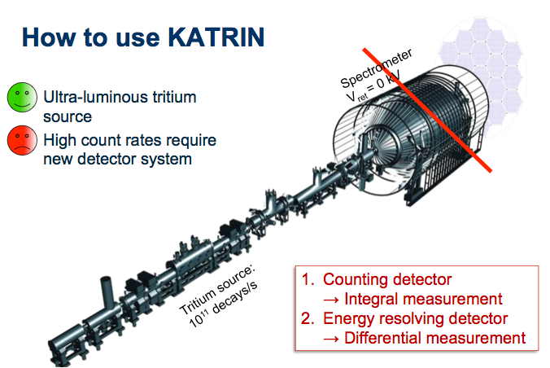
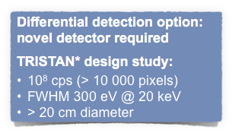
Search for keV-scale sterile ν with KATRIN
The challenge:
High count rates at ~few keV below endpoint
Tiny sterile admixture sin²(θs) expected
Best sensitivity for differential measurement
Development of new techniques necessary!
[Mertens et al. (2015)]
*) TRitium beta decay Investigation on Sterile To Active Neutrino mixing

Slide 25
Search for keV-scale sterile ν with KATRIN
KATRIN „as built“ but
with reduced source
strength, integral
KATRIN „as built“ but
with reduced source
strength, differential
KATRIN with nominal
source strength and
optimized
count rate detector,
(integral)
KATRIN with nominal
source strength and
optimized
count rate detector with
good energy resolution
(differential)
Link to Technologies of other MU topics and MT

Slide 26
Search for non-standard physics with KATRIN

Slide 27
Search for non-standard physics with KATRIN
General Charged Current Interaction allowing Right-Handed Currents:
Matrix element for Beta decay with Mass Mixing Matrix X:
Non-SM:

Slide 28
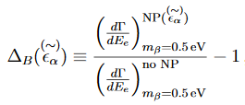
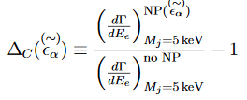
Search for non-standard physics with KATRIN

Slide 29
Search for non-standard physics with KATRIN
Experimental Sensitivity depends strongly on shape of distortion
(e.g. kink like structures preferred)
Improvements on some couplings seem to be within reach
Needs to be quantified from experiment side, taking into account degenaracies with
systematics effects

Slide 30
Summary & Outlook
KATRIN celebrated „Technical inauguration (w/o T₂)“. More than a party …
A first continous 24/7 measurement campaign with the whole beamline, yielding hugh amount of data to check systematics.
Progress in understanding the elevated background, mitigation measures investigated and analyzed.
keV sterile neutrinos: sensitivity plots for different KATRIN configurations and extensions (TRISTAN) published.
Recent detailed innestigations on exotic charged currents with predictions for spectral distortions. Improvements on some couplings seem to be in reach, but needs some more investigations from experiment side to check for degenaracies with systematic instrumental effects.
Contribution to Cross-Topics in Physics & Technology

