Slide 1







From Matter to Materials and Life
Thomas Stöhlker, HI-Jena / GSI
Spokesperson of the Programme

Slide 2
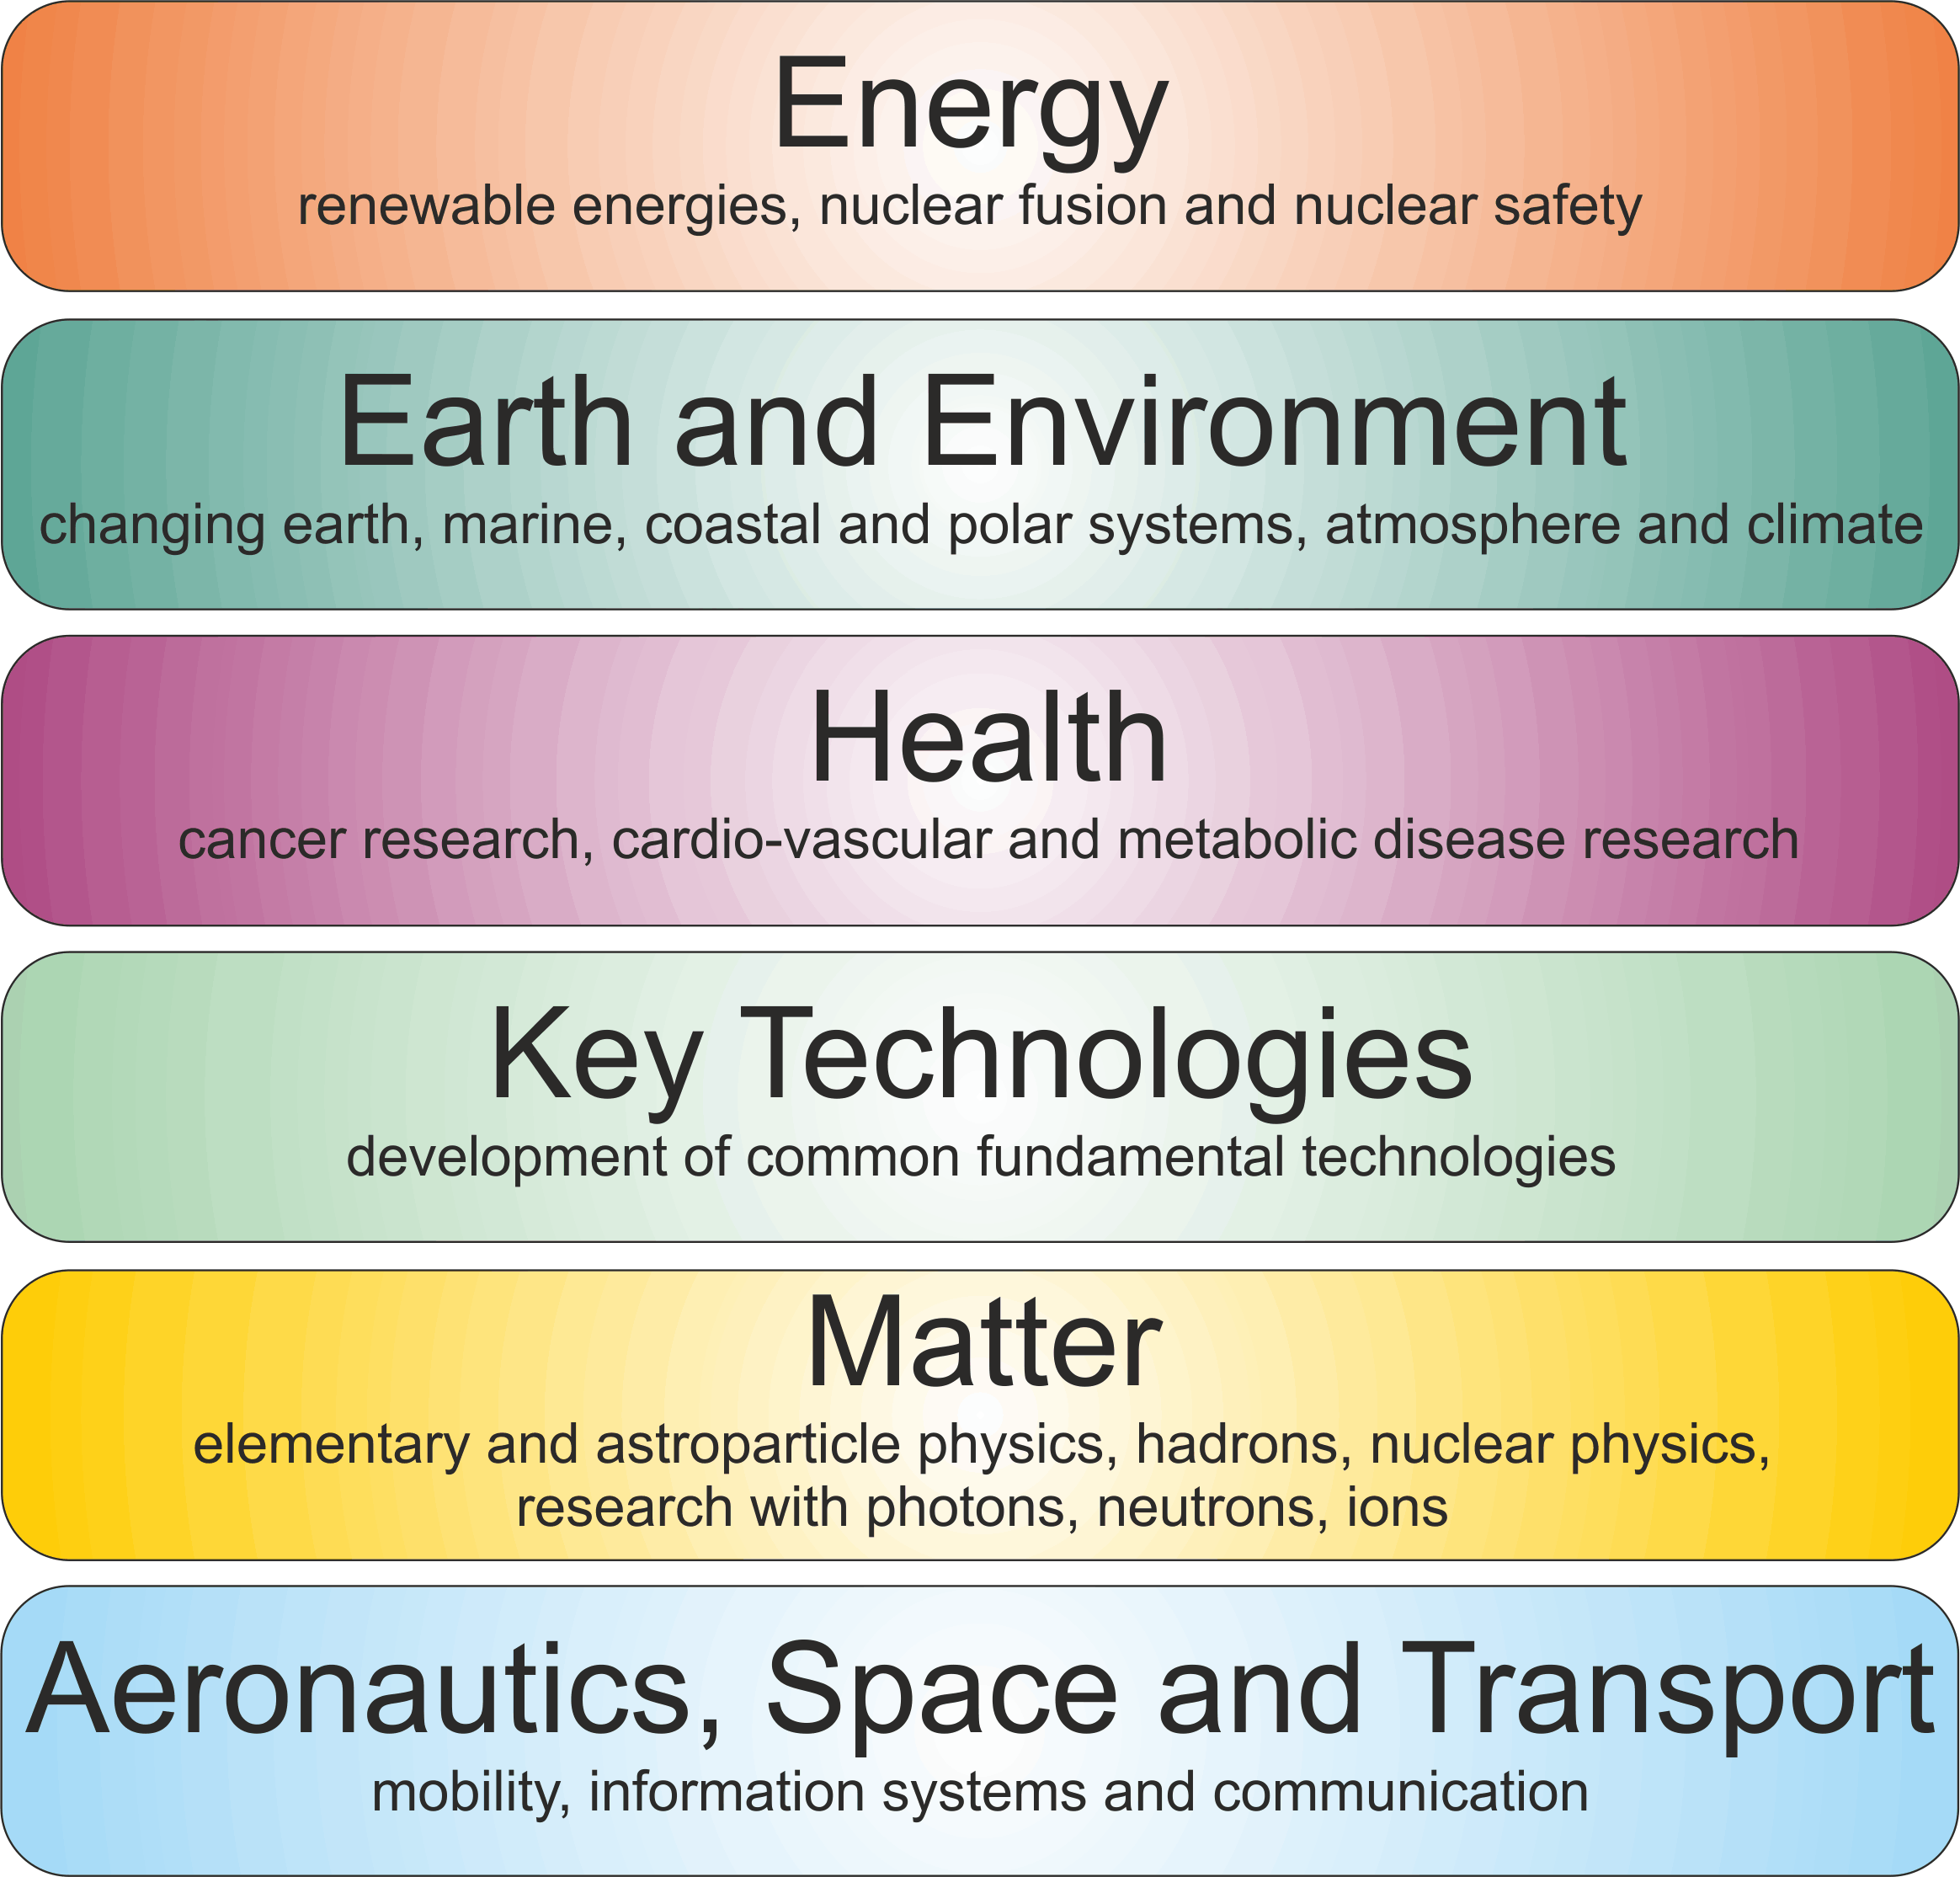

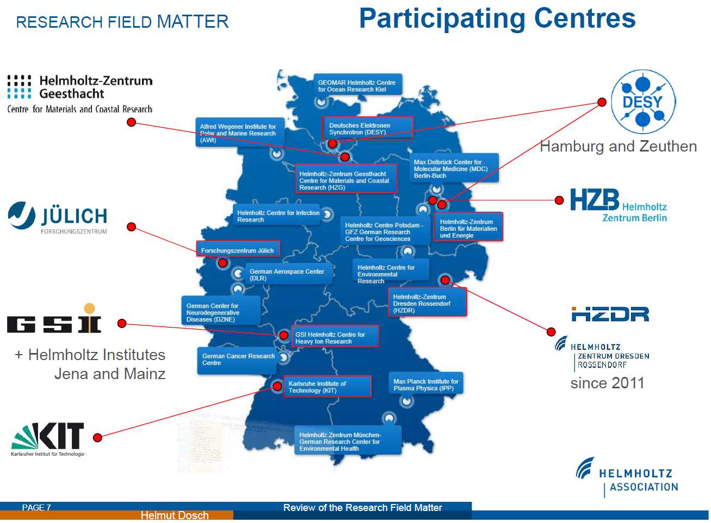
Research Fields of Helmholtz
Research Programs of Matter
Keep in mind: Almost all large research infrastructures are located in the reseach field Matter!

Slide 3
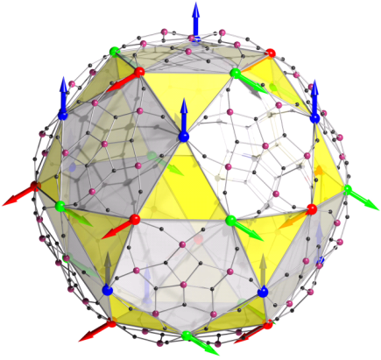
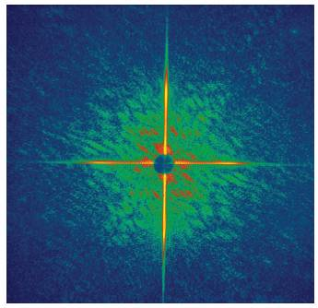
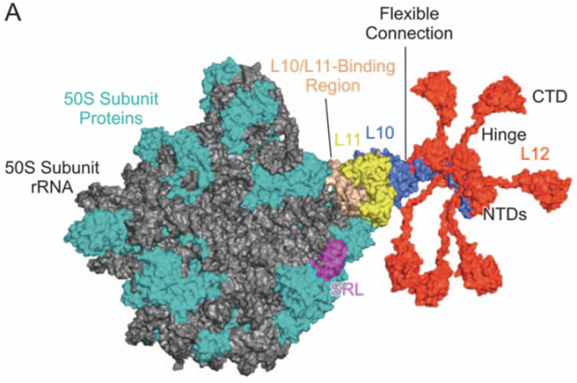
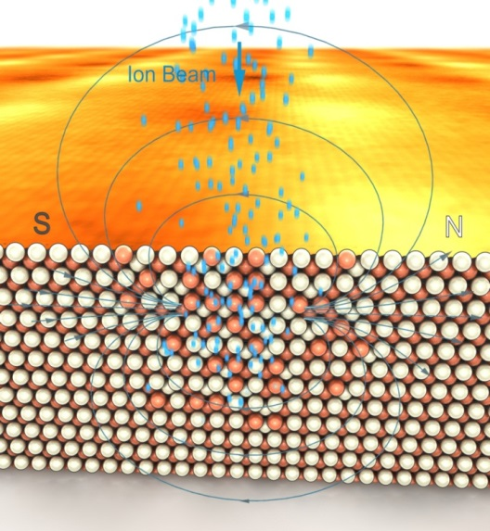
The Helmholtz programme
„From Matter to Materials and Life“
Provide the means to gain essential information on the
Structure, dynamics and function
of matter and materials, which can not be obtained on the lab scale,
and modify the above
Ions
Light

Slide 4
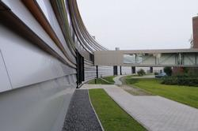
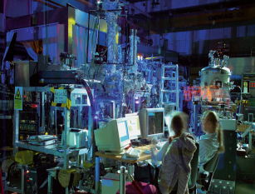
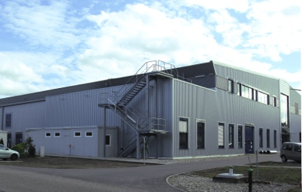
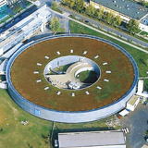
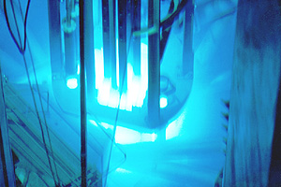

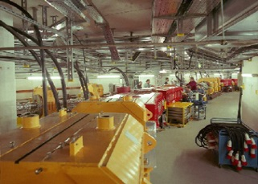
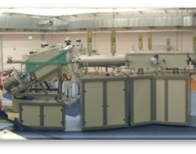
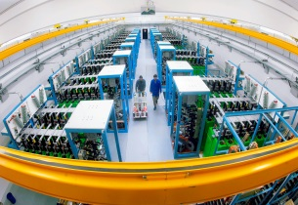
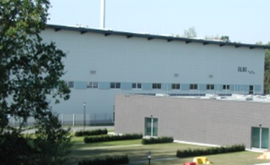
The facilities of „From Matter to Materials and Life“
PETRA III
FLASH
ANKA
PHELIX
BESSY II
Photons
BER II
Outstations
at FRM,
SNS, ILL
Neutrons
Operates large scale infrastructures for the investigation and modification of matter and materials !
GSI
IBC
Ions
HLD
ELBE
Highest EM - Fields

Slide 5
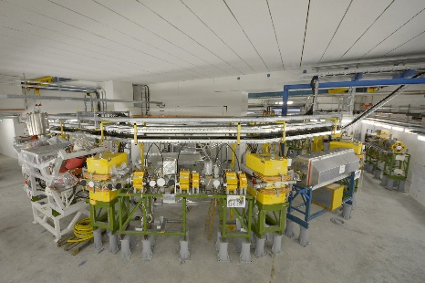
Important structural changes
KIT
ANKA is transfered form a user facilitiy
(LKII) to a In-House research facility (LKI).
GSI/FAIR
In 2017 the CRYRING will be put into
operation for MML relevant research.
In 2018, a midterm research program at
GSI will be started and the facilities will be
available again for user operation.
HZB
End of 2019 the operation of BERII will be
phased out.
ANKA
CRYRING
BER II

Slide 6
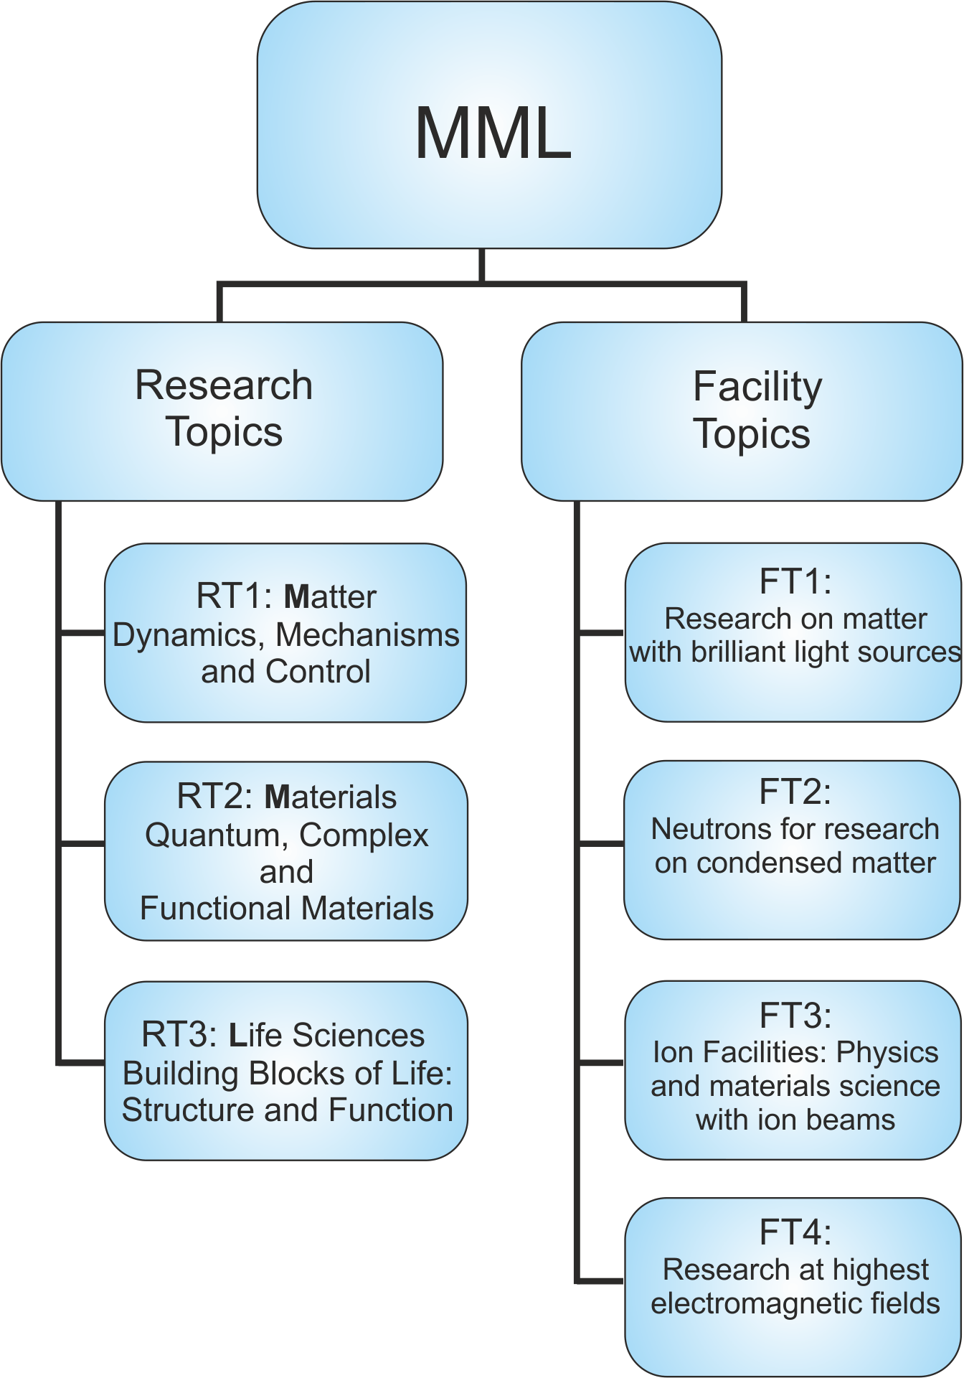
The Helmholtz programme
„From Matter to Materials and Life“
The new structure of the research topics reflects the developement of in-house research during recent years.
Matter: non-perturbative fields, matter under extreme conditions, stellar plasmas, real-time chemical processes, nonlinear and quantum optics, novel phases of matter und science-driven instrumentation, methodology.
Materials: quantum matter under extreme conditions, time and spatially resolved studies on nanomaterials, dynamics in complex systems, functional materials towards devices, in situ/operando studies of functional materials and processes.
Life Sciences: subcellular components down to proteins and biomembranes, cells, tissues and organs up to small organisms, biomaterials, tissue engineering, bionics and biotechnology.

Slide 7
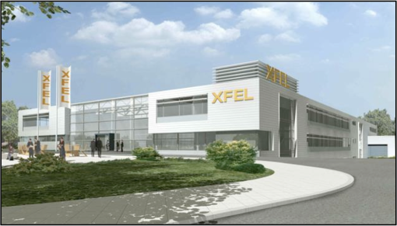
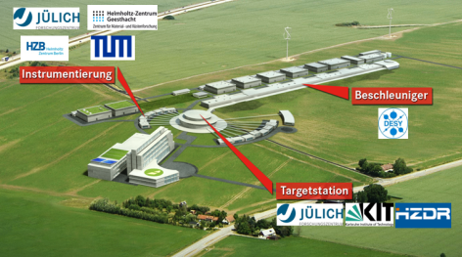
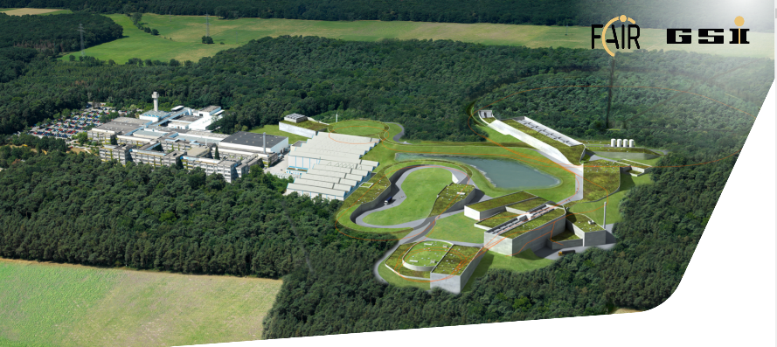
Opportunities and Challenges
Contribution of MML to the commissioning and user-operation of the international large scale facilities XFEL, ESS, and FAIR
Start: 2017
Start: 2020
Start: 2024

Slide 8
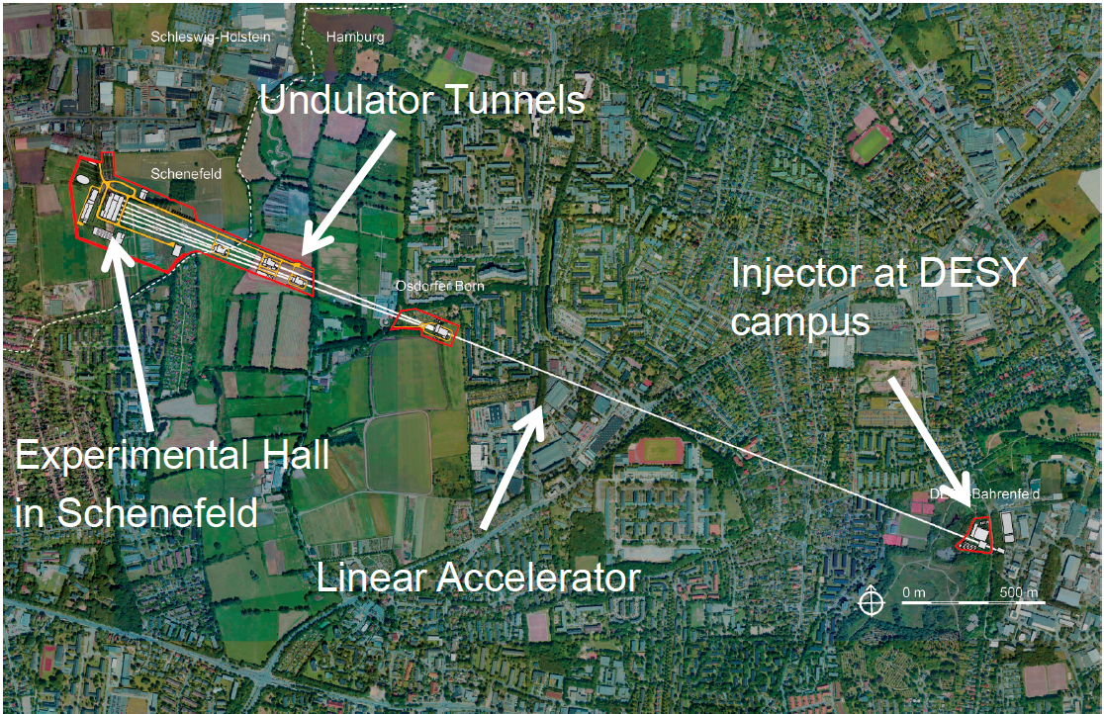
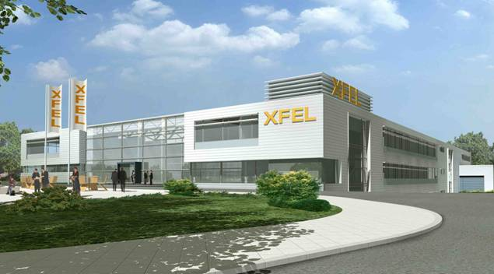
MML Contribution to European XFEL Facility
Status:
First beam in injector since end 2015, successful commissioning
Cool down of the linac right now
First electrons in linac: Jan 2017
First friendly user experiments:
late Spring 2017
Main applications:
Spectroscopy, imaging and diffraction at
ultra short time scales (10-150 fs)
Pump – probe experiments
Coherence and peak brilliance applications
Non-linear effects at high field strength
Low target density experiments

Slide 9
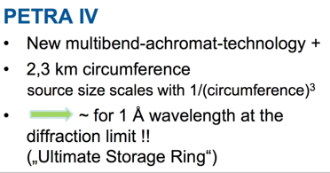
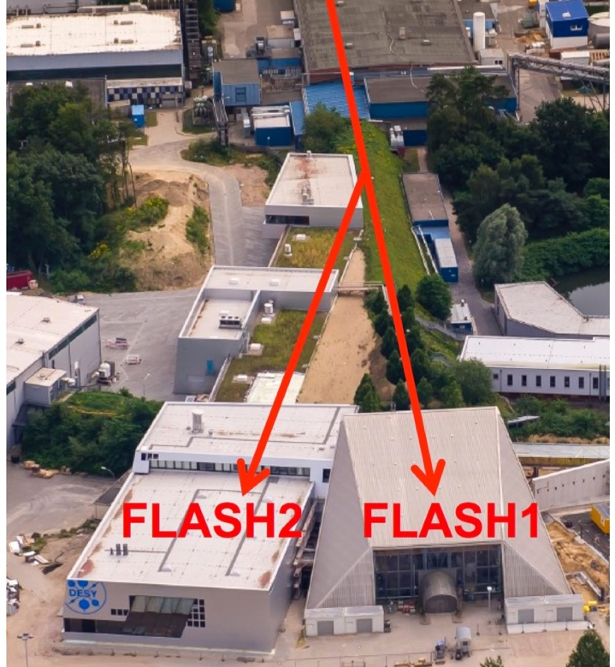
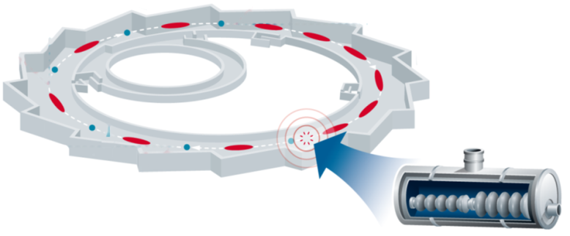
Photon Sources: Anticipated longterm developments
DESY
Application of almost all present day synchrotron radiation techniques spatially resolved on the O(nm) lateral resolution
Ultimate hard X-ray nanoscope
time scale: ~2025
FLASH2020 Upgrade of the FLASH linac toward higher repetition rate (0.1 – 1 MHz)
➔ up to a factor of 100 higher efficiency
for weakly interacting samples possible
HZB
Upgrade: BESSY VSR - Variable Pulse length
Keep brillance & stability of 3rd generation SRS
Add short bunches: sub-ps and ps MHz rep. rate
Let user switch individually

Slide 10
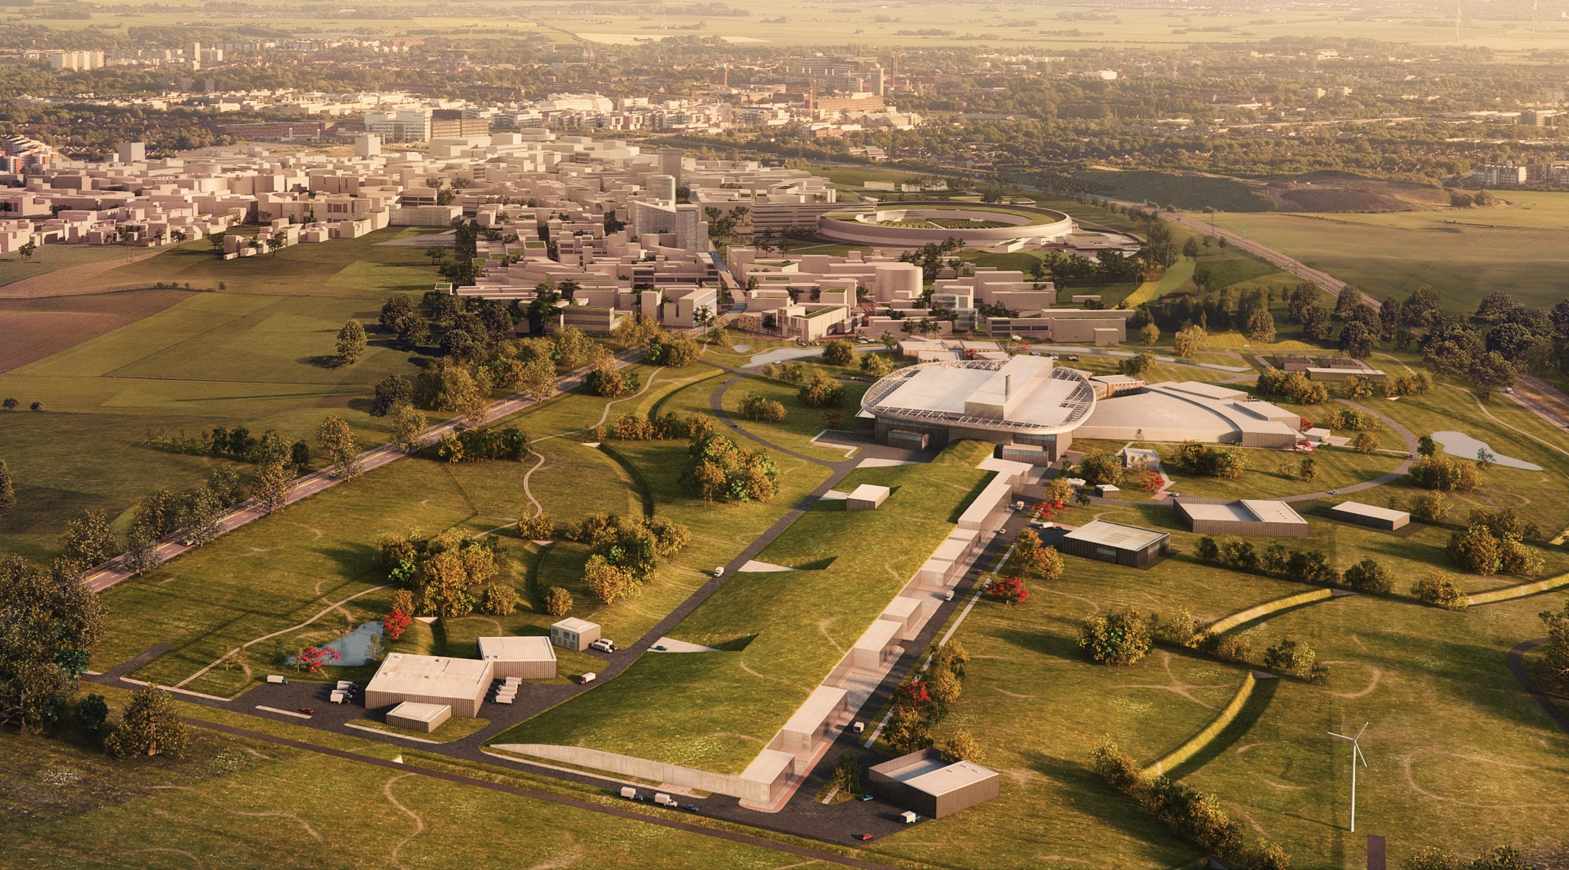
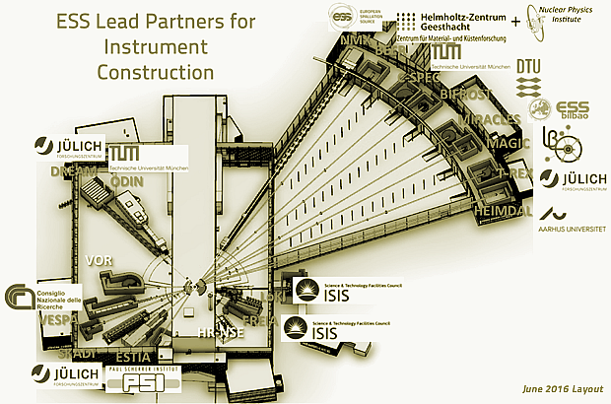
Neutrons: European Spallation Source ESS
17 European partner countries
world leading neutron source
2019: first neutrons
2023: start user operation
22 instruments
first tranche:
15 instruments selected
7 out of 15 instruments
with German participation:
BEER: engineering diffraction
C-SPEC: Cold chopper spect.
MAGIC: single X-tal diffraction
T-REX: bispectral chopper spect.
SKADI: small angle scattering
DREAM: powder diffraction
ODIN: imaging
Lund, Sweden
MAX IV
science village
ESS
past 2020

Slide 11
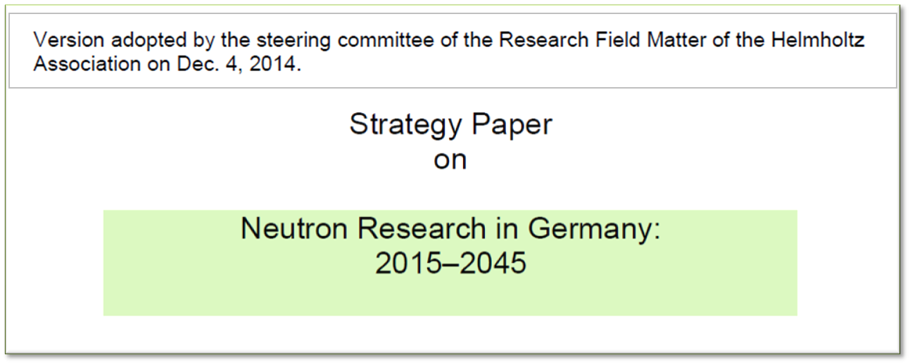
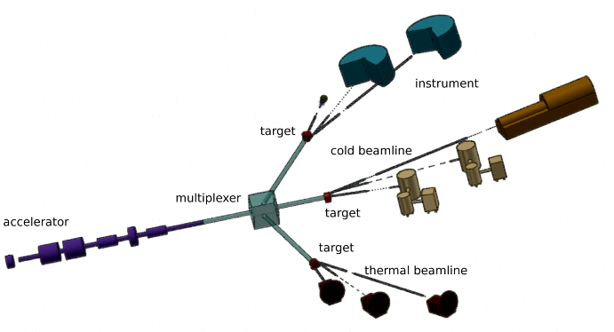
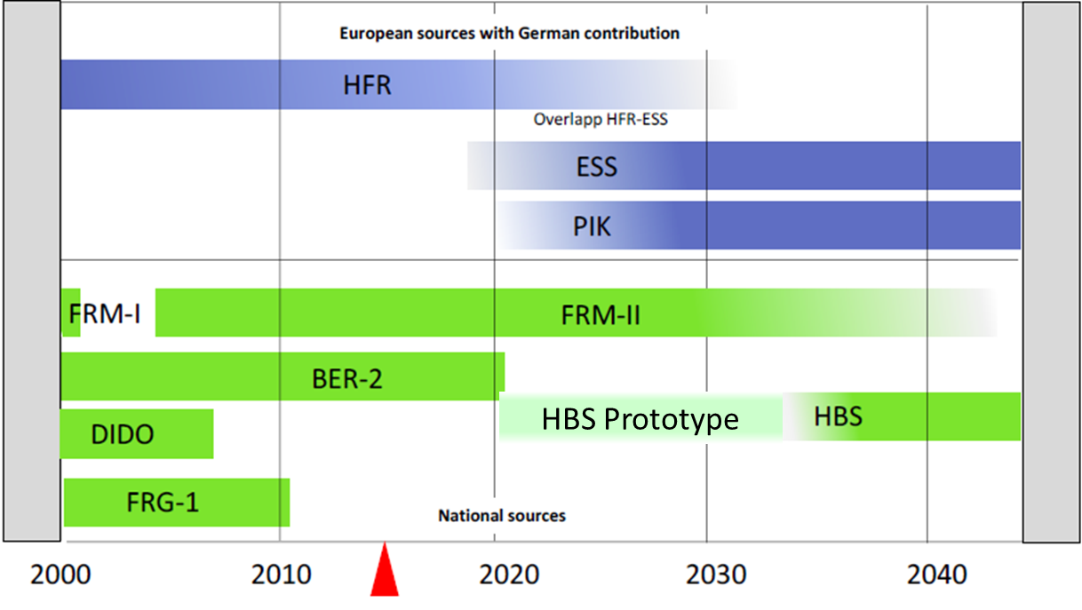
German Neutron Strategy
High Brilliance Neutron Source HBS
optimize the accelerator driven source from ion source to detector for every single instrument
European Spallation Source (ESS)

Slide 12
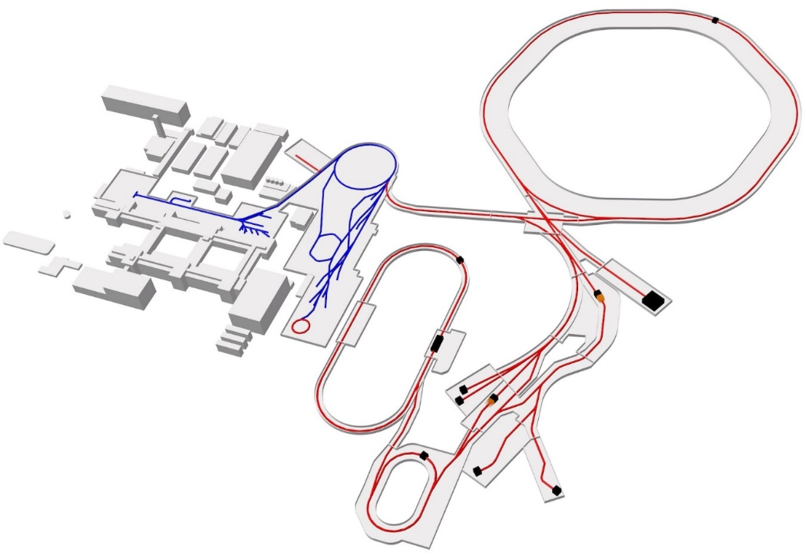

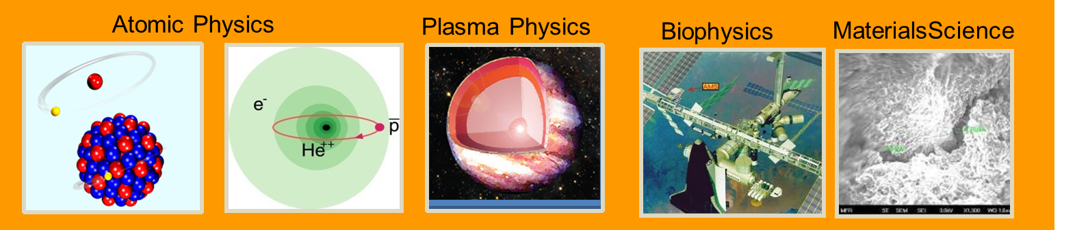
MML participation in FAIR
Research Topics
Non-perturbative fields
Correlated multi-body dynamics
Metrology: fundamental constants
Materials under extremes
Radiation hardness of materials
Space radiation biophysics
Particle therapy
Stellar plasma physics
Planetary astrophysics
…
….
highest charge states
stored and trapped ions
relativistiv energies
highest intensities

Slide 13
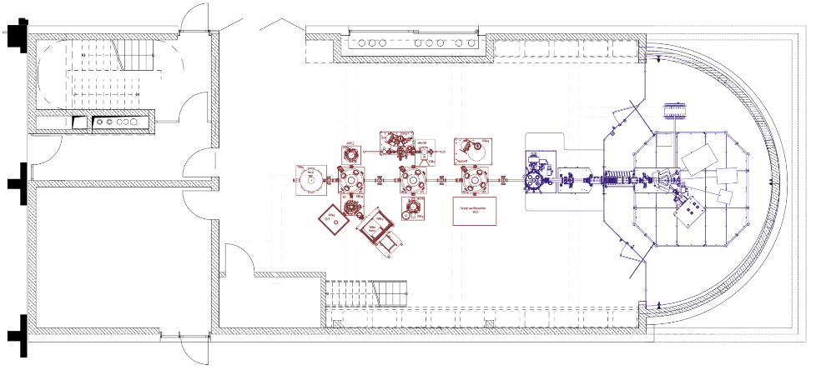
Strategic Developments at HZDR and GSI
IBC Extension: LEINEF (Low Energy Ion Nano-Engineering Facility)
CRYRING at GSI
Tackling main challenges for future Energy, Information Technology and Environment
Stored ions at any charge state but low beam energies: 0.1 to 15 MeV/u
Precision experiments in the realm of strong fields and astrophysics
Surface / Materials science
Modification and analysis of thin films, surfaces and 2D materials

Slide 14
Thank you for your attention
Summary
The Helmholtz programme „From Matter to Materials and Life“
focusses on large scale infrastructures for photons, neutrons, ions and high electromagnetic fields
provides essential insights which can not be obtained by other means
provides essential contributions to grand challenges ranging from energy to health

