Slide 1

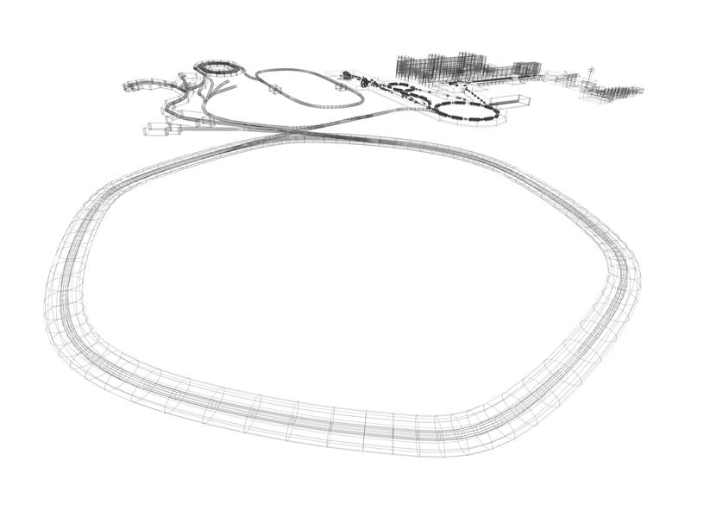
GSI / FAIR Strategy
towards 2025
Paolo Giubellino
Matter & Universe Meeting, HI Mainz, 12/13 Dec. 2016

Slide 2
Outline
Introduction
Major events and decisions
Civil construction – realization plan
Beam time 2016 and recent research highlights
Intermediate research program FAIR Phase 0
Updated physics programs by the Collaborations
Summary and Outlook

Slide 3
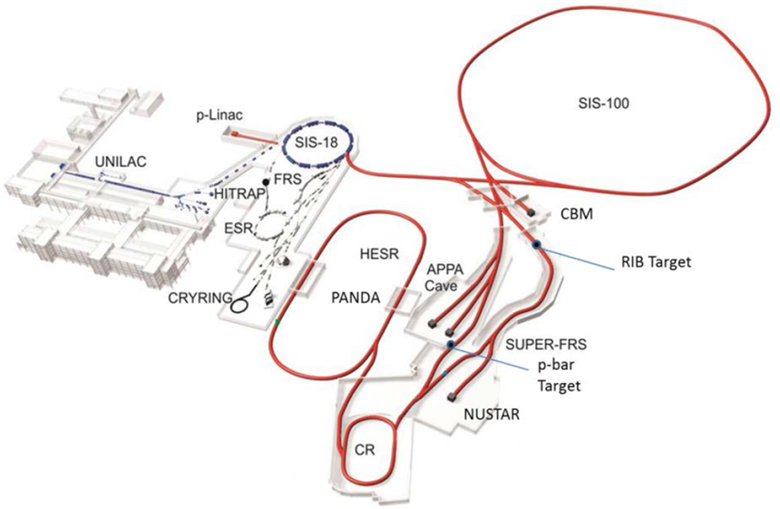
FAIR Accelerator Complex
GSI
100 m
FAIR

Slide 4
FAIR Accelerator Complex
FAIR
... accelerates particle beams from
(anti)protons up to uranium ions with
very high intensities
  up to a factor of ~100 increase for primary Uranium beams (~ 5 x 10¹¹ U²⁸⁺ ions /s),
  up to a factor of ~10.000 increase for secondary rare isotope beams
high pulse power (up to ~ 50 kJ / 50 ns)
suite of storage cooler rings equipped with stochastic and electron cooling for brilliant
beam quality
... develops and exploits innovative particle
separation and detection methods, as well as
novel computing techniques
... to perform forefront experiments
towards the production and
investigation of
New Extreme States of Matter.
GSI
100 m
FAIR
Notes:
Aus Langanke Vortrag (1.8.16)

Slide 5

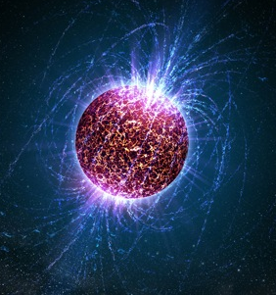
FAIR – four research pillars
CBM
nuclear matter at high densities
APPA
ions in extreme
electro-magnetic fields
PANDA
hadron physics with antiprotons
NUSTAR
neutron-rich nuclei

Slide 6
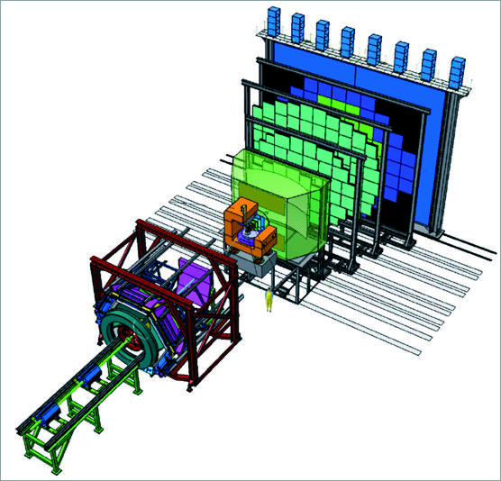
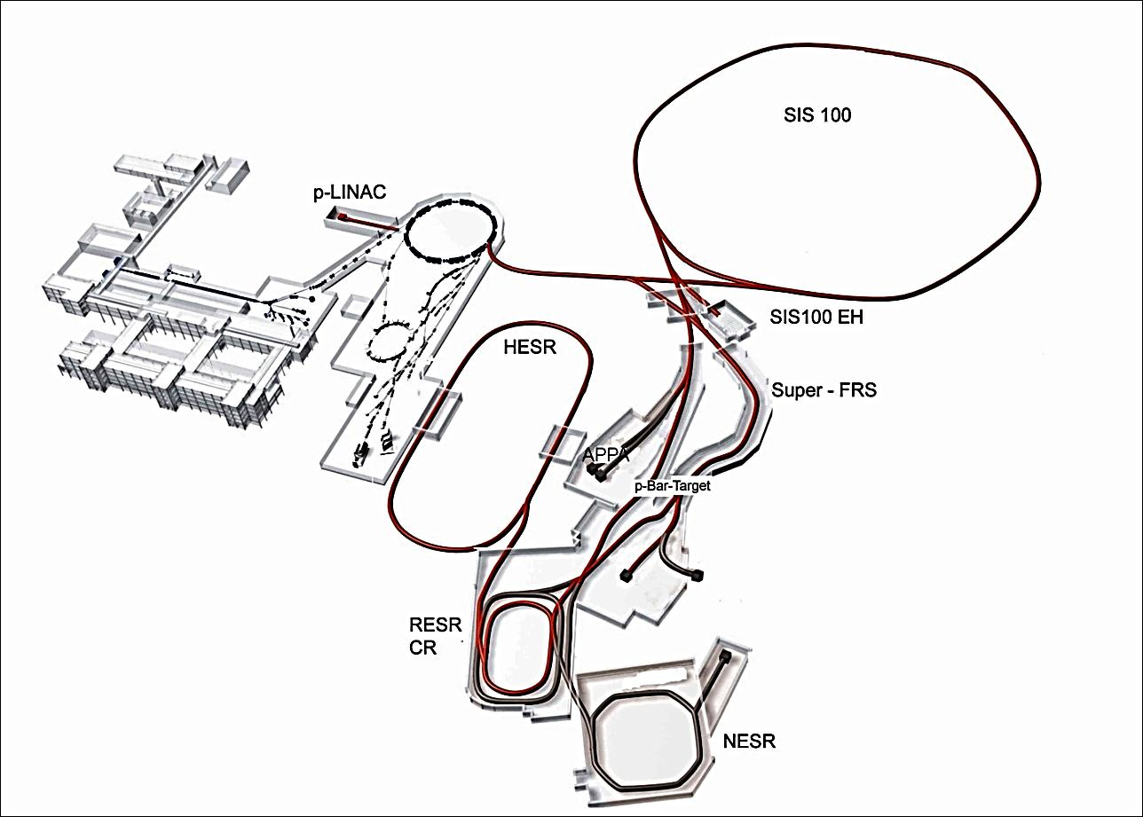
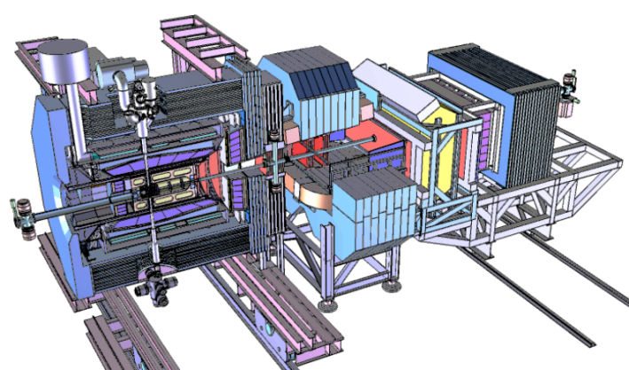
FAIR – four research pillars
APPA
CBM
NUSTAR
Super-FRS
PANDA
PANDA

Slide 7
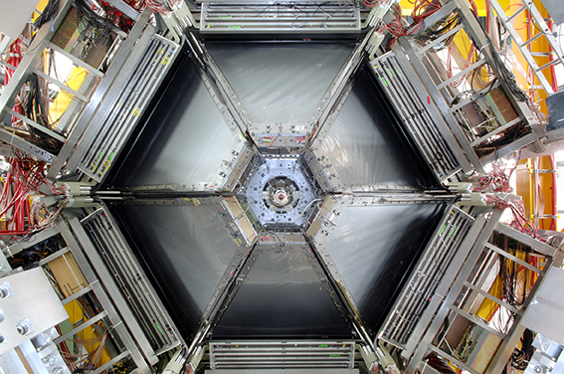
FAIR – four research pillars
Atomic Physics and Fundamental Symmetries,
Plasma Physics,
Materials Research,
Radiation Biology,
Cancer Therapy with Ion Beams / Space Res.
Dense and Hot Nuclear Matter
Nuclear Structure far off stability,
Physics of Explosive Nucleosynthesis (r process)
Hadron Structure & Dynamics with cooled antiproton beams
APPA
CBM
NUSTAR
PANDA

Slide 8
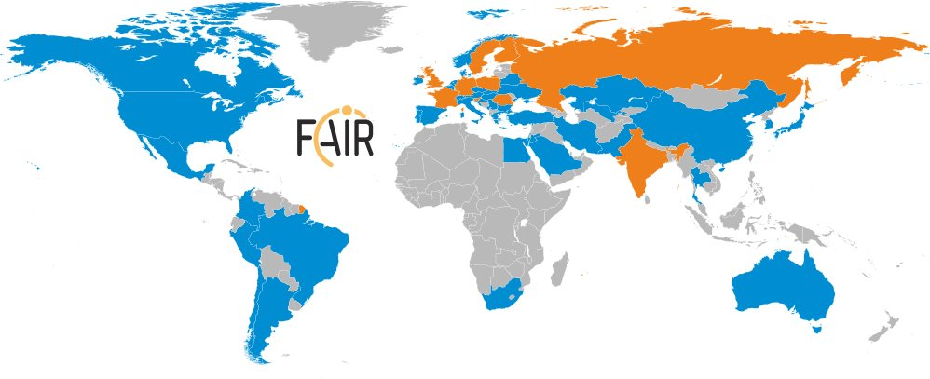
International Participation in FAIR
FAIR governed by international convention
  9 shareholders + 1 assoc. partner (orange)
Scientists from all over the world are engaged
  More than 200 institutions from 53 countries are involved with their scientists (orange + blue) → FAIR community growing

Slide 9
Major events and decisions

Slide 10
Major events and decisions ...
... Council decisions from June/September 2015
Despite the cost increase in civil construction Council confirmed in June 2015 the goal to realise the FAIR facility as outlined in the Convention → Modularised Start Version (MSV)
MSV to be completed by 2025 at the latest; stepwise realisation approach in order to start experiments as early as possible
In September 2015, the Shareholders committed to confirm the first tranche of additional funding in 2016; commitments for the second tranche are to be made by 2019

Slide 11
Major events and decisions in 2016
Confirmation of most FAIR partners to cover their share in the additional cost for civil construction has been received; the remaining confirmations are expected soon.
13 September 2016: BMBF approved funding for the civil construction of FAIR northern site area
Inquiry and contracting of civil construction has started 26 September and 22 November 2016: first calls for tender for ground water lowering, trench sheeting excavation and building shell for construction have been launched.
7 December 2016: Full integrated planning for the FAIR construction and commissioning presented in the Council. Solid resource loaded plan for the completion of the project by 2025.

Slide 12
Civil construction – realization plan
FAIR CC animation

Slide 13
FAIR construction site
Northern and southern area:
Northern
site area
Southern
site area

Slide 14
FAIR civil construction – realization plan
FAIR CC animation

Slide 15
Beam time 2016
and
recent research highlights

Slide 16
Research at GSI continues
Beam Time 2016 – brief summary
  3 months, from April 25 to July 21
  Global machine availability was about 75% for parallel operation as in recent years
  Very efficient parallel operation at SIS/ESR: average beam delivery to three experiments in pulse-to-pulse operation
  The envisioned testing and experimental program was successfully served – essentially all scientific and technical objectives could be achieved.
  Instrumental highlight: start of commissioning of the Cryring
  Physics highlight: Pioneering measurements of proton-capture reactions at the internal target of ESR demonstrating the feasibility of precision studies of astrophysical reactions at storage rings.

Slide 17
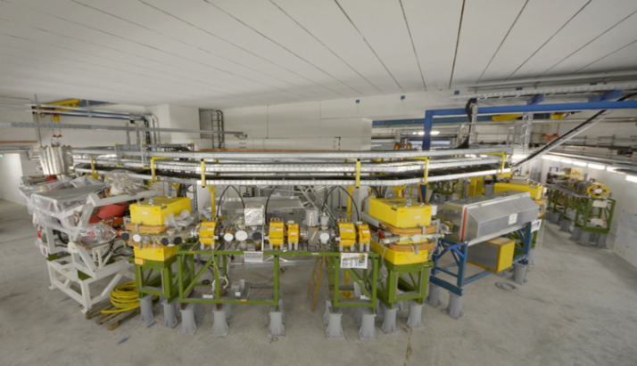
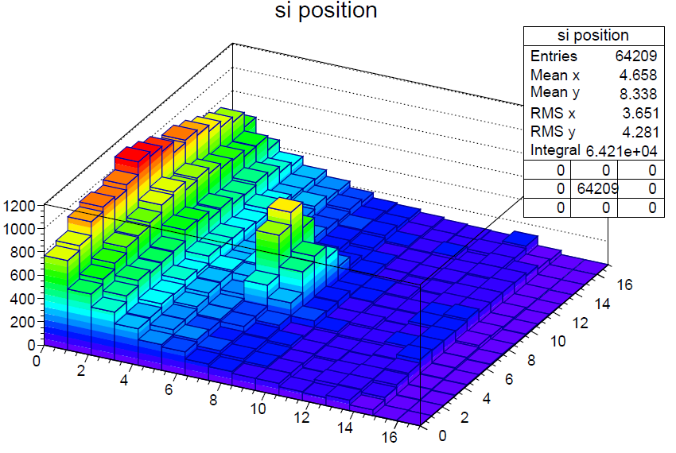
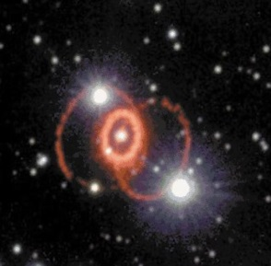
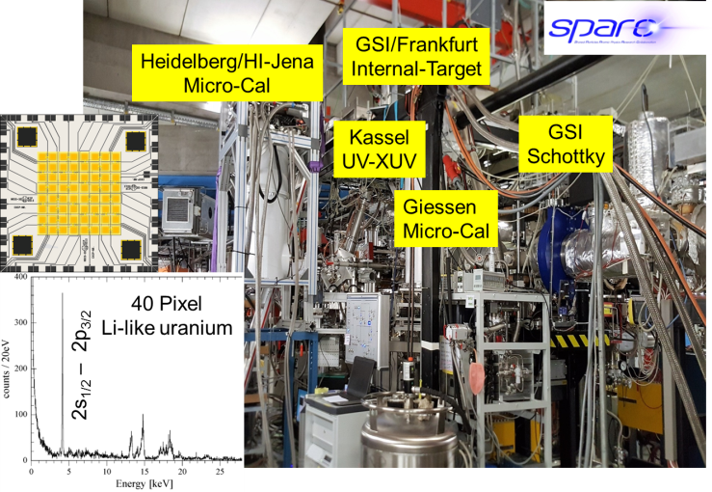
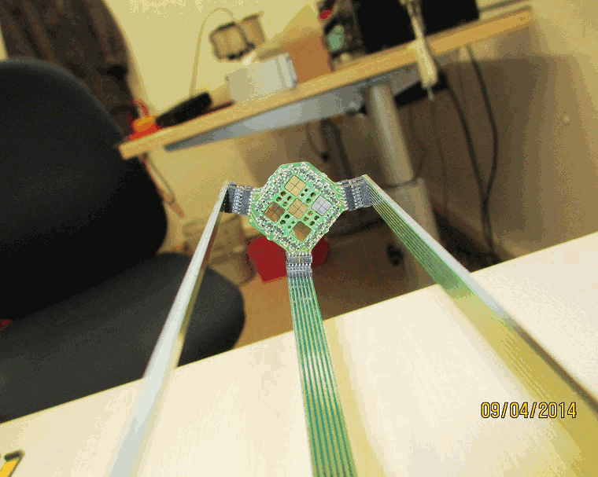
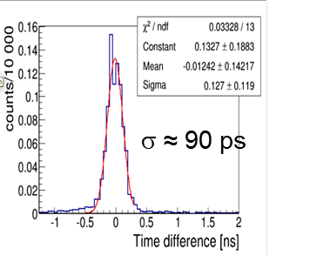
Highlights from 2016 Beam Time at GSI
Successful start of commissioning
of the Cryring@ESR (first turn achieved)
Cryring@ESR
Successful proof-of-concept of nuclear
astrophysics studies in storage rings
using the 124Xe (p,γ) nucleosynthesis reaction
(p,g) signal
Successful test of novel APPA / SPARC instrumentation
Tests of CVD diamond detector
  In vacuum operation without cooling
  Rate capability up to 10⁷ MIPs/s/mm2
  Timing resolution (sigma) 90ps
  Radiation hard material CVD diamond

Slide 18
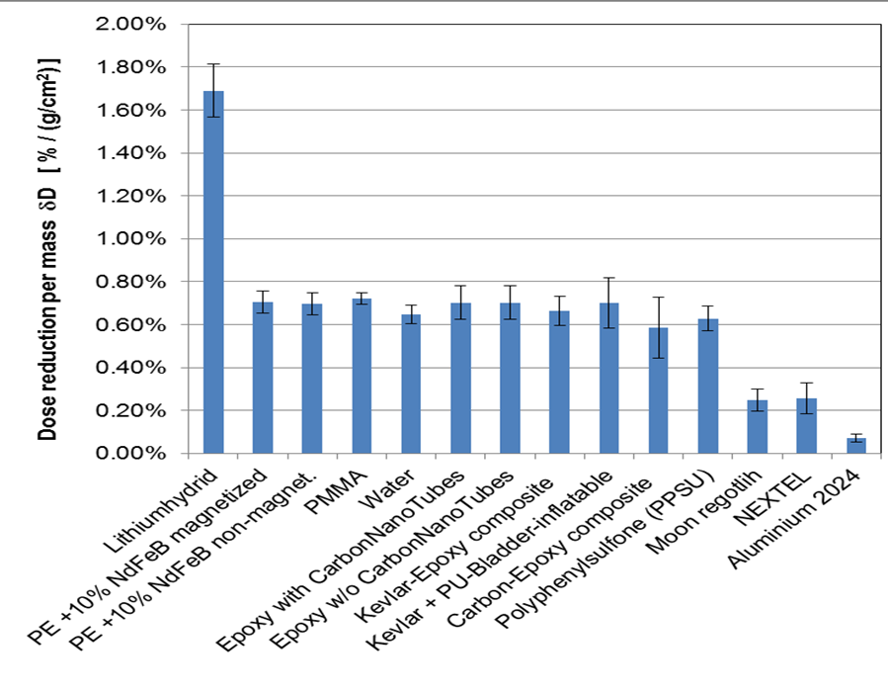
Further research highlights
- Biophysics
Measurement of shielding properties
of Lithium Hydrid (LiH) in combination with FAIR relevant detector setup
LiH is very promising shielding material for reduction of the astronauts dose during long-term
space missions.
Awards:
Recognition by the editorial board of Physics in Medicine and Biology of the paper by M. Krämer et al. (PMB 2000) about treatment planning for ion beam therapy as one of the 25 most important papers in the 60 years history of the journal
Best-Paper-Award 2016 of the German Radiation Research Society for the paper by Hufnagl et al. about “Modelling of cell cycle dependent radiosensitivity” (DNA Repair 2015).
Notes:
Lithiumhydrid ->Lithium Hydrid

Slide 19
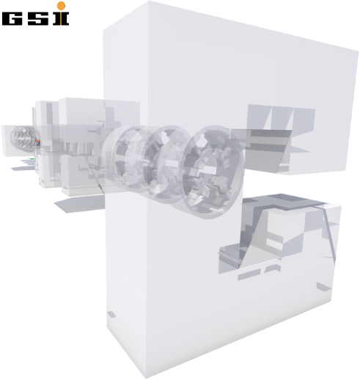
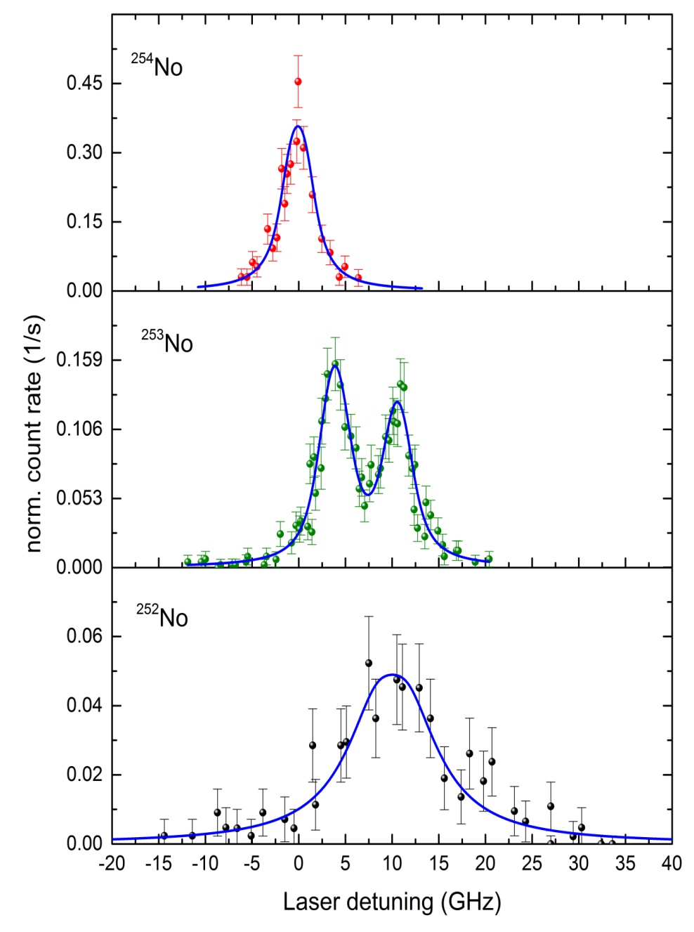

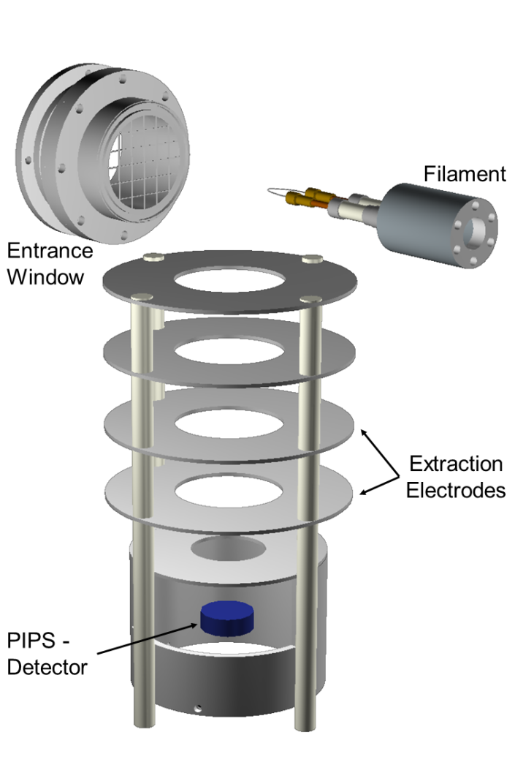

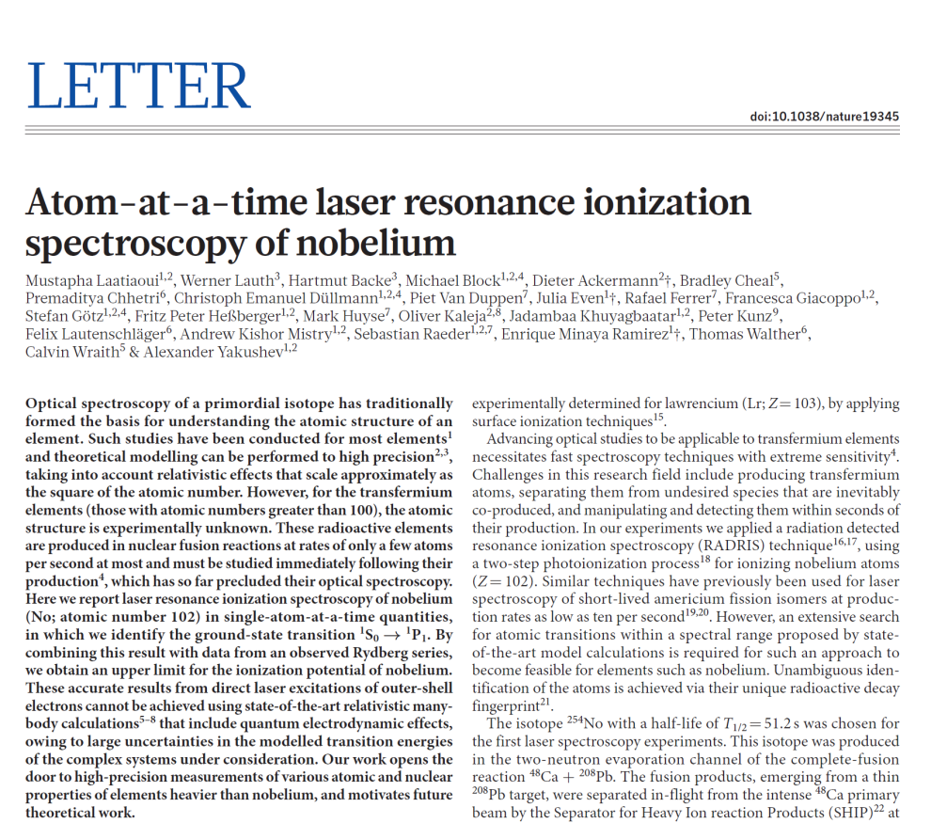



Further research highlights
- Laser spectroscopic investigation of No (Z=102)
λ₁ λ₂
²⁵⁴No
  doi:10.1038/nature19345, Sept. 2016
+
²⁵³No
Achievements:
First ever successful laser spectroscopy beyond fermium
Production rates: ~ 1 atom/s
Overall efficiency up to 10%
First ionization potential of nobelium precisely measured
Nuclear spin and moments extracted for the isotope ²⁵³No
100 mbar
Argon
²⁵²No
+

Slide 20
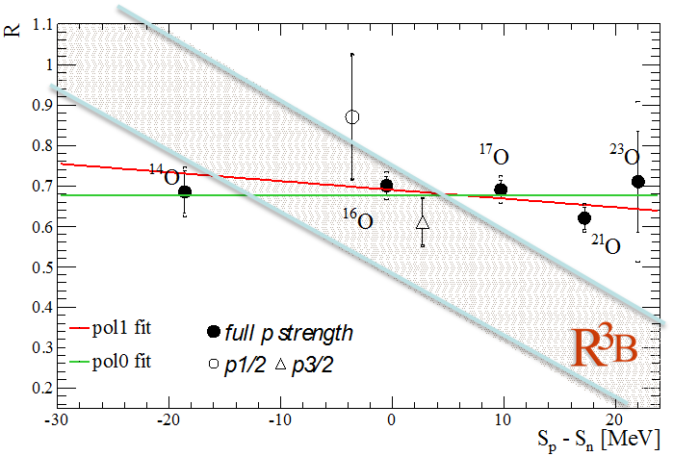
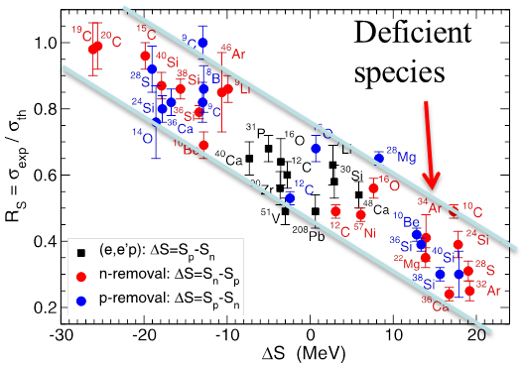

Further research highlights – No Quenching of single-particle strength as function of neutron-proton asymmetry
Puzzle
Results from knockout experiments using extended targets at 50-100 MeV/u reveal an unexplained quenching of single-particle strength for large neutron-proton asymmetries.
(p,2p) in inverse kinematics at R3B
Quenching for large
asymmetries?
J.A. Tostevin
and A. Gade,
PRC 90 (2014) 057602
Results of the experiment:
First exclusive large-acceptance (p,2p) experiment with radioactive beams accomplished
Clean reaction mechanism, quantitative reaction theory developed and tested
Wide range in asymmetry (S_{p}-S_{n}) covered
➔ Only weak dependence on asymmetry observed ➔ Puzzle resolved!
➔ Reason for systematic change of cross sections for conventional knockout to be clarified
L. Atar et al. (R3B collaboration), publication in preparation
Notes:
Experimental data left hand picture: the ratio of measured single-particle strength and theoretical value (IPM independent particle model) is depending on the neutron-proton asymmetry, high asymmetry leads to an apparent quenching of the single-particle strength. R3B measured single particle strengths in oxygen isotopes (from proton to neutron rich) by quasi-free scattering in inverse kinematics. Only a weak dependence was found when the effects of the reaction mechanism was folded out with an appropriate theory.

Slide 21
Further research highlights
- Inelastic alpha scattering off ⁵⁸Ni (100 MeV/u)
Giant Monopole Resonance of ⁵⁸Ni
First pilot experiment at ESR sets the world records:
Lowest c.m. angle measured in inverse kinematics
Most accurate extraction of monopole strength in inverse kinematics
Milestone towards reaction
studies with stored exotic beams
20.5(6)
Published Oct 2016:
J.C. Zamora et al., Phys. Lett. B 763 (2016) 16
Notes:
Abstract
A new technique developed for measuring nuclear reactions at low momentum transfer with stored beams in inverse kinematics was successfully used to study isoscalar giant resonances. The experiment was carried out at the experimental heavy-ion storage ring (ESR) at the GSI facility using a stored ⁵⁸Ni beam at 100 MeV/u and an internal helium gas-jet target. In these measurements, inelastically scattered α -recoils at very forward center-of-mass angles (θ_{cm}≤1.5°θcm≤1.5°) were detected with a dedicated setup, including ultra-high vacuum compatible detectors. Experimental results indicate a dominant contribution of the isoscalar giant monopole resonance at this very forward center-of-mass angular range, corresponding to some 27. It was found that the monopole contribution exhausts 79−11+12% of the energy-weighted sum rule (EWSR), which agrees with measurements performed in normal kinematics. This opens up the opportunity to investigate the giant resonances in a large domain of unstable and exotic nuclei in the near future. It is a fundamental milestone towards new nuclear reaction studies with stored ion beams.
The experimental set-up to detect the isoscalar giant monopol resonance used only one DSSD detector with 64x64 mm size area (not a full ring ring of detectors) under a lab angle from 27 to 37 degrees.
Thus one could easily raise the efficiency of the experiment by employing more detectors.

Slide 22
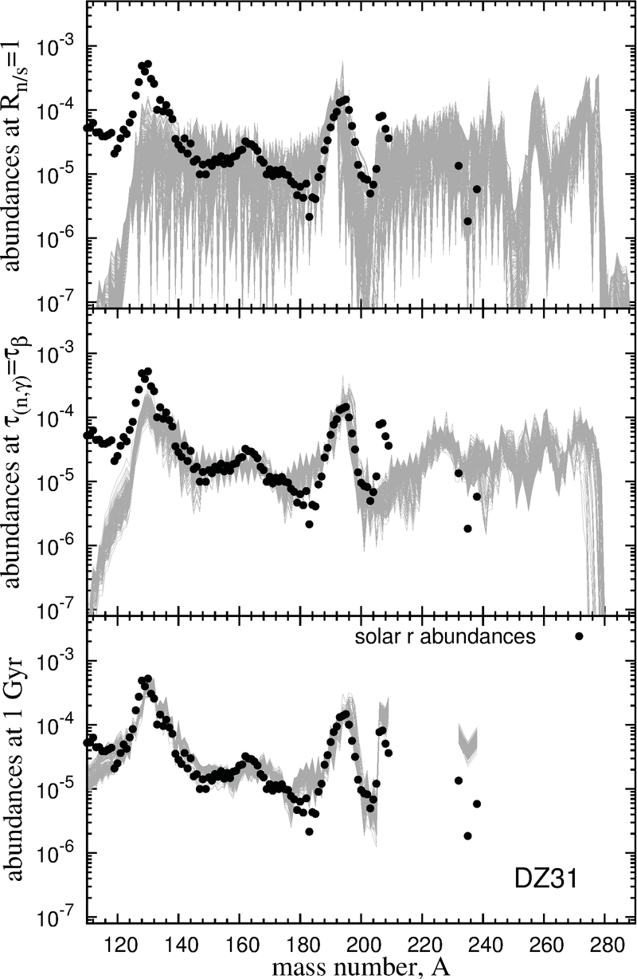
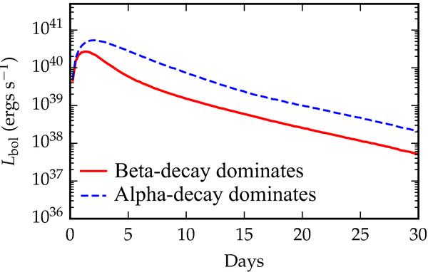
Research highlight -
Theory r-process in neutron star mergers
Neutron star mergers are likely a r-process site
Sensitive to nuclear physics: mainly fission yields and properties of exotic neutron nuclei with N ~ 130
Electromagnetic transient, kilonova, light curve depends on competition between late time alpha and beta-decay
Evolution abundances 528 trajectories
G. Martinez-P., PRC 92, 055805 (2015)
3rd r process
maximum
arXiv:1605.07218 [astro-ph.HE]
.
grey pattern: model calc.
Robust pattern due to fission
Notes:
J. Mendosa-Themis, PRC 92, 055805 (rechts)
J Barnes, arXiv 1605.07218 (unten links)
Figure on the right:
The merger of neutron stars is a strong candidate for the location of
the r-process, in particular for the heavy elements (A>120). The abundance
pattern is robust, since it depends mainly on the fission yields. Only weak
dependence on astrophysical conditions.The differences can
be traced to different values for the neutron separation energy in r-process nuclei around
N=130 in different models.
Figure left bottom:
Higher kilonova luminosity if alpha-decay dominates: signature of translead nuclei in r-process.
(kilonova = neutron star-neutron star or neutron star-black hole merger)

Slide 23
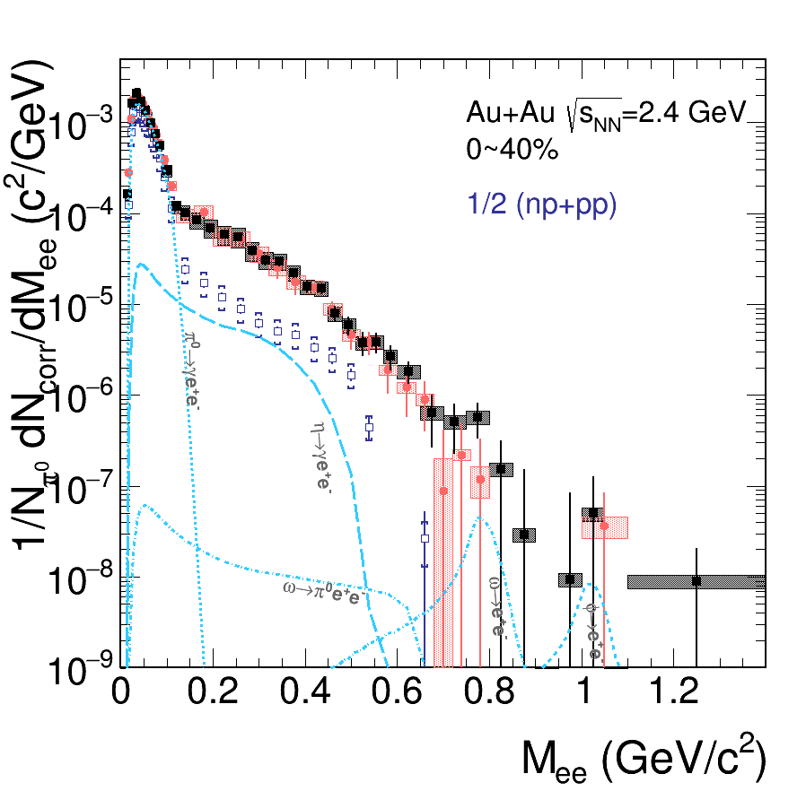

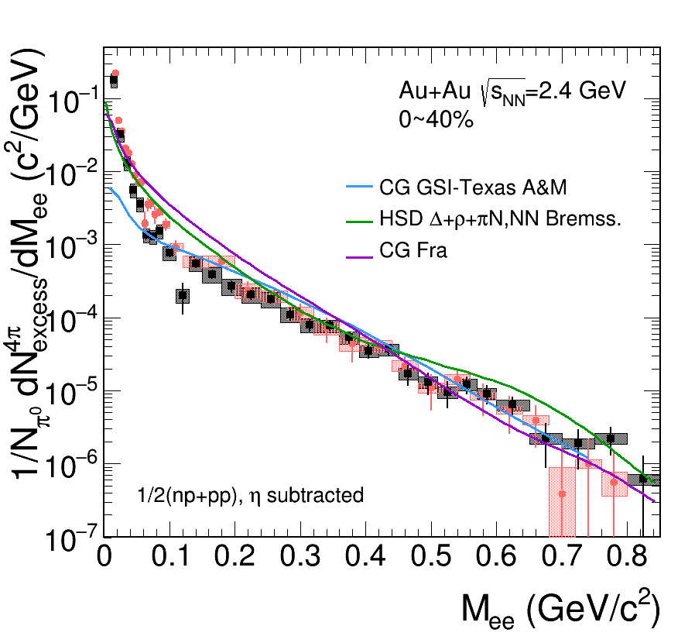
Further research highlights –
Virtual photon radiation off Au+Au collisions
Observed radiation of virtual photons much more intense as expected from assuming incoherent superposition of photons emitted in NN collisions
  Regeneration of baryonic resonances
  Strong modification of spectral functions
Excess yield driven by temperature and size/lifetime (four-volume integral)
Inclusive excess mass spectrum
  all known sources subtracted
  fully corrected for acceptance
Almost exponential spectrum up to
vector meson region.
Fit to dN / dM ∝ M^{3/2} × e^{−M/T} →
T_{emitting} _{Source} = 95 ± 5 MeV

Slide 24

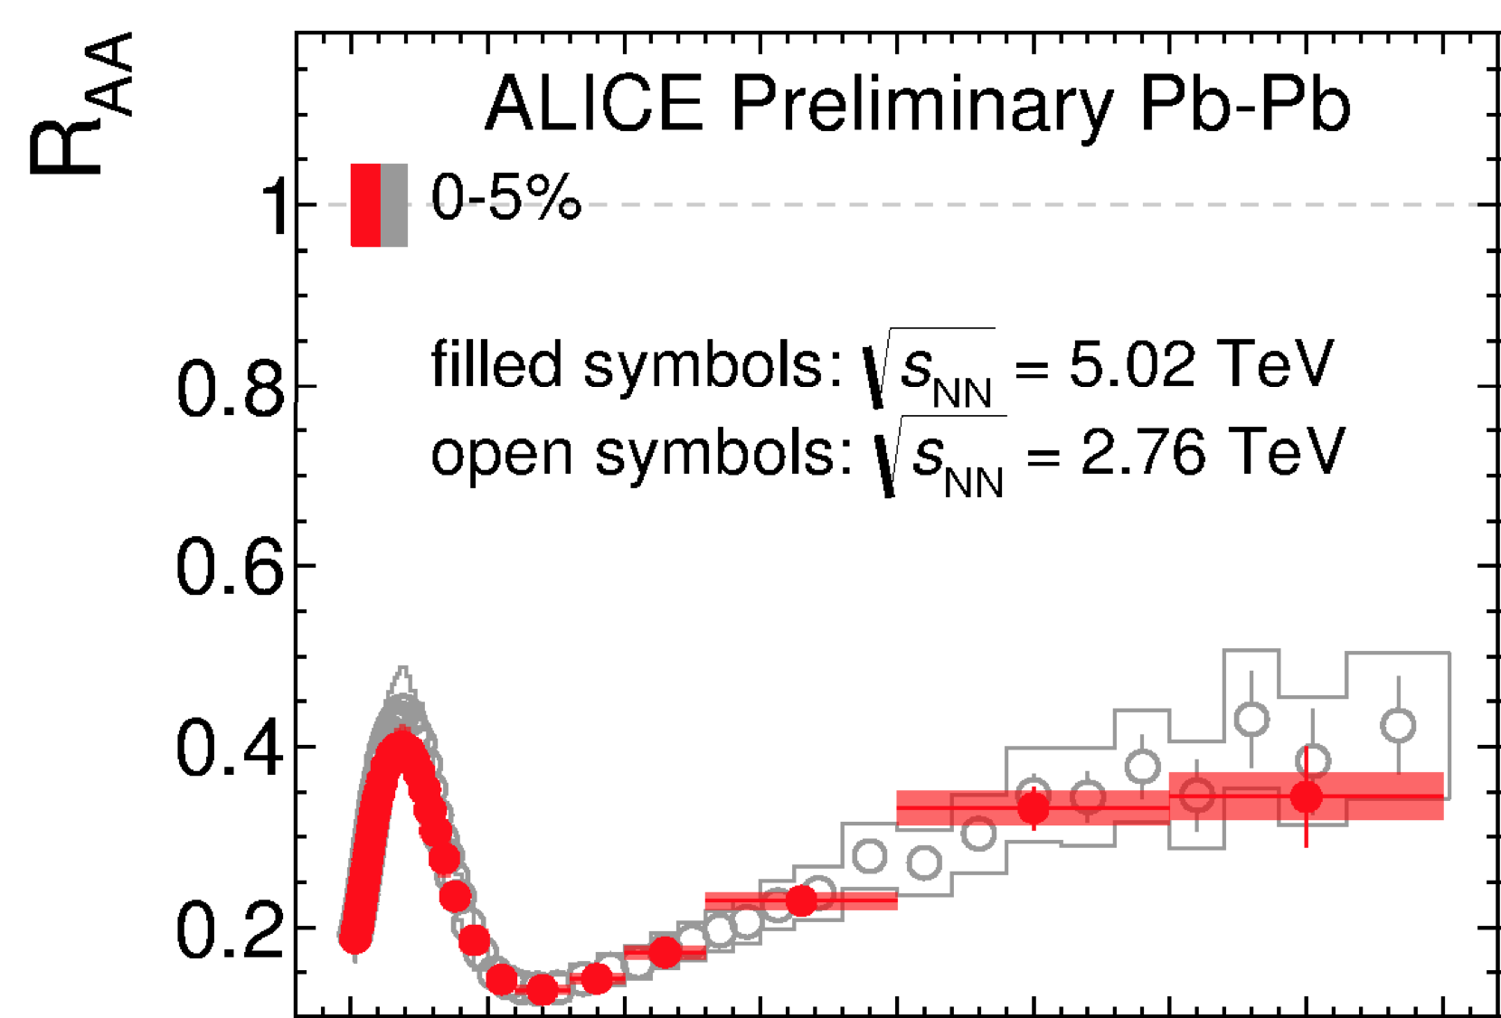
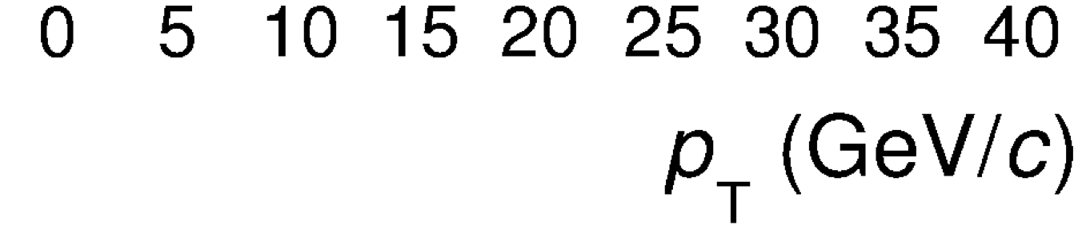
ALICE: LHC run 2, Pb-Pb at √s_{NN} = 5.02 TeV
Characteristics of quark-gluon plasma produced at the highest energy ever.
Nuclear modification factor of inclusive charged particles. Substantial reduction of systematic uncertainties wrt previous analyses!
Transverse momentum spectrum harder than at lower energy: similar R_{AA} means stronger energy loss in denser medium.
Notes:
12/12/2016
24
24

Slide 25
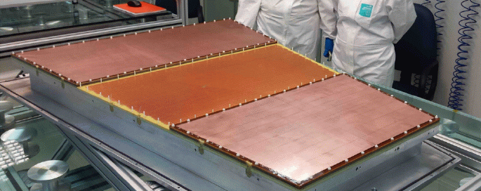
ALICE: Time Projection Chamber upgrade
Outer ReadOut Chamber (OROC) pre-production ongoing
Gas Electron Multiplier (GEM): largest foils framed at GSI in the detector laboratory.
First OROC (with foils framed at GSI) completed in Bucharest ...
... and installed close to the ALICE experiment at the moment (October 31).
Next OROC being constructed at GSI.
Detailed testing until Christmas 2016.
Production Readiness Review for TPC upgrade project in January 2017.
Notes:
12/12/2016
25
25

Slide 26
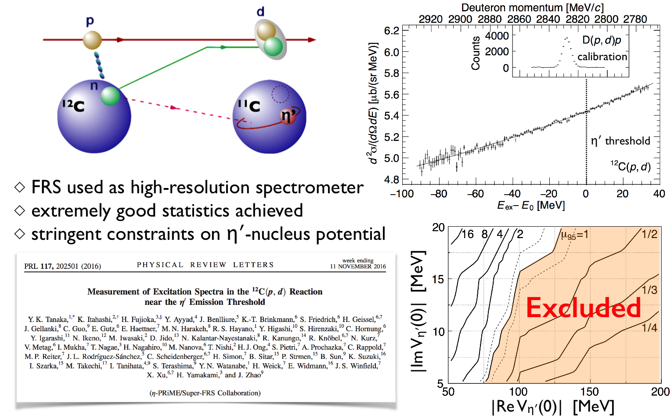
Further research highlights - Search for η‘ mesic nuclei by spectroscopy of ¹²C(p,d) reaction with FRS
Abstract
Excitation spectra of C11 are measured in the C12(p,d) reaction near the η′ emission threshold. ... In contrast to theoretical predictions on the possible existence of deeply bound η′-mesic states in carbon nuclei, no distinct structures are observed associated with the formation of bound states. The spectra are analyzed to set stringent constraints on the formation cross section and on the hitherto barely known η′-nucleus interaction.
Notes:
Excitation spectra of 11C are measured in the 12Cðp; dÞ reaction near the η0 emission threshold. A proton
beam extracted from the synchrotron SIS-18 at GSI with an incident energy of 2.5 GeV impinges on a
carbon target. The momenta of deuterons emitted at 0° are precisely measured with the fragment separator
(FRS) operated as a spectrometer. In contrast to theoretical predictions on the possible existence of deeply
bound η0-mesic states in carbon nuclei, no distinct structures are observed associated with the formation of
bound states. The spectra are analyzed to set stringent constraints on the formation cross section and on the
hitherto barely known η0-nucleus interaction.
The mesic nucleus – if one had seen any – would have been detected by “structures” in the energy spectrum the outgoing deuterons.
As you may remember such prominent structures had been found in similar experiments at the GSI FRS for heavy pionic atoms (Sn and Pb).

Slide 27

Further research highlight – Results from
HIM BES-III analysis: new resonance discovered
Precise cross section measurement of e⁺e⁻→π⁺π⁻J/ψ
from 3.77 to 4.60 GeV at BESIII
The e⁺e⁻→π⁺π⁻J/ψ cross section was measured with unprecedented precision with BESIII data.
The mass & width precision of the Y(4260) resonance was improved by a factor of ~3; a new resonance near 4.32 GeV/c² was observed for the first time with 7.6σ significance.
arXiv:1611.01317, BES-III collaboration, corresponding author: Z. Liu, HIM
Notes:
This was an hommage to the hadron physics activities at HIM (of Frank Maas) where the meeting takes place ;-)
And over and above it is not so easy for the PANDA people to carry out relevant physics experiments “at home”.
But sure, we can take that out.

Slide 28
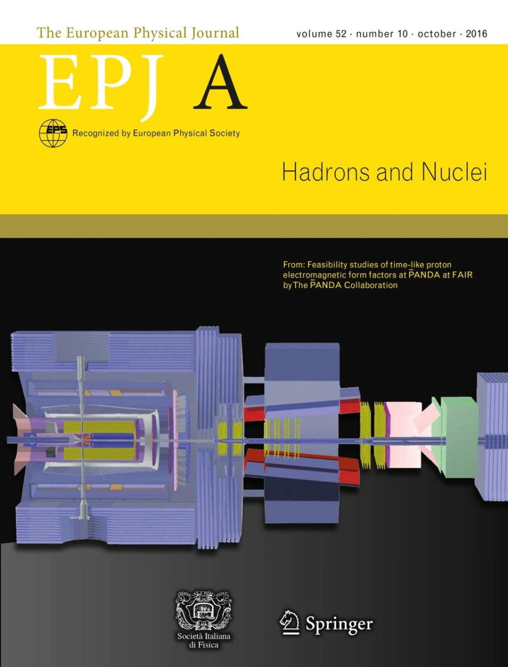
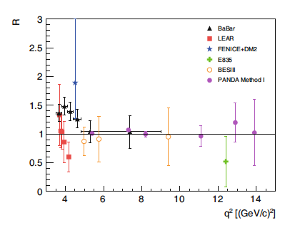
Other research highlight
- Feasibility studies for PANDA
EPJ A Highlight
COVER EPJA October issue (2016)
“Feasibility studies of time-like proton
electromagnetic form factors at
PANDA at FAIR”
Corresponding author:
D. Khaneft (PhD-Student HIM)
A. Dbeyssi (Helmholtz-Postdoc HIM)

Slide 29
Roadmap for
Intermediate Research Program
FAIR Phase 0

Slide 30
FAIR Phase 0 Program
Goals
  Forefront research by employing and testing new FAIR detectors
  Exploiting upgraded GSI accelerator facilities
  Education of young scientists
  Maintain and extend skills and expertise
  Serve national and international user community
  and attract new participants in FAIR

Slide 31
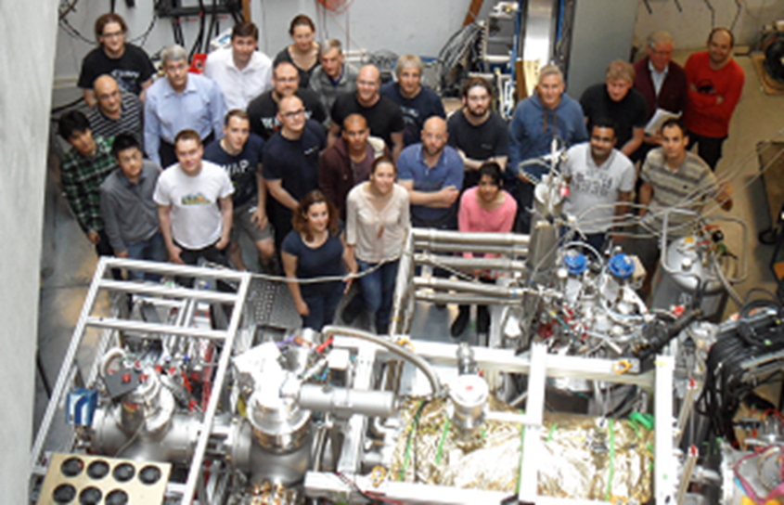
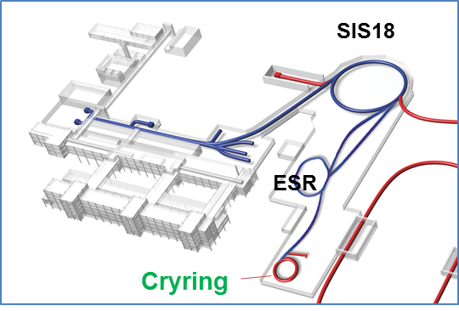
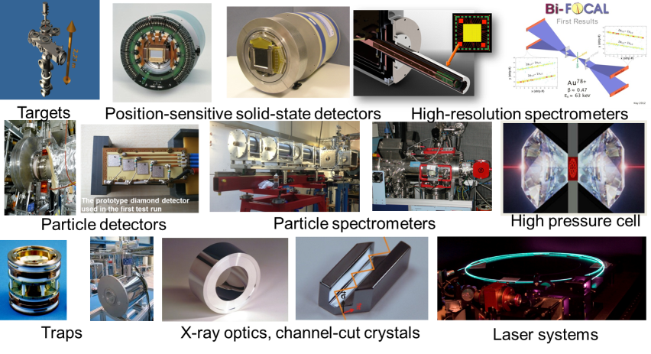
FAIR Phase 0 Program
  Benefit from UNILAC and SIS100 upgrade
  Make use of Cryring, R3B magnet and other novel FAIR instrumentation
LEB Stopping Cell
SPARC instrumentation

Slide 32
FAIR Phase 0 – scientific opportunities
(to be complemented by external activities)
APPA Facility Research Activity
SPARC ESR-HITRAP- Strong field QED, atomic collisions, fundamental
SPARC CRYRING symmetries, border to nuclear physics
BIOMAT M Branch, Z0 Biophysics, heavy ion therapy, Material Science
/Cave A
WDM/HEDgeHOB HHT/PRIOR Plasma physics, proton radiography
WDM/HEDgeHOB PHELIX Plasma physics, proton acceleration
CBM
CBM/HADES HADES Di-lepton production in pion-induced and HI reactions
CBM External Beam energy scan at STAR/RHIC (tests/ physics at NICA)
NUSTAR
NUSTAR FRS Separator-/spectrometer expt.’s with exotic nuclei
NUSTAR FRS-ESR Nuclear physics with exotic beams in storage rings
NUSTAR HISPEC/DESPEC In-beam and stopped-beam spectroscopy experiments
NUSTAR R3B@SIS18 Reactions with relativistic radioactive beams
NUSTAR SHIP, TASCA Physics and chemistry of SHE
PANDA
PANDA HADES Hyperon Dalitz decays with HADES (use of PANDA F-TRK)
PANDA External Search for exotic states, studies of charmonium and time- like form factors at BESIII/Beijing/IHEP. Magnetic moment of Δ(1232), e-m universality, multi p0 prod. at MAMI

Slide 33
Next Steps
The new management has asked the Collaborations to summarize their expected FAIR phase 0 research highlights in a one page document.
Definition of the level of resource allocation – personnel and funding – for FAIR phase 0 (as integral part of the overall resource planning for FAIR/GSI)
  Definition of beam time periods for the coming years, based on the shut-down planning for FAIR
  Specify available ion beams and beam parameters
  Establish an international Program Advisory Committee
  Prepare the 1st call for proposals for the beam time slot 2018/19 (advertisement in late spring 2017)

Slide 34
Updated physics programs
by the Collaborations
APPA, NUSTAR,
CBM and PANDA

Slide 35
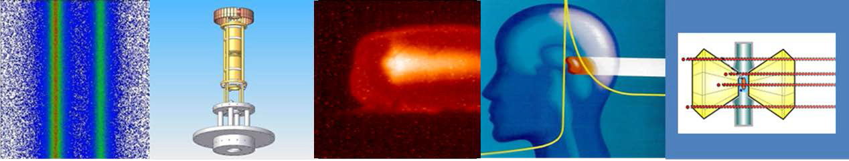
From fundamental to applied research –
Atomic physics, Plasma Physics, Application
APPA

Slide 36


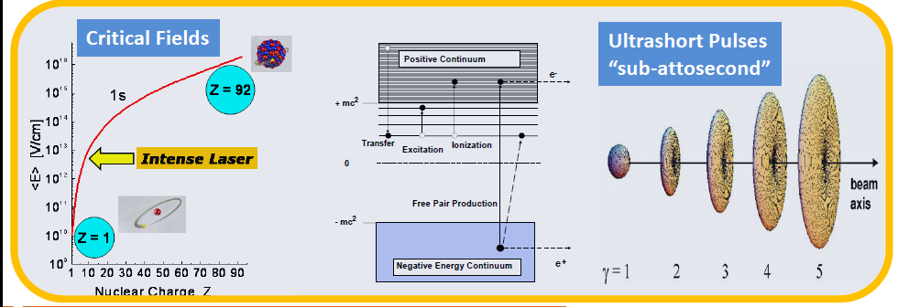
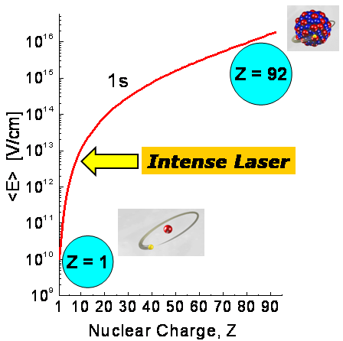

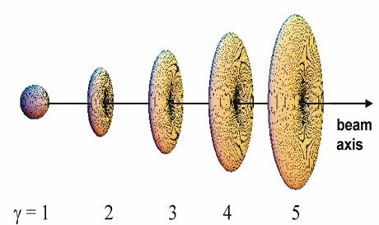
Atomic & Fundamental Physics
Interplay between Relativity, Correlation, and QED in the Non-Perturbative Regime
αZ ≈1
Radiative corrections in the non-perturbative regime
Correlated multi-body dynamics for atoms and ions
Precision determination of fundamental constants
Influence of atomic structure on nuclear decay properties
Critical Fields
Ultrashort Pulses “sub-attosecond”
Positive Continuum
_{e}-
+ mc²
Transfer
_{Excitation} Ionization
0
Free Pair Production
- mc²
Negative Energy Continuum
_{e}+
36

Slide 37
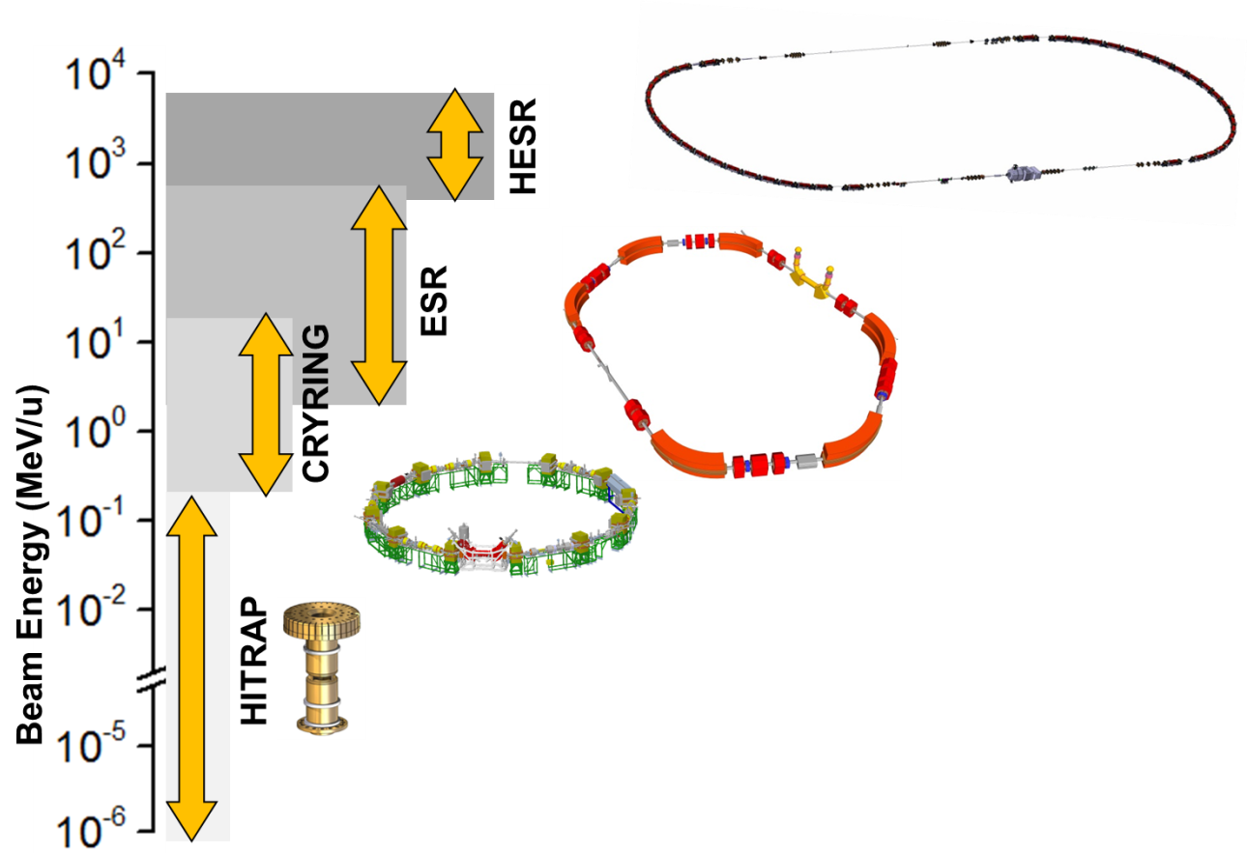
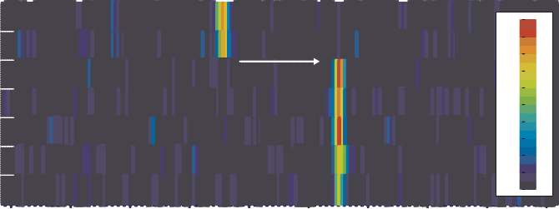
Ion Beam Facilities / Trapping & Storage
Stored and Cooled
Highly-Charged Ions (e.g. U⁹²⁺) and Exotic Nuclei
From Rest to Relativistic Energies (up to 4.9 GeV/u)
Worldwide Unique
Cooling: The Key for Precision
1,0
Δp/p ~ 10⁻⁵
uncooled beam electron cooled beam
beam intensity (arb. units)
0,8
0,6
0,4
0,2
0,0
0,88
0,91
0,94
0,97
1,00
f / f
1,03
1,06
1,09
1,12
0
From Single Ions to Highest Intensities
recording time / seconds
0
192 _{Pb} 81+
0.95
30
60
e⁻ capture
0.87
0.80
0.77
intensity / arb. units
90
120
150
180
Qec = 3.37MeV ¹⁹² _{Tl} ⁸¹⁺ |  |  |  | 0.67
 |  |  |  | 0.62
 |  |  |  | 0.57
 |  |  |  | 0.52
 |  |  |  | 0.48
 |  |  |  | 0.44
 |  |  |  | 0.40
127400 127500 127600 | 127700 | 127800 | 127900 128000 | 128100 128200
240
127300
frequency / Hz
37

Slide 38
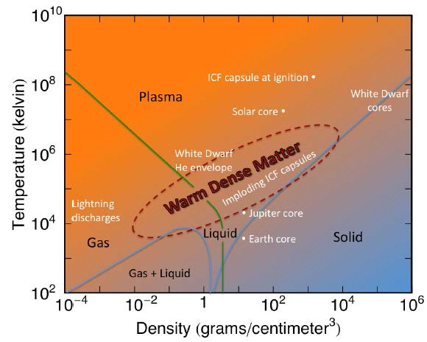

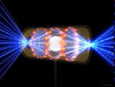



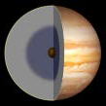



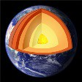
High-Energy Density Science
Dense plasmas
Temperatures 10³...10⁶K
Densities 0.1...1000x solid
Pressures kbar...Gbar
A great challenge for theory:
Strong coupling: E_{pot} ≥ k_{B}T
Quantum effects: E_{F} ~ k_{B}T
Collisions (conductivity, heat transport): Λ_{C}<0
Partial ionization
Continuum lowering
Exotic states, complex properties:
Equation of state, melting + phase transitions, transport properties, metallization,...
Transport properties (heat, radiation), equilibration,...., non-equilibrium states
Interaction of ions and photons with plasma
Atomic & nuclear physics in dense plasmas
• ...
Dense plasmas are stongly correlated many particle quantum systems
38

Slide 39
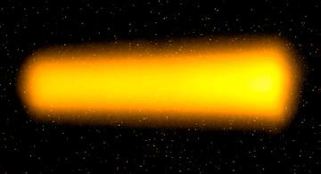
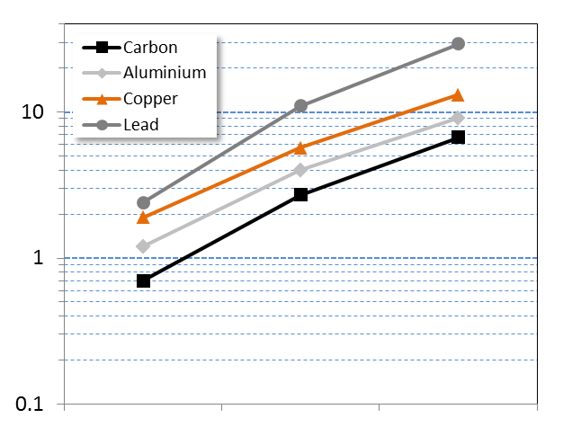
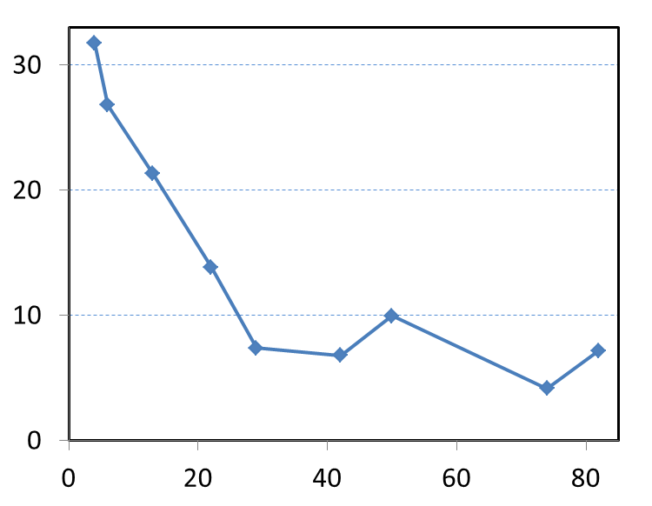
FAIR will offer exciting new possibilities for research in High-Energy Density Science
Unique properties of heavy-ion driven plasmas
Protons as dense matter probe
Long range (~m) of relativistic protons
High-resolution imaging of small angle deflection →accurate density meas.
Ultra-intense proton pulses allow for
short (~10ns) time exposure
large volumes (mm³)
uniform conditions
thermal equilibrium
any target material
rep. rate, reproducibility
U@350 MeV/u Target: W
3 mm
10 GeV p
temperature [eV]
stopping range [m]
→ probing of large, dense samples !
^{T}crit ^{T}boil
→ heating of large, dense samples !
SIS18
(upgrade)
SIS100
(Day-1)
SIS100
(full performance)
target Z
FAIR will produce the worlds largest volumes of uniform HED matter
(x100 increase in specific energy deposition over GSI)
FAIR will host the worlds highest resolution proton microscope
39

Slide 40


BIOphysics & MATerials Research in APPA
Biophysics
BIO*MAT
Materials Research
Ion-beam interaction
living cells
cell tissue
materials, solids
surfaces and bulk
Swift heavy ion expertise in
radiation biology
medical physics
space research
in-situ damage analysis
radiation hardness
ion-track nanotechnology
User support at UNILAC and SIS-18 facilities
all ion species, full energy range, broad fluence range
many different research fields, interdisciplinary research
40

Slide 41

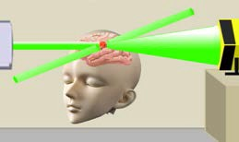
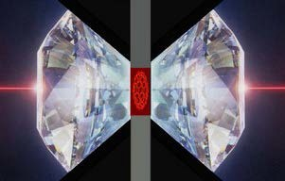
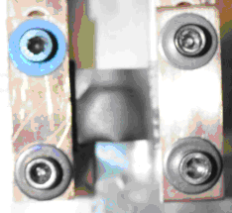
BIO*MAT
Research topics at FAIR
Biophysics
Materials Research
Space radiation biophysics
Biological effects of very high energetic ions
Shielding measures: new materials
Particle therapy: “theranostics” (use of high energetic proton beams for simultaneous diagnostics and therapy)
Ion-matter interaction at highest energies and highest charge states
Materials behavior under extreme conditions (high flux irradiations)
Irradiations under multiple extremes (high pressure, temperature, dose)
Radiation hardness of accelerator and spacecraft components
41

Slide 42








BIO*MAT
Existing and future BIO-MAT facilities
Cave M
Medical Cave
UNILAC user facilities
Cave A
Irradiation Cave
APPA Cave
High energy Cave
Cryring
Target station
42

Slide 43


Slide 44







NUSTAR - Origin of elements in the universe
„Nucleosynthesis sites“ in the universe
„Nucleosynthesis sites” at FAIR
MATS & LaSpec
HISPEC/DESPEC
R³B
SFRS
SIS
100
production
target
ILIMA, EXL at CR
and at ESR, HESR, Cryring
44

Slide 45

NUSTAR - Origin of elements in the universe
„Nucleosynthesis sites“ in the universe
High SIS100 energies + SFRS: superior charge separation
and beam quality
MATS & LaSpec
HISPEC/DESPEC
R³B
SFRS
SIS
100
ILIMA
production
target
45

Slide 46
Unparalleled features of (Super)FRS separator
Feature | FRS | Super-FRS
In the SIS-18/SIS-100 energy domain: worldwide unique separator and high-resolution spectrometer | + | ++
Take advantage of high-energy and high-intensity beams (cross sections, thick targets, kinematical forward focusing, fully stripped ions, etc.) | + | ++
Primary and secondary nuclear beams of all elements from protons up to uranium with energies up to ... | 4.5 GeV (p) 1.0 GeV/u (U) | 5.1 GeV (p) 1.5 GeV/u (U)
High primary-beam suppression power, high separation power, high background suppression | + | ++
Unique high momentum-resolution, multiple-stage spectrometer with large acceptance and flexible ion-optical settings and dispersion matching | 2 or 3 stages plus supplemen-tary detectors | Multiple stages, including E-buncher/spectr.

Slide 47



Unique experimental instrumentation and storage rings
SIS100/18
MATS & LaSpec
HISPEC/DESPEC
R³B
Super-FRS
ILIMA
Production
target
... plus exp. opportunities (ILIMA, ExL)
at storage rings CR, HESR, ESR, Cryring

Slide 48
Physics goals/ highlights of the NUSTAR day 1 program
  Understanding the 3rd r-process peak by means of comprehensive measurements of masses, lifetimes, neutron branchings, dipole strength, and level structure along the N=126 isotones;
  Equation of State (EoS) of asymmetric matter by means of measuring the dipole polarizability and neutron-skin thicknesses of tin isotopes with N larger than 82 (in combination with the results of the first highlight);
  Exotic hypernuclei with very large N/Z asymmetry.
Notes:
The third r process peak is responsible for the production and abundances of the very heavy elements Pt, Au, Pb and beyond (around N = 126) .
it is and will remain the only) peak which, regarding isotopically clean separation of the involved exotic nuclei, can only be studied at GSI/FAIR due to the high energies available.

Slide 49
NUSTAR Strategy towards Phase 0 and Phase 1
Phase 0
  R&D and experiments to be carried out with the upgraded GSI facilities and available FAIR/NUSTAR equipment, in particular the GLAD Magnet at R3B, new instrumentation for particle and γ spectroscopy, storage rings and traps.
Phase 1
  Core detectors and subsystems completed
  First measurements with FAIR/Super-FRS beams
    Carry out experiments with highest visibility as part of the core program and within the FAIR MSV

Slide 50

CBM

Slide 51

CBM: FAIR delay and competing experiments
FAIR delay
Main objectives of the CBM physics program at SIS100 not affected by the delay of the MSV due to unrivalled rate capability of the CBM setup (see figure).
Competing experiments
STAR at RHIC-BNL (BES)
NA61 at CERN-SPS
MPD at JINR-NICA
BM@N at JINR
CBM: world wide unique high-precision measurements of rare diagnostic probes like multi-strange hyperons, hypernuclei, dileptons, charm, and multi-differential observables.

Slide 52

Consequences of the FAIR evaluation for CBM:
Focus on SIS100 beam energies
Physics program: Exploring QCD matter at neutron star core densities (> 5 ρ₀)
nuclear matter equation of state
search for phase transition,
phase coexistence, exotic phases
onset of Chiral symmetry restoration
hypernuclei, strange matter
Detector optimization:
➢ Compact detector configuration to increase acceptance
  ➢ Reduction of detector layers for TRD and Muon system
  Adoption to larger beam deflection at lower energies:
  Horizontal displacement of forward hadron calorimeter
  Horizontal adjustment of beam pipe
  Larger acceptance of beam dump

Slide 53






FAIR phase 0 experiments with CBM detectors
1. Install, commission and use 430 out of 1100
CBM RICH multi-anode photo-multipliers (MAPMT)
in HADES RICH photon detector
2. Install, commission and use
10% of the CBM TOF modules
including read-out chain
at STAR/RHIC (BES II 2019/2020)
3. Install, commission and use 4 Silicon
Tracking Stations in the BM@N experiment
at the Nuclotron in JINR/Dubna
(start 2019 with Au-beams up to 4.5 A GeV)
4. Install, commission and use the
Project Spectator Detector at the
BM@N experiment

Slide 54


Slide 55

Strategy of PANDA
After intense discussion with the scientific community, there is – a focusing of the first key experiments
– a definition of the start setup
– a proposal for Phase 0 experiments/activities
And in addition:
  Development of dedicated analysis methods at ELSA, MAMI, BESIII, Jlab, COMPASS to ensure a quick start of PANDA.
  Application of modern PANDA technologies at present and future facilities, e.g. Trackers, Cherenkov (DIRC), EMC, Photon readout, Readout electronics
55

Slide 56
Actions by PANDA since the 2015 Review
PANDA internal scrutiny process (Final report September 2015)
PANDA physics workshop in Uppsala, 8. - 12. June 2015
EMMI rapid reaction task force, 12.-14. October 2015
Results:
  Definition of key day-1 experiments with high impact
  Definition of reduced setup for the day-1 program
  Proposals for PANDA Phase 0
Towards FAIR with cutting edge physics & education of young scientists:
  Development of dedicated analysis methods at ELSA, MAMI, BESIII, Jlab, COMPASS to ensure a quick start of PANDA.
  Application of modern PANDA technologies at present and future facilities, e.g. Trackers, Cherenkov (DIRC), EMC, Photon readout, Readout electronics
56

Slide 57
International Context
Competing experiments: ATLAS, Belle-II, BESIII, CLAS12, CMS, COMPASS, GlueX, JPARC, LHCb
PANDA physics program now focused onto:
  Strangeness: High statistics sample of unexplored territory
  hyperon (Λ∗, Σ∗, Ξ∗, Ω∗) spectroscopy
  Charm(-like):
  X,Y,Z-factory, high statistics allow new approach to lineshapes, transitions, nature of the states
  Heavy-light mesons unexplored high spin states, lineshape
  Nucleon Structure:
  highest rates at lower q² for G_{E}, G_{M}, TDA, WACS, TMD
  Hypernuclei and nuclear targets:
  Hyperon-potential in nuclei, excited states of ΛΛ-hypernuclei
57

Slide 58
PANDA Phase 0 Projects
Already 2018++
PANDA equipment/analysis tools will be used for physics
  Straw Trackers at HADES
  Excited Hyperon Transition Formfactors
  Cracow, Juelich, Orsay, Uppsala, +TRK
  Backward PWO Calorimeter at MAMI
  Magnetic Moment of the Δ(1232), e-μ universality, multi π⁰ prod.
  Mainz Uni and HIM, +EMC
  Develop/apply PWA tools at e.g. Jlab, BES-III
  Meson spectroscopy with (non)exotic quantum numbers
  Bochum, GSI, Mainz +PhysAna
58

Slide 59
Summary and Outlook
FAIR is in good shape for full completion by 2025.
GSI/FAIR Research Strategy towards 2025:
R&D for and construction of the FAIR experiments
FAIR phase 0 – intermediate research program bridging the construction phase from 2018 until commissioning of the FAIR accelerators and experiments.
FAIR phase 0 opens the opportunity for the GSI campus Darmstadt to re-enter with the according LKI and LKII activities the Helmholtz PoF process (PoF IV) and the Helmholtz IVF programs.

Slide 60

FAIR construction field - today

Slide 61

FAIR 2025
Thank You!

Slide 64
Back-up

Slide 65



Strategic objectives
FAIR phase 0
research
program
Construction
of FAIR
Upgrade
of existing
accelerators
Campus
development

Slide 66
Integrated project schedule

Slide 67
FAIR Project Master Time Schedule
Setup
Level 1
project management : audit, project steering
Master Schedule Plan
Level 2
subproject leader : audit, subproject steering
Subproject Overview Plans
FSB leader : construction realization strategy
Plan of Realization (PdR)
Level 3
work package leaders
Plan of Planning (PdP)
bottom-up planning
bottom-up buildings planning
commissioning plans
bottom-up acc. inst. planning
bottom-up acc. components planning
installation plans
procurement plans

Slide 68
FAIR Project Master Time Schedule
Setup
Level 1
Master Schedule Plan
Level 2
Subproject Overview Plans
Plan of Realization (PdR)
Level 3
Plan of Planning (PdP)
installation
time frame
commissioning plans
installation plans
procurement plans

Slide 69



FAIR Project Master Time Schedule
Content
step 1
define project deliverables
components along beamlines
Q4 2015 - Q3 2016 done
step 2
project phases planning
(big picture)
September 2015
done
step 3
define project structure
organization chart + WBS
2015 - Q3 2016
done
FAIR organization chart
components „along beam lines“
(example)
FAIR work packages

Slide 70
FAIR Project Master Time Schedule
Content
FAIR
Project
390 WP
6 ACC
4 EXP
FSB
163 ACC
218 EXP
9 FSB
subprojects
work packages
SIS100
SIS18
36 WP
Super FRS
21 WP
CR
14 WP
HESR
9 WP
p bar
p Linac
28 WP
CBM
44 WP
NUSTAR
79 WP
APPA
63 WP
PANDA
32 WP
COMMONS
55 WP
FSB
9 WP
18 plans
1 plan
54 plans
57 plans
21 plans
34 plans
88 plans
2 plans
55 plans
30 plans
31 plans

Slide 71


Level 1 Schedule Baseline Top view
Rev. 1.0 - 07.12.2016

Slide 72


Level 1 Schedule Baseline – detailed view
Rev. 1.0 - 07.12.2016
Time frames for Installation are defined

Slide 73


Level 1 Schedule Baseline – detailed view
Rev. 1.0 - 07.12.2016

Slide 74


Level 1 Schedule Baseline – detailed view
Rev. 1.0 - 07.12.2016

