Slide 1
Nuclear physics meets sources of UHECR
MUTag 2016
Anatoli Fedynitch
DESY Zeuthen

Slide 2
The universe in multiple messengers
... a challenge for theory
Theory (source distribution)
Physics of astrophysical neutrino sources = physics of cosmic ray sources
Multi-messenger interpretations must rely on theory (acceleration, radiation processes, particle escape, geometry, ...)
Theory (radiation model)
Large astrophysical uncertainties
Theory (infrared etc BGs)
Theory (magn. fields, …)
W. Winter

Slide 3
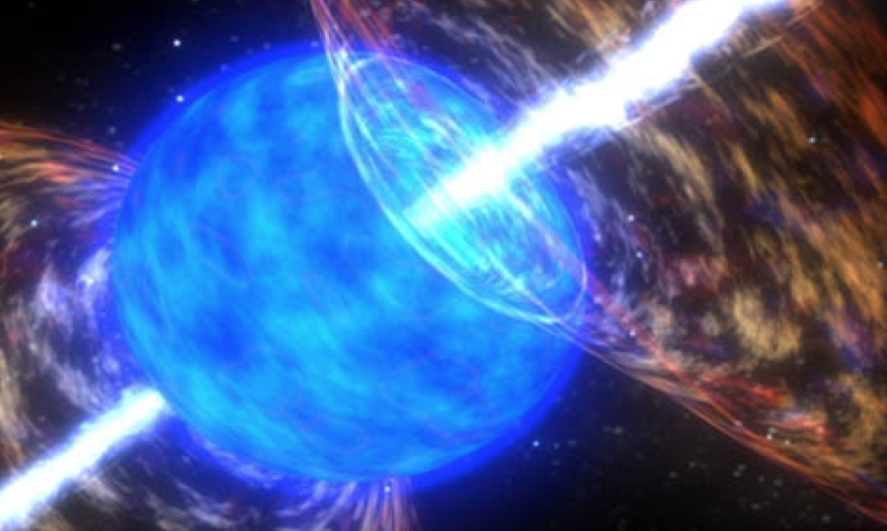
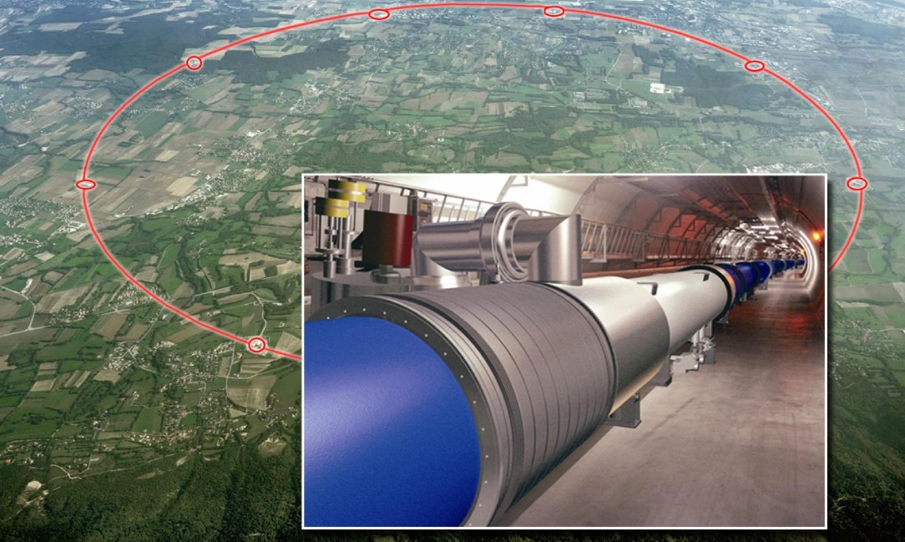
Cosmic vs. terrestrial particle accelerators
AGN, GRB
LHC
How are particles accelerated to such extreme energies?
Lorentz force = centrifugal force
E_{max} ~ q B R
E_{max} ~ 300,000,000 TeV
B ~ 1 mT – 1 T
R ~ 100,000 – 10,000,000,000 km
E_{max} ~ 13 TeV
B > 8 T
R ~ 4.3 km

Slide 4
Acceleration of heavy nuclei and their role for neutrinos
Thanks to Auger we (hopefully ☺) know that CR at highest energies are not just protons
Acceleration mechanism and abundance of heavier nuclei in cosmic accelreators is one question
Auger Collaboration, ICRC 2015
Our questions:
What are the conditions for escape of nuclei from the various source classes?
How does the presence of nuclei affect the expected flux of neutrinos and their flavors?

Slide 5
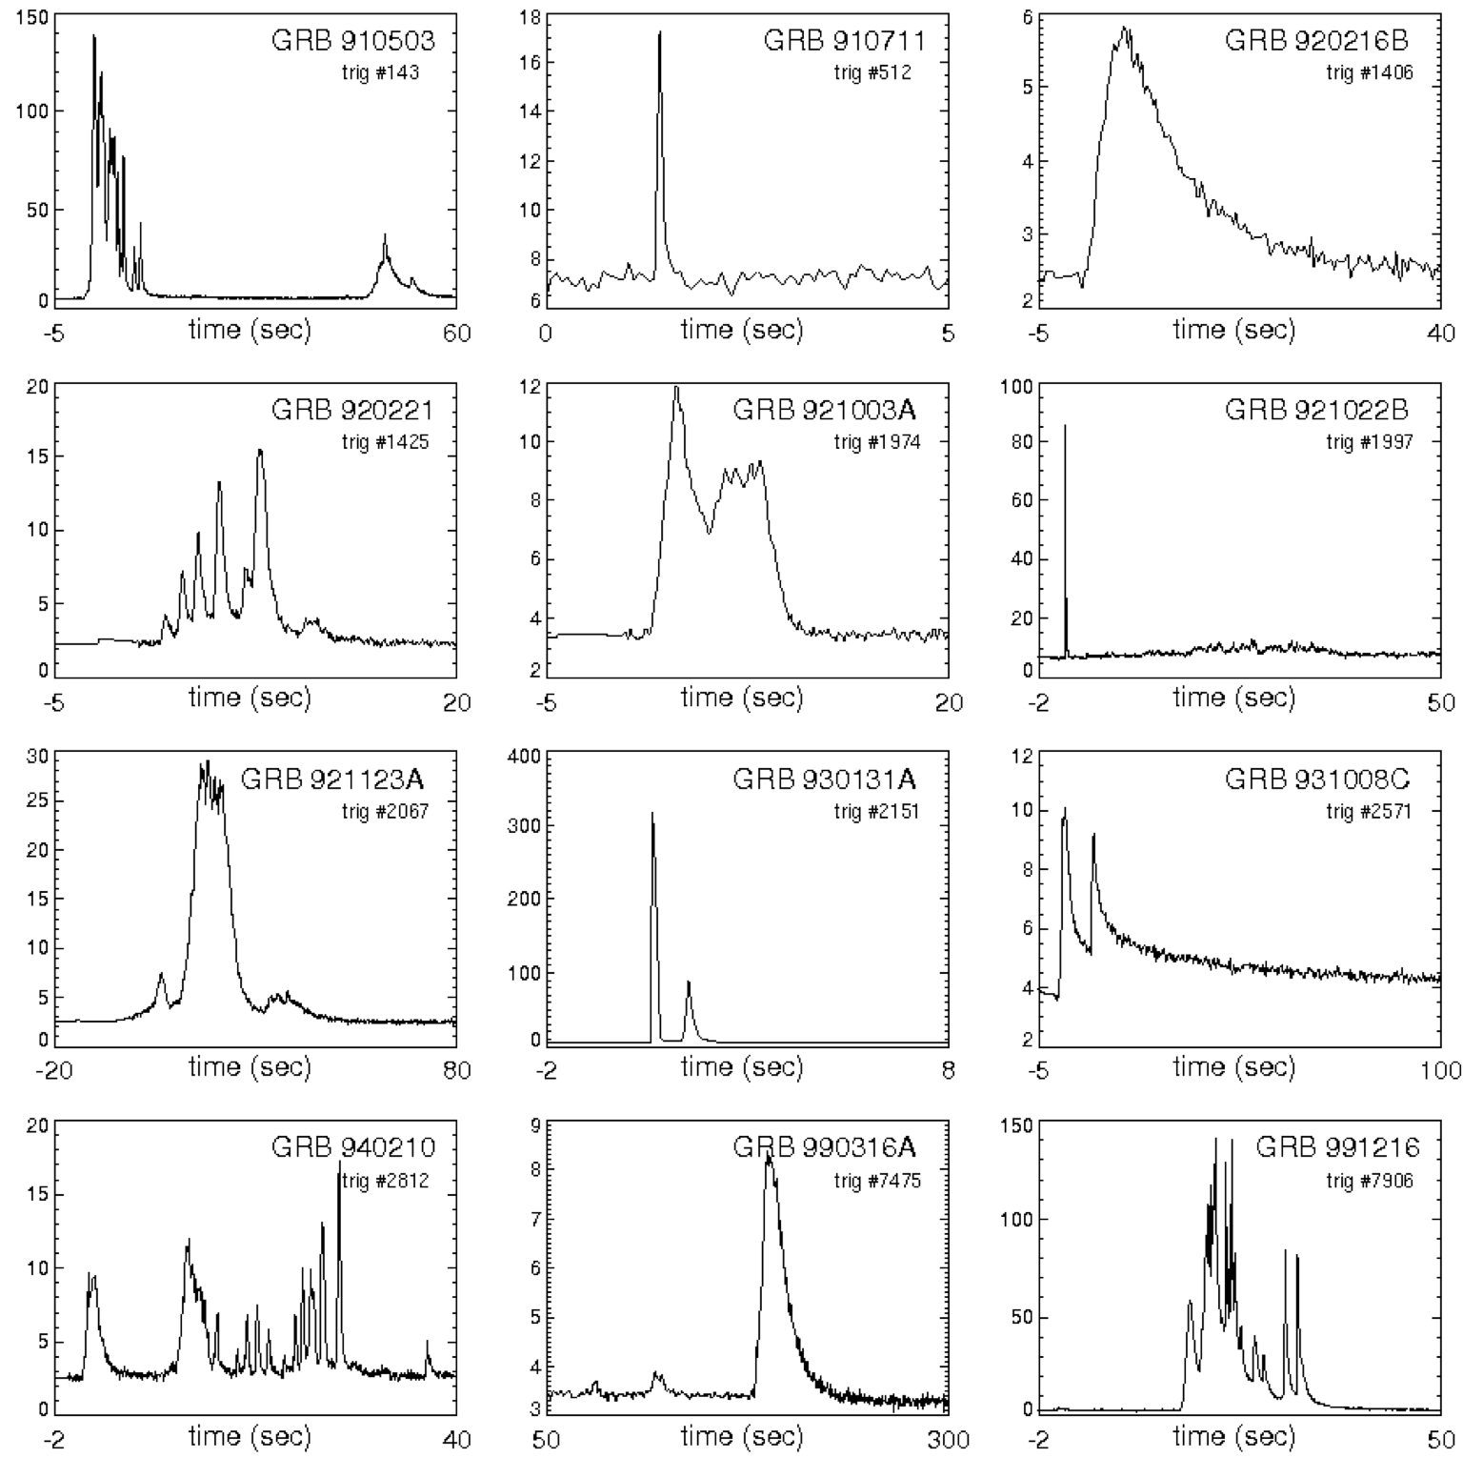
Candidate for UHECR source: Gamma-ray bursts (GRBs)
Daniel Perley
Most energetic electromagnetic (gamma-ray) outburst class
Several populations, such as
Long-duration bursts (~10 – 100s), from collapses of massive stars?
Short-duration bursts (~ 0.1 – 1 s), from neutron star mergers?
Observed light curves come in large variety
W. Winter
Source: NASA

Slide 6
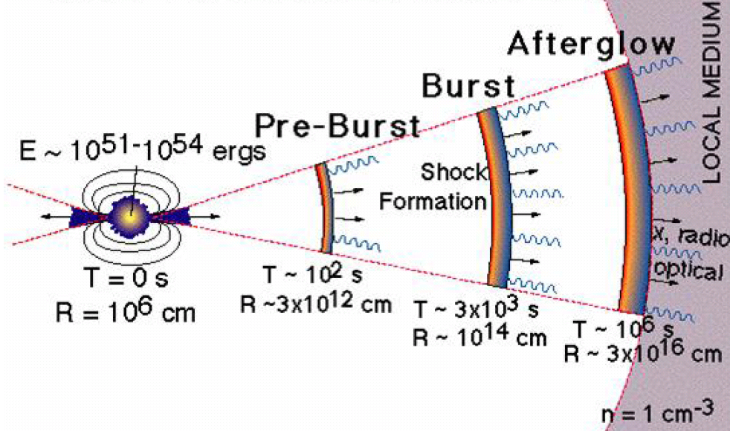
GRB - Internal shock model
(Source: SWIFT)
Γ ∼ 200−1000
Engine
“Isotropic equivalent energy“
Prompt phase:
collision of shells ⇨ Shocks ⇨ Particle acc.
Maximum energy of escaping UHECR depends on competition between acceleration and cooling (of individual particle species)
γ, ν and CR non-trivially coupled

Slide 7
Source candidates: Active Galactic Nuclei
K. Murase et al. Phys.Rev.D 90 (2014) 023007
Target photon density
dust torus
continuum jet
Longer dynamical time scales than GRB
Other processes can limit maximum energy
accretion disc

Slide 8
Modelling of radiation zone
Boltzmann Equations for each particle species (and energy bin)
Evolution of density for particle species i
Energy loss:
synchrotron
adiabatic
…
Escape:
dynamical timescale
interactions
decays
…
Injection from:
acceleration zone
interactions or decays
Q_{ν,out}
Radiation zone: A_{p}, A_{γ}
Interactions
Beam of p, A, …
Q_{A’,out}
Q_{γ,out}

Slide 9
How does nuclear physics enter?
How often does a nucleus/particle in a source interact?
Photon energy in nucleus rest frame
Depends on target photon field n_{γ}
n_{γ} isotropic in shock rest frame
σ_{j}^{abs} from nuclear models or parametrizations
j = p, n, α, … ¹²C, ...⁵⁶Fe
high energy nucleus
+
“low” energy photon
=
photo-nuclear physics in MeV – GeV range

Slide 10
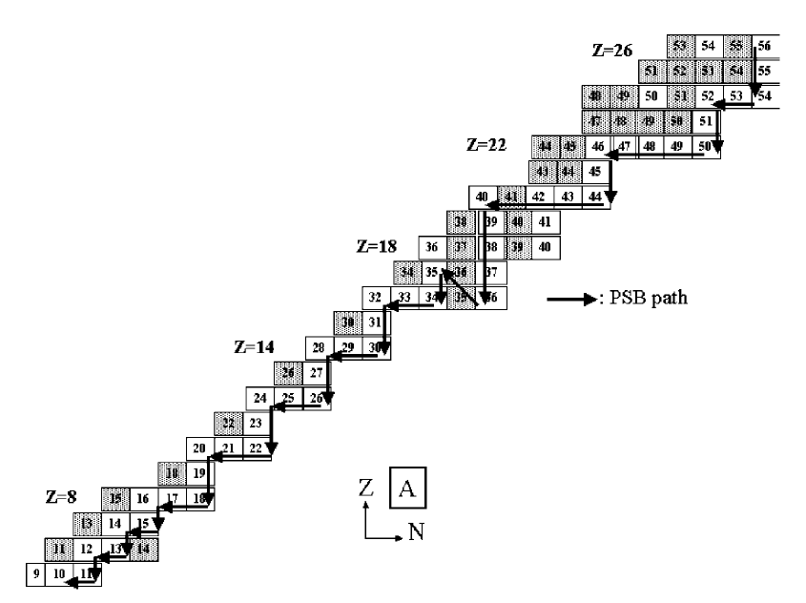
Typical astrophysical “photo-disintegration” models
Basic (propagation) calculations were based on PSB Puget et al Astrophys.J. 205 (1976) 638-654
Only one stable isotope per isobar (same A)
In each photodisintegration, one heavy nucleus is produced in the final state together with N nucleons
No competitive channels
Or more sophisticated interaction models
CRPropa 2/3
based on TALYS for A >= 12
Data and GEANT 4 for A < 12
Competitive channels + some optimization
Khan et al, Astropart. Phys. 23 (2005) 191-201

Slide 11
Elemental composition in disintegration chain of GRB
Obtained by injecting only iron in a numerical GRB setup, dominated by photo-disintegration
PSB disintegration chain goes not down to light elements; multi-nucleon emission and break-up is weakly described

Slide 12
Known nuclear absorption cross sections up to mid-heavy isotopes
EXFOR database contains 14 absorption cross sections < Fe
47 measurements where at least one inclusive cross section available
Nuclear model dependent σ_{abs} possible
Located mostly on main diagonal (stable elements)
All other isotopes need model prediction!
D. Boncioli, A. Fedynitch and W. Winter
arXiv:1607.07989

Slide 13
How good are the models? (Example 1: Calcium-40)
⁴⁰Ca is double magic, ⁴⁰Ar not. No reason for cross sections to be equal!
PEANUT reproduces data where available
Cross sections in TALYS weakly depend on nuclear mass, and very weakly on element
Astrophysical box model (e.g. in Murase and Beacom, Phys Rev. D81 2010) has insufficient description

Slide 14
How good are the models? (Example 1: Calcium-40)
Up to factor two differences in disintegration rates!

Slide 15
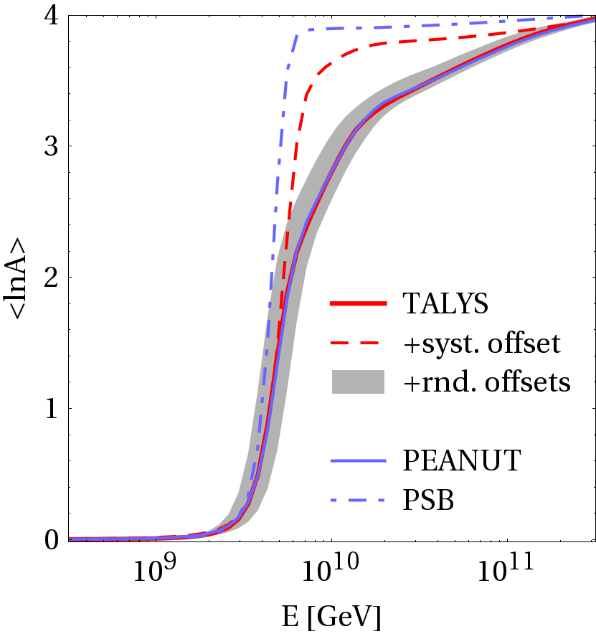
Effect on CR composition at the source
CR escape from source environment
(without propagation!)
Simplified nuclear models produce over-simplified results
More realistic models predict a softer transition from light to heavier composition
Differences between realistic models or random fluctuations average out in optically thick (for nuclei) sources unless systematic shifts exist
Predictive power for unstable elements is significant source of uncertainty
Need for (exp.) verification of photo-nuclear σ_{abs} for unstable elements

Slide 16
Neutrino production at the source
Ideal pγ source
Ideal pp source
Neutrino production

Slide 17
Flavor compositition expected from ideal scenarios
Clear expectation of flavor composition from idealized models
Electron anti-neutrino fraction is crucial for the Glashow resonance event rate in neutrino detectors. Signature for mechanism in the source!
The Glashow resonance
D. Biehl, A. Fedynitch, A. Palladino, T. Weiler and W. Winter, arXiv: 1611.07983

Slide 18
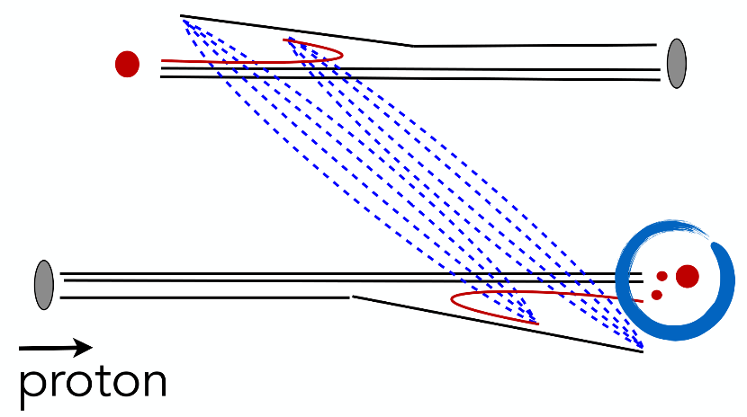
“De-idealization“
Pion charge ratio for different values of injection spectral index
Exclusive (s-channel) production of π⁺ in pγ is contaminated by π⁻ (anti-ν_{e}) in multi-pion processes and secondary neutron interactions
The (forward) pion charge ratio in pp collisions is not equal to one!
Good estimate can be obtained from hadronic interaction models, here: average of EPOS-LHC, QGSJet-II-04 and SIBYLL 2.3
Nuclei produce many neutrons in disintegration → charge ratio 1

Slide 19
Discrimination between scenarios

Slide 20
Glashow events from sources of cosmic ray nuclei
Presence of nuclei in UHECR sources results in higher number of Glashow events
95 IC-86 equivalent years needed (~10 years Gen-2)
…but not from pp sources, or if diffuse flux comes from many different sources types
More details and other scenarios in 1611.07983

Slide 21
Summary/Conclusion
Presence of nuclei changes the multi-messenger interpretation of the neutrino sky, UHECR and their sources
More sophisticated theoretical methods and models are necessary and part of ongoing effort
Serious uncertainties from nuclear physics: photo-disintegration and photo-meson production at XX MeV – X GeV
Flavor composition of astrophysical neutrinos sensitive to various source scenarios
Glashow resonance can serve as a discriminator in IceCube Gen-2

Slide 22
Backup

Slide 23
Treatment of uncertinaties
Random offsets: unmeasured cross sections are varied by factor 0…2 randomly, those with some certainty between 0.5...1.5
Systematic offset = “don’t trust unmeasured cross sections”

Slide 24
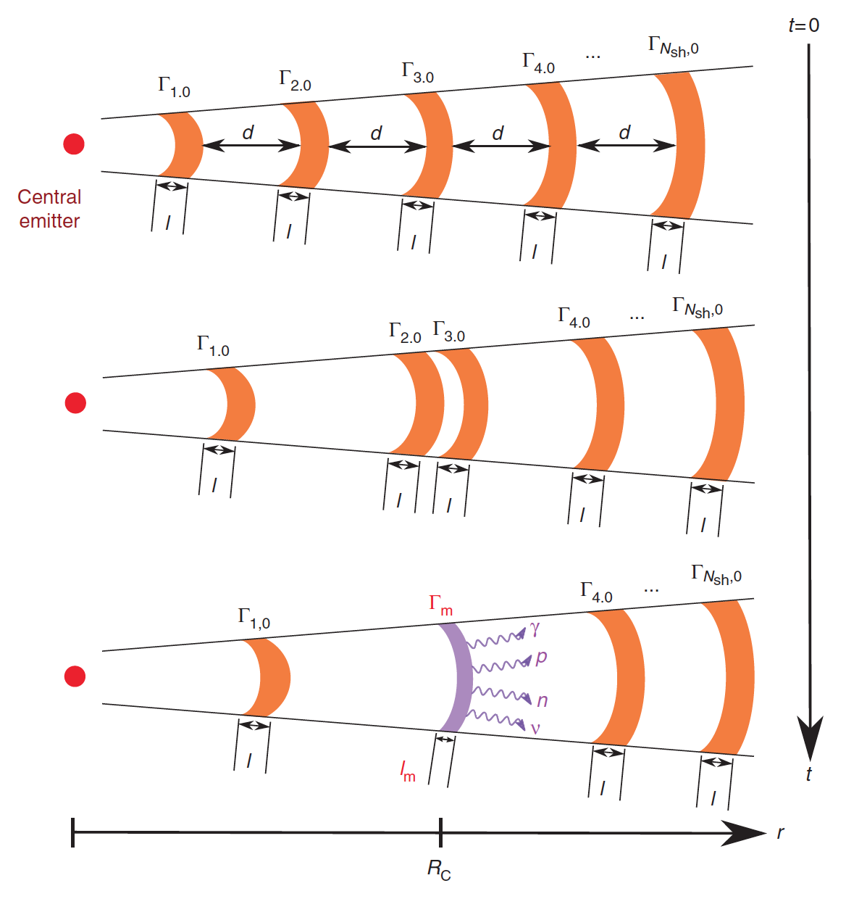
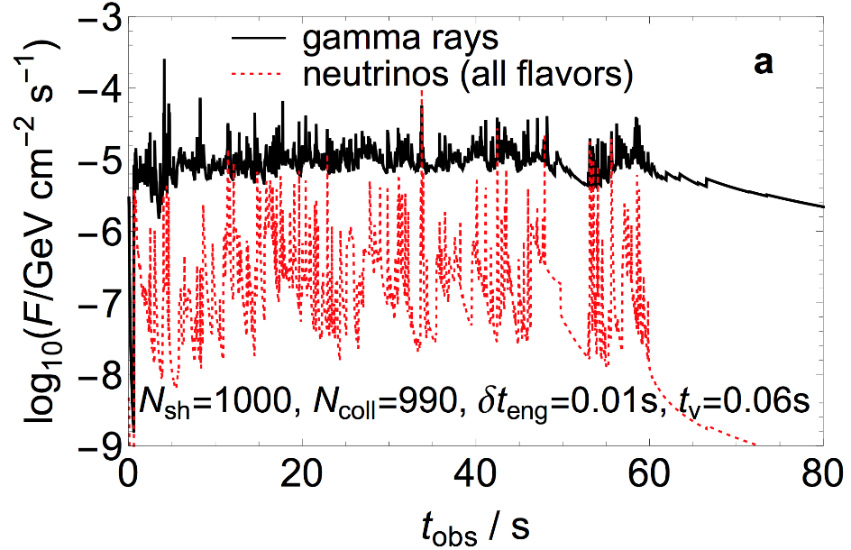
How can such a model explain the observed light curves?
Distribute shells with varying Γ
The light curves can be predicted as a function of the engine parameters
Efficient energy dissipation (conversion from kinetic to radiated E) requires broad Γ distribution
Consequence: Collision radii are widely distributed!
From: Bustamante, Baerwald, Murase, Winter, Nature Commun. 6, 6783 (2015)
W. Winter

Slide 25
Example 2: Sodium-23
E1 strength function not known a priori
²³Mg is Isobar Analog State (IAS) of ²³Na: meaningful to assume similar cross sections

Slide 26
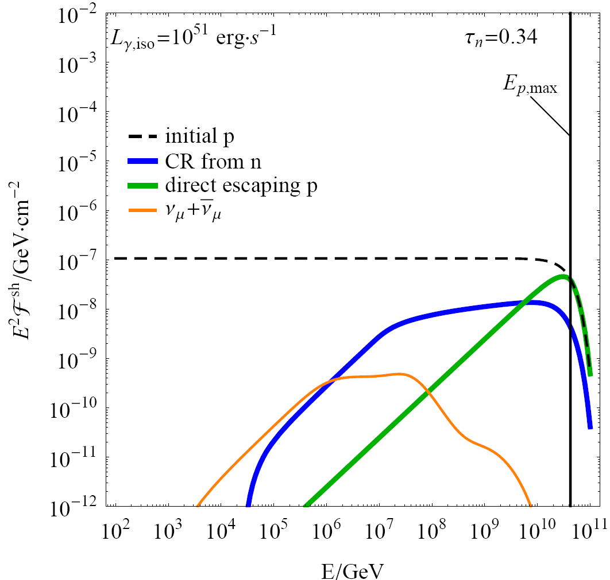
How do cosmic rays escape from the source?
Three extreme cases:
Neutron model Neutrinos and cosmic rays (from neutrons) produced together (depends on pion prod. efficiency, blue curve, softer) (pure neutron model excluded in IceCube, Nature 484 (2012) 351)
Direct escape (aka “high pass filter”, “leakage”) Cosmic rays can efficiently escape if Larmor radius reaches size of shell width (conservative scenario, green curve, hard) (from:Baerwald, Bustamante, Winter, ApJ 768 (2013) 186; same argument used for nuclei in Globus et al, 2014)
“All escape”: magnetic fields decay quickly enough that charged cosmic rays can escape (most aggressive scenario, dashed curve, ~ E⁻²)
Diffusion, …
E⁻²
hard
softer
(without prop. effects)

Slide 27
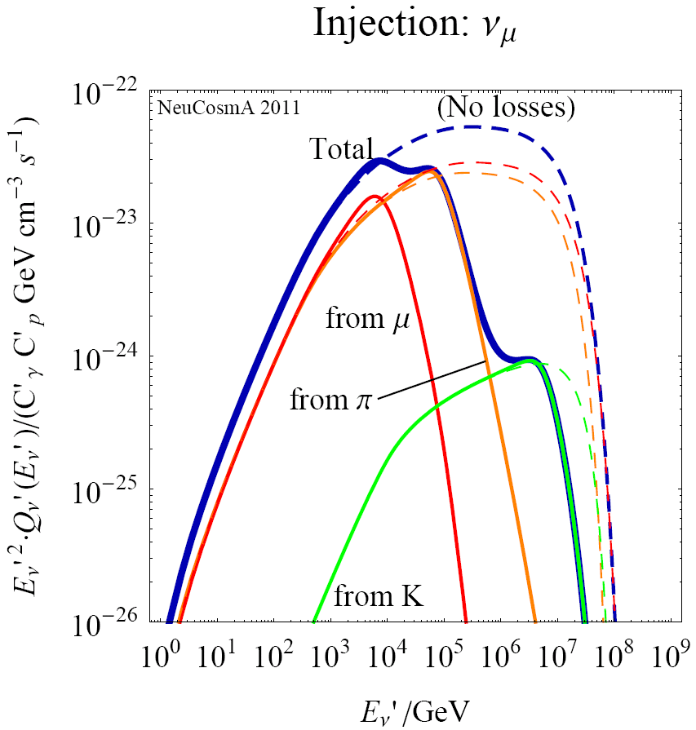
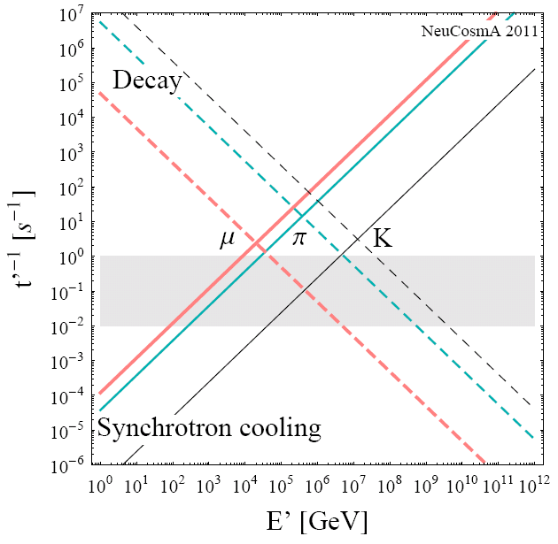
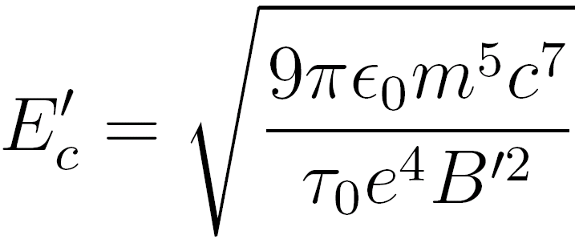
In the presence of strong B: Secondary cooling
Example: GRB
Secondary spectra (m, p, K) loss-steepend above critical energy
E‘_{c} depends on particle physics only (m, t₀), and B‘
Leads to characteristic flavor composition and shape
Decay/cooling: charged μ, π, K
(“escape”)
ν_{μ}
Adiabatic
(energy loss)
Baerwald, Hümmer, Winter, Astropart. Phys. 35 (2012) 508; also: Kashti, Waxman, 2005; Lipari et al, 2007; ...

Slide 28
A simple toy model for the source
If neutrons can escape: Source of cosmic rays
Neutrinos produced in ratio (ν_{e}:ν_{μ}:ν_{τ})=(1:2:0)
Delta resonance approximation:
Cosmic messengers
High energetic gamma-rays; typically cascade down to lower E Additional constraints!
(Same process during propagation of cosmic rays in CMB: “cosmogenic neutrinos”)

