Slide 1
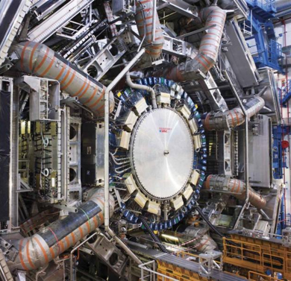
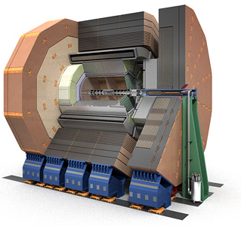
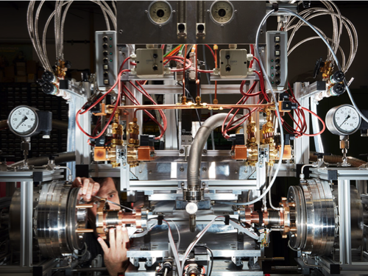
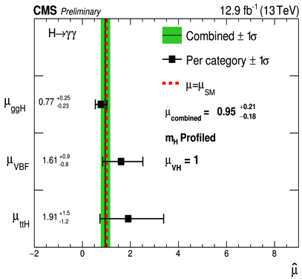

From POF 3 to POF 4
Fundamental Particles and Forces.
Thomas Schörner-Sadenius
(on behalf of Joachim Mnich)
MUTAG 2016
Mainz, 12 December 2016

Slide 2
Outline
> Reminder: the POF 3 topic “Fundamental Particles and Forces”
> POF 3 highlights from particle physics
> Roadmaps and strategies
> Plans and ideas for POF 4

Slide 3
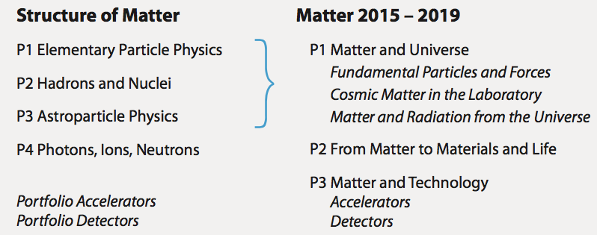
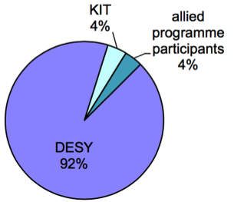

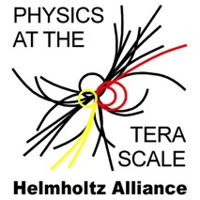
Fundamental Particles and Forces
The topic in POF 3
> Successor of POF 2
programme “Elementary
particle physics”
Topic speaker:
Joachim Mnich (DESY)
Andreas Heiss (KIT)
> Involved centres
DESY
KIT (theory)
> Two LK 2 facilities: GridKa at KIT, Tier 2 centre at DESY
> Helmholtz Alliance “Physics at the Terascale” to ensure close collaboration with universities
⬥ 3 weeks ago: annual meeting with 180 participants
(Personnel)
Notes:
Tortendiagramm based on 200 FTE, incuidng 138 scientists and 60 PhD (o.5 FTE)
Allied programme participants are LK2 personnel at GridKa dn Tier 2

Slide 4
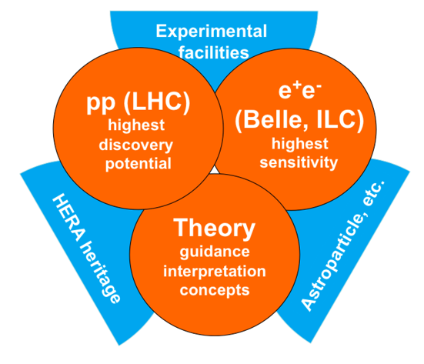
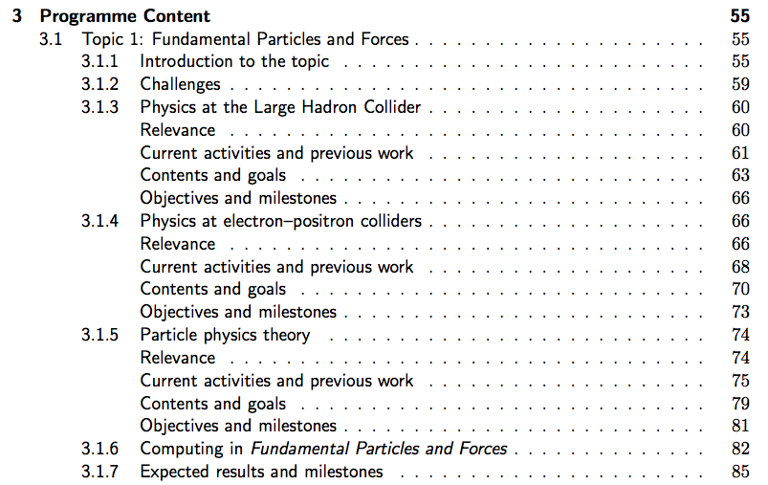
Fundamental Particles and Forces
Strategy in POF 3
> Building on core competencies:
design, construction and operation
of large-scale facilities
> In line with national, European and
global roadmaps, in particular
European strategy
> LHC as flagship – unique facility
with long-term perspectives
> Close ties to programme
Matter & Technologies
Topic Accelerator R&D with work
on plasma wakefield acceleration,
super-conducting RF etc.
Topic Detector Technologies &
Systems for generic detector
developments; synergies e.g.
with photon science community

Slide 5
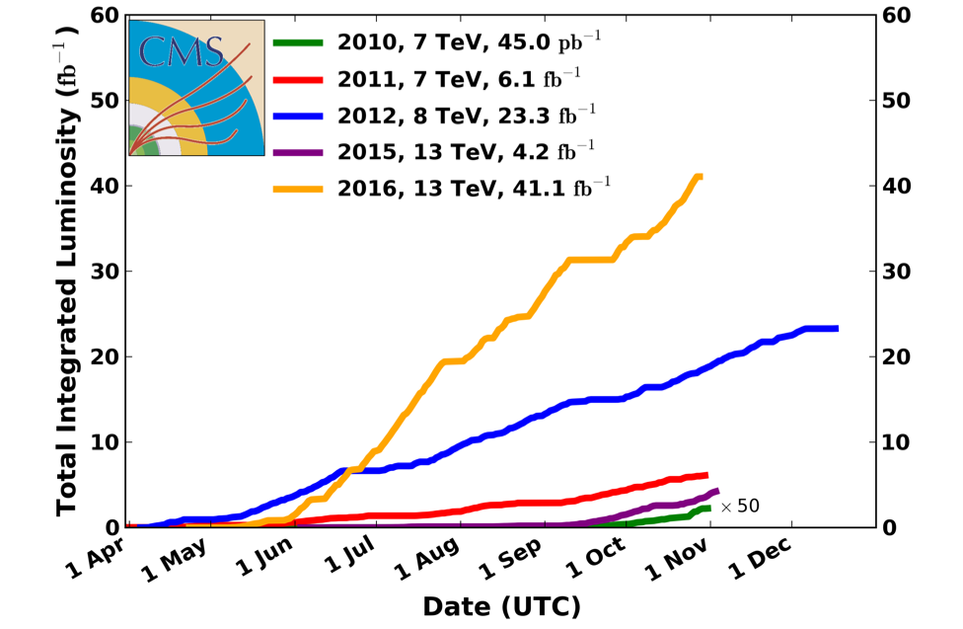
Highlights
From particle physics since the start of POF 3
> LHC operations! After 30 fb⁻¹ in Run 1 (2010-2012, 7/8 TeV), collected about 45 fb⁻¹ in Run 2 (2015/16) at 13 TeV so far!
> Incredible performance of machine and detectors; hoping for 150 fb⁻¹ until 2018!

Slide 6
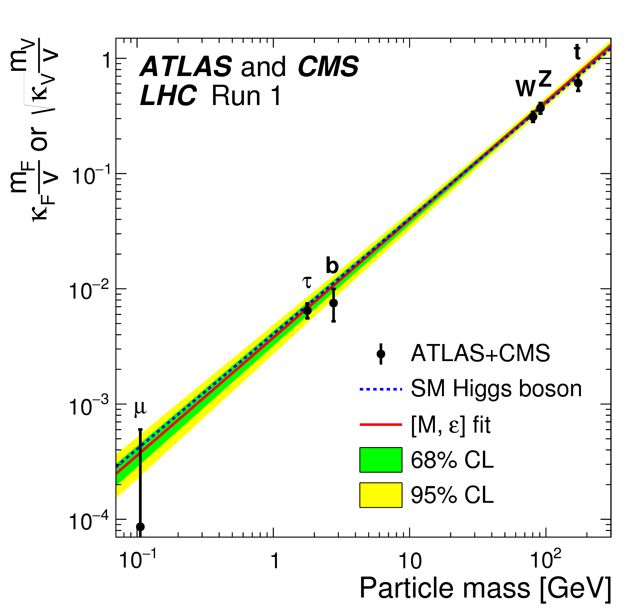
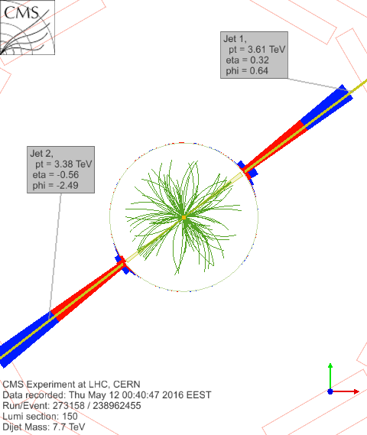
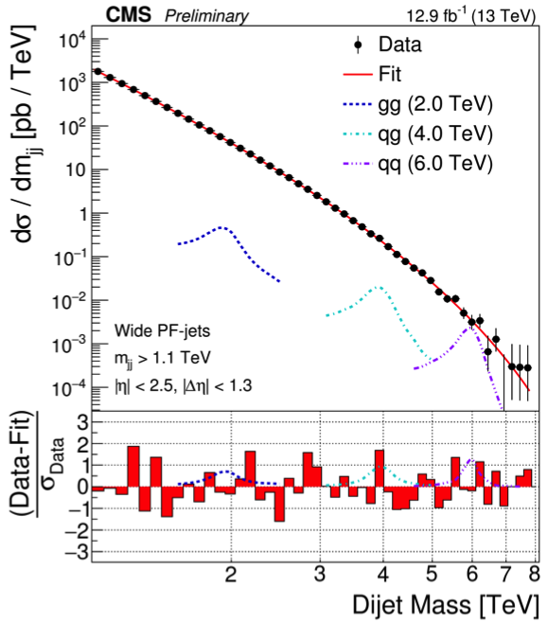
Highlights
LHC luminosity → precision physics and increased BSM reach and sensitivity
Top Xsection – precision tests of EW
physics, α_{S}, PDFs, window for new physics
Higgs properties measurements
e.g. couplings versus mass
Narrowing down on “new physics”
(here: SUSY exclusions)
Dijet events up to inv. masses of
8 TeV (SM, PDFs, searches)

Slide 7
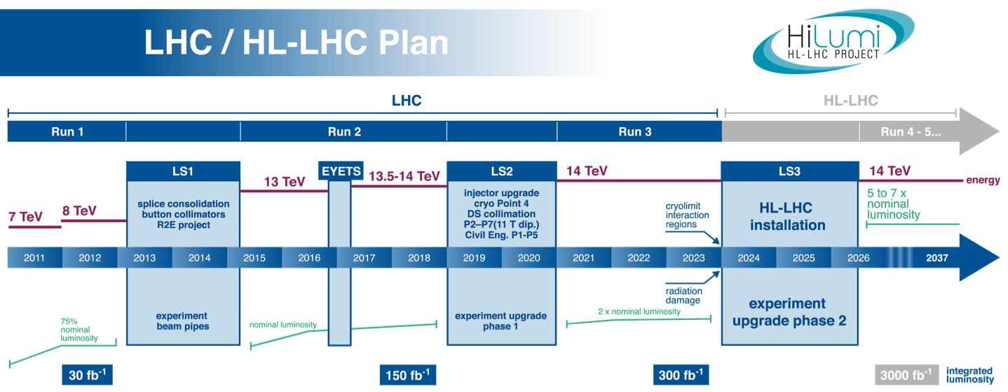
Highlights
LHC luminosity → precision physics and increased BSM reach and sensitivity
> HL-LHC upgrades approved; now detector upgrades in funding process (trackers, calorimeters, muon systems, trigger&DAQ)
> Germany: > 100 M€ approved for phase 2 upgrades!
-- 90 M€ BMBF funds for universities 2015-24
-- 20 M€ Helmholtz strategic invest funds for ATLAS+CMS tracker endcaps + ALICE
-- 10 M€ DESY invest / base funds for detector assembly facility

Slide 8
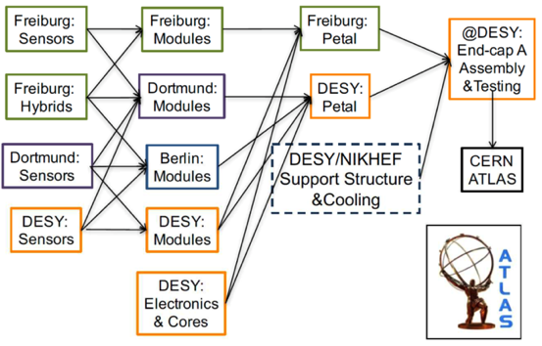
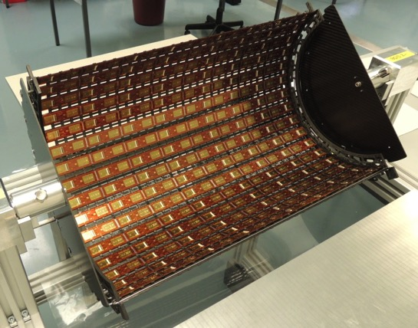
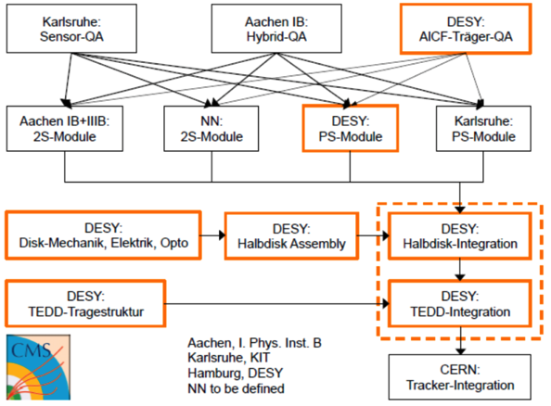
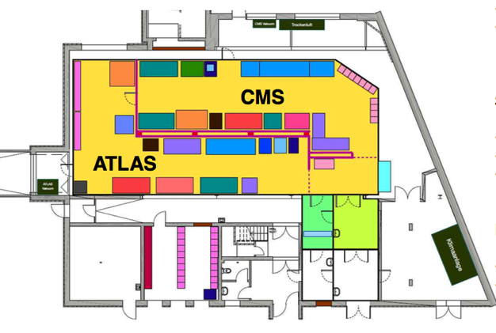
Highlights
LHC upgrades well on track!
Phase 2 tracker endcaps
upgrade organisation
Phase1: CMS 4th pixel layer (DESY, KIT, UHH)
DAF ready for production
mid-2017
Notes:
DAF – 255 m2 ISO 6 cleanroom in 25c

Slide 9
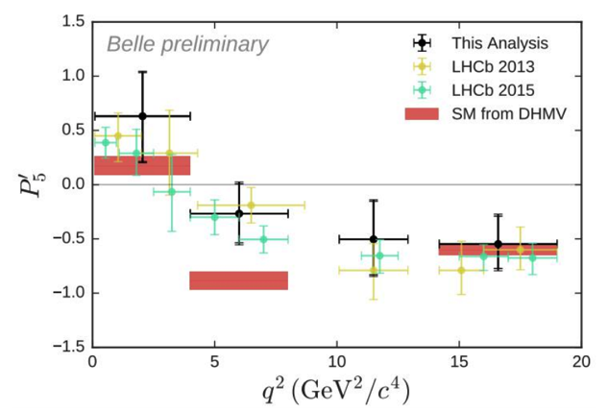
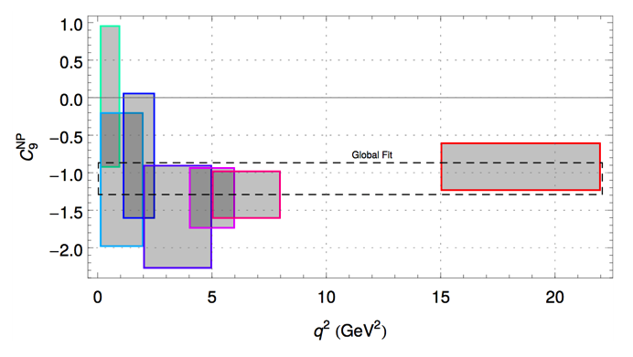
Highlights
Belle data
> FCNC: angular analysis of B→Kll decay –
LHCb deviation of 3.4σ in µ channel
confirmed by 2.1σ in e+µ in Belle data
-- Complementary LHCb – Belle!
> Supports evidence for discrepancy with Standard Model
-- can be cured with BSM contribution
to Wilson coefficient C₉!
Simon Wehle, Ph.D. thesis
arXiv:1605.06059
S. Descotes-Genonet al.
> Preparing for similar analysis at Belle II:
-- e - µ separation
-- tau channel
-- neutrino channels
> Investigations e.g. by KIT theory!
➔ Pin down lepton non-universality?

Slide 10
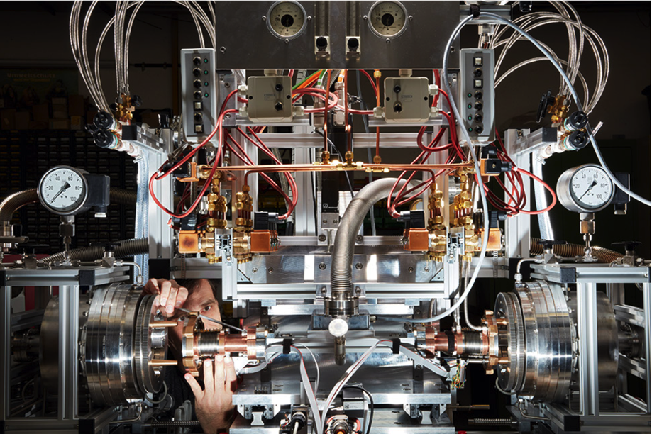
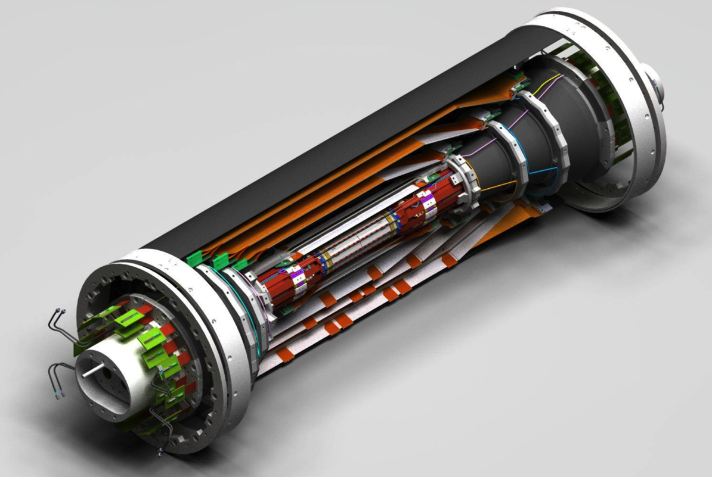
Highlights
> Preparations for Belle II: pixel DEPFET detector built by German groups; many crucial contributions from DESY: vacuum system for inner region, vertex region infrastructure, cooling system, testbeams ...

Slide 11
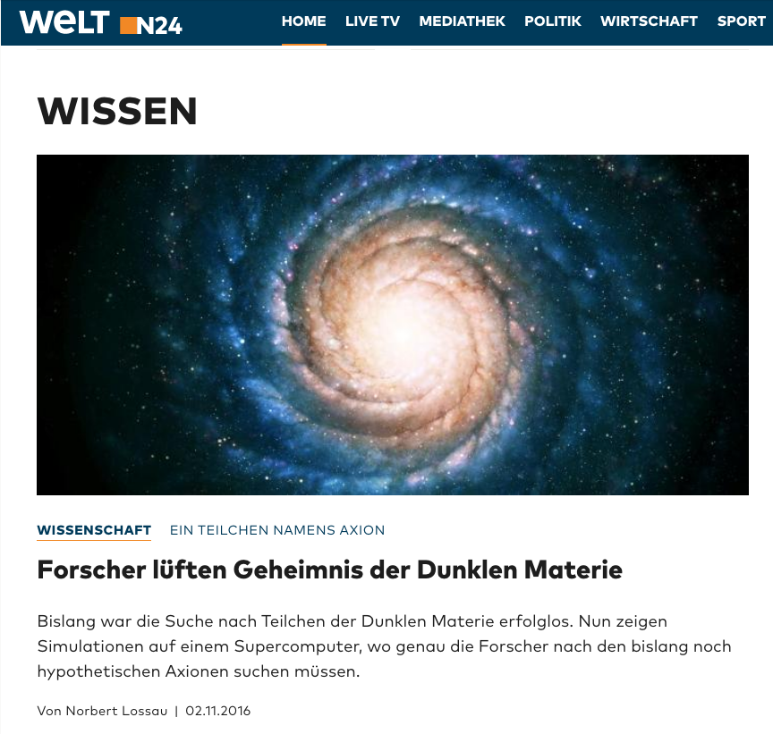
Highlights
Dark matter ... Puzzle solved?

Slide 12
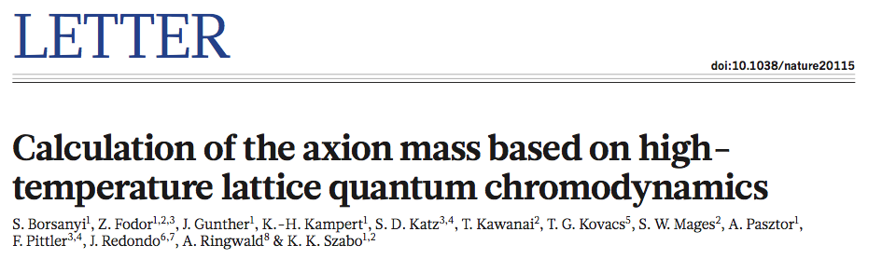
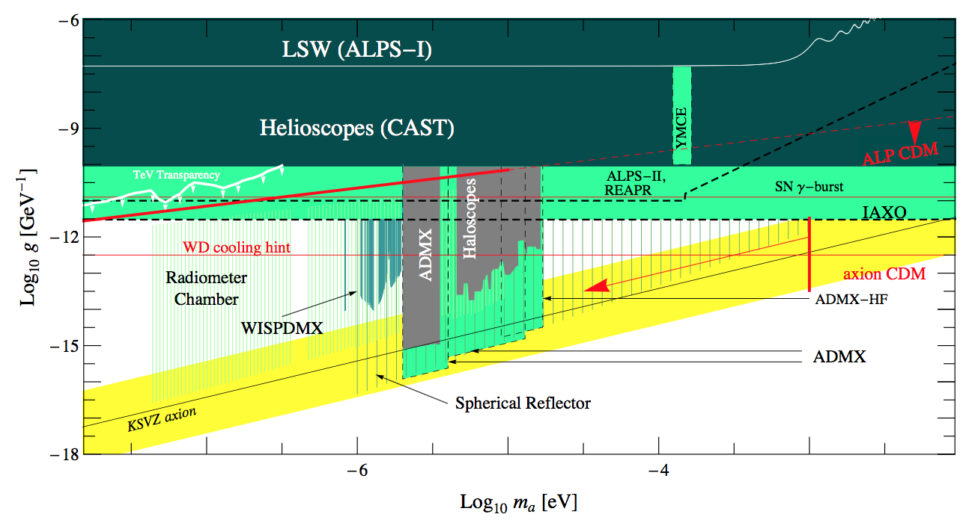
Highlights – Nature 539 (2016) 69-71
DESY (Ringwald), Wuppertal (Fodor, Kampert), …
> Determination of axion
mass using lattice QCD
  Axions: promising DM
  candidates!
  Calculations performed on
  JuQUEEN HPC / Jülich
  For post-inflation axion scenario axion
  mass narrowed down: 50-1500 µeV!
> In next years, post-inflation axions to be
confirmed or ruled out by experiment
  MADMAX, Orpheus, antenna dish experiments …
[Horns, Lindner, Lobanov, Ringwald 14]
Notes:
- Kannst Du mir in einem Satz (naiv, ich weiss …) den Unterschied zwischen pre/post-inflationaeren Axionen erklären?
Es geht hier um die Frage, ob die Peccei Quinn Symmetrie beim Aufheizen nach der Inflation wieder restauriert wird.
Diesen Fall bezeichnet man als post-inflationary PQ symmetry breaking scenario.

Slide 13
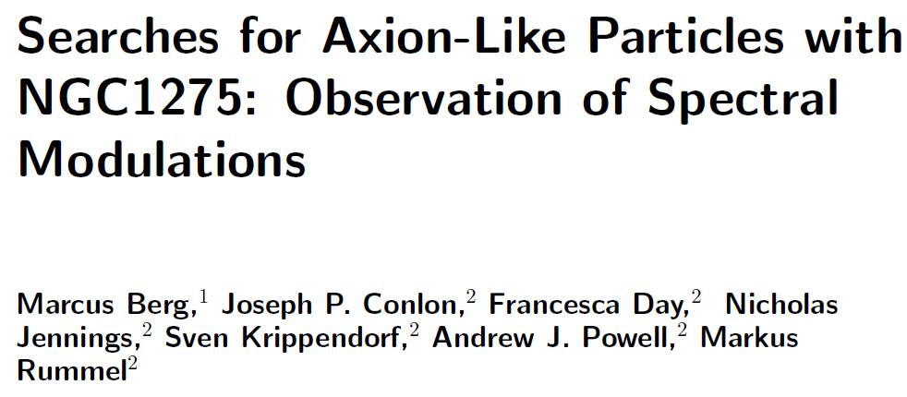
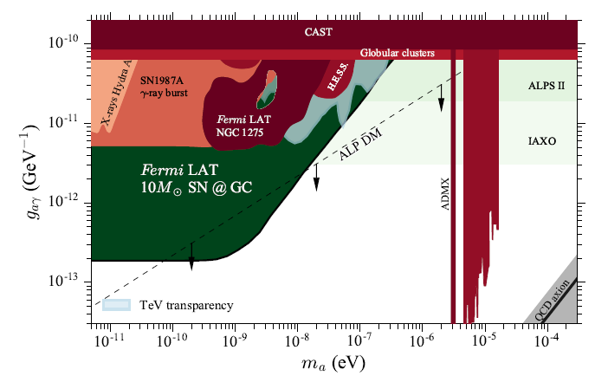
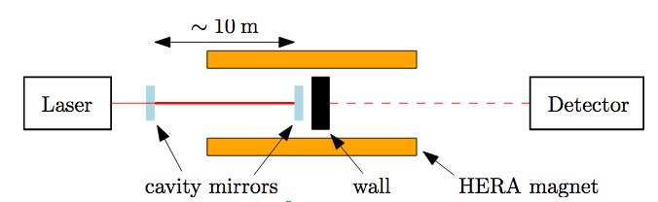
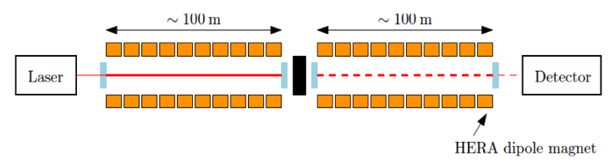
Highlights
ALPS – proceeding towards 100 m optics cavities!
> Search for light dark matter (WISPs):
-- Evidence for an ALP with
m < 10⁻¹² eV and g = 1-5·10⁻¹² 1/GeV ?
> Upcoming and planned experiments
will greatly enhance sensitivity!
(https://arxiv.org/abs/1605.01043)
> ALPS „light shining through the wall“ experiment progressing well:
-- ALPS I (2007-10)
-- ALPS IIa now being prepared (2 dipoles,
power built-up, laser, detectors, etc.)
-- ALPS IIc (2019) with 20 dipoles!
Notes:
Status now: length lock and auto-alignment on 20 m cavity in ALPS 2a lab working stably.
Good cavity performance
Now working on production cavity before the wall – demonstrate power built-up of 5000
Next steps:
Continue high-power tests of production cavity
Implement central bread-board
Operate and characterise regeneration cavity
Simultaneously operate both cavities
Develop towards 20 HERA magnets – ALPS 2c for 100 m in Hera north hall

Slide 14
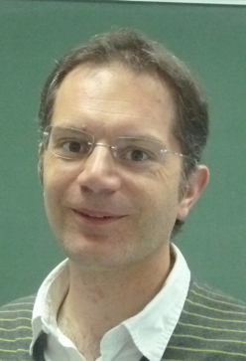
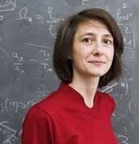
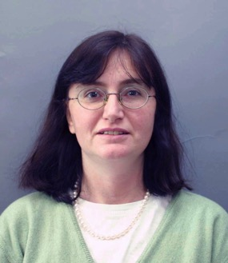
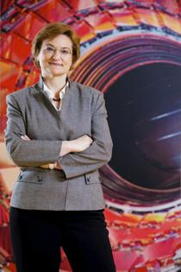

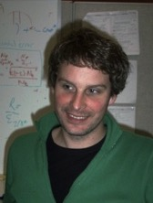
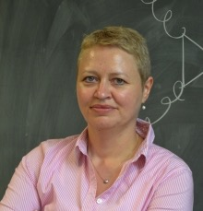
Highlights
High-level recruitments to the topic
Geraldine Servant: Cosmology / phenomenology
Barcelona → DESY/UHH
Christophe Grojean: Phenomenology
Barcelona → DESY/HUB
Elisabetta Gallo: CMS / ILC
Florence → DESY/UHH
Kerstin Borras: CMS
DESY → DESY/RWTH
Christian Schwanenberger: CMS
Manchester → DESY
Krisztian Peters: ATLAS
CERN → DESY
Beate Heinemann: ATLAS
Berkeley → DESY/Freiburg
Recent ERC grants:
  Kay Schmidt-Hoberg: ERC Starting Grant
  Alexander Westphal: ERC Consolidator Grant
  Kerstin Tackmann: ERC Starting Grant
  (Kristin Lohwasser: ERC Starting Grant)
  Several YIGs → strong university collaborations

Slide 15
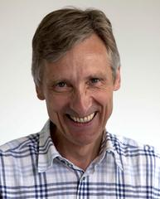
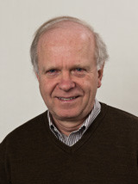
Highlights
> Eckhard Elsen recruited as CERN Director
for Research and Scientific Computing
> Term 2015-2019
> Theorist Wilfried Buchmüller retired – but still
active with modified status!

Slide 16


Strategies and roadmaps
In global particle physics
Update of European Strategy for by CERN Council (May 2013)
– LHC, incl. HL-LHC
– accelerator R&D
– strong support for ILC
– importance of theory
– role of national labs
USA: Snowmass conclusions and recommendations to P5 in line with worldwide strategy statements
German Committee for Particle Physics (KET, Nov. 2012)
– highest priority: LHC
exploitation (incl. phase 2)
– strong support for
Japanese ILC plans
Japan: Future HEP Projects
– „... Japan should take the leadership role in an early realisation of an e+e- linear collider.“
Different flavours in different regions of the world
But well-coordinated global approach to the future of the field
Next update of European strategy due ~2020 → implications for us!

Slide 17
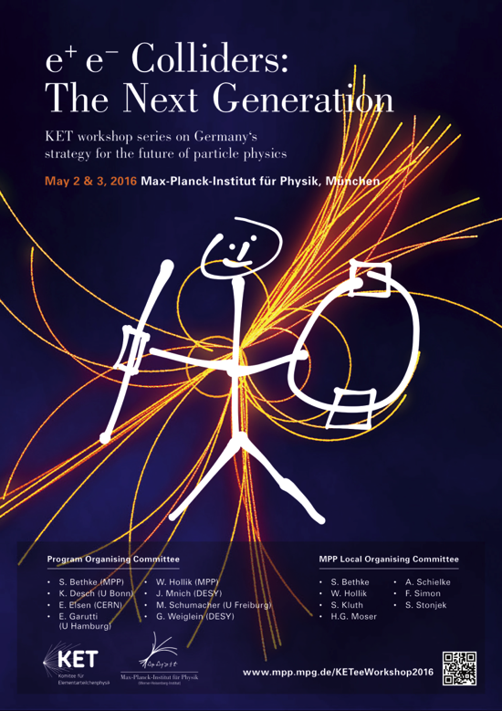
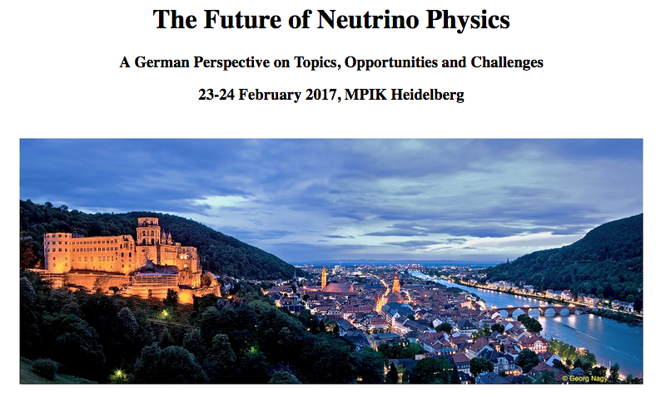
Strategies and roadmaps
Discussions in Germany with KET, KAT, KHuK, and within DESY
> Committees: series of workshops for
consensus building; issuing statements
> So far on future e+e- machines,
soon for neutrino physics (with KAT, KHuK)
> Results will serve as input for European strategy process
> In parallel: POF 4 and DESY-internal strategy processes on the way

Slide 18
Plans and ideas for POF 4
Concentration on three fundamental questions ( i.e. subtopics)

Slide 19
Plans and ideas for POF 4
Concentration on three fundamental questions ( i.e. subtopics)
Support
Guidance
Interpretation
New directions
Design, construction,
operation, exploitation
Grid & cloud
HPC exploitation
Generic, low-level and application software
Big data solutions
Data analytics
Strategic planning
Contributions to
commissioning +
operations

Slide 20
Plans and ideas for POF 4
Elementary particle physics in Helmholtz in POF4 in 22 lines
Input for Matter strategy document!

Slide 21
Plans and ideas for POF 4
Tackling fundamental questions - many options!
N. Walker, ICHEP ‘14
> Will decide together with national and international partners!

Slide 22
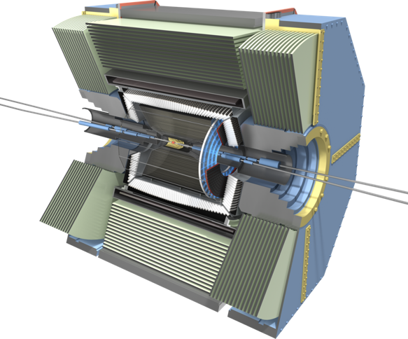

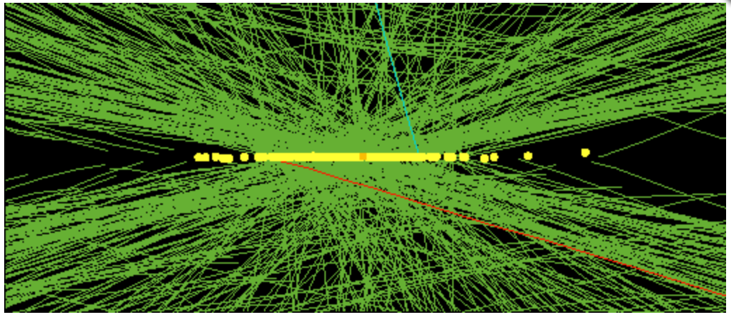
Set for POF 4
Theory
Belle II
LHC

Slide 23
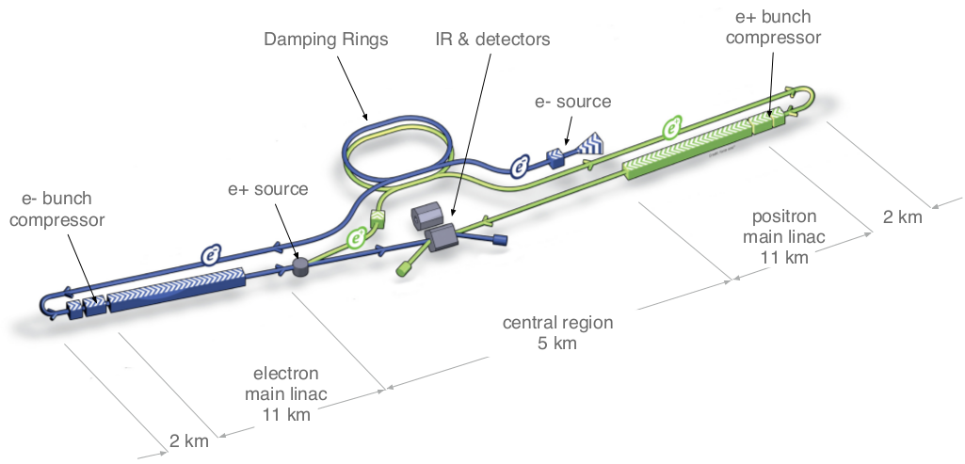
Options: ILC?
ILC – a 30+ km linear
accelerator for precision
physics and searches?
Decision in Japan around 2018

Slide 24
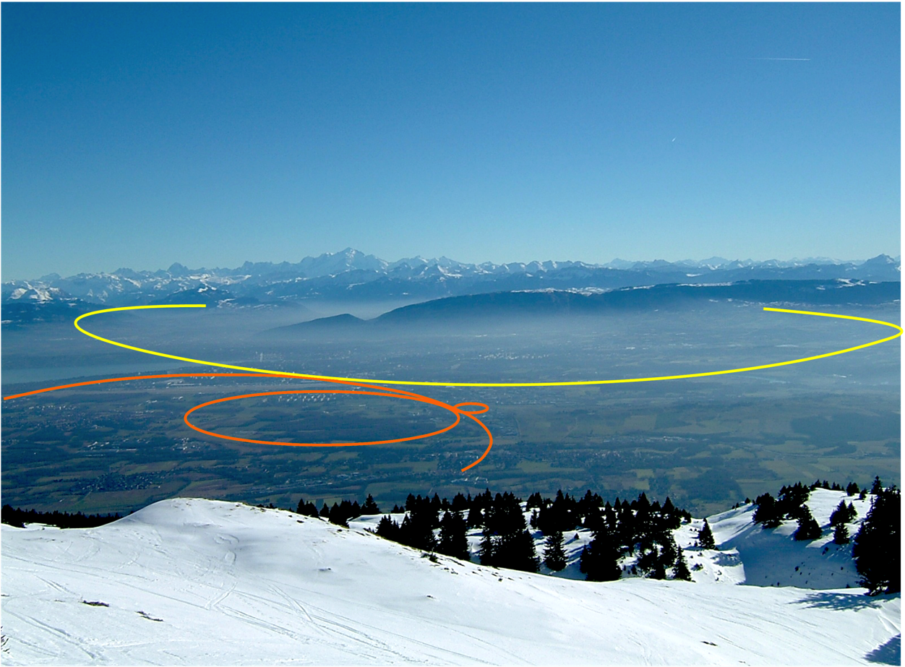
Options: FCC?
A Future Circular Collider
with 100 km circumference
for 100 TeV discovery physics?
FCC (100 km)
LHC (27 km)

Slide 25

Advertisement: FCC week in Berlin 2017

Slide 26
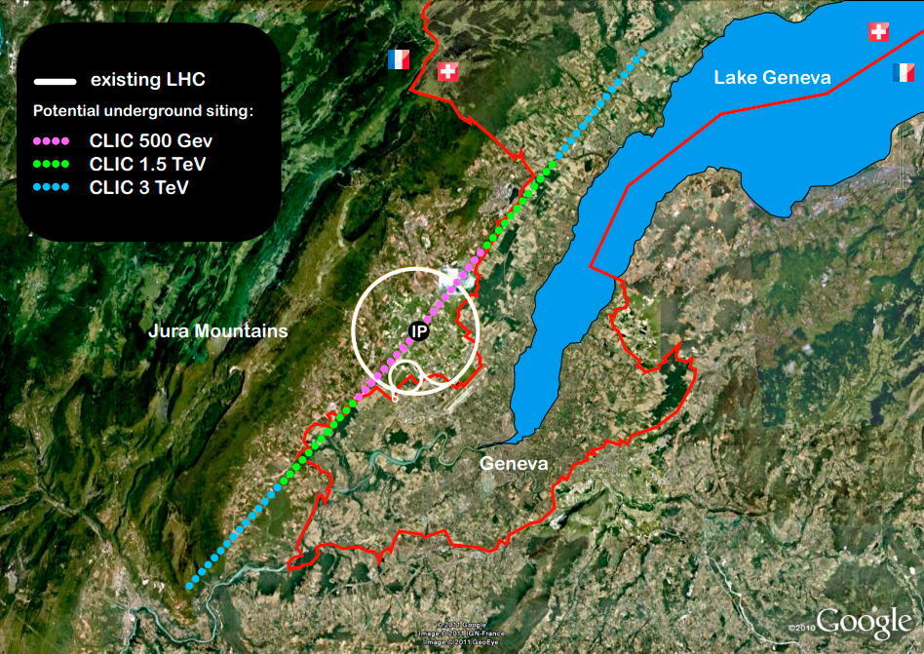
Options: CLIC?
A Compact Linear Collider
for highest e+e- energies?

Slide 27
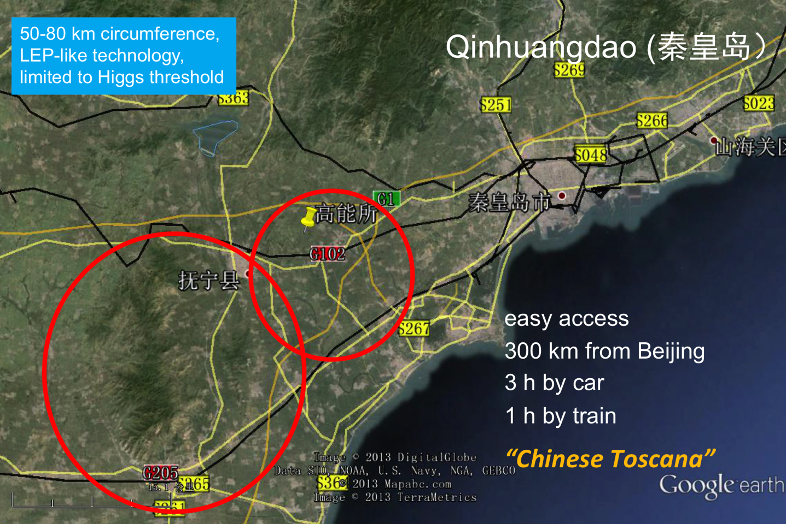
Options: CEPC?
  A 50-80 km LEP-like e+e- machine in China, with
  future options for pp?

Slide 28
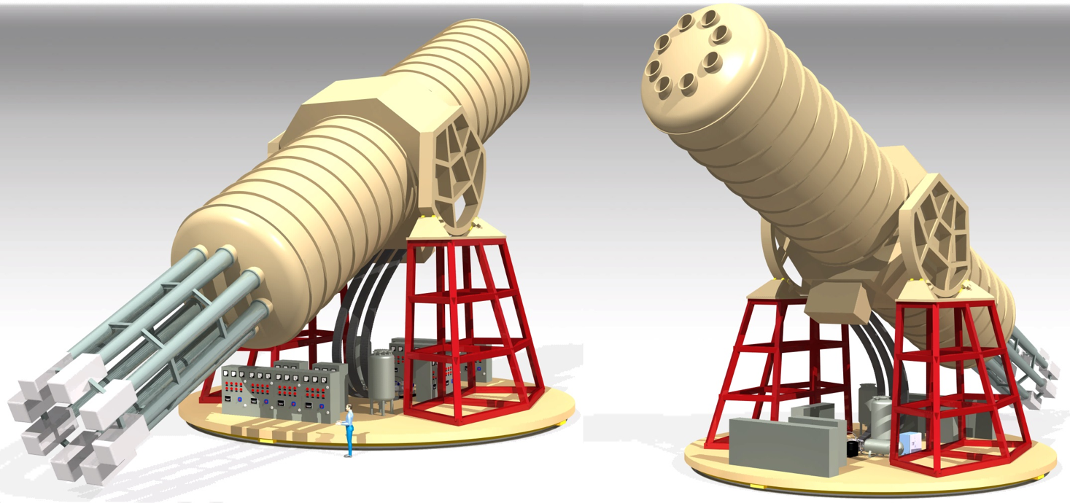
Options: IAXO?
Or non-collider options? IAXO at DESY?

Slide 29
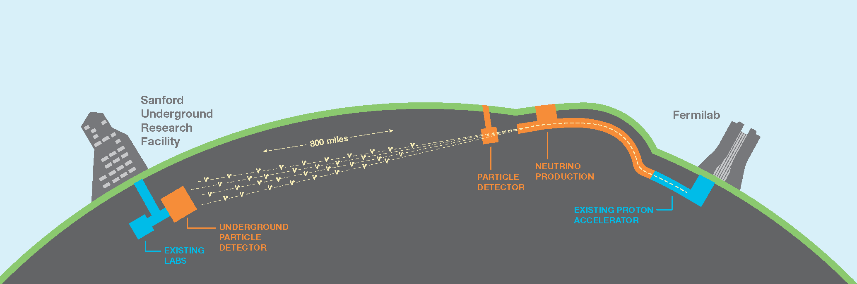
Options: DUNE?
  A 50-80 km LEP-like e+e- machine in China, with
  future options for pp?
A Future Circular Collider
with 100 km circumference
for 100 TeV discovery physics?
FCC (100 km)
LHC (27 km)
ILC – a 30+ km linear
accelerator for precision
physics and searches?
A Compact Linear Collider
for highest e+e- energies?
Or a muon collider? When will plasma wakefield accelerators be an option?

Slide 30
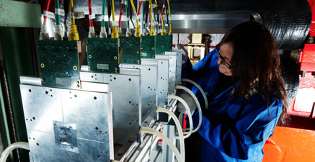
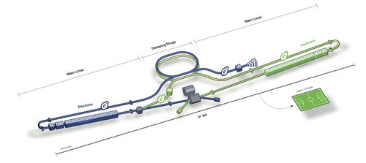
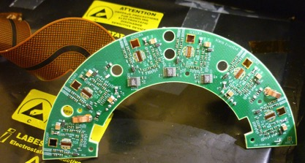




Instead of a summary
Maintain and further develop „lifecycle competence“ as key partner in national and international particle physics
Development
Conception
Design
Construction
Data
Preservation
Operation
Physics
analysis
Interpretation

Slide 31
Backup

Slide 32




Challenges
We understand only 5% of the universe’s energy and matter content!
Where and what is dark matter/energy?
In particle physics
The Standard Model is not the final answer: many unmotivated parameters, and complex structure
We lack a uniform description of the
very small and the very big things.
We don’t understand why we exist!
– Matter-antimatter asymmetry
– Connection to cosmology

Slide 33

Answers?
by Hitoshi Murayama

Slide 34


MUON G-2 LATTICE CALCULATION
Situation for muon g-2:
3-4 sigma discrepancy between experiment and theory
  Largest theory error from hadronic contributions → lattice input mandatory
New methods developed by DESY NIC
group give much improved accuracy
  Running JuQUEEN HPC using 65536 processors in parallel
  New lattice results at physical pion mass!
  First results for muon anomalous magnetic moment in this situation!
  Prospects to match precision of new g-2
  experiments at FNAL and J-PARC (reduction of exp.
  uncertainty by factor 4).
Selected as the NIC excellence project
November 2016!
Lattice
PDG
Notes:
F = Zerfallskonstanten
Das Histogramm hat nichts mit g-2 zu tun, zeigt nur, dass wir an der phys. Pionmasse arbeiten und damit dieses wichtige Limit erreicht habe, was zusammen mit den neuen Methoden auch g-2 zugute kommen wird.

Slide 35

PWA SIMULATIONS ON JuQUEEN HPC
From 5/16-5/17 20M CPU hours
(~500000 cores)
Selected NIC excellence project May 2016!
Decisive preparatory step for FLASHForward.
Shown here: Plasma wave driven by e⁻ bunch ionising He injected into H plasma
  Creates high-quality e⁻ beam (fields > 100 GV/m)
  Pulse length several 100 attoseconds
  A. Martinez de la Ossa,
  Osterhoff et al.

