Slide 2
Agenda

Slide 3
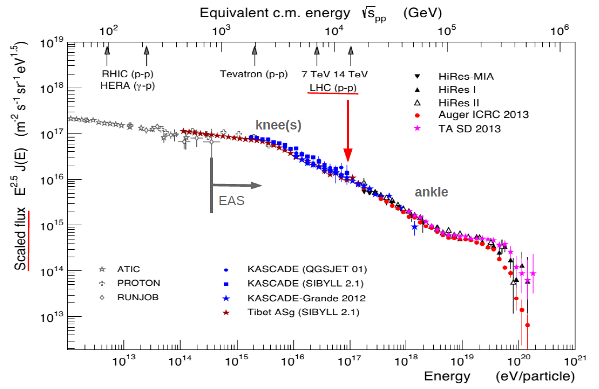
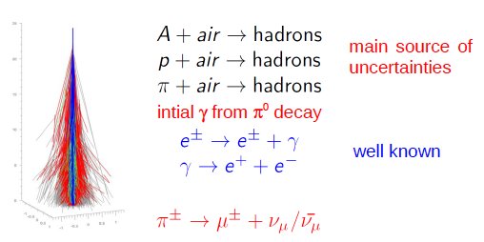
Goal: better understanding of hadronic interactions, (in particular important early in the shower development.)
Tanguy Pierog

Slide 4
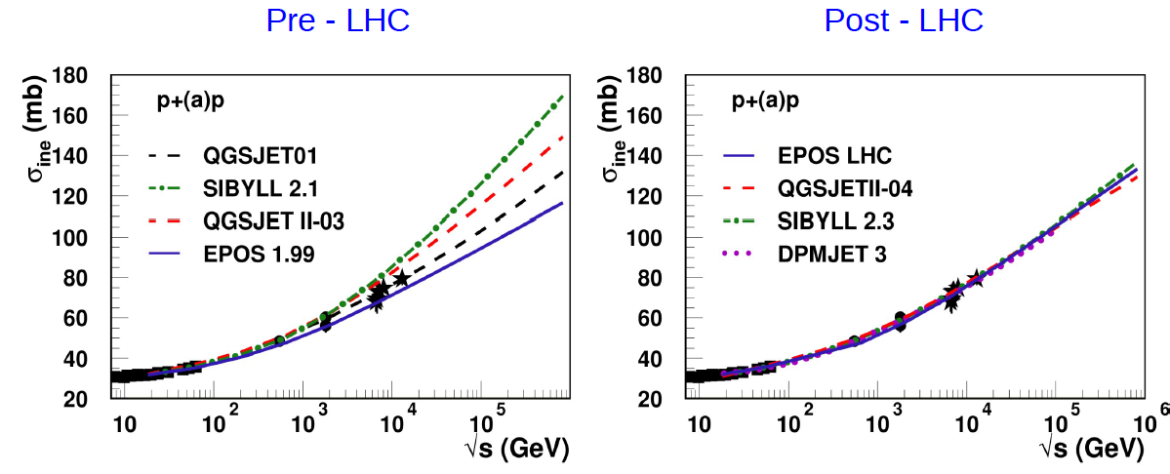
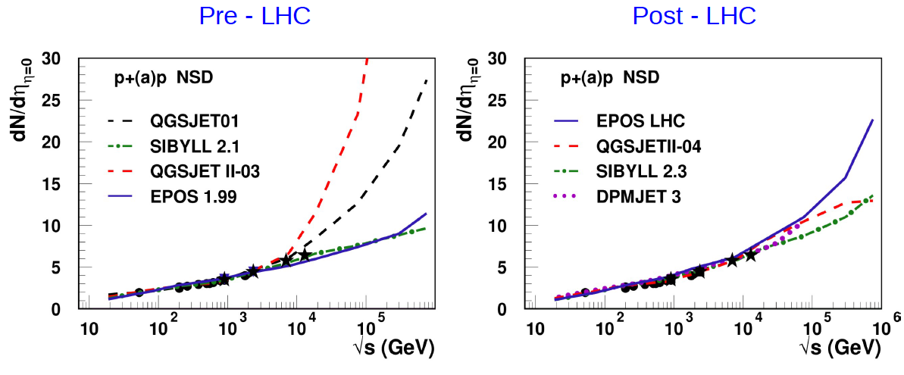
“Money plots”
Cross section
Multiplicity
Tanguy Pierog

Slide 5
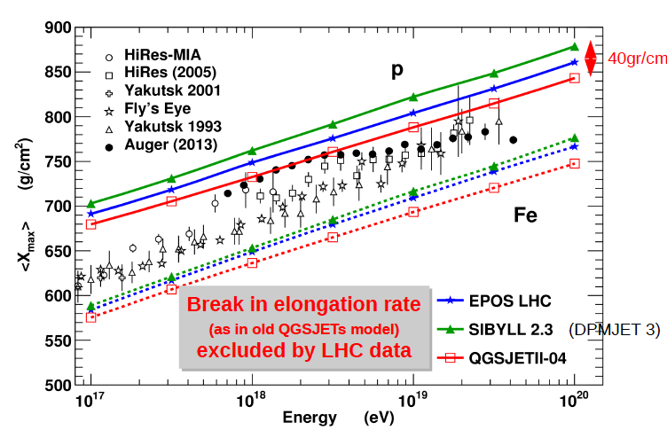
After “tuning” models, clear signal for change of composition
Pion and muon results/simulations
Tanguy Pierog

Slide 6
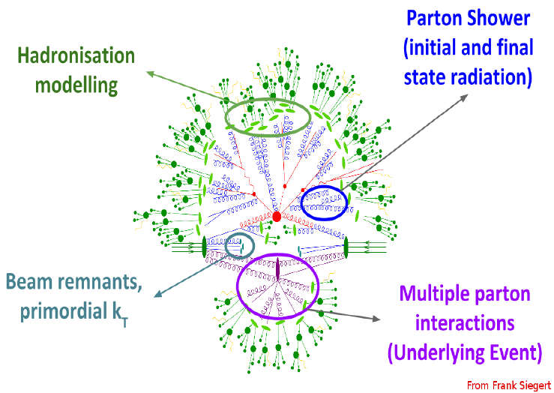
Paolo Gunnellini

Slide 7
?
Paolo Gunnellini

Slide 8
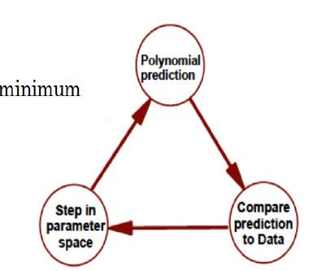
Rivit and Professor
Tune parameters of MC generators
Needed for correct description of the data
Good physics predictions: models may “fail”
DANGER: overtuning
Paolo Gunnellini

Slide 9
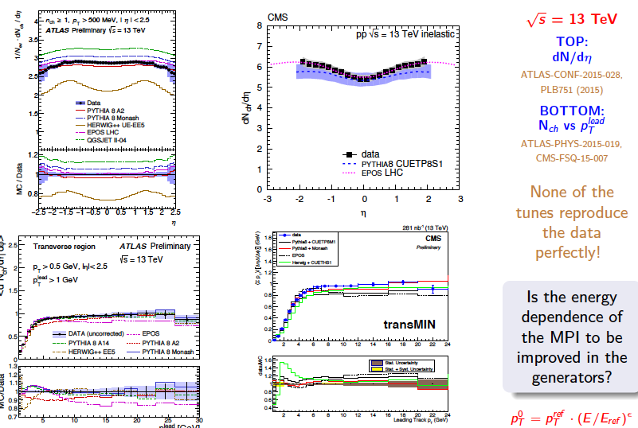
Mostly works well with the 13 TeV data
Paolo Gunnellini

Slide 10
Low sensitivity to forward region
Info on low x (~10^-6) now from J/Psi LHCb
Paolo Gunnellini

Slide 11
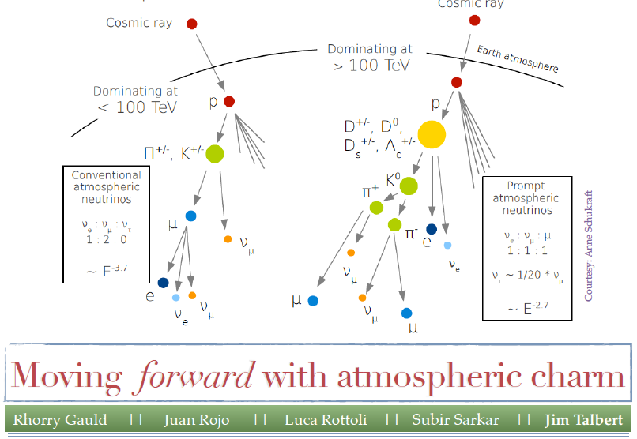

Slide 12
Prompt vs Conventional
Critical energy: below this energy decay probability > interaction probability π ~ 115 GeV K ~ 850 GeV
Open charm ~ 10⁸ GeV
Atmospheric neutrinos from pi, K decay “conventional flux”
Atmospheric neutrinos from open charm “prompt flux”
Jim Talbert

Slide 13
Jim Talbert

Slide 14
Jim Talbert
QCD Input

Slide 15
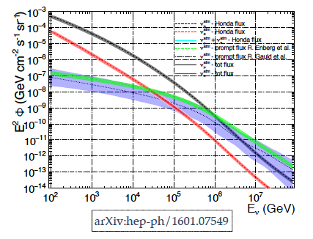
Prompt Atmospheric Neutrino Flux
Perturbative QCD with Charmed hadron and small-x gluon PDF
LHCb
Consistency with previous estimates, but better estimate of uncertainties
Jim Talbert

Slide 16
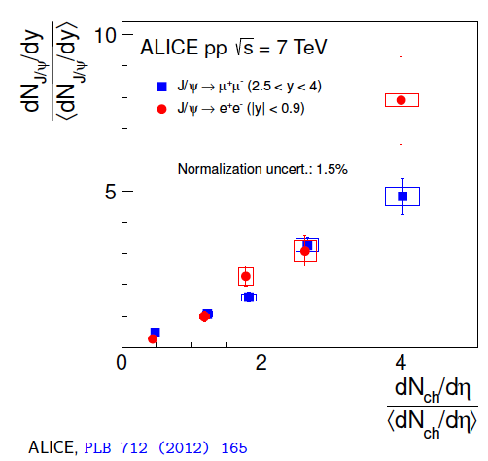
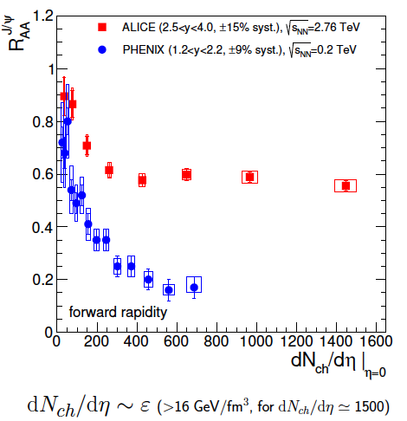
J/Ψ regeneration by D-recombination at freezeout
Anton Andronic

Slide 17
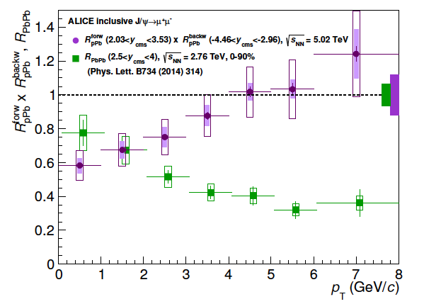
Compare p-Pb with Pb-Pb
Differences between pPb and PbPb further support conjecture that low Pt J/Ψ are from recombination
Anton Andronic

Slide 18
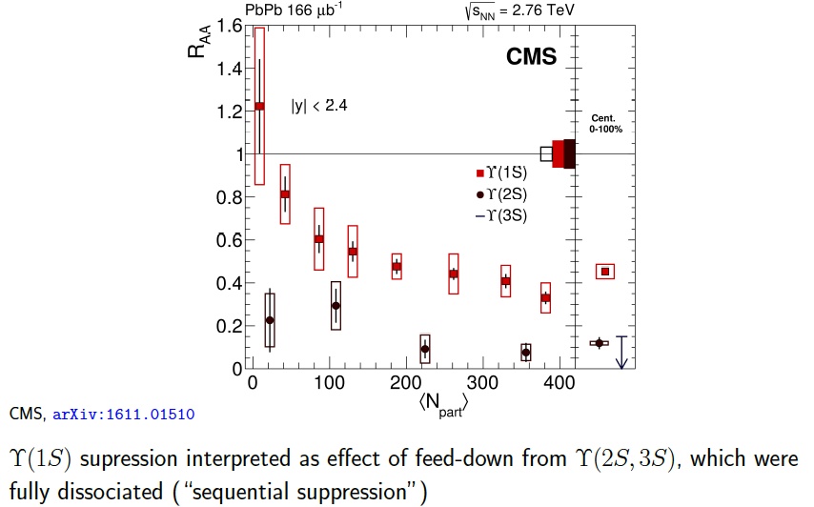
Bottom (Υ) Sector
Anton Andronic

Slide 19
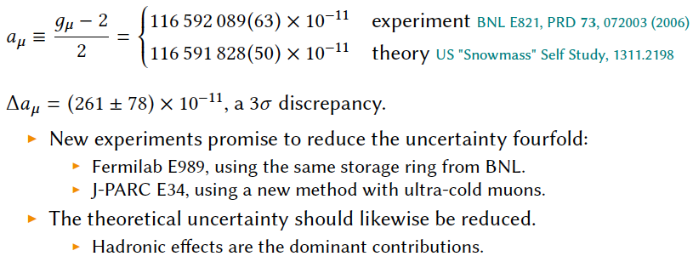
Muon Magnetic moment
Jeremy Green

Slide 20
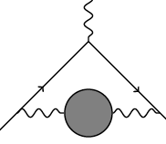
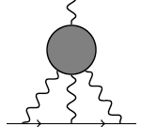
Uncertainty Dominated by Hadronic Effects
Hadronic Vacuum Polarization
Hadronic light-by-light scattering about 2/3 of theory predictions come from π⁰ exchange diagrams, also large contributions from η and η’.
Jeremy Green

Slide 22
Summary
Very active working group
Strong interconnections:
LHC – Air showers
Modeling LHC interactions
Charm@LHCB – prompt/cosmic neutrinos
Heavy Quark recombination in heavy ion reactions
Lattice QCD for Muon g-2

